Slide 1
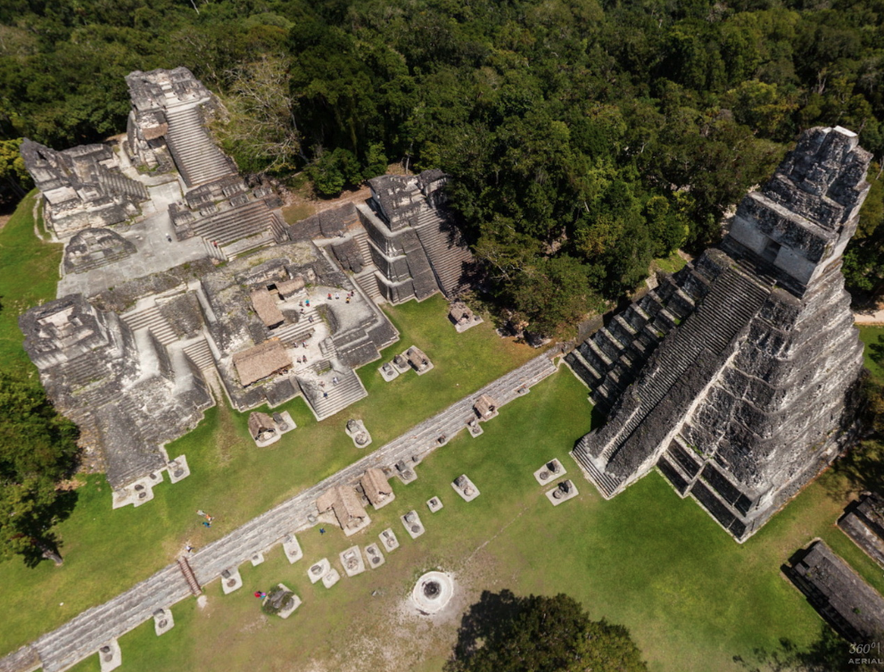

Tikal National Park
Instituto Guatemalteco de Turismo -INGUAT-
1
Notes:
Bienvenida a la presentación “Guatemala Corazón del Mundo Maya”

Slide 2
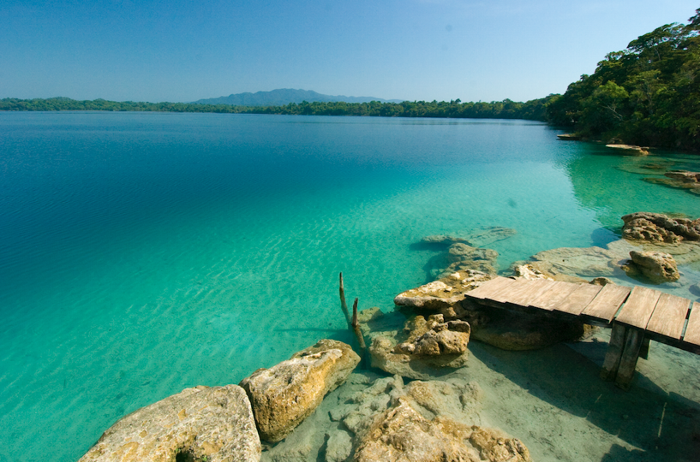
Guatemala has 19 ecosystems and more than 300 microclimates, one of the most diversified natures in the world.
It is a multilingual, multiethnic and multicultural country, product of the Mayan heritage and the Spanish influence during the colonial period.
More than 50% of the population is of Mayan origin.
Guatemala, has three sites declared World Heritage Site by UNESCO:
- Antigua Guatemala
- National Park of Tikal (Natural and Cultural)
- Archaeological Park of Quiriguá.
2
Notes:
Documentos de apoyo y respaldo: Notas de Declaraciones y Nombramientos para Guatemala.

Slide 3
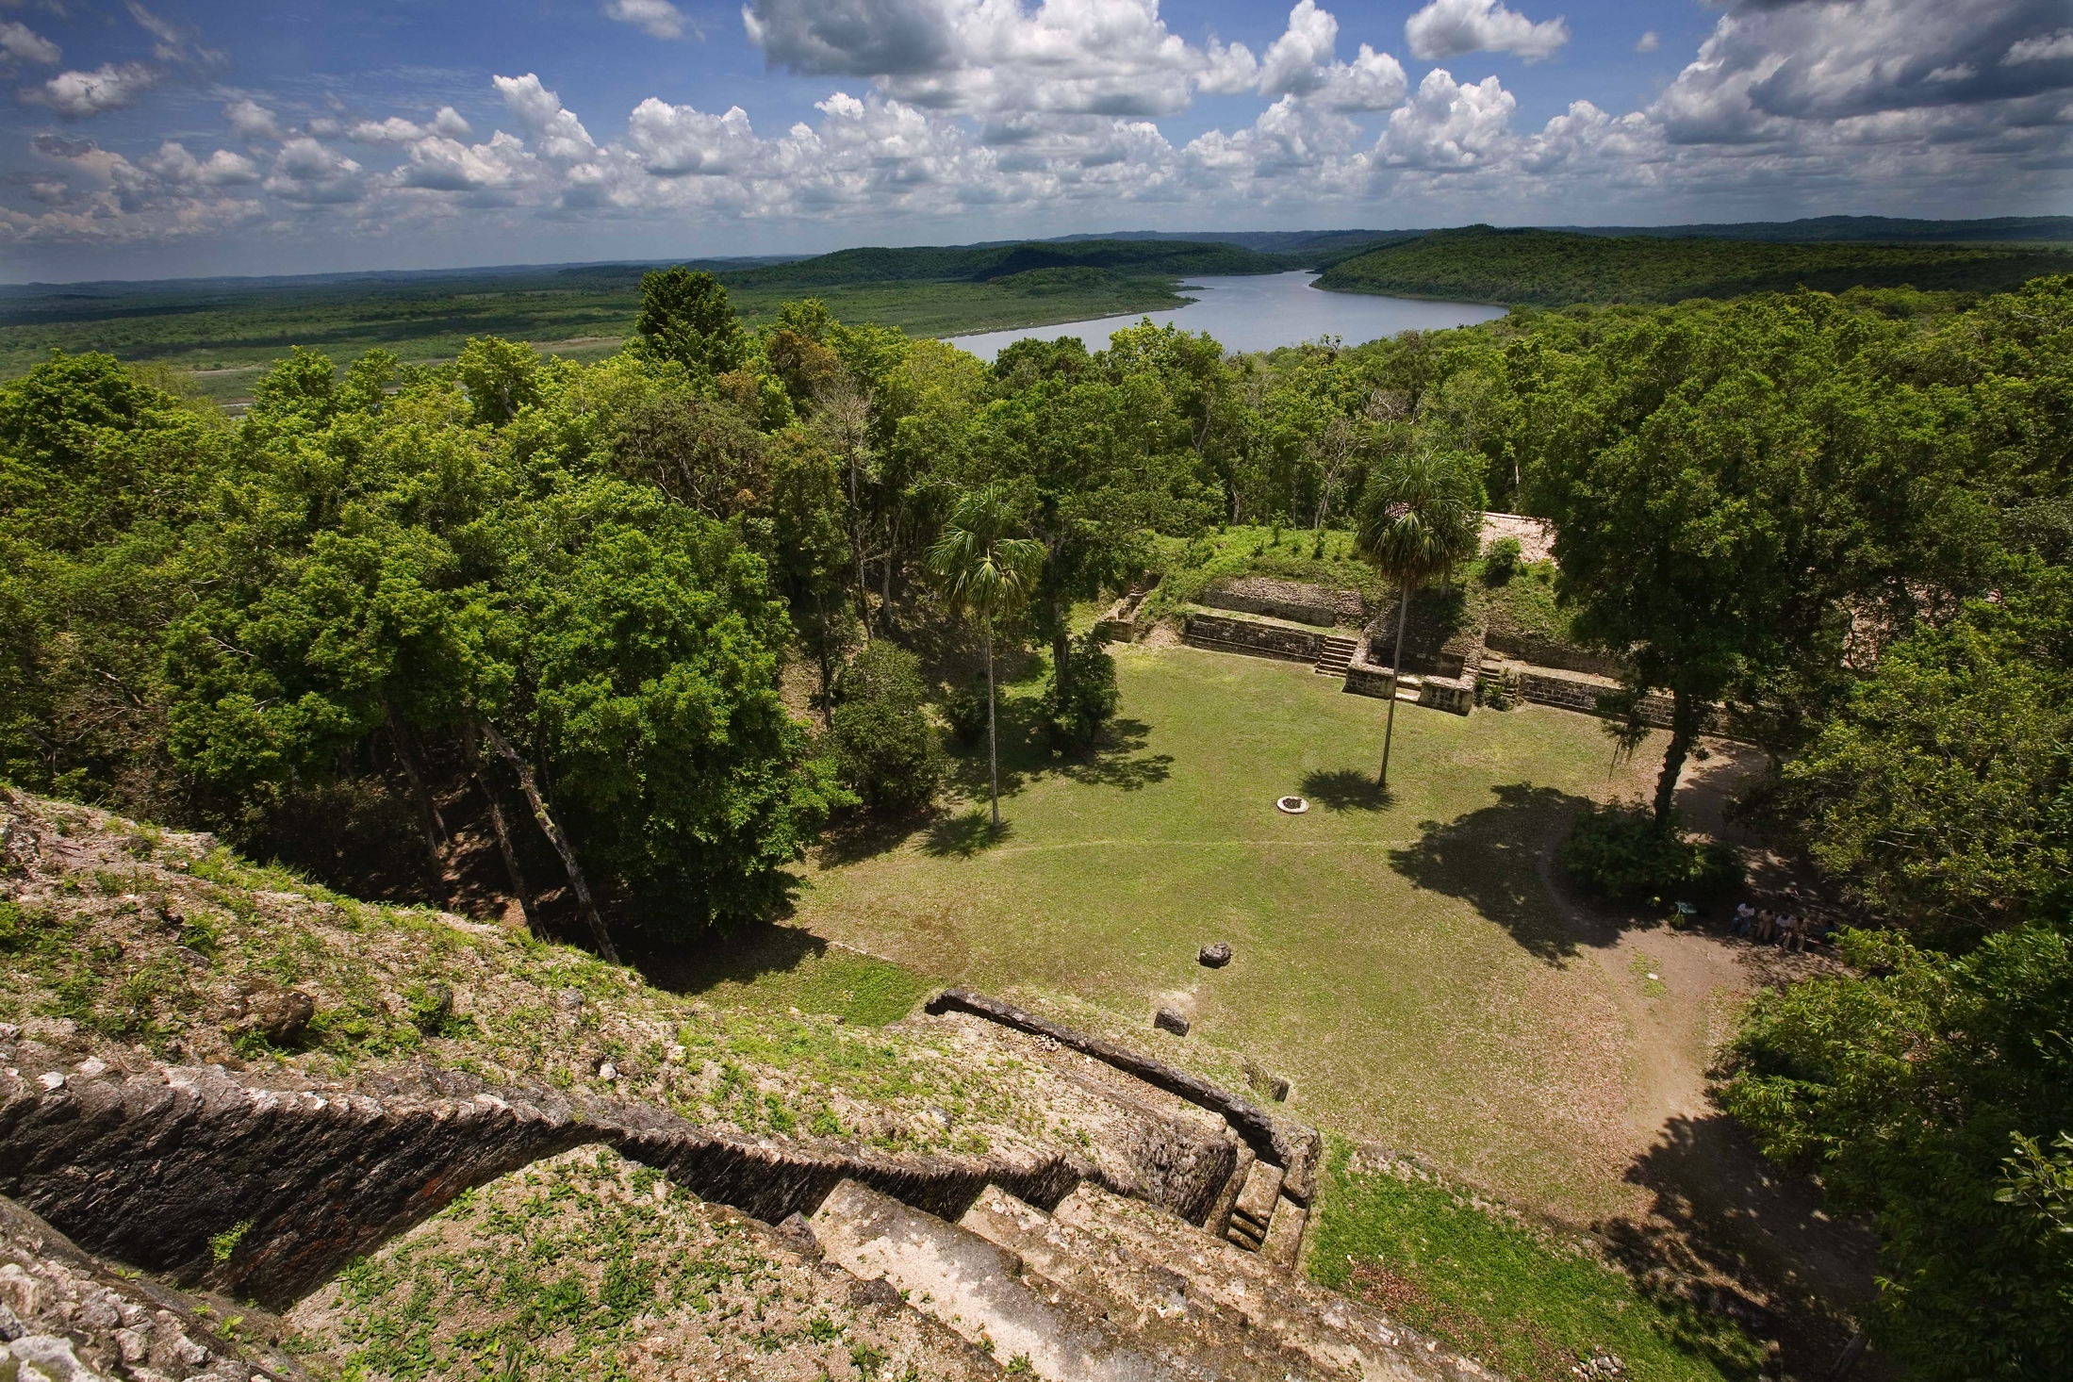
TOURISM IN FIGURES
Visitors: more than 2,000,000 last year with an annual growth of 2.5%
Income from tourism: around US$.1,500 million, with an annual growth of 4.4%.
Hotel infrastructure: 3,286 hotels, with an annual growth of 84%.
Infrastructure available for Events: 5,4 and 3 star hotels and world-class boutique hotels, as well as catering and convention centers with over:
  3,311 rooms for international events.
  186 meeting rooms. (Antigua Guatemala and Guatemala City)
  27,476 m² in convention centers.
Statistics 2013 - INGUAT
3
Notes:
Documento de apoyo y respaldo: estadísticas de INGUAT publicadas en el www.visitguatemala.com

Slide 4
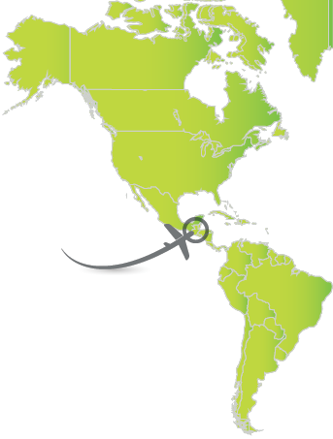

Air Connectivity
2 International Airports and 7 Local airports in the principal cities of the country.
Mundo Maya Airport, located in Petén to 507 km from the City of Guatemala.
International Airport of La Aurora
  Category A1. Considered one of the most modern airports in Latin America.
  Capacity: 4 million passengers annually.
  260 weekly flights with direct connections to USA, Mexico, Central America, Panama, Peru, Colombia and Spain.
Approximate flight time from some of the cities with direct flights to Guatemala
City | Time
NYC | 4h 42min
Houston | 2h 35min
Los Ángeles | 5h
Miami | 2h 37 min
Bogotá | 2h 30 min
Panama | 2h 15 min
Mexico DF | 2h 10 min
Madrid | 11h 30 min

Slide 5
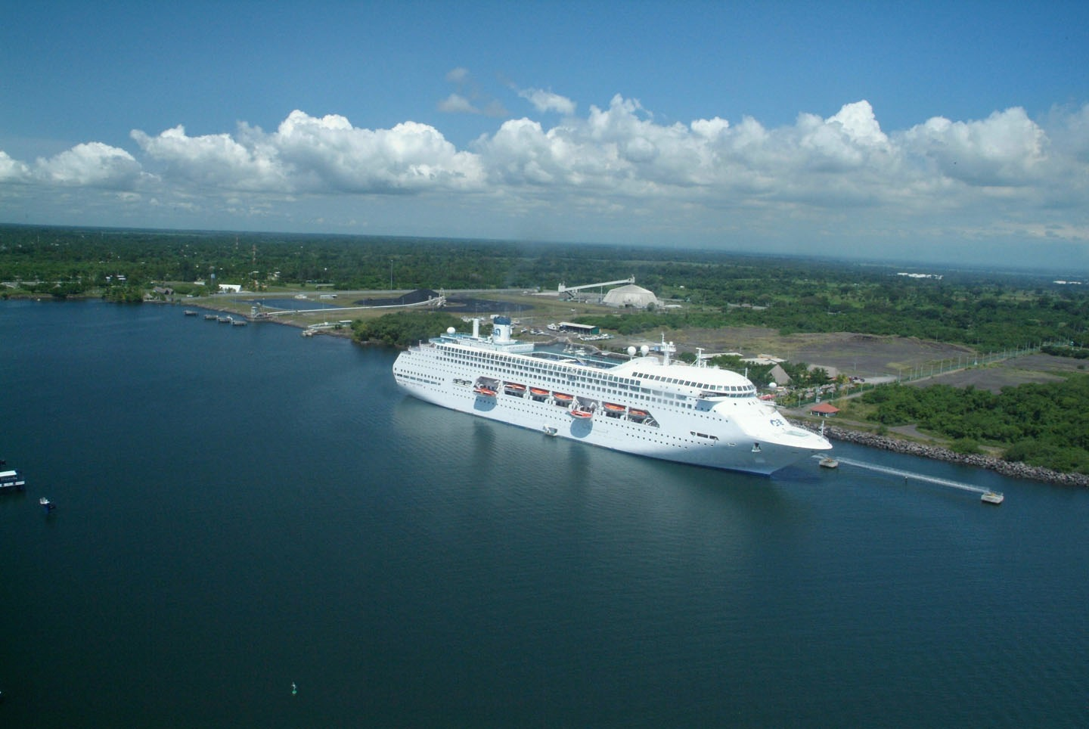
Maritime
Connectivity
Ports: 400 km. from the Atlantic Ocean to the Pacific Ocean.
  Santo Tomás (Atlantic )
  Puerto Barrios (Atlantic )
  Puerto Quetzal (Pacific )
Consolidation of the Mesoamerican Cruise Route, which attracts different cruise lines from Costa Rica, Nicaragua, El Salvador, Chiapas, Huatulco, Mexico.
Notes:
Ver documento de apoyo y respaldo del Segmento de Cruceros.

Slide 6
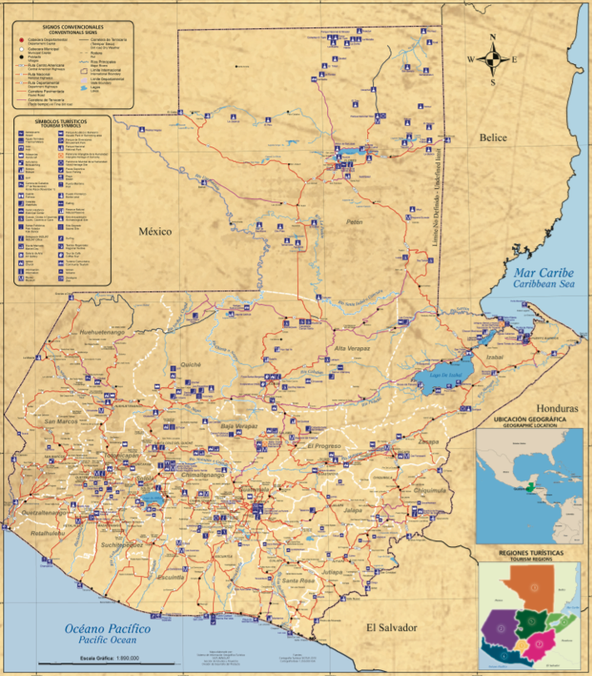
Terrestrial Connectivity
Guatemala has an extensive road infrastructure in the country.
7
8
9
Table of Distances
 | From/To | Time | Kms.
1 | Guatemala City/Antigua Guatemala | 0h45 | 48
2 | Guatemala City/Lake of Atitlán | 3h00 | 145
3 | Guatemala City/Quetzaltenango | 4h30 | 220
4 | Guatemala City/Retalhuleu | 3h30 | 180
5 | Guatemala City/ Chichicastenango | 3h00 | 145
6 | Guatemala City/Río Dulce | 5h00 | 300
7 | Island of Flores/Tikal | 1h00 | 63
8 | Island of Flores/Yaxha | 1h30 | 73
9 | Island of Flores/Río Dulce | 4h00 | 191
6
5
3
2
1
4

Slide 7
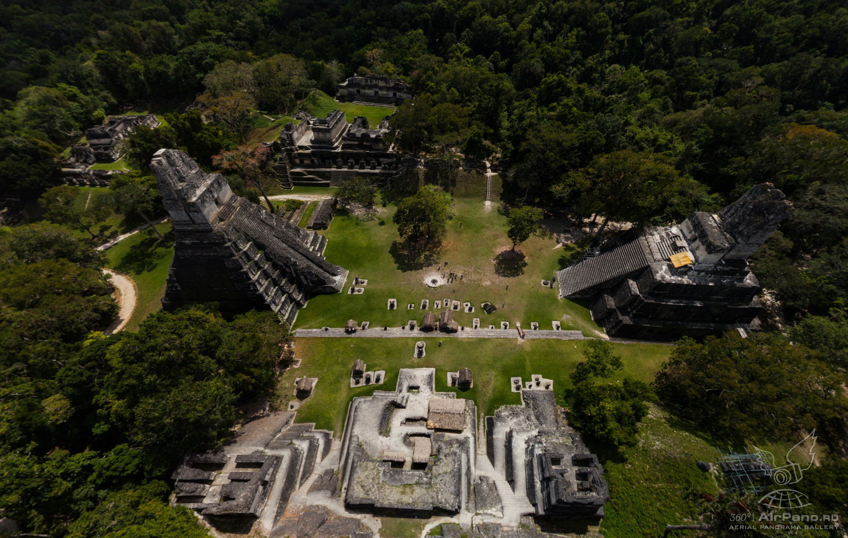
More than 3,000 archaeological sites
1.
Guatemala is
the heart of the Mayan World.
Notes:
Documento de apoyo y respaldo: Informe de Porque Guatemala es el Corazón del Mundo Maya, trifoliar de la Ruta de los Baktunes

Slide 8
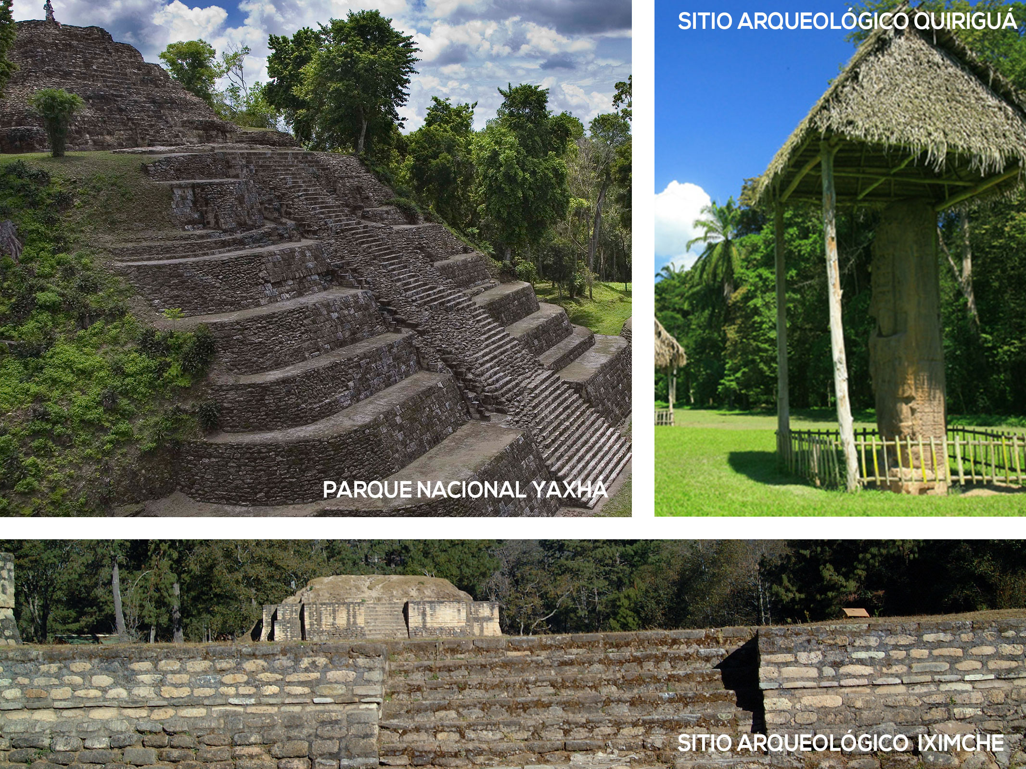
Notes:
Documento de apoyo y respaldo: Trifoliar La Ruta de Los Baktunes

Slide 9
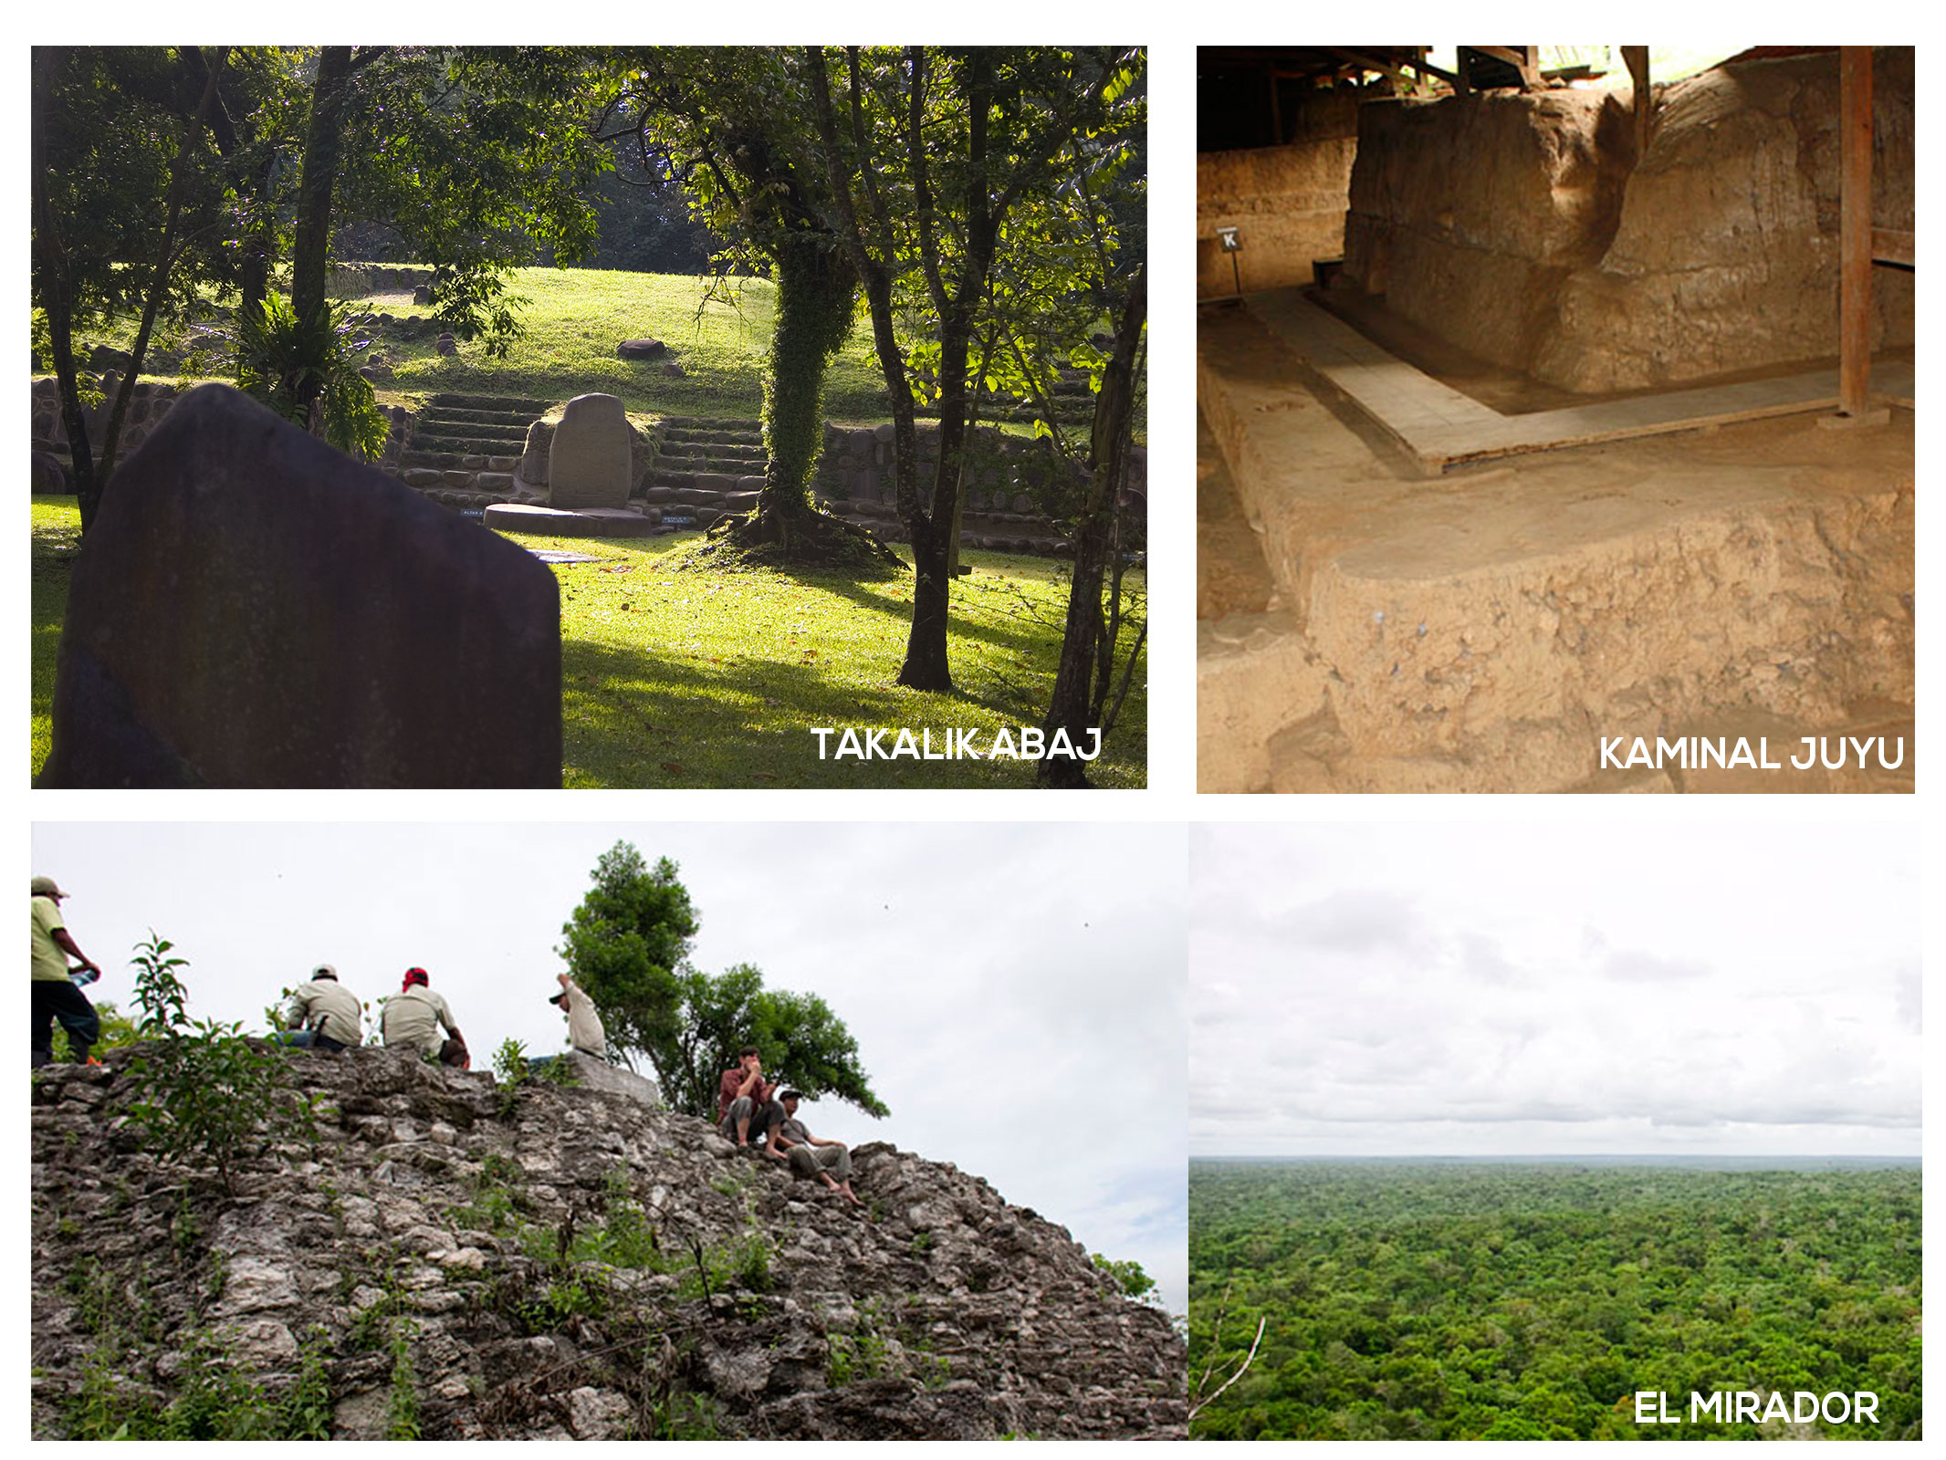

Slide 10
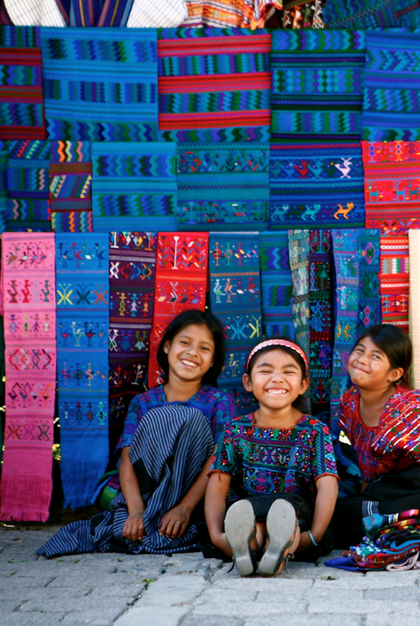
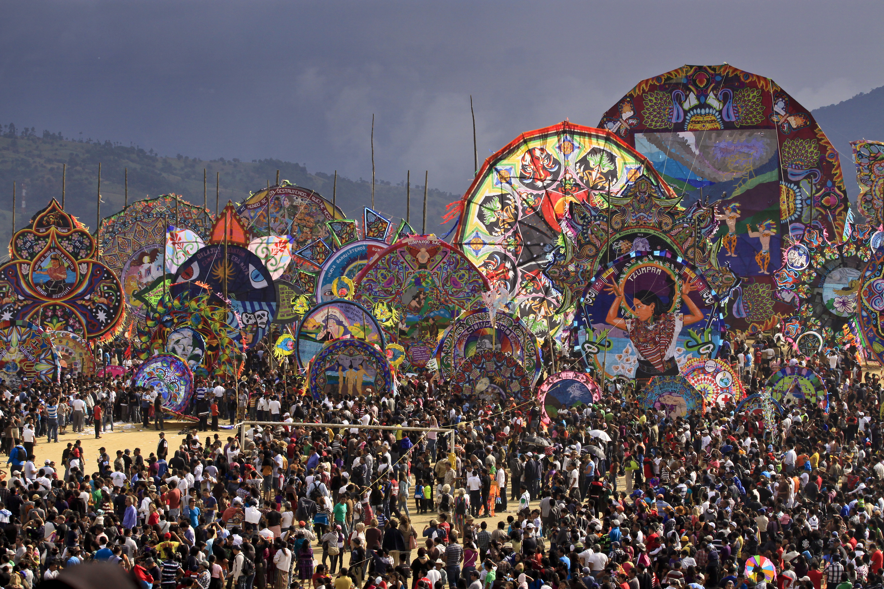
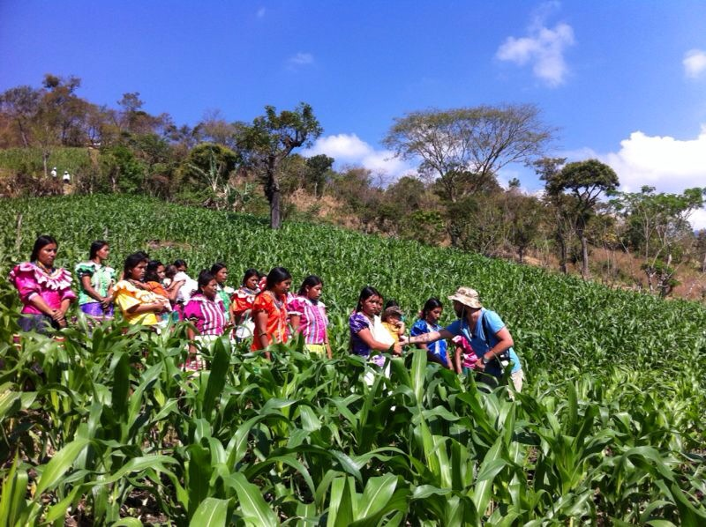
Living Mayan Culture
A rainbow of colors in textiles, handicrafts, art and traditions.

Slide 11
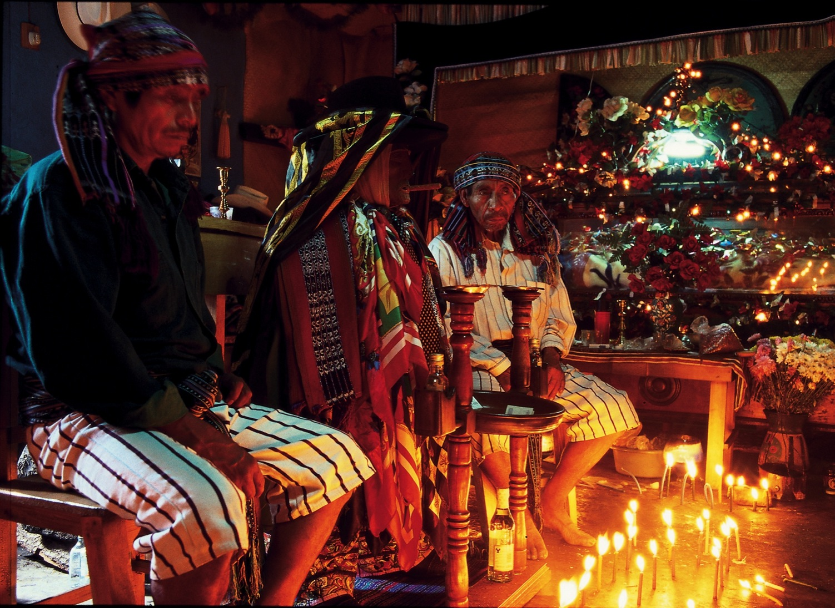
Mysticism and Christian faith traditions and religious syncretism of the living maya culture.
11

Slide 12
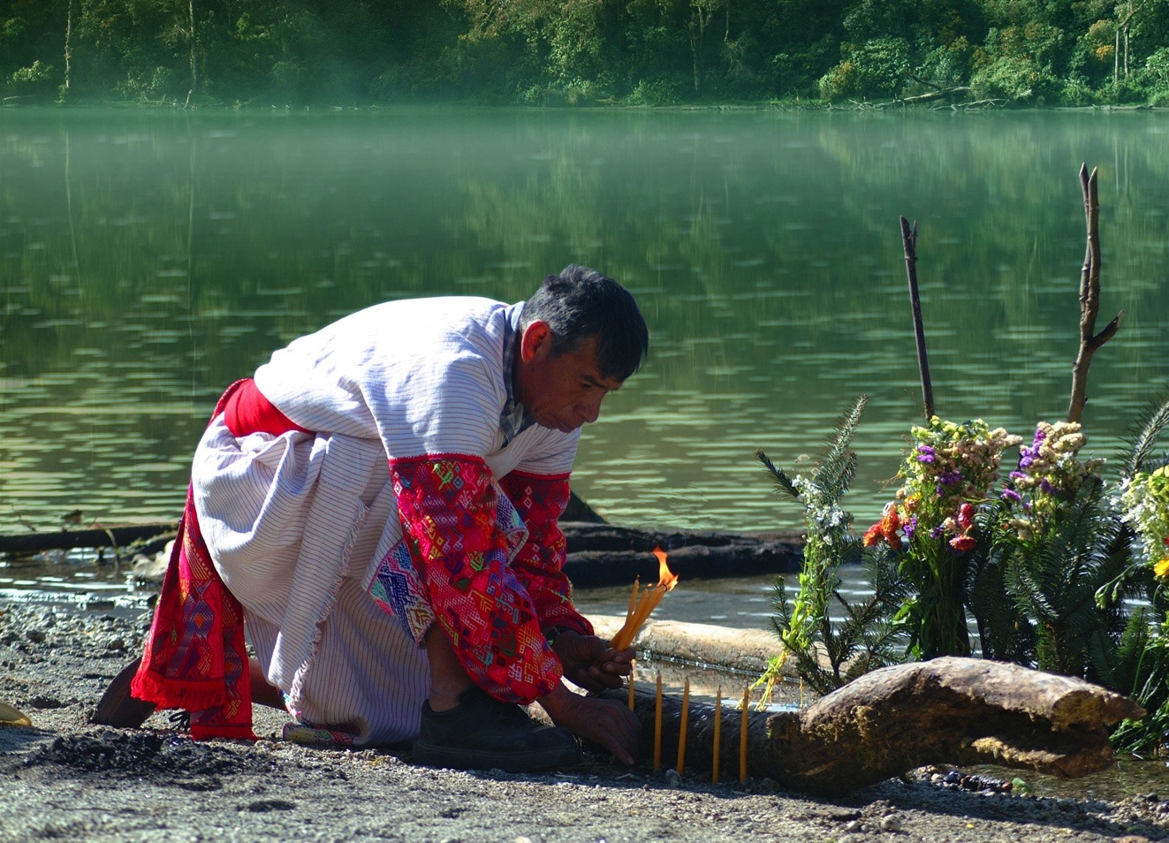
Volcano of Chicabal, Quetzaltenango
Notes:
Material de apoyo: Manual de 7 regiones

Slide 13
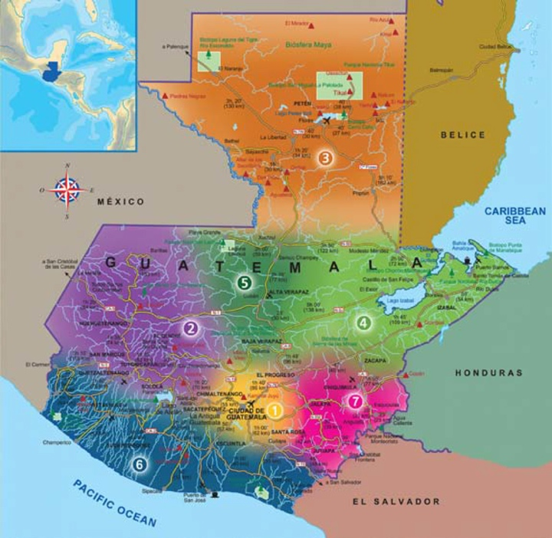
Guatemala, Modern and Colonial
The Highland, Living Maya Culture
Petén, Adventure in the Maya World
Izabal, Green Caribe
Verapaces, Natural Paradise
East, Mystical and Natural
Pacific, Exotic and Diverse
2.
.
Seven tourist regions with a variety of Products and Activities

Slide 14
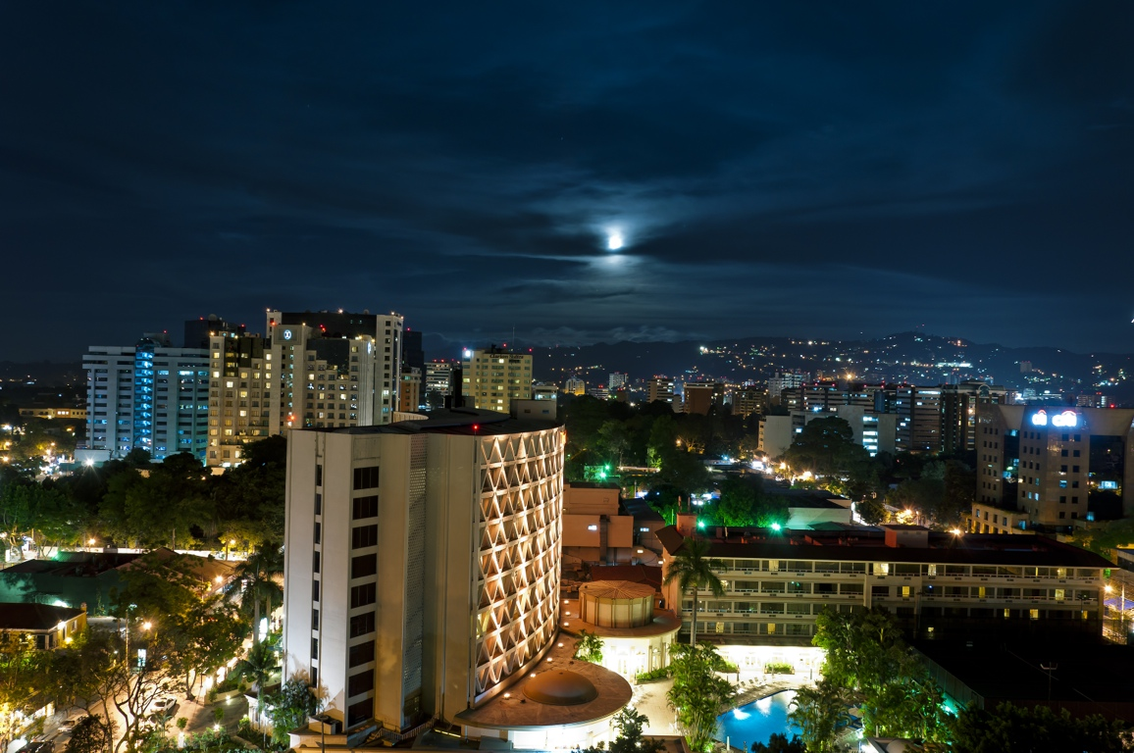
Zone 0, Guatemala City
Guatemala,
Modern and Colonial
14
Notes:
Documento de apoyo y respaldo: Manual y revista de Siete Regiones.

Slide 15
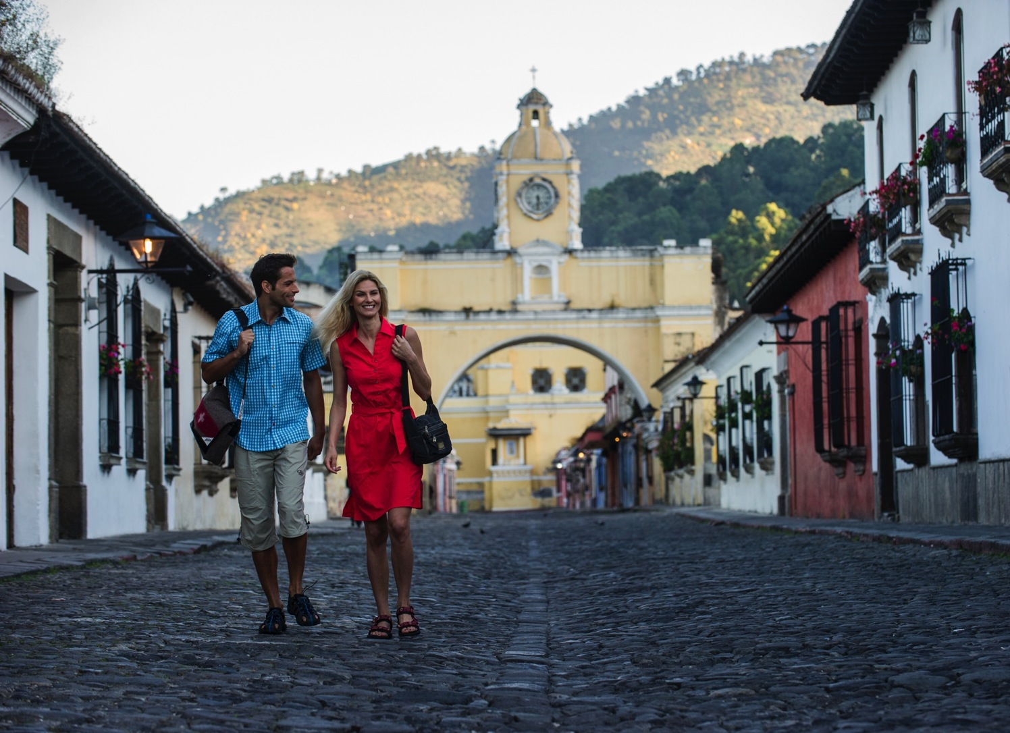
Arch de Santa Catalina, Antigua Guatemala

Slide 16
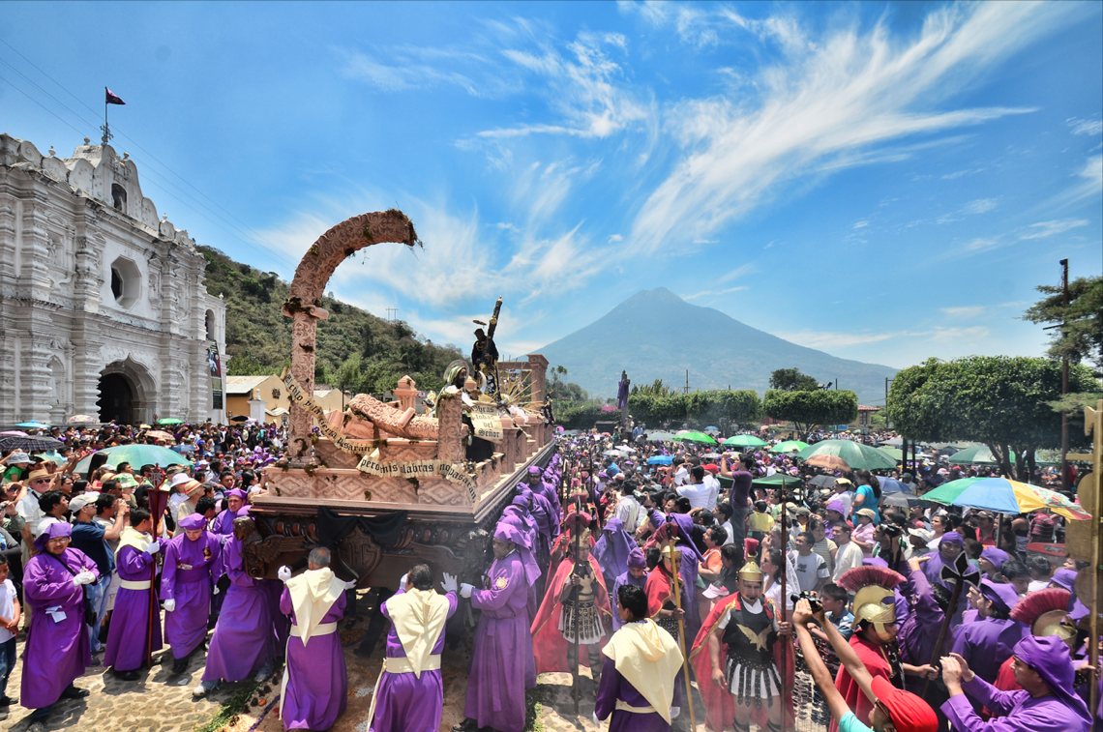
The processions during Easter week in Antigua
16

Slide 17
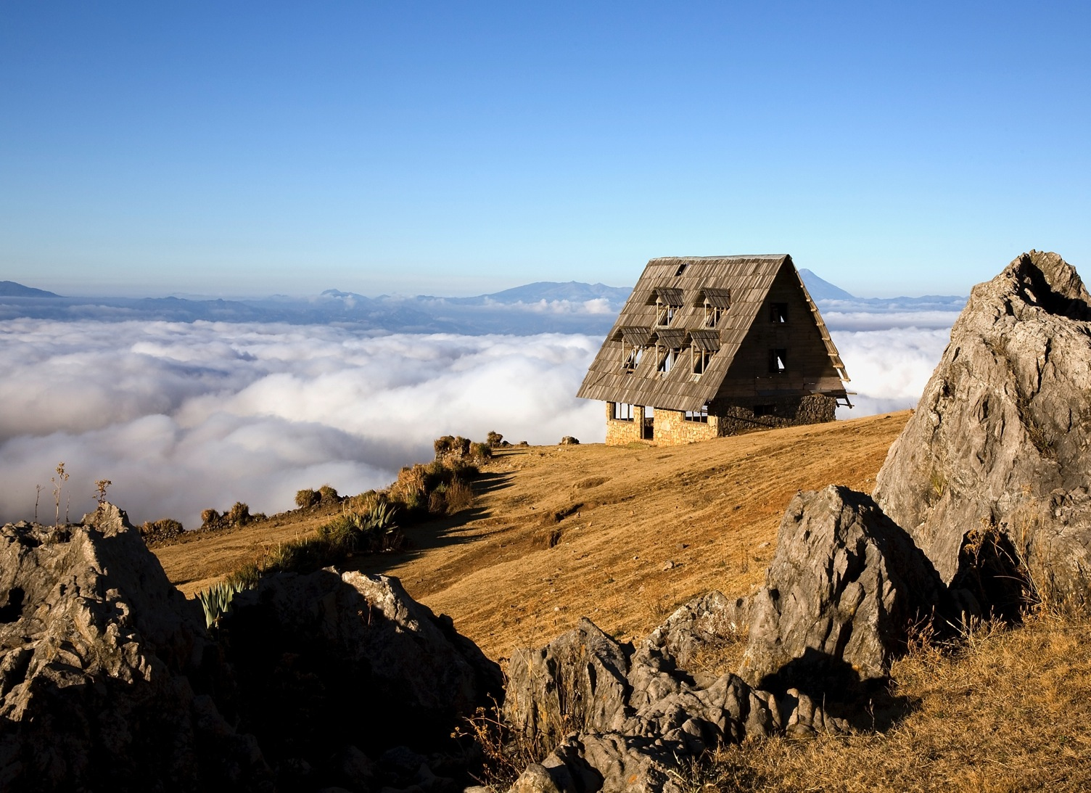
Los Cuchumatanes, Huehuetenango

Slide 18
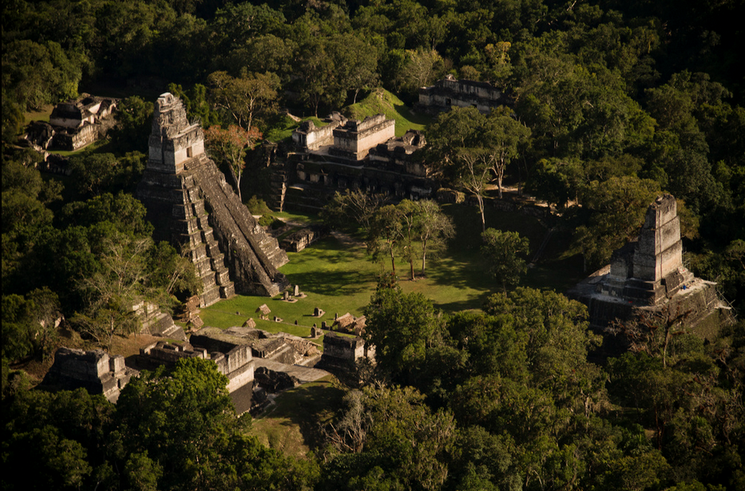
National Park of Tikal, Petén
Petén,
Adventure in the Mayan World
18
Notes:
Material de apoyo: Manual de 7 regiones

Slide 19
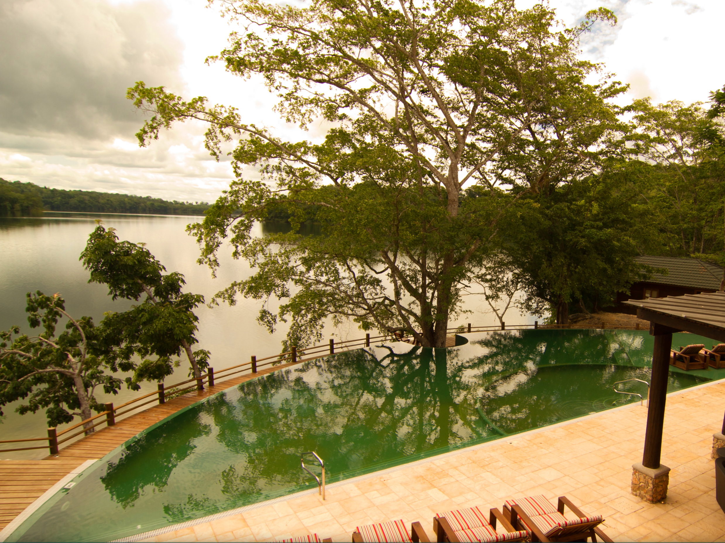
Agregar otra foto de Petén
Equexil Lagoon, Flores, Petén

Slide 20
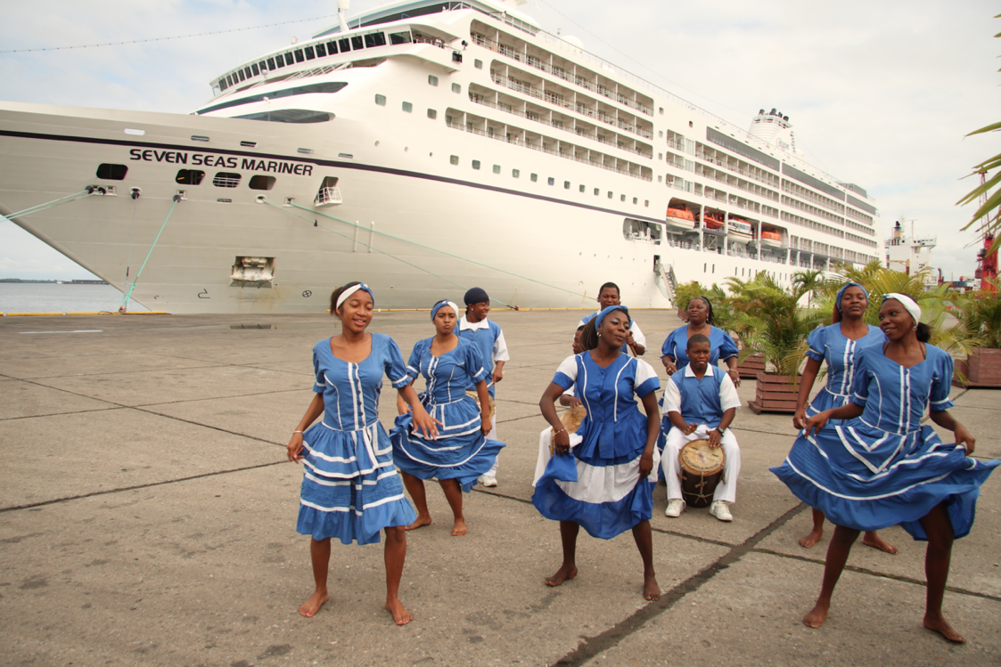
Port of Santo Tomás, Izabal
Izabal
A Green Caribbean
20
Notes:
Material de apoyo: Manual de 7 regiones

Slide 21
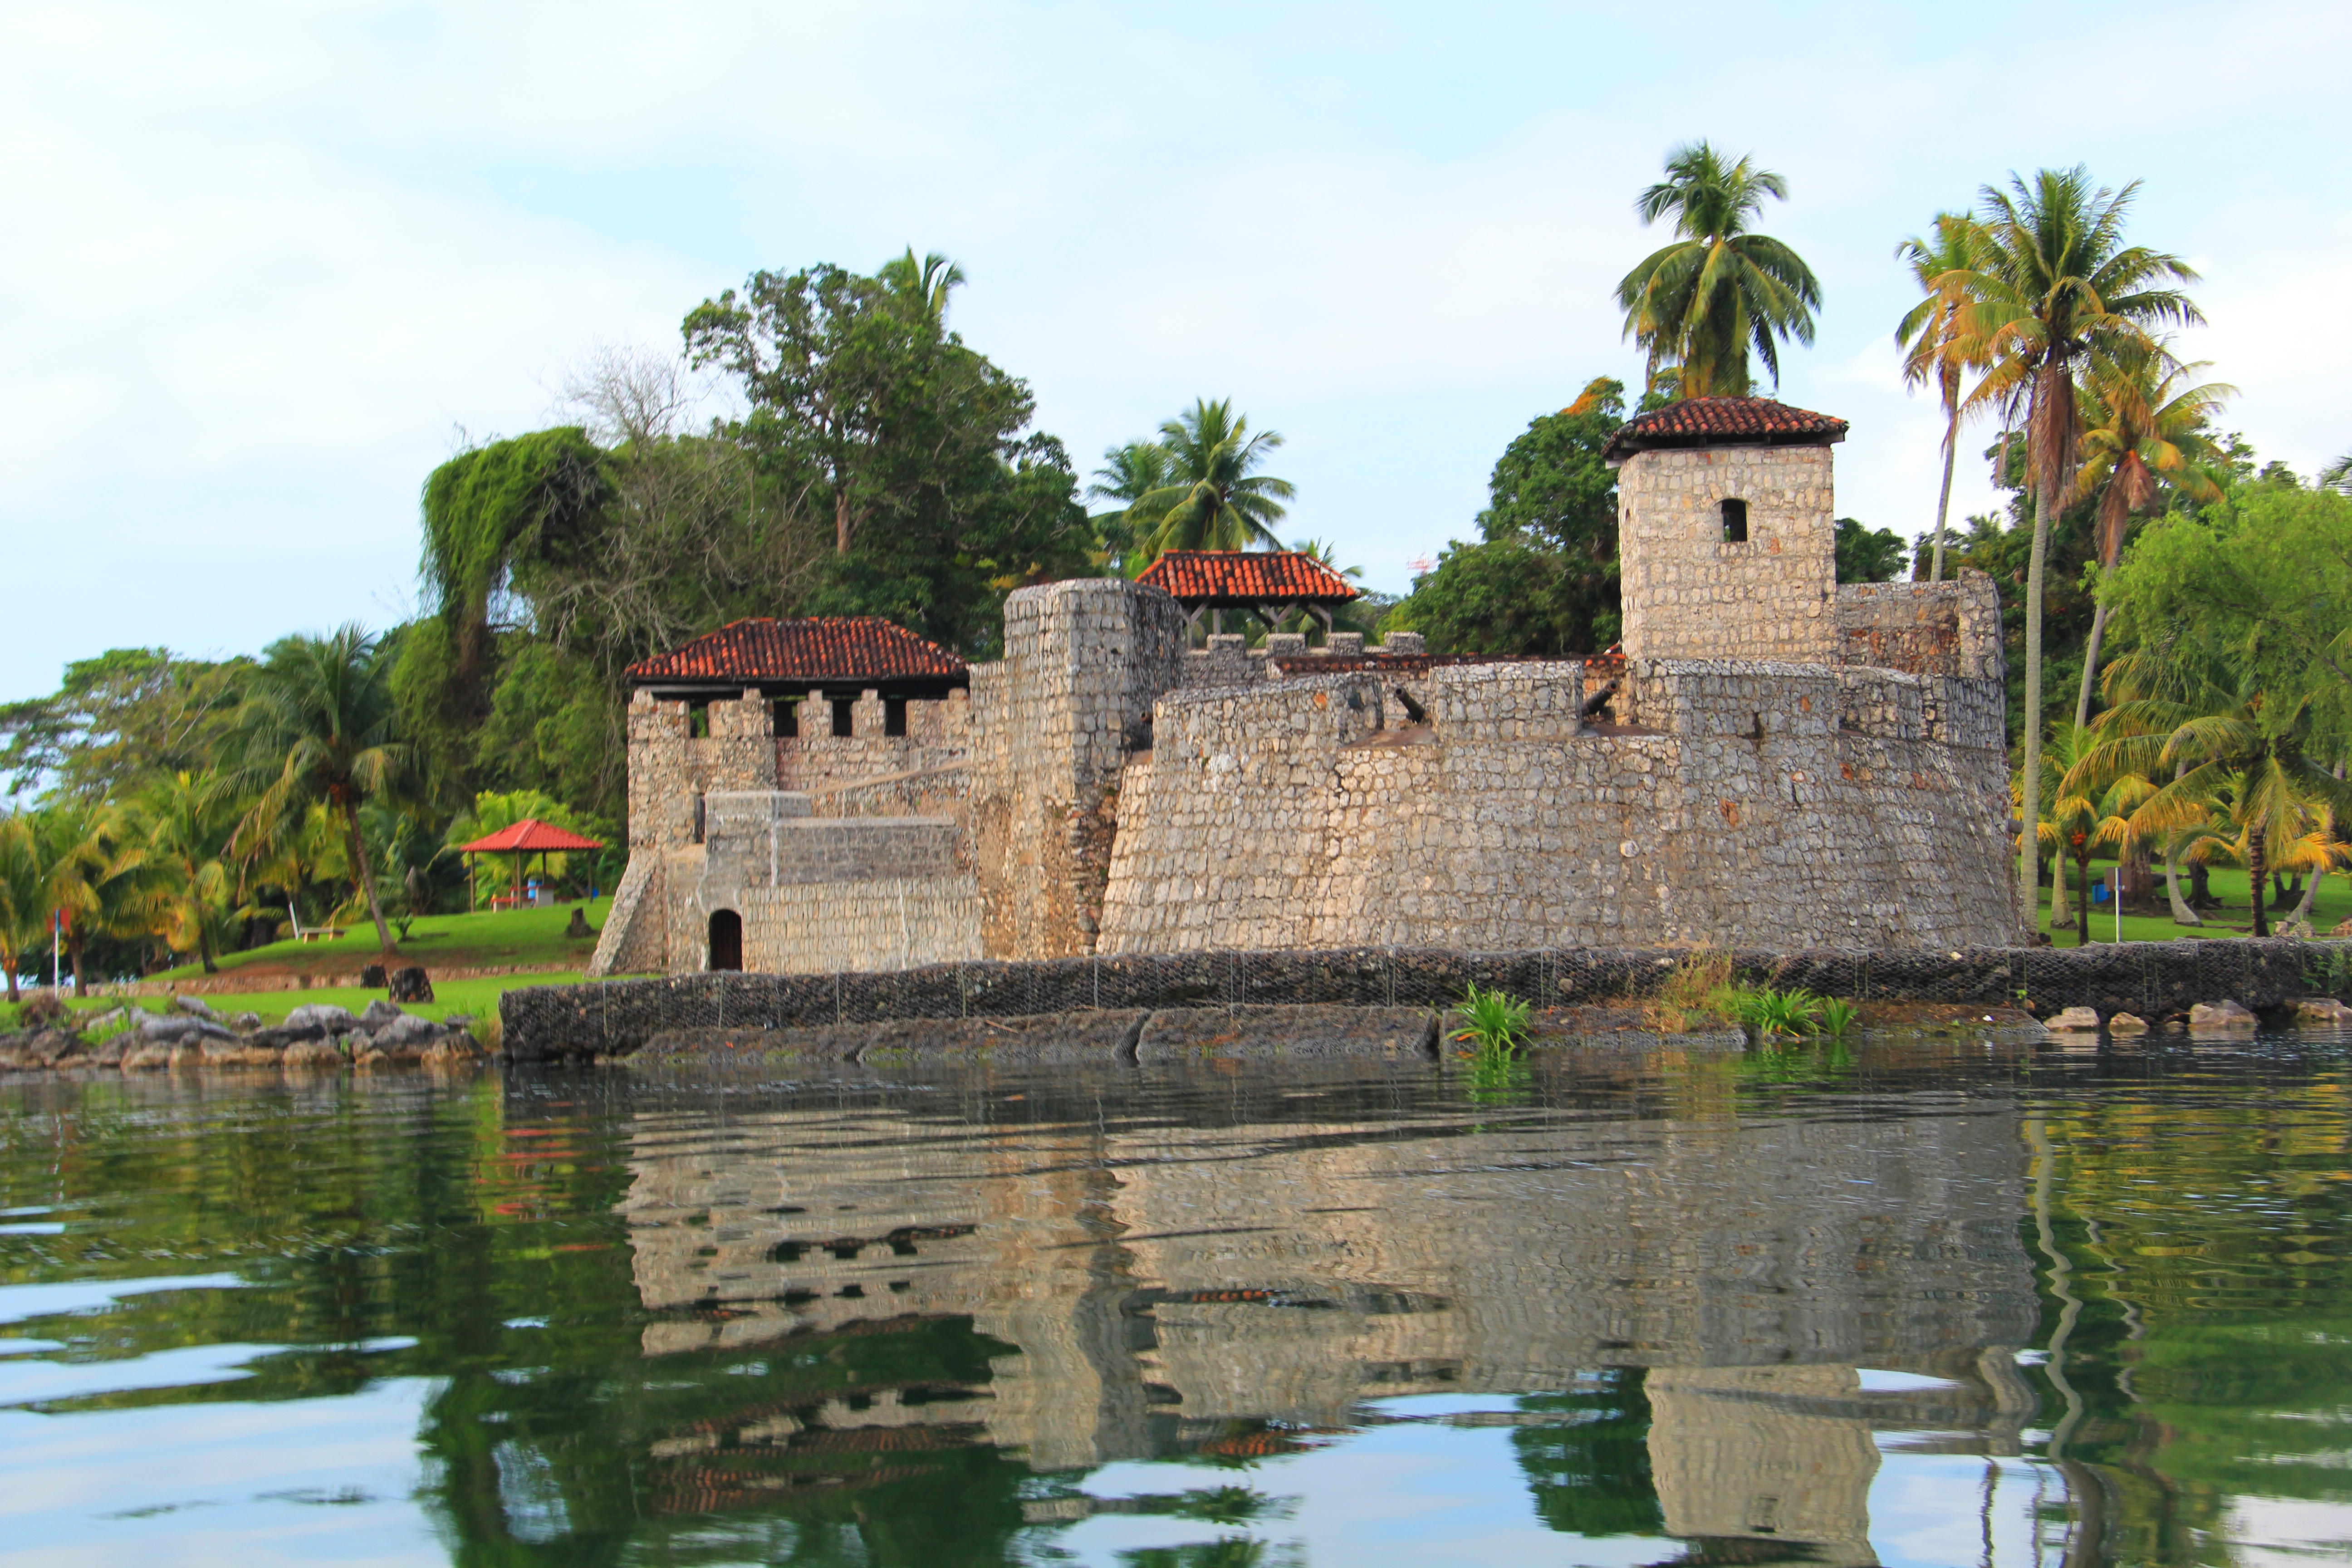
Castle of San Felipe, Río Dulce, Izabal

Slide 22
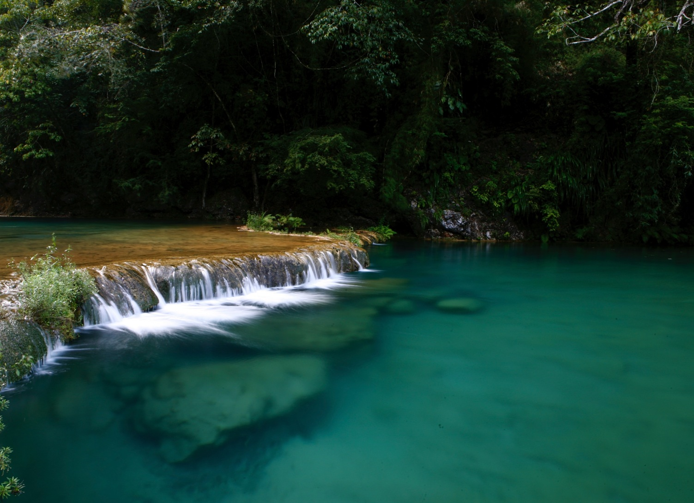
Semuc Champey, Alta Verapaz
Verapaces
Natural Paradise
Notes:
Material de apoyo: Manual de 7 regiones

Slide 23
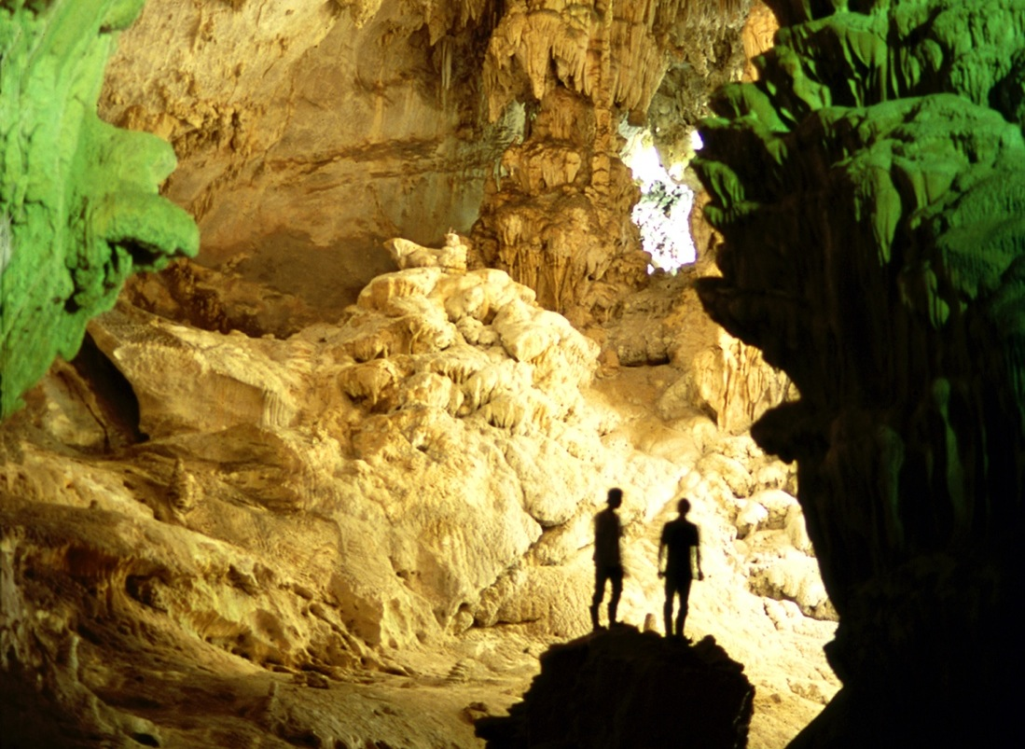
Caves of Lanquín, Alta Verapaz

Slide 24
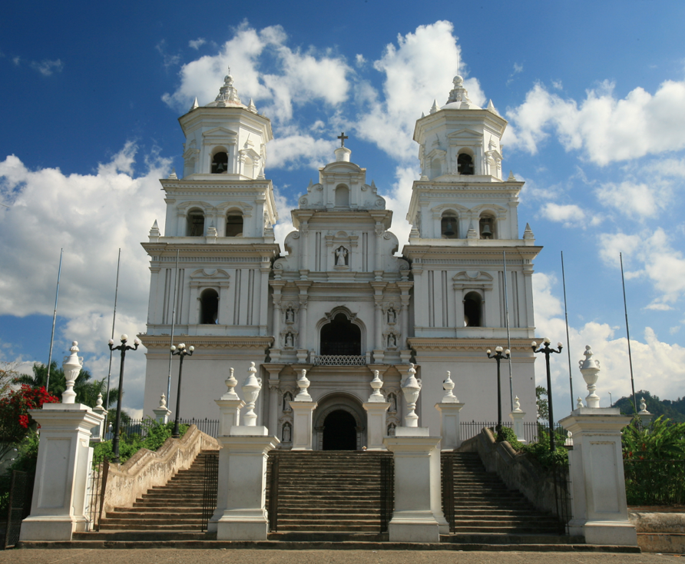
The Basílica of Esquipulas
East
Mystical and Natural
24
Notes:
Material de apoyo: Manual de 7 regiones

Slide 25
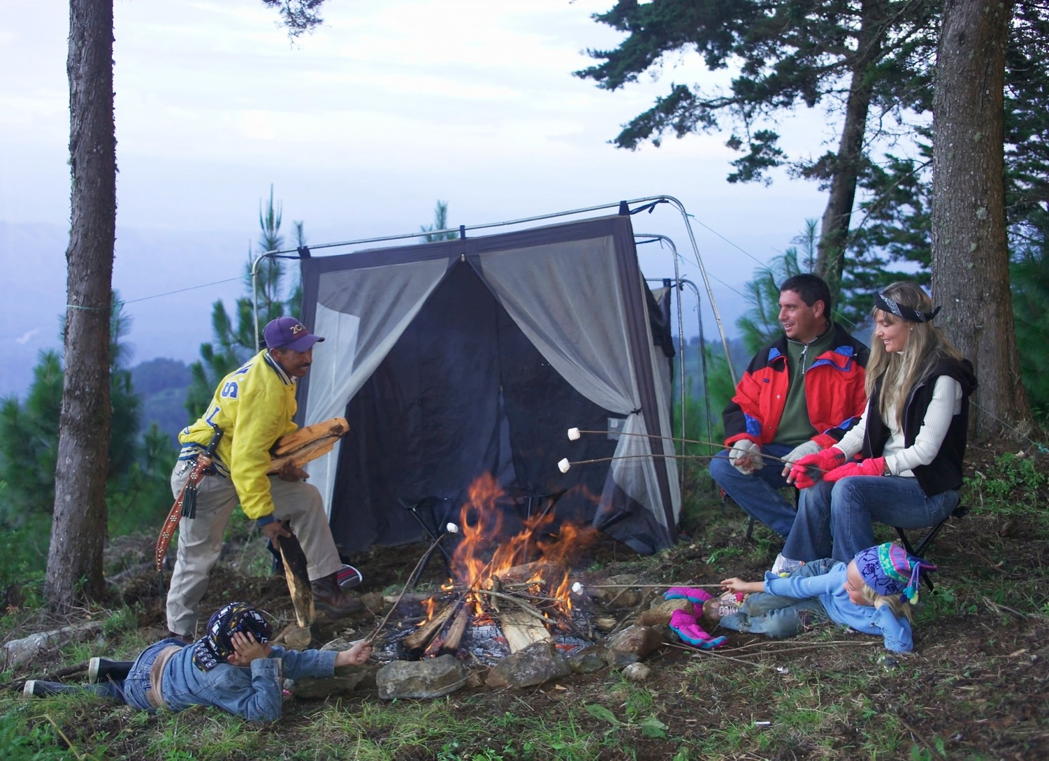
Ipala Volcano, Chiquimula

Slide 26
Port of San José, Escuintla
The Pacific
Exotic and Diverse

Slide 27
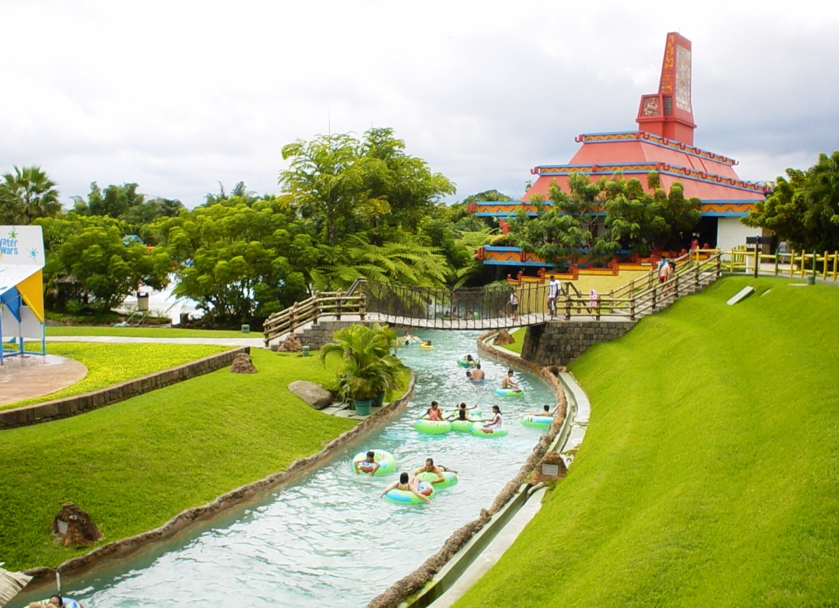

Aquatic Park Xocomil, Retalhuleu

Slide 28
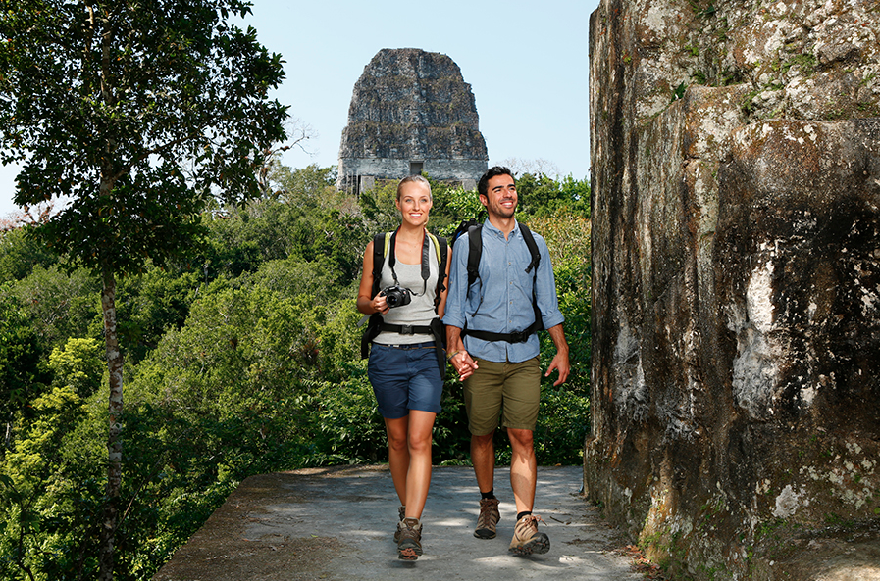
3.
Experiencing nature while trekking and visiting the Mayan world.
28
Notes:
Documento de apoyo y respaldo: Manual de Lecciones de Vida.

Slide 29
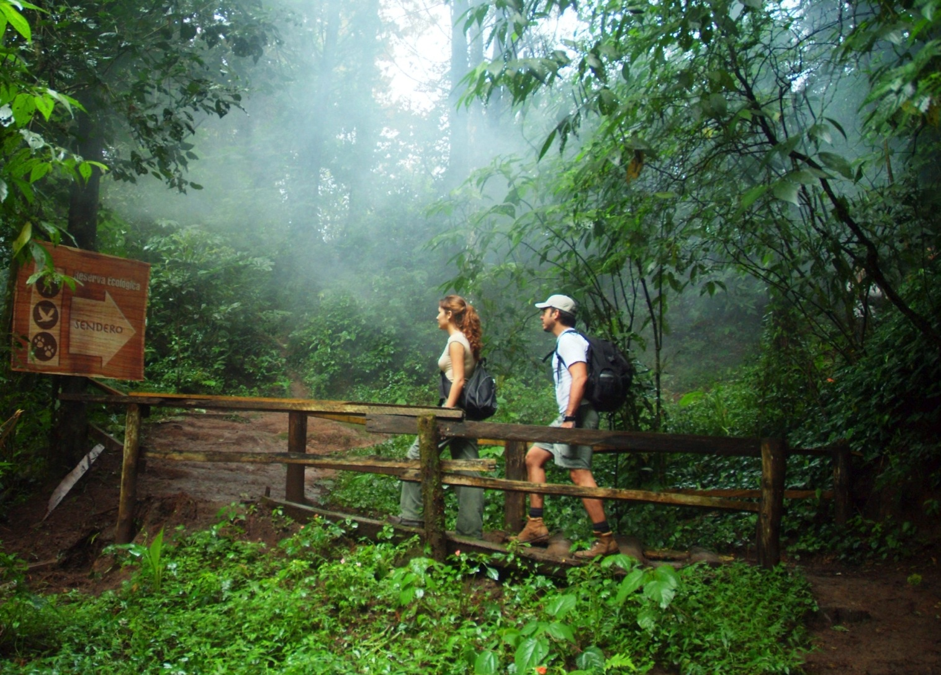
Unique and diverse wildlife.
29

Slide 30
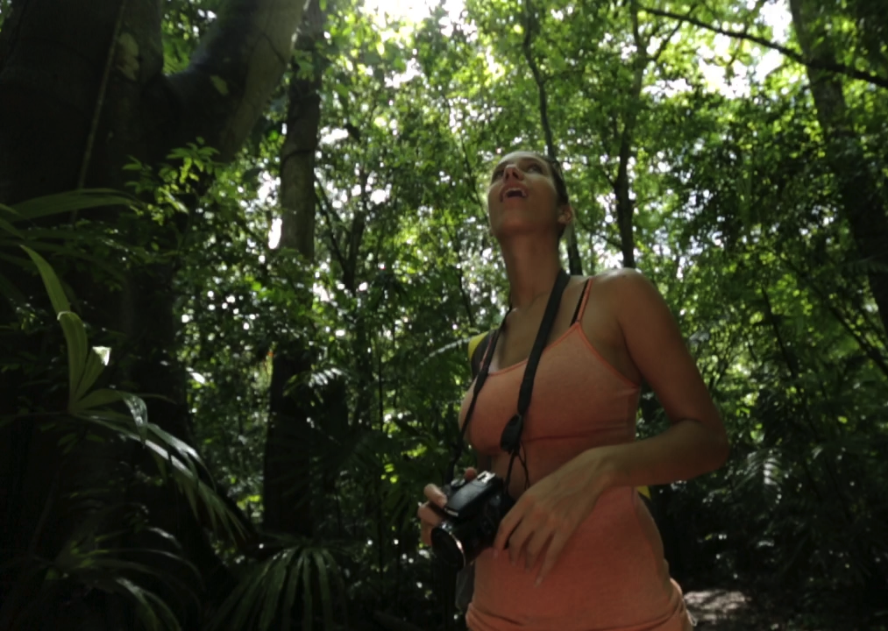
Listening
Listen to the sounds of nature and traditions
Nature with 720 species of birds and other animals
30

Slide 31
Activities in the
Tourist areas
Nature Tourism
  Hiking
  Whale Observation
  Horseback riding
  Bird watching
  Protected Areas
  Agritourism
  Ecotourism
Cultural Tourism
  Living Culture
  Tourism with Community Management
  Museums
  Handicraft
  Gastronomy
  Festivities
  Mystical / Religious
  Archaeology
Adventure Tourism
Speleology (Caving / Spelunking)
Rafting
Mountain Biking
Canopy
Walking /Trekking
Mountaineering
Notes:
Documento de apoyo y respaldo: informe de Productos Turísticos

Slide 32
Sports Tourism
Marathon
Golf
fishing
Surfing
Diving
MICE Tourism
Conventions
Incentives
Meetings
Conferences
Events
Health and Wellness Tourism
̶ Spa
̶ medical treatments
Idiomatic Tourism
̶ Spanish schools in Antigua and Quetzaltenango

Slide 33
4
Destinations you must visit

Slide 34
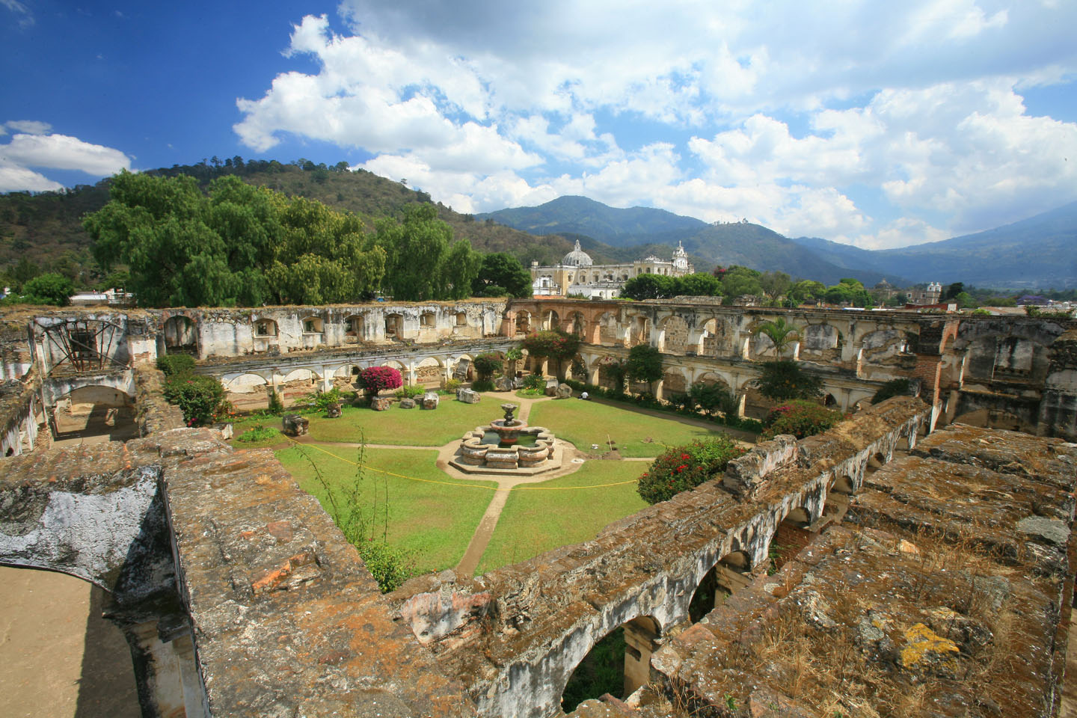
Antigua Guatemala

Slide 35
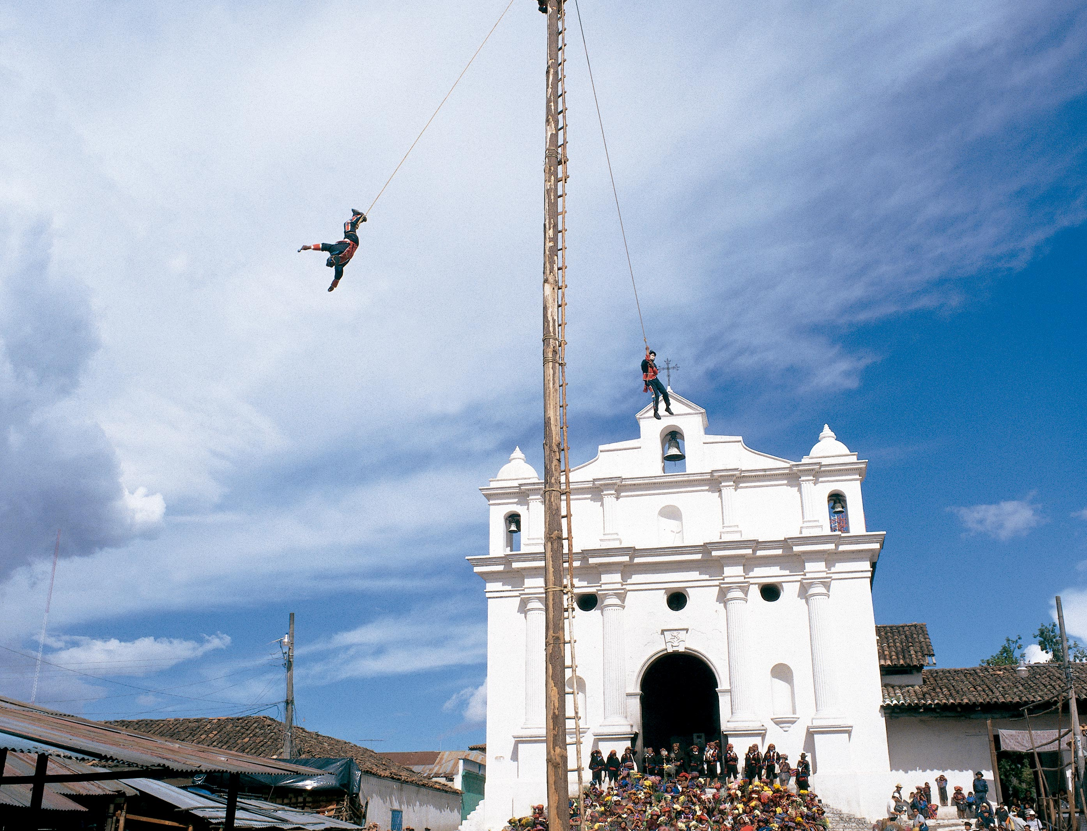
Chichicastenango
35

Slide 36
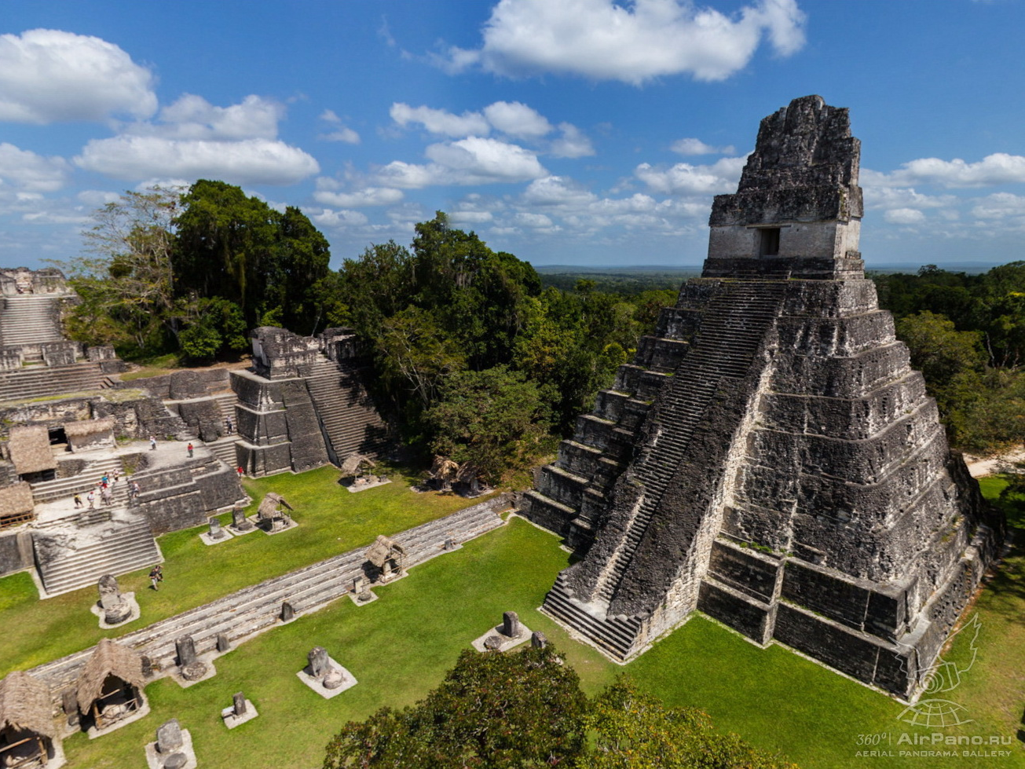
Tikal
National Park of
Tikal

Slide 37
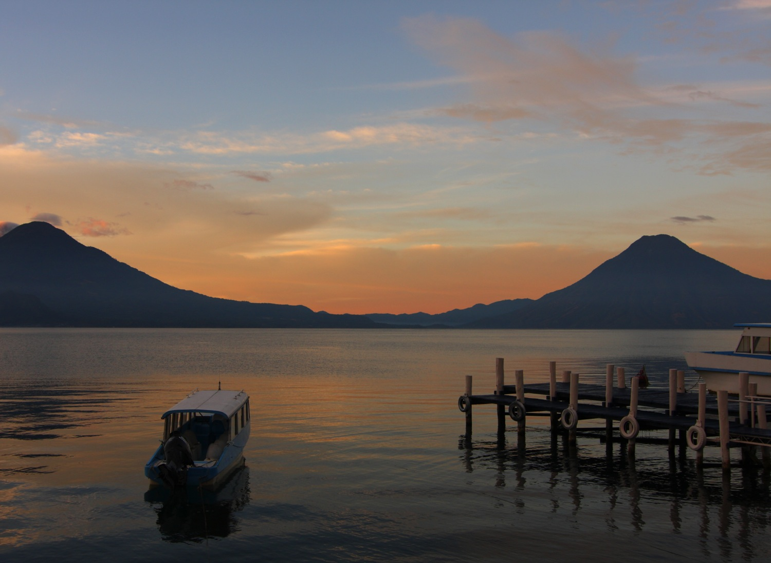
Lake of
Atitlán

Slide 38
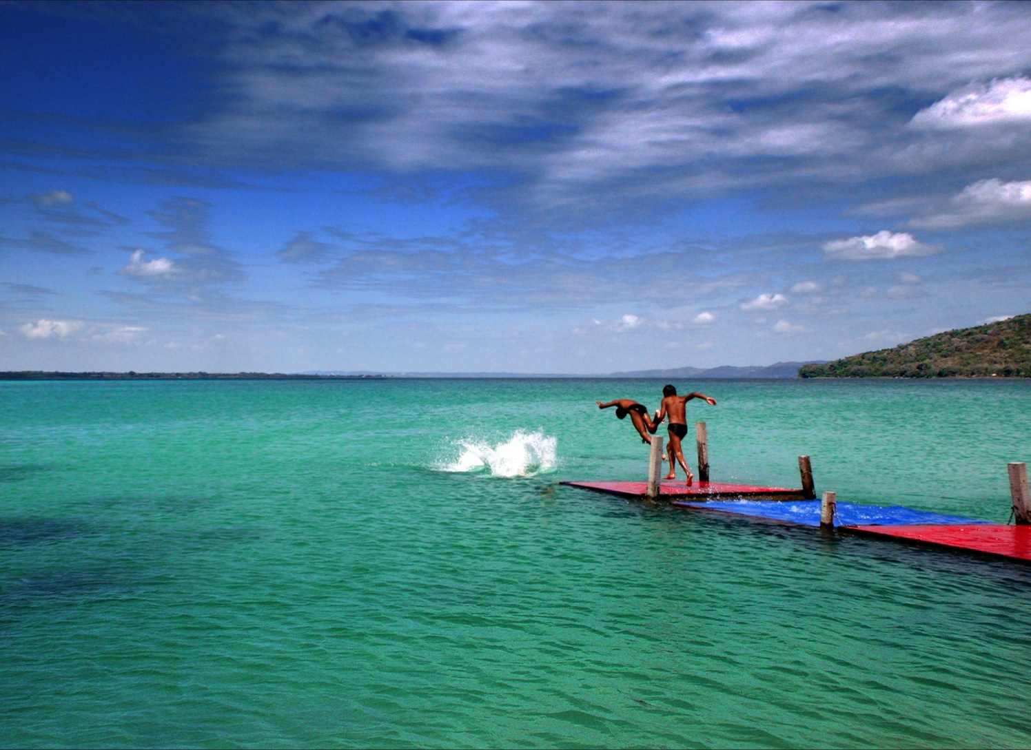
Do not wait to know and promote
Guatemala

