Slide 1


TURKEY - AFRICA FORUM
Mozambique Business Climate and Investment Opportunities
Republic of Mozambique
Investment Promotion Centre (CPI)
Istanbul, May 11, 2016

Slide 2
WHY MOZAMBIQUE ?
COMPARATIVE
ADVANTAGES
COMPETITIVE
ADVANTAGES
WELCOMING
INVESTMENT CLIMATE
Stable Investment Legislation (Predictable, Consistent and Transparent);
Access to preferential markets: SADC, USA, EU, China, India.
Protection against property expropriation;
Non-discriminatory treatment between foreign and domestic investors;
Geo-Strategic Location (as a gateway to SADC);
Rich and Diverse Natural Resources Base;
Notes:
This content has been provided by the creators of easy accounting
software for small businesses, www.billysbilling.com.

Slide 3
Investment Flows
2

Slide 4
APPROVED INVESTMENT
(2010-2015)
Source: CPI

Slide 5
APPROVED INVESTMENT BY SECTOR
(2010-2015)

Slide 6
TOP 10 INVESTORS 2015
Source: CPI
Notes:
Project

Slide 7
PRIORITY SECTORS
AGRICULTURE
INFRAESTRUCTURE
ENERGY
TOURISM

Slide 8
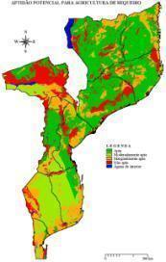
OVERVIEW – EXCELLENT CONDITIONS FOR AGRICULTURE
Mozambique has ideal growing conditions – plentiful water supply combined with diverse micro-climates to support a broad range of agricultural commodities
  Major rivers :Zambezi, Limpopo, Sabie, and others offer tremendous irrigation potential
Land Suitability
Utilization of Arable Land
36.0
5.4
Extensive waterways
15.0%
30.6
High Agricultural Potential
Vast Unutilized arable land
10 distinct agro-climatic zones
Million Hectares
85.0%
Year-round
production potential
Suitable for rainfall agriculture
Arable Land
Utilized
Unutilized
  Tropical climates offer potential for year-round, high yield crop production
Moderately suitable for rainfall agriculture
Source: Ministry of Agriculture; World Bank

Slide 9

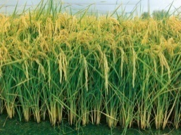












VALUE CHAINS WITH GREATEST OPPORTUNITIES IN AGRICULTURE
13 strategic value chains identified;
6 have been prioritized.
6 prIority value chains
Maize
Rice
Beans
Cassava
Poultry
Red Meat
Arroz
Soja
Banana
13 STRATEGIC VALUE CHAINS
Vegetables
Banana
Sugar
Sesame
Soya
Cashew nut
Cotton
Source: CEPAGRI

Slide 10
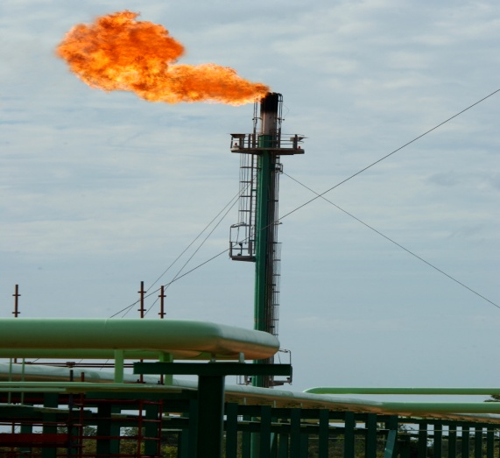
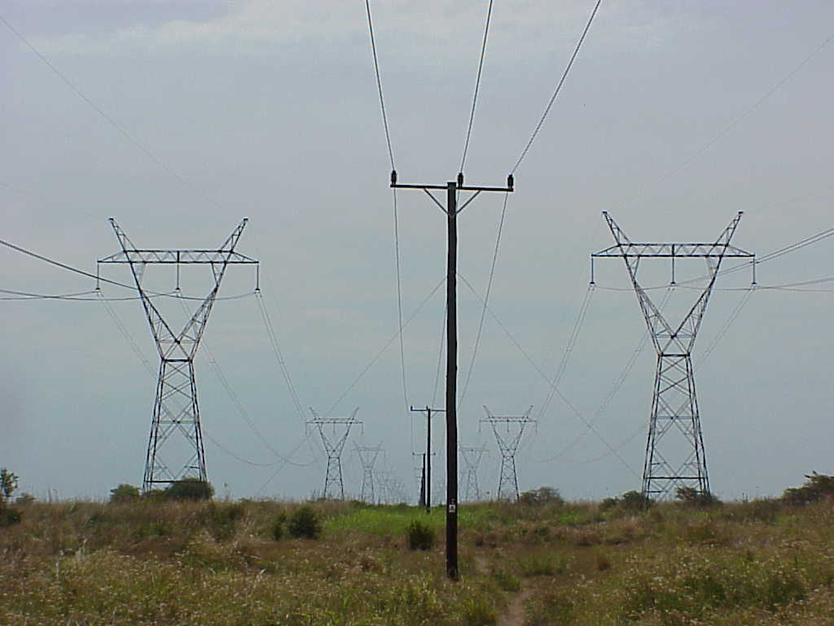
POWER GENERATION

Slide 11
ENERGY RESOURCE POTENTIAL
Mozambique energy resources potential include:
HYDROPOWER - 18.000MW;
COAL -23 billion tonnes;
NATURAL GAS - over 200 TCF,
RENEWABLES - 7.100MW, of which:
  Micro, mini and small hydropower - 4.700MW;
  Wind Power- 1.100MW;
  Solar Power - 1.200MW;
  Biomass Power -130MW
              (Mozambique has a Renewable Energy Atlas)

Slide 12
Mining, Oil & Gas
Projects

Slide 13
MAIN EXISTING MINERAL RESOURCES
Natural Gas
Coal
Heavy Mineral Sands
Bauxite
Limestone
Rare Earth Metals & Tantalite
Gold
Gemstone
Garnet
Graphite
Marble
Bentonite
Base Metals
Phosphate

Slide 14
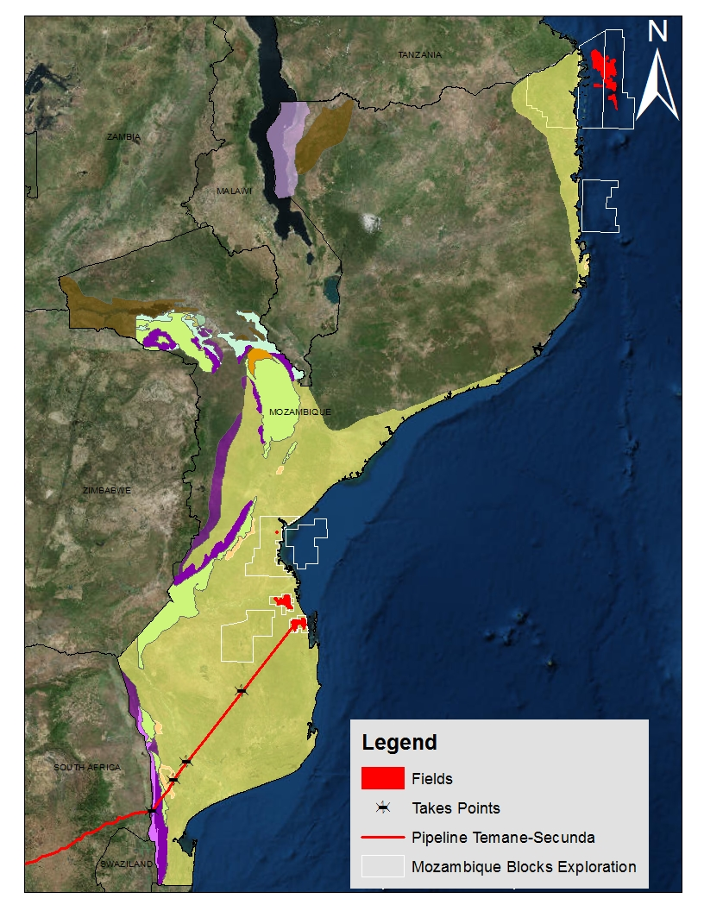
MOZAMBIQUE GAS DISCOVERIES
MOZAMBIQUE HAS SIGNIFICANT GAS RESERVES, POSITIONING IT AS A POTENTIAL KEY PLAYER IN THE ENERGY SUPPLY MARKET GLOBALLY.
Potential Resources
  170 TCF Rovuma Basin
  30 TCF Mozambique Basin
Installed Production Capacity
  197 MGJ/a of Natural Gas
  418,000 bbl/a of Condensate
Installed Pipeline Capacity
  865 km from Temane to Secunda
  350 km local net in Inhambane
  62 km local net in Maputo
Potential Resouces yet to discover
  5th Award for 15 areas
Rovuma
Basin
Mozambique
Basin
Temane
26”gas pipeline
Funhalouro
Chókwe
Magude
Ressano

Slide 15
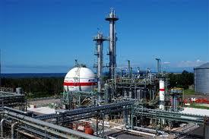
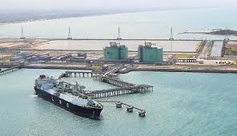
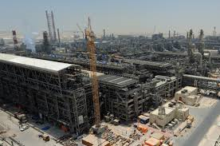
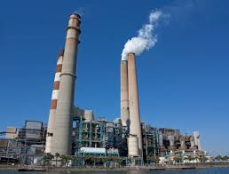
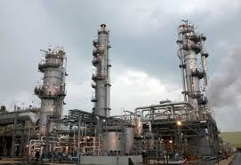
DOWNSTREAM INDUSTRIES
Setting up of Downstream Industries:
  Small LNG Receiving Terminal
  Fertilizer
  GTL (Gas to Liquid)
  DME (Dimethyl Ether)
  Power Plant.
DME Plant
GTL Plant
Power Plant
Fertilizer

Slide 16
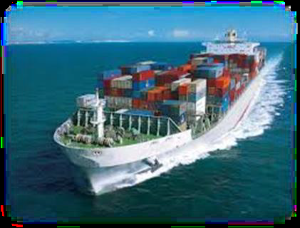
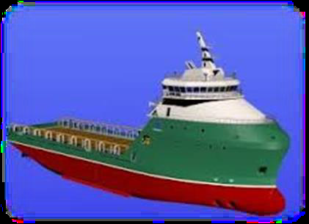
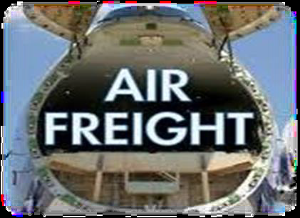
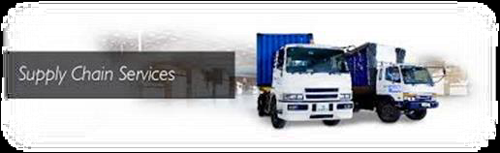
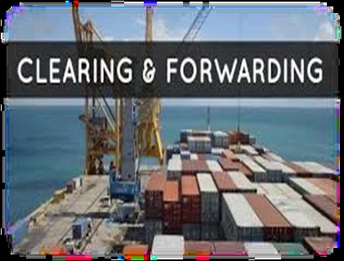
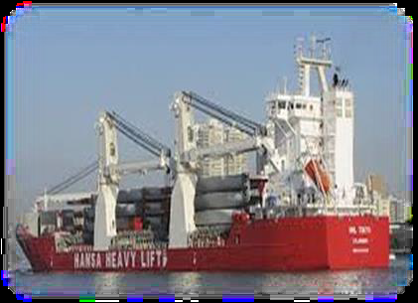
MAJOR OPPORTUNITIES IN LOGISTICS
Shipping Lines
Vessels Operators
Airfreight Operators
Transit & Supply Services
Clearing & Forwarding
Heavy Lift Transport

Slide 17
INFRASTRUCTURE

Slide 18
INFRASTRUCTURE PROJECTS
  Rail, Ports, Container terminals, Shipyards,
  Roads, Bridges
  Dams;
  Dry Docks and Repair Facilities;
  Airport Handling Services;
  Irrigation infrastructure (Dams).

Slide 19
Legal Framework
3

Slide 20
REQUIREMENTS OF ELEGIBILITY TO
FOREIGN DIRECT INVESTMENT
Minimum value of FDI
The foreign investor’s share capital is set at
2.500.000 Mts
Annual Sales volume
Annual Exports of Goods and Services
Creation and retention of jobs
From the 2nd
year of
operation, at
least 25 direct
jobs for
Mozambican citizens
Submission of the investment project to CPI/GAZEDA
7.500.000 Mts from the 3rd year of activities
Exports of goods and services equivalent to
1.500.000 Mts

Slide 21
TAXATION SYSTEM
IMPORT CUSTOMS DUTIES
Equipment 5.0%
VAT
17.0%
IRPC
IRPS
WITHHOLDING TAX
Raw Material 2.5%
Semi-finished products 7.5%
Finished products 20.0%
General 32.0%
Agriculture 10.0%
Minimum 10.0%
Maximum 32.0%
20.0%

Slide 22
TAX INCENTIVES
GENERAL BENEFITS
  In Respect of Import of Goods:
    Exemption from customs duties and VAT on the import of capital equipment, spare and accessory parts.
  In Respect of Income Tax:
    Investment Tax Credit;
    Accelerated Depreciation;
    Tax Exemptions (IFZ; SEZ; Science and Technology Parks).
    Tax Deductions (Professional Training; Use of new Technology);
    Deferral of tax payment.

Slide 23
TAX INCENTIVES
SPECIFIC BENEFITS
CREATION OF BASIC INFRASTRUCTURES;
TRADE AND INDUSTRY IN RURAL AREAS;
MANUFACTURING & ASSEMBLY INDUSTRY;
AGRICULTURE AND FISHERIES;
HOTELS AND TOURISM
SCIENCE AND TECHNOLOGY PARKS
LARGE SCALE PROJECTS
RAPID DEVELOPMENT ZONES
INDUSTRIAL FREE ZONES
SPECIAL ECONOMIC ZONES

Slide 24

BILATERAL TREATIES & AGREEMENTS
South Africa
Germany
Algeria
Belgium
China
Cuba
Denmark
Egypt
USA
USA (OPIC)
Finland
France
Indonesia
Italy
Mauritius
Netherlands
Portugal
Sweden
United Kingdom
Vietnam
India
Switzerland
Zimbabwe
Spain
Japan
Brasil
Turkey (Negotiation)
Botswana
India
Italy
Macau
Mauritius
Portugal
South Africa
United Arab Emirates
Vietnam
Agreements to prevent Double Taxation and Fiscal Evasion
Investment Promotion and Reciprocal Protection Agreements
Notes:
24

Slide 25
How may CPI assist
5

Slide 26
HOW MAY CPI ASSIST YOU?
Company Registration,
Visa, etc.
Investment Process
and Aftercare
Information on
Economy, Industry
& Legislation
Facilitation of Domestic & Foreign Investment
Potential Projects,
Sites, Business
Partners
Concession of
Fiscal/Custom
Incentives
Meetings with
Government Officials
OFFERS A PACKAGE OF SERVICES TO ASSIST NATIONAL AND FOREIGN INVESTORS FACILITATING ACCESS TO INCENTIVES OFFERED BY THE GOVERNMENT AND THE ESTABLISHMENT OF THEIR BUSINESSES.

Slide 27
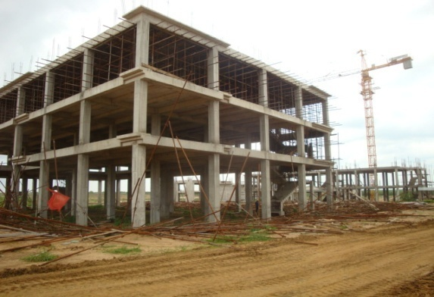

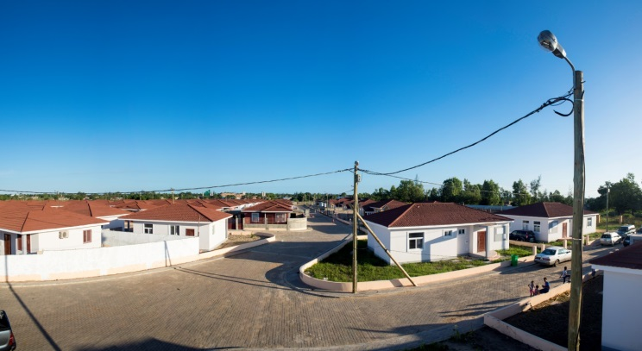
THANK YOU!

