Slide 1
Business Passport: Canada
An Introduction for Investors
Presented by
Stephen Green | stepheng@gands.com
Eren Sari | erens@gands.com

Slide 2
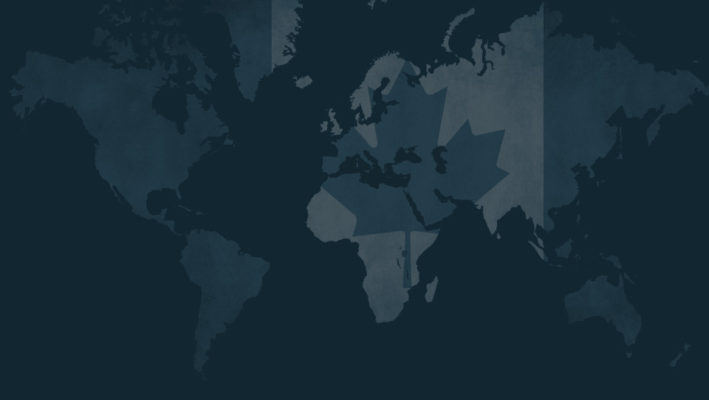
Agenda
Overview
Temporary Entry for Business Professionals
Ontario Immigrant Nominee Programs
Quebec Immigrant Investor Program
Why Canada?
Questions
www.gands.com

Slide 3
Overview
www.gands.com

Slide 4
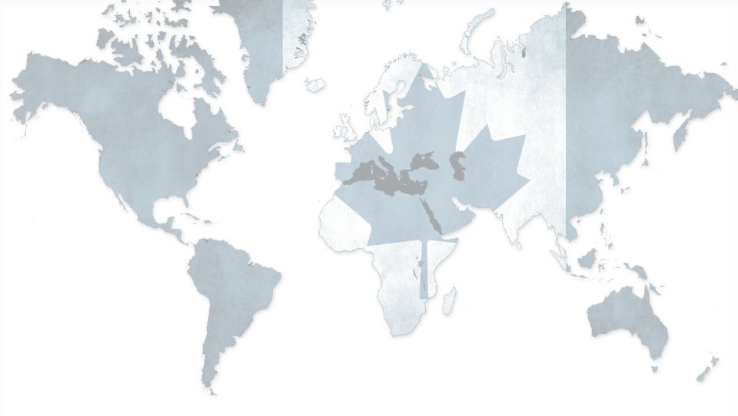
Overview
Canada actively seeks to recruit highly skilled investors and entrepreneurs from around the world
The Federal government and provinces work together to create programs to facilitate entry of business professionals
Both temporary permits and permanent resident streams
Temporary Entry as business visitors permits foreign nationals to set up meetings and pursue international business opportunities prior to making investor applications
Election of Liberal Majority government promises to reduce wait times and stream line application processes
www.gands.com

Slide 5
Temporary Entry for
Business Professionals
www.gands.com

Slide 6
What makes a person a “Business Visitor”?
Broad category facilitates entry of foreign nationals into Canada for the purposes of engaging in international business or trade.
There must be no intent to enter Canadian labour market
Business activity must be international in scope, a presumption of underlying cross-border business activity
Primary source of remuneration must be outside Canada
Principal place of employer must be outside Canada
Accrual of profits of the foreign employer must be outside Canada
www.gands.com

Slide 7
Business Visitors may:
Buy goods and services for a foreign business or government
Attend meetings, conferences, conventions or trade fairs
Provide after-sales service
Train employees at a Canadian subsidiary of a foreign parent
Be trained by a Canadian parent for employment at a foreign subsidiary
Attend Board of Directors meetings
Business Visitors may not:
Engage in employment that will provide services or create competition within, or remove opportunities from, the Canadian labour market.
Receive any form of remuneration from the Canadian company
www.gands.com

Slide 8
Ontario Immigrant Nominee Program
www.gands.com

Slide 9
Overview
Two new Ontario investor streams for individual investors and businesses seeking to bring their business to Ontario
Program permits Ontario to nominate individuals for Permanent Residence in Canada per program objectives
Both programs expected to launch in Fall 2015
www.gands.com

Slide 10
The Entrepreneur Stream
Minimum investment of $500,000 in a new or existing business
Minimum net worth of $800,000
Create at least two full-time permanent positions for Canadians or Permanent Residents
Meet language and other requirements prior to being nominated
www.gands.com

Slide 11
The Corporate Stream
Minimum investment of $5,000,000 in a new or existing Ontario business
Nominate key staff currently employed at Corporation who are essential to the Ontario business
Create five full-time permanent positions for Canadians or Permanent Residents for each key staff nomination
www.gands.com

Slide 12
The Quebec Immigrant Investor Program
www.gands.com

Slide 13
Program Overview
Open to Investors intending to settle in Quebec
Offers Permanent Residency in exchange for an Investment
Investment may be passive in nature
Program limited to 1,750 applications:
No more than 1,200 from China
Program Cap does not apply if you demonstrate Advanced Intermediate knowledge of French
Application must be made by January 29, 2016
www.gands.com

Slide 14
Program Requirements
Intention to settle in Quebec
Net worth of CAD $1,600,000
Interest-Free Investment of CAD $800,000 through authorized Financial Intermediary
Investment may be financed through a Canadian Financial Institution
Business/Management experience – the investor must submit documentation proving ownership or management of a “qualified business” for at least 2 of the last 5 years
www.gands.com
Notes:
Management experience is defined as the exercise, for at least two years in the five years preceding the application for a selection certificate, of duties related to the planning, management and control of financial resources and of human or material resources under your authority; the experience does not include experience acquired in the context of an apprenticeship, training or specialization process attested to by a diploma.
Business/Management experience may be in:
Industrial or commercial business
Legal profession
International or government agency

Slide 15
Who Can Apply
Primary Applicant (The Investor)
Spouse (includes same-sex partners)
Children
Under the age of 19
Age 19 and over if financially dependent due to mental or physical condition prior to turning 19
www.gands.com

Slide 16
Other Provincial Programs
www.gands.com

Slide 17
Provincial Programs
Provinces work with Federal Government to create application programs tailored to investors
Most programs require active investment
Investment requirements vary – from $150,000 and up
Programs permit entrepreneurs to open new businesses or acquire existing business
www.gands.com

Slide 18
Why Canada?
www.gands.com

Slide 19
Overview of International Programs
 | Canada (Quebec) | Portugal Golden Visa | Antigua & Barbuda CIP
Net Worth Required | CAD$1,600,000 | None | None
Investment Conditions | $800,000 passive guaranteed investment or Financing option | Real-Estate investment of €500,000 or Passive Investment of €1M or Creation of 10 jobs | US$200,000 to approved charity or development fund or US$400,000 Real-estate or US$1,500,000 to establish a business
Main Advantages | Permanent Residency with passport in as little as 2 years Visa free access to EU, United States and Schengen zone Healthcare and Education | Marginal minimum stay requirement Residency Permit Visa free access to Schengen zone Non-Habitual Tax Resident Regime Leads to EU Citizenship & Passport in 6 years | No Personal Income Tax Minimal Residency Requirement Obtain passport within 3-6 months Visa Free access to Canada, United States and EU, Schengen zone
www.gands.com

Slide 20
Reasons to Choose Canada
Stable and democratic society with a history of multi-culturalism
One in every five residents was born outside of Canada
Secondary education (High School) is free
Canadian Universities are affordable and rank competitively with their counterparts internationally
The children of permanent residents qualify for the same tuition rates and Canadian Citizens
www.gands.com

Slide 21
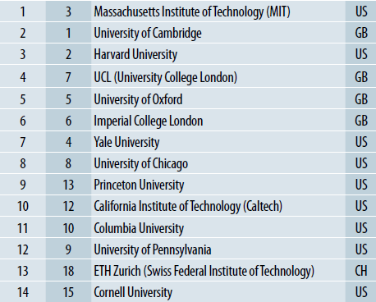
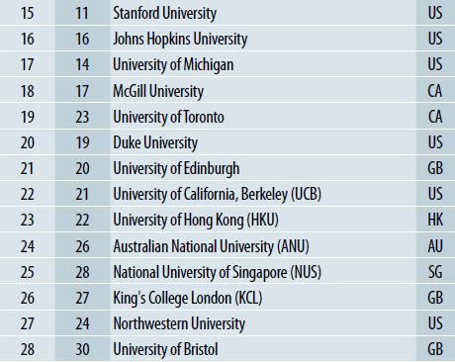
World University Rankings*
*QS World University Rankings 2012
www.gands.com

Slide 22
Cost of University*
 | McGill University | University of Toronto | Cornell University | Harvard University
Quebec Residents | $3,963.61 | N/A | N/A | N/A
Canadian Residents | $8,322,31 | $7,239.50 | N/A | N/A
International Students | $17,859.31 | $34,133.50 | $47,050 | $42,292
US Students | N/A | N/A | $30,910** | $42,292
* total tuition cost for full-time studies (Bachelor of Arts)
**For Residents of New York State (some programs only)
www.gands.com
Notes:
Permanent Residents who make Quebec their primary residence within 3 months of obtaining their status qualify as “Quebec Residents” for tuition purposes
Permanent Residents outside Quebec qualify for “Canadian” tuition rates

Slide 23
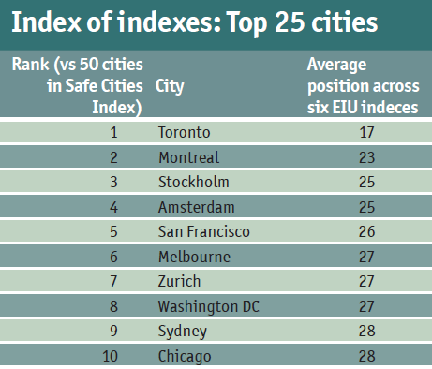
The Economist Liveability Survey (2015)
Canadian cities consistently place in the top 10 for most liveable cities in the world
www.gands.com

Slide 24
Green and Spiegel LLP
390 Bay Street, Suite 2800
Toronto, ON M5H 2Y2
Canada
+416.862.7880
www.gands.com

