Slide 1
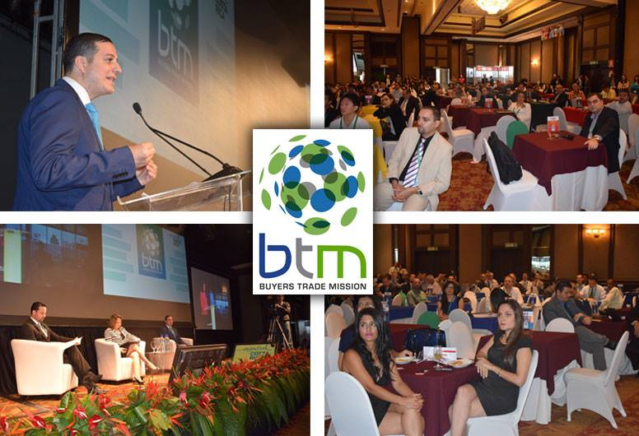
SEPT. 21-24, 2015
San José, CR

Slide 2
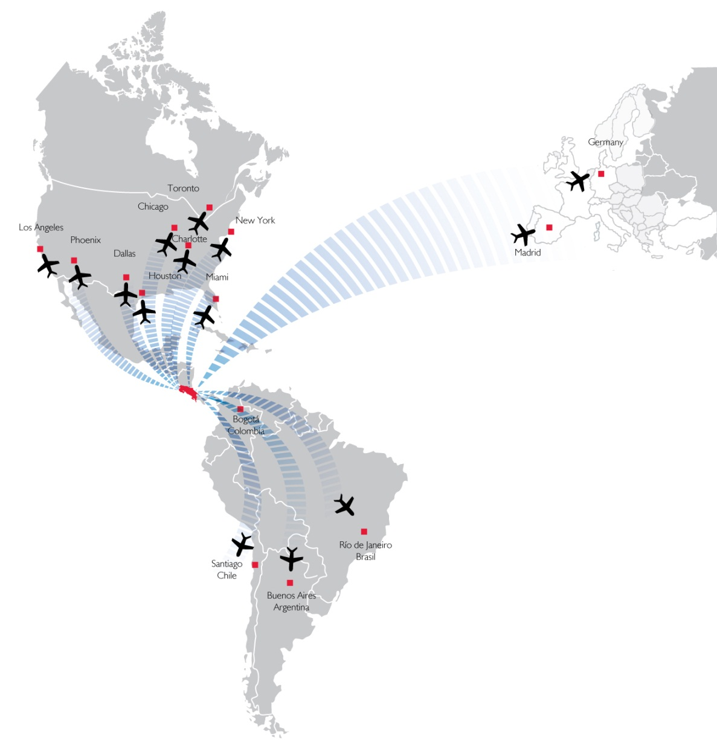
WHERE WE ARE….
Middle of the Americas
No army since 1948
Environmentally friendly

Slide 3
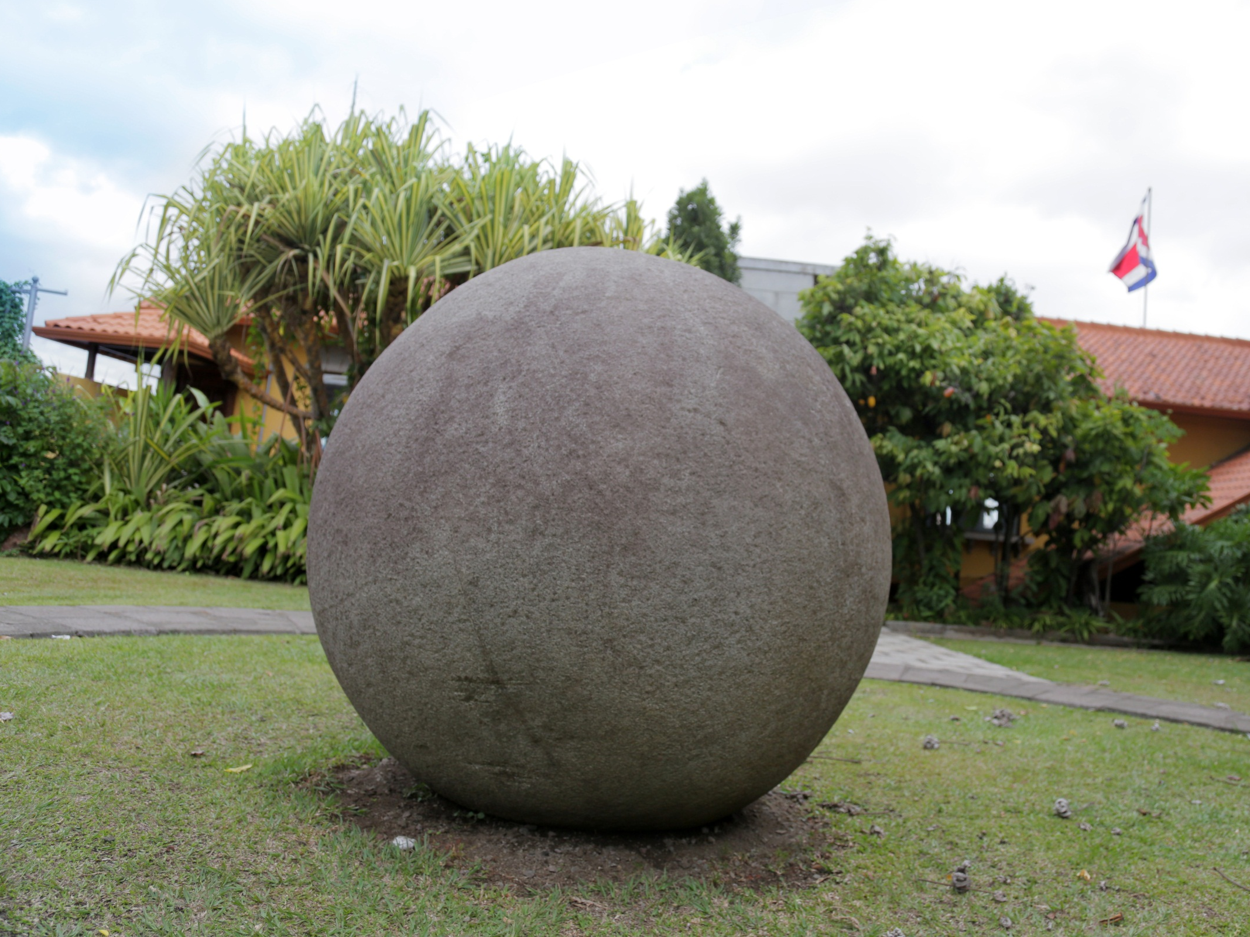
90% of power is generated from renewable sources

Slide 4
Quality of Life
Excellent Business Climate
Quality Infrastructure
Pura Vida!

Slide 5
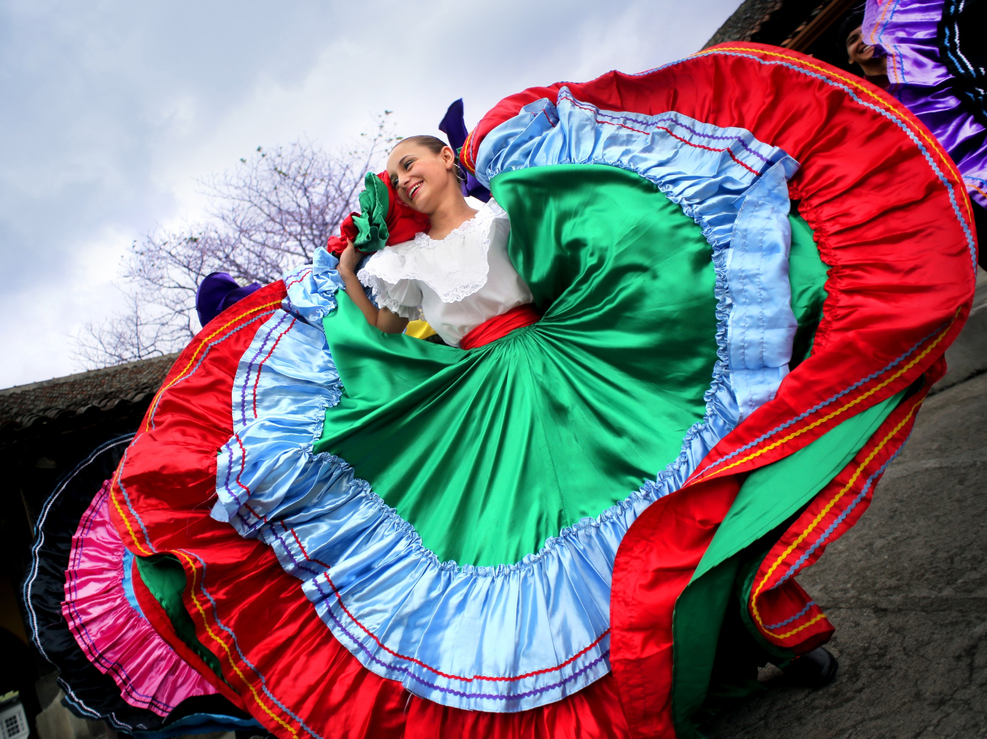
4.457 Different Products
155 Destination Countries

Slide 6
BACKGROUND
Since 1999, the BTM is Costa Rica´s most important fair
2014: 200 international buyers (2 Turkish)
2014: 60% new visitors/ 40% return visitors

Slide 7
BY THE NUMBERS…
Buyers from over 35 countries meet B2B with over 150 local producers.
A 3 day event that produces: US$8 million in closed business YTD.

Slide 8
WHICH PRODUCTS?
IQF Fruit + Tubers
Juices (NFC + Non NFC)
Sauces + Marmalades
Coffee
Sugar Free (cookies, jams, sweets, etc.)
Snacks
So much more...

Slide 9
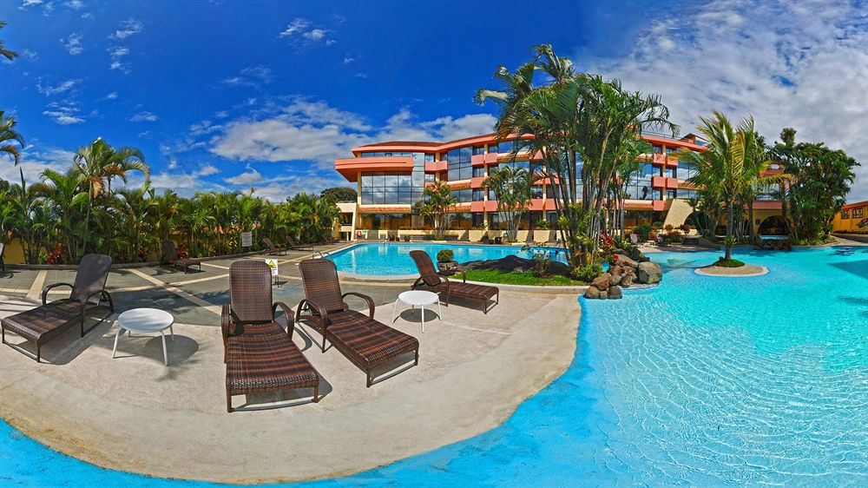
OUR OFFER TO YOU…
As is customary, the lodging and lunch during the event is covered by PROCOMER. Visitors from Turkey get free hotel from SEPT 19-25.
All activities to be held at Wyndham Herradura Hotel & Conference Center.
Potential to visit manufacturing operations

Slide 10
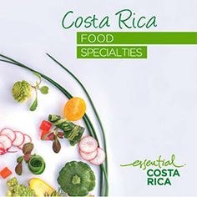
A TASTE OF COSTA RICA
http://esencialcostarica.com/specialties/

Slide 11
Edgar Sánchez Wilke
esanchez@procomer.com

