Slide 1
Guatemala
Ministry of Foreign Affairs
Viceministry for Promotion of Trade, Investment and Tourism
Ambassador Rodrigo Vielmann
Viceminister Foreign Affair Guatemala
DEIK, Istanbul, December 18, 2015

Slide 2
GUATEMALA has a privileged geographical location, in the center of the Americas

Slide 3
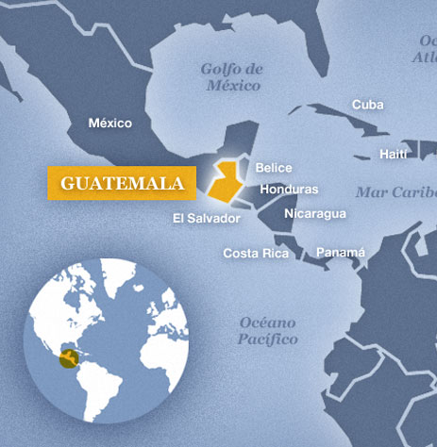
Guatemala
Capital: Guatemala
Area: 108,889 Km²
Temperature: 15°C – 25°C (59°F – 77°F)
Population: 16 millions of habitants
Youngest population of Central America 70% is under 40 years old
Language: Spanish
GDP per capita: US$ 3,330 US$5,000 PPP
Notes:
PPP: purchasing power parity

Slide 4
Stable Macroeconomic climate
In the last 20 years we had:
Stability in GDP growth: 4.1%
Moderate inflation movements: 2.9%
Moderate fiscal deficit: close to 2%
Very moderate debt: 24% of GDP
International reserves: US$7.5 billion

Slide 5
Central America 2015 GDP Growth Estimate
Source: CEPAL

Slide 6
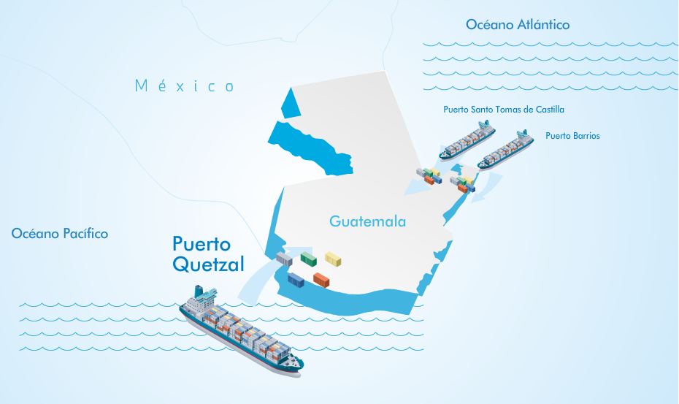
Ports
Guatemala has access to both oceans, Atlantic and Pacific, where 77.1% of the total burden of foreign trade is handled
In the Atlantic are: Puerto Santo Tomas de Castilla and Puerto Barrios - 297 km from Guatemala City
In the Pacific Ocean, Puerto Quetzal is located - 98 km from Guatemala City
Santo Tomas y Puerto Quetzal are certified BASC (Business Alliance Security Commerce)

Slide 7
Airports
2 international airports and 17 local
La Aurora Airport:
Category A1 by the FAA (Federal Aviation Administration) of the United States of America
Ability to receive 4 million of passengers per year
More than 200 flights weekly
Mundo Maya International Airport
La Aurora International Airport

Slide 8
Roads
The main sections of the Guatemalan Road Network are defined as follows:
Central American Routes: 1,335 miles
National Routes: 1,488 miles + 215 miles of the Northern Transversal Strip (FTN, for its acronym in Spanish). The FTN joins the Mexican border with Izabal and the Atlantic Shore.
Departmental Routes: 1,732 miles

Slide 9
Turkish Embassy in Guatemala
Mr. Ambassador Vehbi Esgel Etensel, is the Ambassador of Turkey in Guatemala. On August 31st., after his arrival, Mr. Ambassador met with Guatemalan Foreign Affairs Minister Carlos Raul Morales, to whom he presented his copies of credentials

Slide 10
Foreign Direct Investment

Slide 11
Growth in Foreign Direct Investment
Millions of US$
+8%
+5%
Source: Invest in Guatemala
Notes:
Comparación anual, 5% entre el 2012 y 2013
8% de crecimiento entre el 2013 y 2014

Slide 12
Sectors of Oportunity

Slide 13
Forestry
Forest surface allows the production of wood of the highest quality
Of the entire forestry surface, 82% is hardwood forests, 10% coniferous and 8% are mixed forests
In Guatemala the average growth of trees is 18-25 years, elsewhere it is 80 years
The sector´s growth during the last years demonstrates its dynamism; it produces mainly rubber, latex, wooden articles, furniture, paper, cardboard, pencils, and wooden boards

Slide 14
Light Manufacturing
Guatemalan went from producing around US$3 billion (2001) to more than US$10 billion (2013) accounting for a growth rate of over 120%
The evolution of the industry is mainly based on the efforts to transform it by producing goods with high added value and intensive use of technology
The main export products are: plastics, paper and cardboard, chemicals, machinery and electromechanical devices

Slide 15
Food Industry
Immense natural richness of Guatemala in terms of microclimates, fertile lands and work force at competitive costs
Guatemala stands out in the production of several agro-industrial products, such as:
Tropical fruits
Vegetables and legumes
Cattle
Cardamom and spices
Confectionery
Beverages
Sweet and savory snacks
Production of biofuels

Slide 16
Cardamom
Production
Year | Harvested area (hectares) | Production (Tons)
2010 | 62,187.76 | 22,590.3
2011 | 63,794.86 | 26,054.3
2012 | 65,122.46 | 35,194.2
2013 | 69,035.40 | 37,797.9
2014 | 72,389.34 | 40,129.3
Leading producer and exporter of cardamom in the world
67%
Exports
2014
Source: Bank of Guatemala
Notes:
67% del total de las exportaciones mundiales 2014

Slide 17
Garments and Textiles
The industry growth around 70% during the last decade
Sector includes 156 apparel manufactures, 42 textile mills, more than 200 services and trimming companies and 14 agents
Integration of the sector by being a one stop shop that includes all of the parts of the value chain (from textile mills to full package companies)
Brands: Adidas, Nike, Polo Ralph Lauren, American Eagle Outfitters, Dona Karan New York, Guess, Tommy Hilfiger, Old Navy, Gap, Abercrombie & Fitch, and Hollister

Slide 18
Garments and Textiles
The apparel and textile industry in Guatemala has evolved over the years to meet customer needs
in response time
quality
supply chain integration and technology

Slide 19
Exports garments and textiles
EXPORTED DOZENS (garments): 41,965 million
More than 90,000 workers Youth, expertise and productivity
EXPORTED POUNDS (textile): 50,645 million
13.8% of exports
Leading national sector
of exports
Notes:
Growth 0.99%

Slide 20
Top Products from the Apparel & Textile Industry exported from Guatemala
These products account for 70% of total exports
Knit tops for women, men and children (cotton)
Trousers for men, women and children (cotton)
Syntethic Trousers
Knit tops for women, men and children (synthetics)
Baby Wear

Slide 21
Main Exports Markets in 2014
USA
79%
Central America
14%
Mexico
Other countries
3%
3%
Canada
1%

Slide 22
Contact Centers & BPM
Guatemala has the largest, youngest economically active labor force in Central America
English proficiency is high among the young generations
Culture oriented to customer service
Private sector, Government and Academia work in synergies in order to support the growth and sustainability of the industry

Slide 23
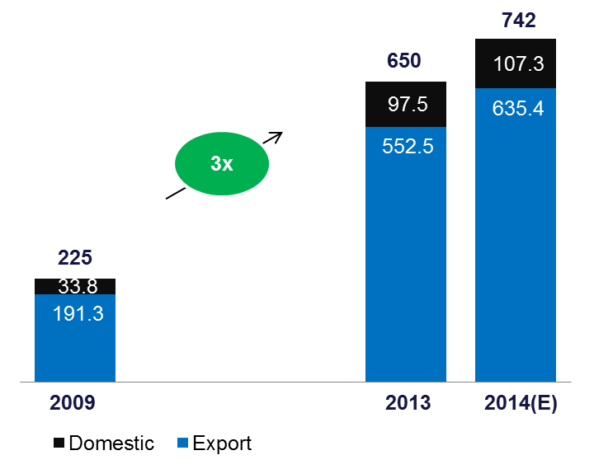
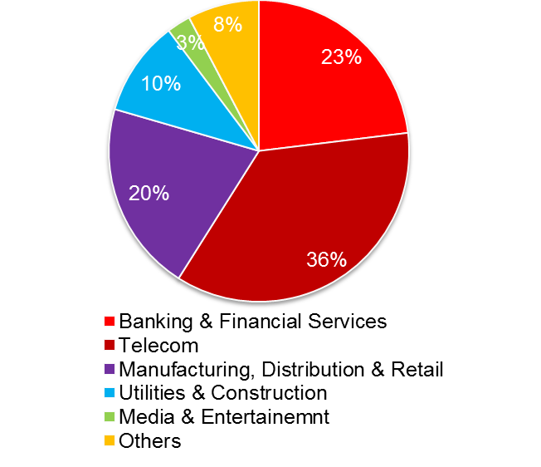
Guatemala BPM Industry Insights
Total BPO Revenues (2009-2014) USD MM
Tholons Insights Survey Estimates, Excludes Software & IT Services
Estimated Split by Verticals, %
Tholons Insights Survey Estimates, Literature Reviews and Interviews
The Tholons Insights survey estimates the growth of the sector at ~3 times since 2009
Projected growth rate of exports is estimated at about 15% for 2014 showcasing the growth potential of the sector
Healthy mix of verticals covered by the sector
Notes:
Tholons is a leading full-service Strategic Advisory firm for Global Outsourcing and Investments.

Slide 24
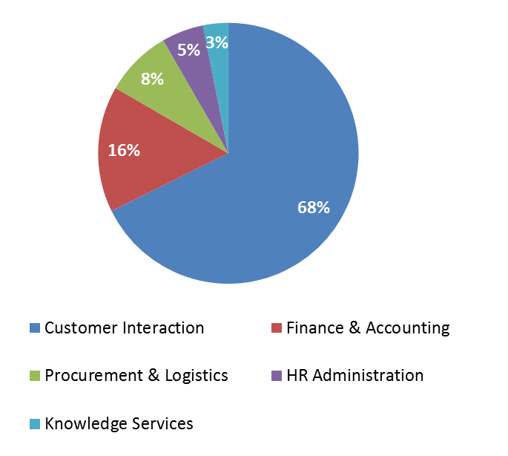
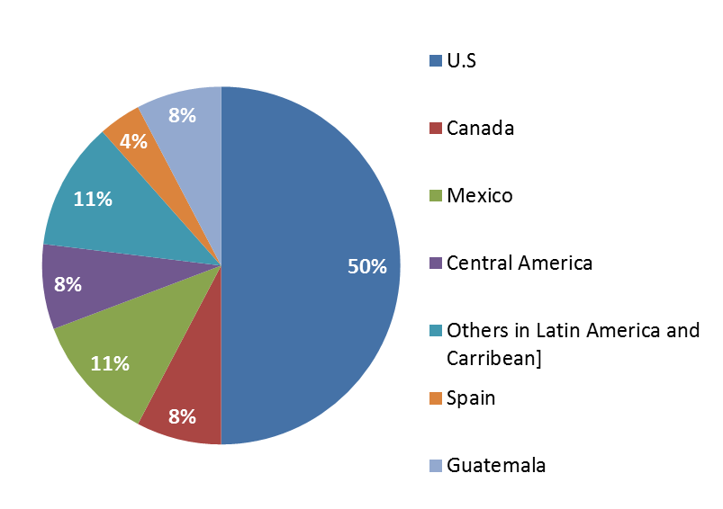
Guatemala BPM Industry Insights
Revenue Estimates by Service lines in the BPO sector % revenue contribution
Geographic Coverage of BPO players in Guatemala
Customer Interaction includes: Customer Service, Tech. Support, Telemarketing and Media Assistance, FAO is a growth area that companies are exploring on the back of high quality accounting students available in the industry

Slide 25
Technological Infrastructure

Slide 26
Achievements
Top 10 Reforming Economies in the World according to the World Bank. 2014 and 2015.
Increase of 13 positions in the Top 100 Outsourcing Destinations Ranking, by Tholons
Guatemala is among the “Leading Latin American Offshore Services Locations, 2014”. Gartner
Guatemala is included among the major contenders in the Transaction-Intensive BPS countries and the Leading Delivery Locations, 2014. Everest Group
Notes:
Top 100 Outsourcing Destinations Ranking 79
Gartner is the world's leading information technology research and advisory company
Everest Group is a consulting and research firm focused on strategic IT, business services, and sourcing

Slide 27
Software
Web Design
Web site Analysis
Hosting, Antispam. E-mails
Customer Service
Telemarketing
Back office: Data management, data entry
E-commerce
Banking and insurance solutions
Accounting and Finance Process
Biometric Security
Business Process
Management BPM
Customer Relationship
Management CRM
Enterprise Resource
Planning ERP
Human Resources
Image Solutions
Mobile Solutions
School administration software

Slide 28
Software
Cybergames
Unloading of Mobile Contents
Mobile Marketing
Marketing and Digital Publicity
E-mail Marketing
Digital Animation
Social Media

Slide 29
Energy and Oil
Several studies elaborated by different institutions have proven the existence of oil reserves of up to 83 million barrels; but there are indicators that it might be up to 750 million
Guatemala is one of the few countries in Latin America that allows private companies to extract and sell hydrocarbons in national territory
Thanks to the Law of Incentives for the Development of Renewable Energy Projects around 70% of new electricity projects in Guatemala are related to renewable energy

Slide 30
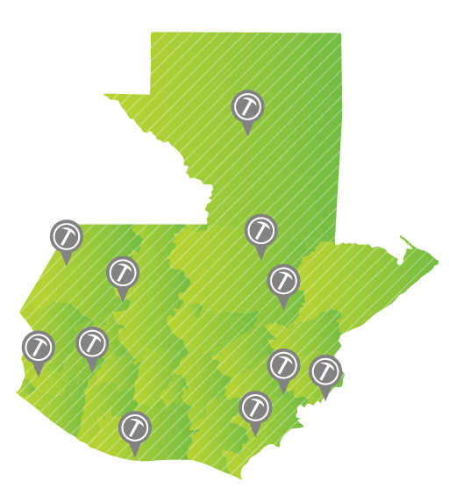
Mining
Abundance of mineral deposits
The country has a high potential to exploit gold, silver, nickel, iron, limestone, granite, jade, among others
Guatemala is the first Central American country and the second in Latin America to be certified by the Extractive Industries Transparency Iniciative (EITI) for its transparency and accountability

Slide 31
Foreign Trade

Slide 32
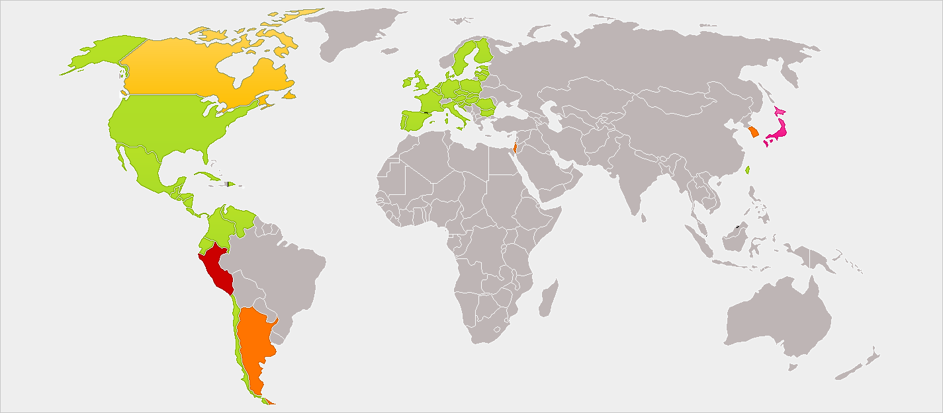
Agreements
Trade Agreements in force
Trade Agreements signed but not in force
Trade Agreements under negotiation
Investment Agreements
Source: Invest in Guatemala
Proposed Trade Agreements

Slide 33
Exports by sector 2014
Source: Bank of Guatemala

Slide 34
Main products exported 2014
Source: TradeMap – Bank of Guatemala

Slide 35
Main products exported 2014
Source: TradeMap – Bank of Guatemala

Slide 36
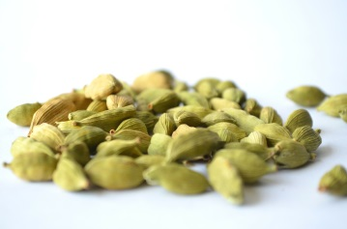
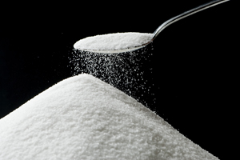
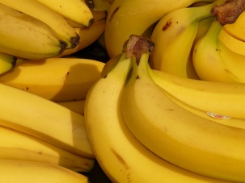
Export platform
US$100 million annually on Software and Visual Effects
1st. Exporter of Snow Peas to the US
1st. World exporter of cardamom
1st. World exporter of cuttings poinsettia
1st. Provider of wooden keys for Yamaha and Gibson guitars
1st. Supplier of manufactures of the Central America Region
1st. Coffee supplier to Starbucks Coffee and 3rd Provider of Japan
2nd. Sugar exporter in Latin America
8th. World exporter of bananas
Source: Ministry of Economy

Slide 37
Imports by sector 2014
Source: Bank of Guatemala

Slide 38
Main products imported 2014
Source: TradeMap – Bank of Guatemala

Slide 39
Main products imported 2014
Source: TradeMap – Bank of Guatemala

Slide 40
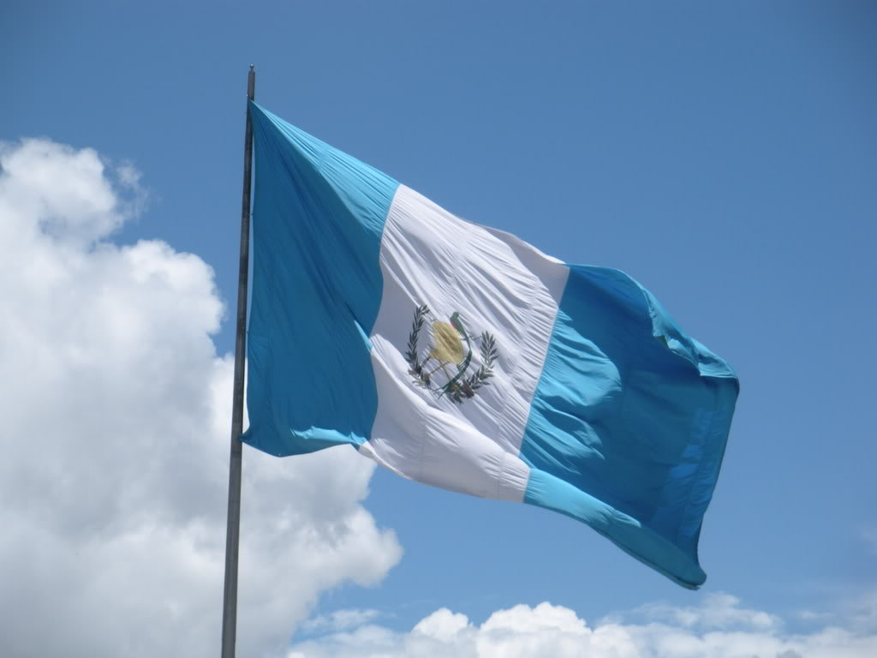
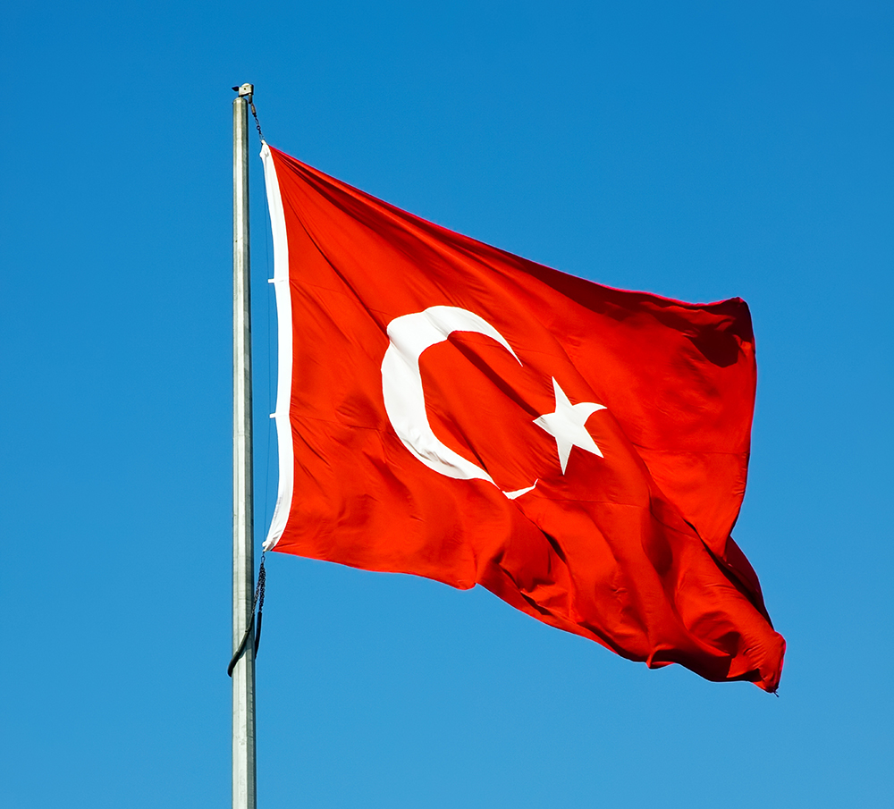
Guatemala-Turkey current trade figures

Slide 41
Turkey's imports from Guatemala
2012 | 2013 | 2014
7,132 | 10,898 | 10,785
14.6%
3 years
89.3%
5 products
Unit : US Dollar thousand
Source: TradeMap
Notes:
Tomato, cucumber, flowers seeds
verage growth in the last 3 years 14.6%
89.3% of total exports in the top 10 products

Slide 42
Turkey's exports to Guatemala
2012 | 2013 | 2014
27,623 | 19,748 | 20,722
-9%
3 years
35%
5 products
Unit : US Dollar thousand
Source: TradeMap
Notes:
Decrease in the last 3 years -9%
35% of total exports in the top 5 products

Slide 43
Tourism

Slide 45
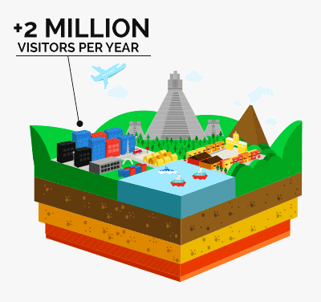
Tourism
Guatemala has over 9,500 species of flora and fauna immersed in 14 eco-regions and habitats
Is a country with all the features to achieve first-world tourism. It has places with unique views, hotel infrastructure, roads, space to practice extreme sports and the most privileged weather of the region
January to July 2015
1.25 million of tourists
$912.1 millons

Slide 46
Turkish: International departures by region of destination
 | 2010 | 2011 | 2012 | 2013 | 2014 | 2015* | 2016* | 2017* | 2018* | 2019*
Africa | 173.9 | 108.5 | 122.1 | 154.2 | 169.5 | 177.4 | 184.4 | 192.7 | 199.5 | 207.3
Pacific Asia | 472.3 | 549.8 | 676.3 | 524 | 572 | 620.2 | 672.8 | 731.1 | 788.4 | 848.6
Europe | 3,821.50 | 3,318.50 | 3,508.90 | 4,280.90 | 4,808.80 | 5,342.30 | 5,928.80 | 6,546.90 | 7,222.40 | 7,959.80
Middle East | 2,154.40 | 2,520.30 | 1,794.00 | 2,923.90 | 3,299.70 | 3,731.70 | 4,253.80 | 4,839.50 | 5,520.60 | 6,306.90
North America | 260.6 | 251.6 | 171.3 | 126.6 | 138.9 | 142.9 | 147.1 | 151.2 | 155.1 | 159.6
South and Central America | 4.9 | 2.3 | 1.5 | 2 | 2.1 | 2.2 | 2.2 | 2.2 | 2.3 | 2.3
Values in Miles
*Estimations
Source: Ministry Of Culture And Tourism,TTIC analysis

Slide 47
Visitors from Turkey
8.2%
Source: INGUAT Guatemalan Institute of Tourism
Notes:
Average Growth in the last 5 years 2009-2014: 8.2%

Slide 48
Guatemala is a Visa Free territory for turkish nationals

Slide 49
Tourism in Guatemala
7% Growth

Slide 50
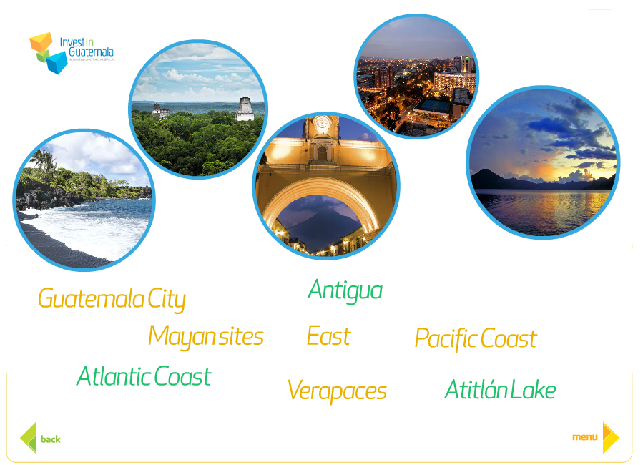
Guatemala
Multilingual country, with 25 languages: 22 Mayan origin languages, one Xinca and one Garifuna
Our weather is amazing, 72 degrees all year-round : “The land of eternal spring”
World Heritage Sites
Guatemala was included as one of the 19 mega-diverse countries of the world
42,000 square miles different attractions

Slide 51
Notes:
Iberian-American Capital of Culture in 2015

Slide 52
Best kept colonial city in Latin America
Just during Holy Week: more than 1 million visitors
Notes:
Surrounded by 3 volcanoes and mountains that are perfect for mountain climbing, biking and bird watching

Slide 53
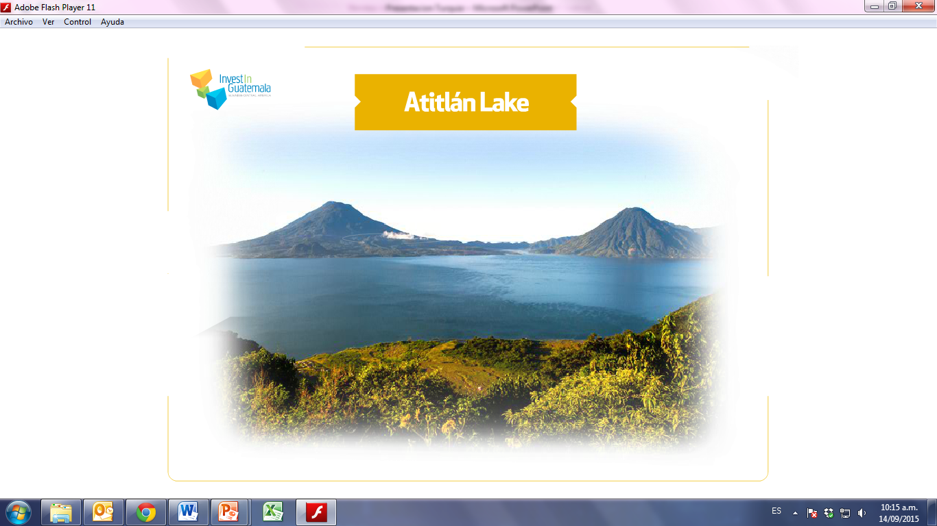
50,000 tourist during peak season
Notes:
Lake Atitlan, ranked as one of the most beautiful lakes in the world, which is surrounded by indigenous villages and three impressive giants volcanoes: (Atitlan - Toliman - San Pedro)

Slide 54
Notes:
Guatemala is the country with the largest number of Archaeological sites throughout the region, more than 3,000 nationwide

Slide 55
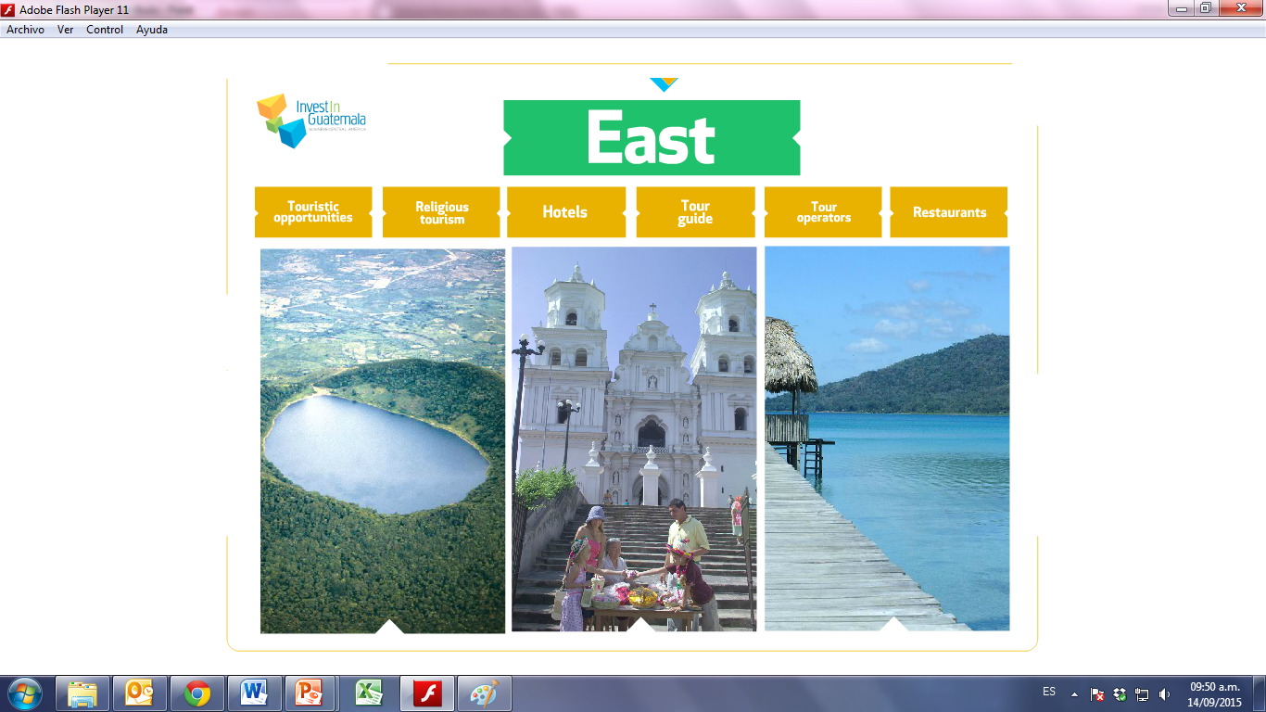

Slide 56
Notes:
Over 720 species of birds

Slide 57
Notes:
The Guatemalan Pacific is characterized by extensive black volcanic sand.
Here visitors can participate in conservation of marine turtles and conduct tours to observe flora and fauna, especially migratory waterfowl, in the mangroves.

Slide 58
Acces by land, air and sea broad
opportunities for touristic projects
This is one of the major Ports of arrival of cruise ships in the country
Notes:
The arrival of cruise ships to the country increased from 48 cruises in the 2011-2012 season to 72 cruises for the season and 74 in 2013-2014

Slide 59
Contact Information
Department of Tourism / Ministry of Foreign Affairs
cbarrientos@minex.gob.gt
+(502) 2410-0000 ext. 4010
Guatemalan Chamber of Tourism
info@camtur.org
+(502) 2472-7356, 2472-7362, 24727363
http://www.camtur.org
COMITURS
ana.echeverria@agexport.org.gt
+ (502) 2422-3502
http://comiturs.com/
Notes:
Thank you for your attention,….

Slide 60
What are you waiting for?
ww.visitguatemala.com
Notes:
Thank you for your attention,….

Slide 61
Thank you
Ambassador
Rodrigo Vielmann
Viceminister of Foreign Affairs
Guatemala
vielmann@minex.gob.gt
vielmann@gmail.com

