Slide 1
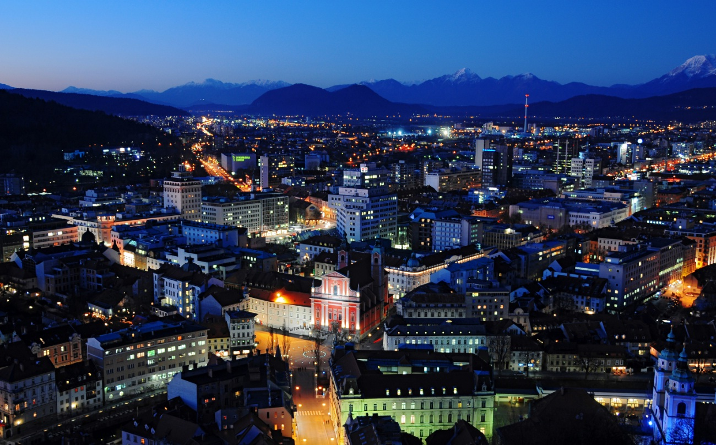
Business environment in Slovenia
Ljubljana
Istanbul, 16 January 2014
Boštjan SKALAR
Acting Director
Notes:
1

Slide 2
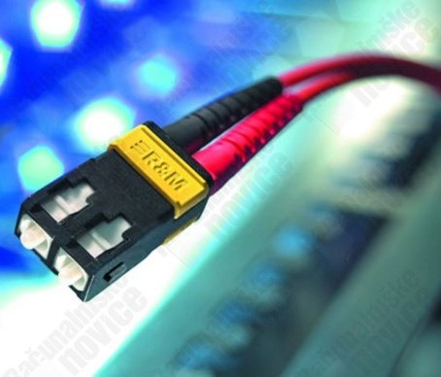


About SPIRIT Slovenia, public agency
SPIRIT Slovenia acts as One Stop Shop,
offering comprehensive business support
in one place to Slovenian and foreign companies
during their activities.
The basic areas of activities:
promotion of development of entrepreneurship, technology, innovation,
promotion of internationalization and foreign direct investment, and
promotion of Slovenia as a tourist destination.

Slide 3
Index
Slovenia - the right mix of Qualities (4Qs)
Export driven economy
FDI in Slovenia
Taxes
Financial Incentives Support
Services for foreign investors

Slide 4
Export driven economy
Top export categories of goods, 2012
€ 26.8 billion exports of goods and services in 2012; approx. 76 % of GDP
69 % of exports of goods destined for EU
Priority markets:
  Turkey
  Azerbaijan
  Russian Federation
  Kazahstan
  China
  India
Geographic distribution, 2012

Slide 5
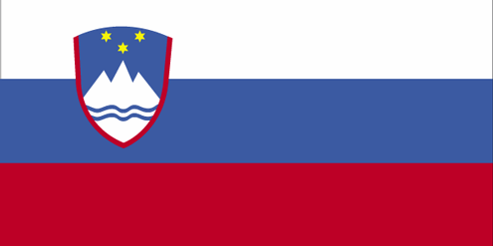

Bilateral relations between countries
Bilateral trade Slovenia – Turkey 2007 – 2013 (in € million)
Exports to Turkey
Electrical machinery & equipment 15%,
Paper & cardboard 12%,
Machinery & mechanical appliances 9%,
Paints & colouring matters 9%,
Iron & steel 7%,
Vehicles 7%
Imports from Turkey
Vehicles 28%,
Pharmaceutical products 11%,
Machinery & mechanical appliances 8%, Electrical machinery & equipment 8%,
Iron & steel 5%,
Plastics & plastic products 5%
328
Source: Statistical Office of the Republic of Slovenia, 2013

Slide 6
FDI in Slovenia
Distribution of FDI by industry
FDI stock end-year
Financial services & insurance | 44%
Retail | 15%
Pharmaceuticals & chemicals | 9%
Machinery & electrical equipment | 5%
Motor vehicles and rubber products | 4%
Telecoms & transport | 3%
Wood-processing, pulp & paper | 3%
Utilities | 3%
Other | 14%
Main investing countries in Slovenia, 2012
Source: Bank of Slovenia, 2013

Slide 7

FDI flows between Slovenia and Turkey
FDI share as a percentage
of GDP (2012):
34.1%
Inward FDI stock as of end-2012 EUR 11.7 billion
Outward FDI stock as of
end-2012 EUR 5.6 billion
Turkish direct investment in Slovenia (end of 2012):
EUR 5.8 million
Slovenian direct investment in Turkey (end of 2012):
EUR 6.9 million
Source: Bank of Slovenia & Bisnode, 2013

Slide 8








FDI flows between Slovenia and Turkey
Slovene companies on Turkish market
Turkish companies on Slovene market
Source: Izvozno Okno & Bisnode, 2013

Slide 9
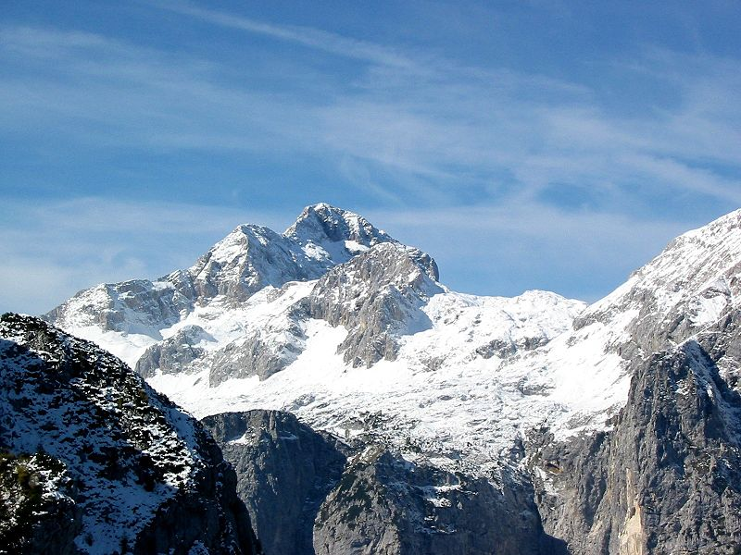
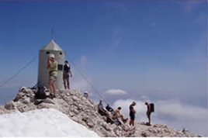
SLOVENIA – The right mix of Qualities
Quality infrastructure
(Four Qs For You)
4Qs4U
Quality link to regional markets
Quality workforce
Quality of life

Slide 10
Quality of workforce
Not cheap but cost-effective
Technologically-minded (long industrial tradition), innovative spirit,
Highly educated:
22% university degree,
57% secondary school,
Excellent IT & foreign language skills
(English, German, Italian, Serbo-Croatian, …)

Slide 11
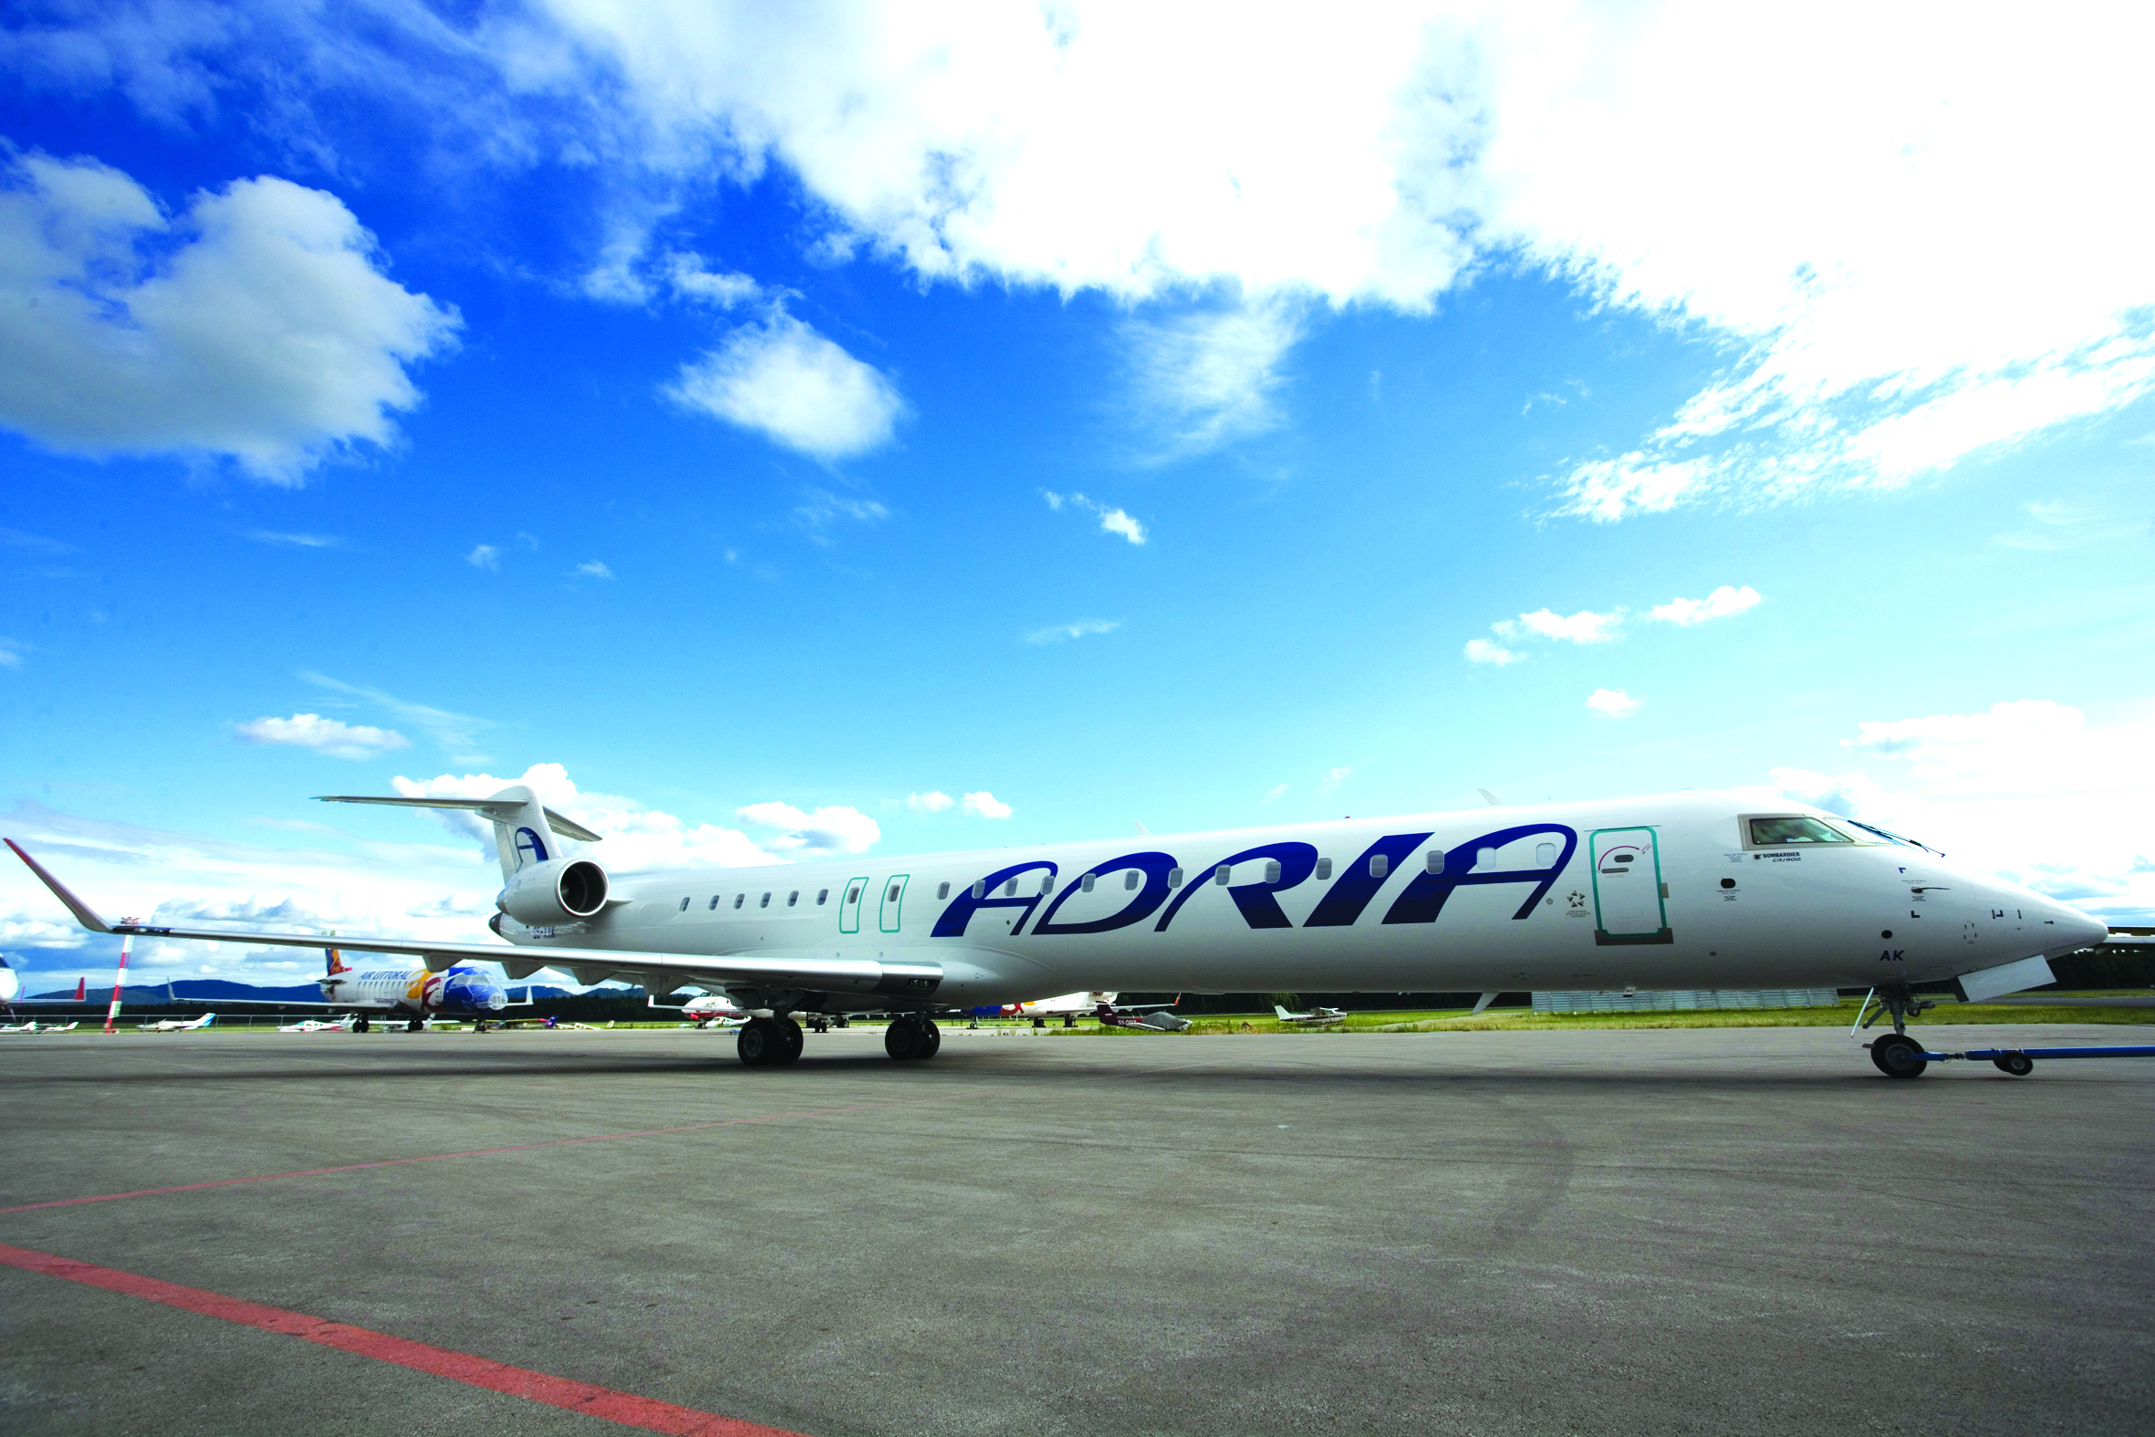
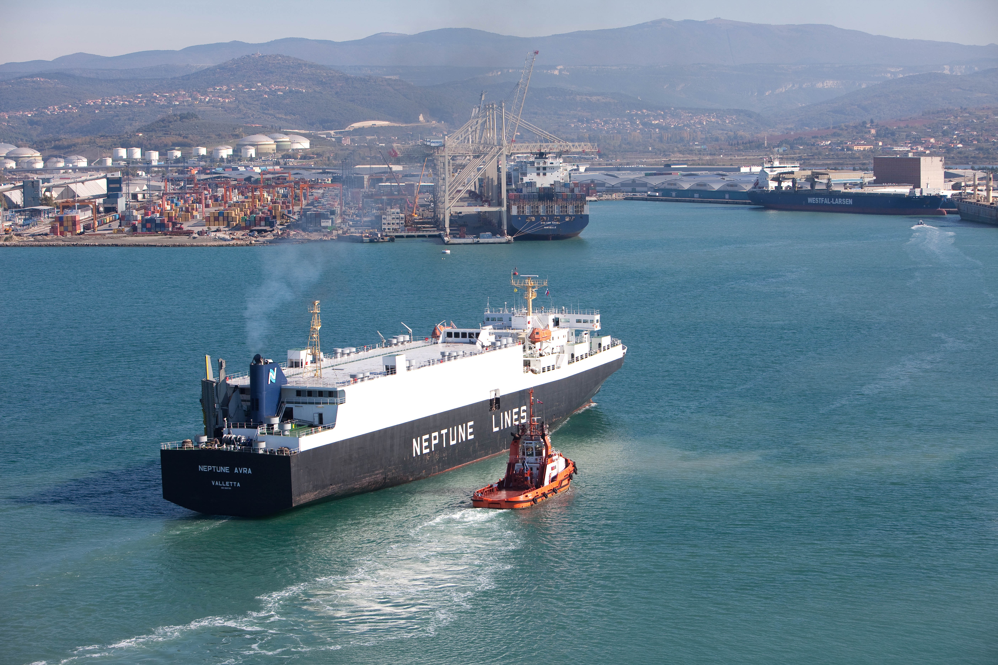
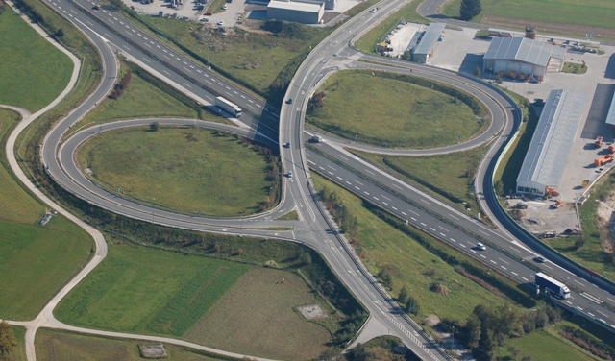
Quality Infrastructure
Quality of overall infrastructure
International airports handle
  passenger & cargo transport
Port of Koper - The shortest way from
  Black Sea to Central Europe
A number of logistics parks constructed
  close to highways
Country | Value | Rank/148
Switzerland | 6.6 | 1
Germany | 6.2 | 10
USA | 5.7 | 19
Slovenia | 5.2 | 31
Czech Rep. | 5.1 | 37
Italy | 4.8 | 53
Poland | 4.0 | 84
Source: WEF – The Global Competitiveness
Report 2013-2014

Slide 12
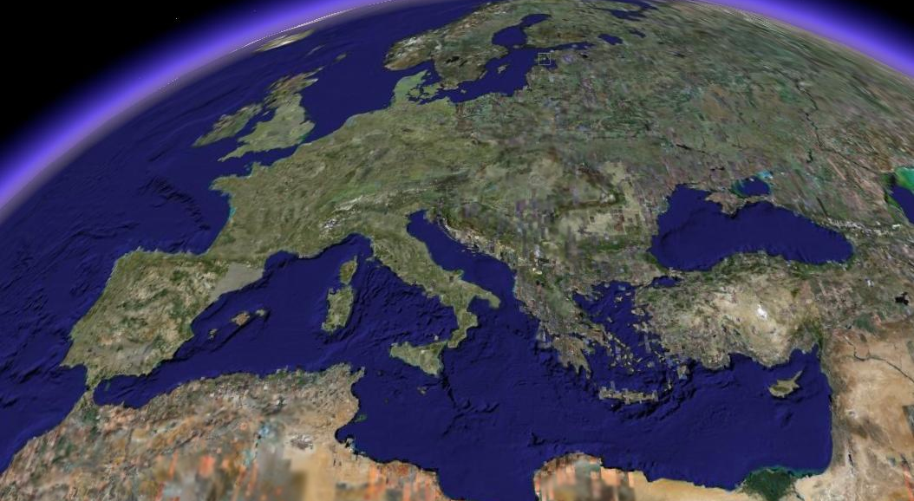
Quality link to regional markets
1000 km
Moscow
500 km
Prague
Corridor V.
Munich
Vienna
Kiev
Paris
Zurich
Budapest
Slovenia
Zagreb
Milan
Belgrade
Corridor X.
Barcelona

Slide 13
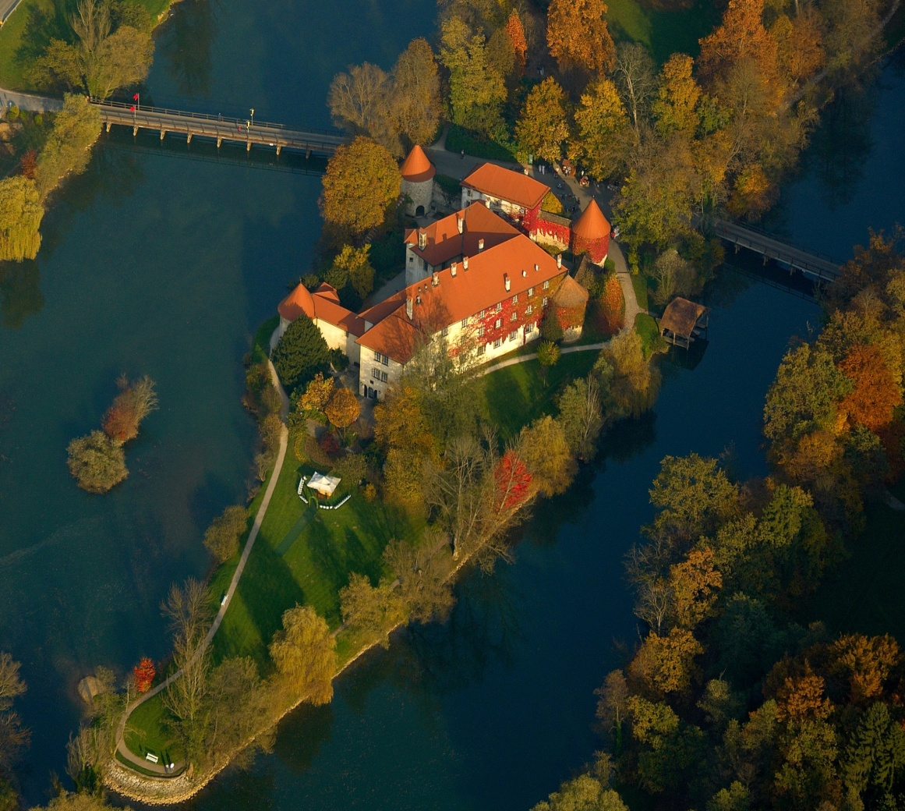
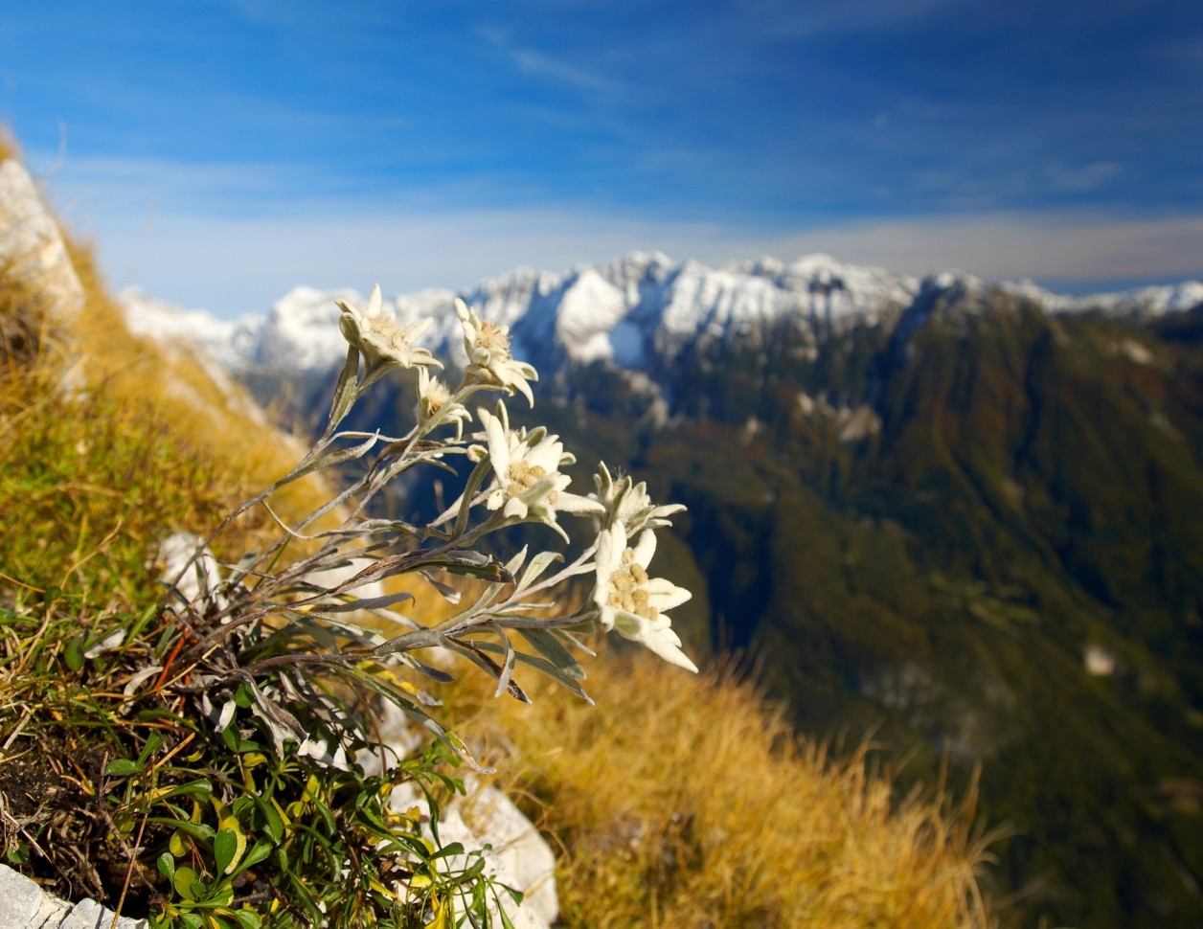
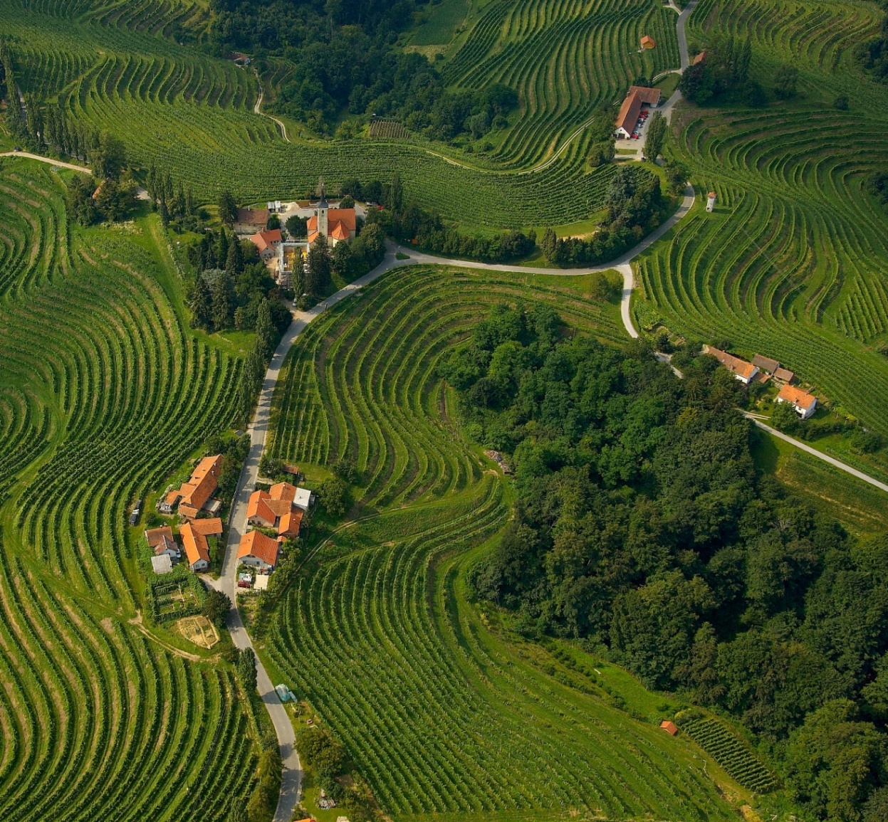
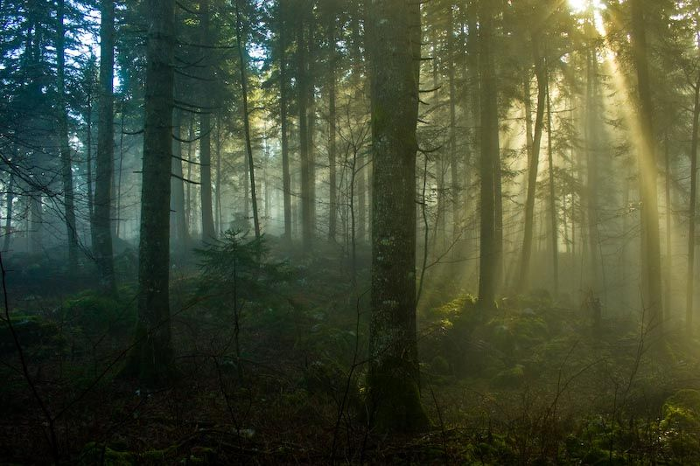
Quality of Life
High standard of living (International Living 2012 Index – 15th place out of 51 countries)
Cultural and geographical diversity
At the intersection of Roman, German and Slavic culture
    Mixture of Alpine, continental and Mediterranean climates
Over a third of the territory is protected
Tourists from Turkey
In 2012: 13,763 visitors with 27,535 overnight stays (1.8 % more than in 2011)

Slide 14
Taxes
Corporate income tax | 17%
Tax relief | - up to 100% of the amount invested in R&D up to 40% of the amount invested in equipment and intangible long-term assets
Capital gains tax | 0 – 20% (depending on a holding period)
VAT (Value added tax) | 22% - standard rate; 9.5% - reduced rate
Social security contributions | 16.1% paid by employer; 22.1% paid by employee
Personal income taxes | progressive tax rates: 16%, 27%, 41% and 50%

Slide 15
Financial incentives support
  Foreign direct investment (FDI) grant scheme for 2013 - closed
ACTIVITY | VALUE OF INVESTMENT | NUMBER OF NEW JOBS
Manufacturing projects | € 1 million | 25
Strategic services | € 0.5 million | 10
R & D | € 0.5 million | 5
Results 2013 :
7 signed contracts (5 manufacturing projects, 2 R & D)
value: € 7,357,020 €
value of all investments: € 34,541,412
400 new jobs created

Slide 16
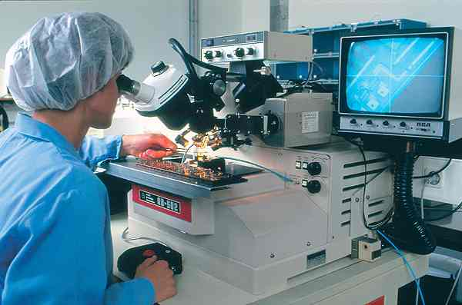



Services for foreign investors
InvestSlovenia Team offers:
Information on industries, legislation, taxes and incentives,
Information on industrial sites and local suppliers,
Links with industry and local authorities,
Organisation of fact-finding missions, business and
investment conferences and trade shows,
web portal: www.InvestSlovenia.si
Financial incentives support
e-mail: invest@spiritslovenia.si

Slide 17
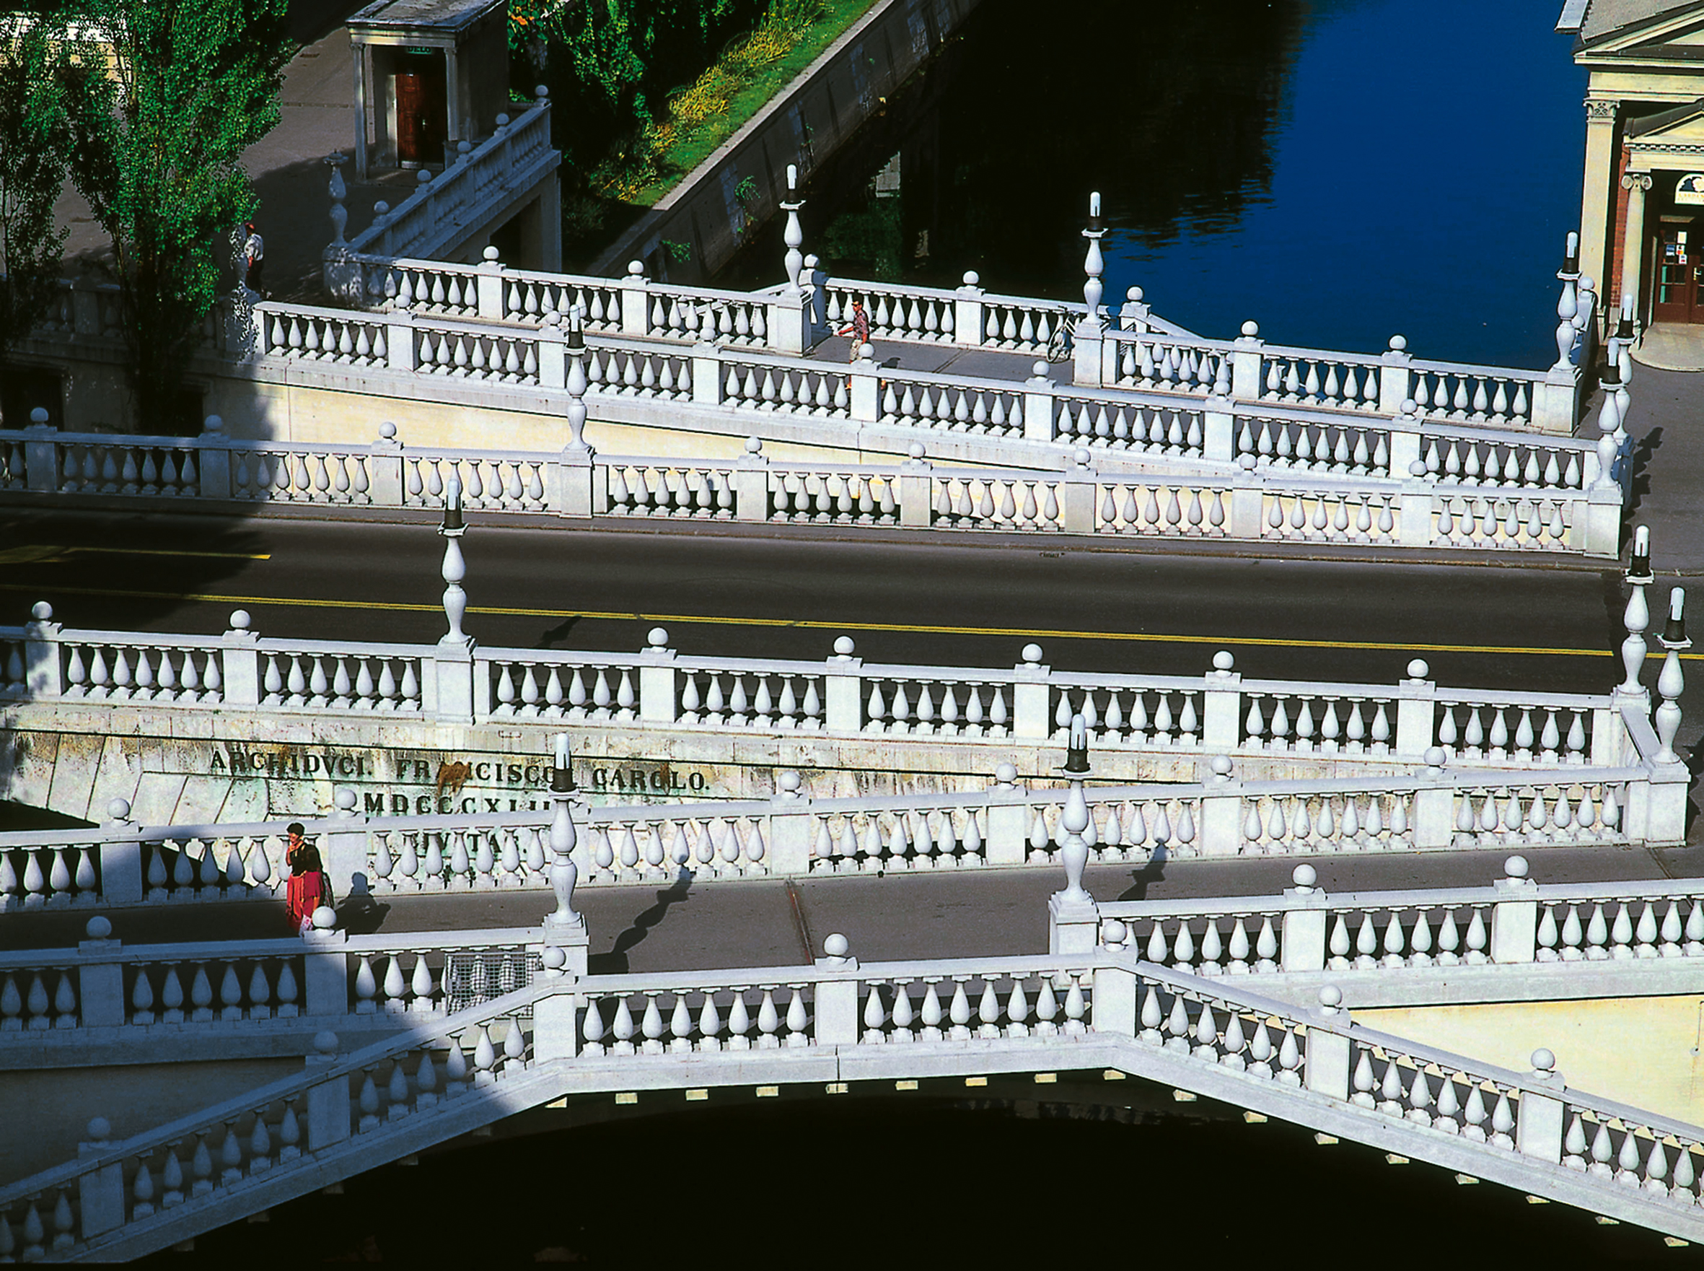

Main messages
Commitment for privatisation, interest from private companies for cooperation with foreign investors
Slovenia as a hub for CEE and SEE countries - access to knowledge and quality workforce
Follow up - individually or by sector (inward delegation)

