Slide 1


THE BANK AND Health IN AFRICA
Human Development Department - OSHD
Fabrice Sergent
Istanbul, 28 January 2016
Notes:
Introduction of OSHD
These kids are here to remind us of the demographic dividend story: lower number of inactives by active person-A window of opportunity limited in time.
By 2050 Africa will have 2.3 billion inhabitants and the largest workforce on earth (close to 1.5 billion): this can be wonderland, but this can also be a disaster if the youth is not educated in a manner that make them fit for evolving in modern society, have the necessary skills to be employed (or , create their own job), and be healthy and thus, productive.
As you all know, to cash dividends, one has to invest in first place. It is the same for the demographic dividend.

Slide 2
outline
Overview of the health situation in Africa and related challenges
The Bank’s strategies: High5s; Ten-Year Strategy;
Human capital strategy
Financing instruments
Highlights of the Bank’s Portfolio and pipeline

Slide 3
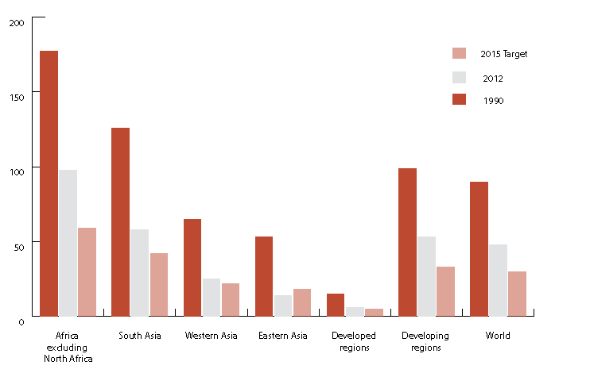
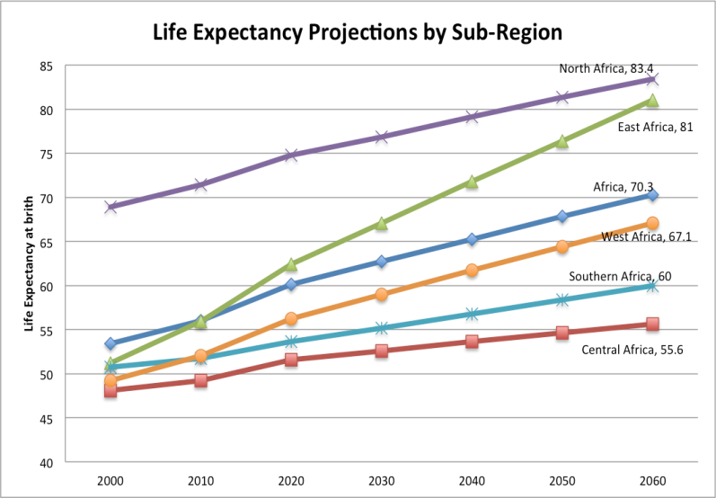
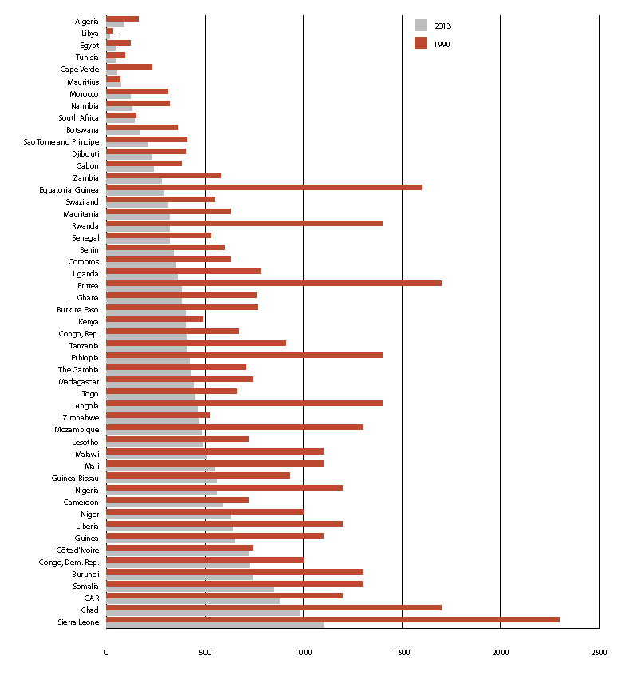
HEALTH IN AFRICA: WHERE ARE WE?
U-5 Mortality
Progress….but must do better…and CAN!
Maternal Mortality
Notes:
NOT GLOOMY, but a lot of work ahead!
Spectacular progress towards the MDGs but Africa lags behind
Encouraging progress has been made in drop in child mortality, AIDS incidence and malaria. But Africa the poorest continent with the highest fertility rates, poorest access to essential medicines
AND……: Some countries do considerably better than the others at same levels of expenditure. What are the challenges then?

Slide 4
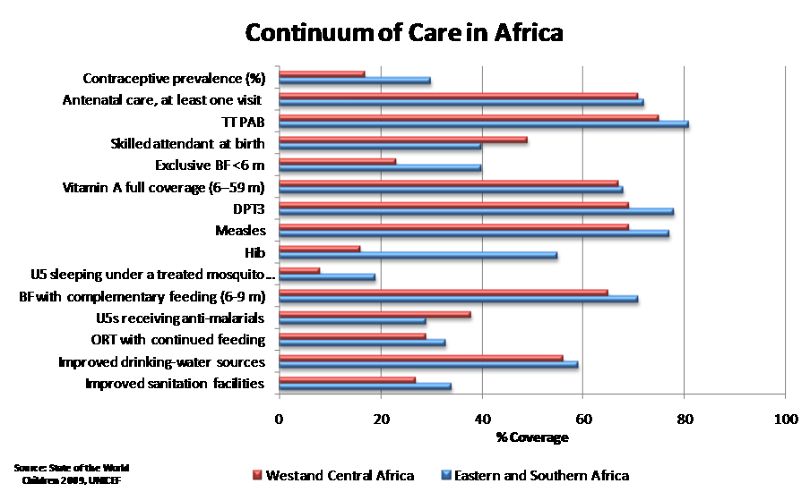
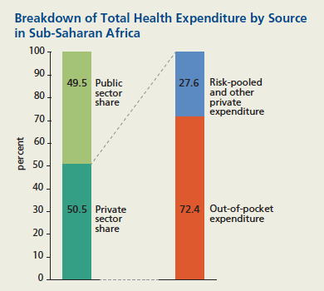
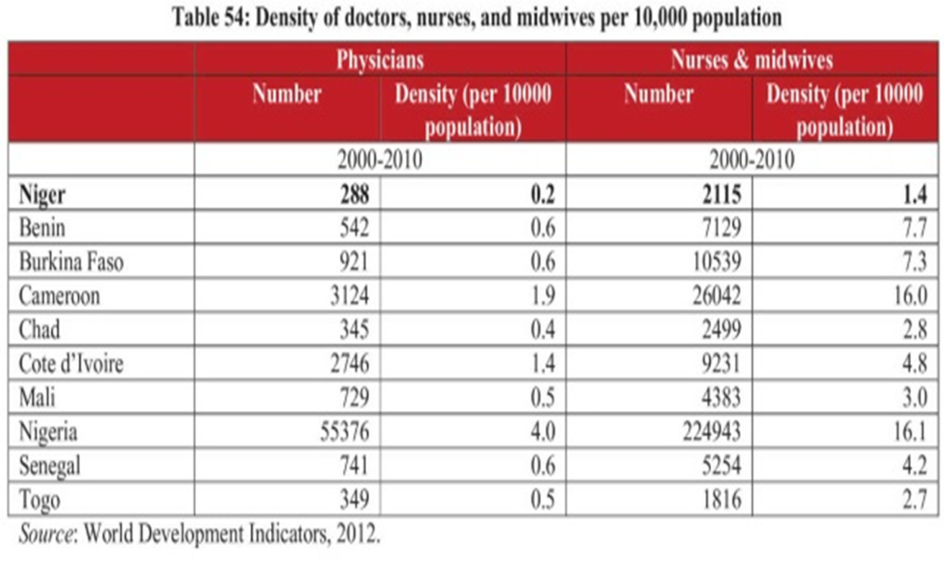
KEY ISSUES
Notes:
-Still low health budgets, coupled with weak prioritisation of high impact interventions leading to low coverage
-Prevailing out-of-pocket health expenditure (shocks, consumption of unregulated services)
-Substantial inequality
-HR crisis (a central cause of the Ebola catastrophy): WHO norm is 23 health staff (physicians+nurses+midwives) per 10,000 inhabitants.

Slide 5
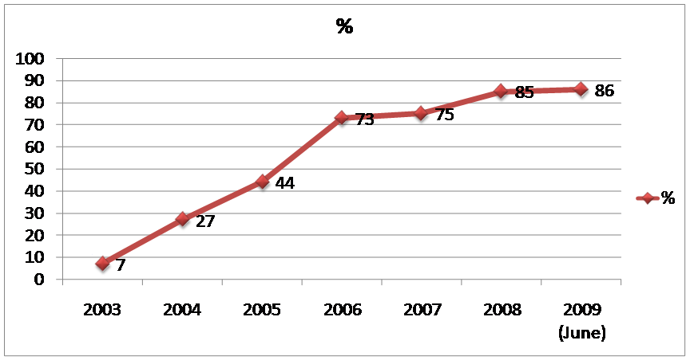
SUCCESS STORIES
CBHI Coverage Utilisation of Health Services
Notes:
Success stories do exist in Africa.
For a long time the best African success what that of Rwanda, which dramatically improved the health status of its population in a short period of time.
The first graph shows the evolution of enrollment in community-based health insurance.
The second graph shows the evolution of health services’ utilisation
The third graph shows the tremendous improvements made on infant mortality and U-Five mortality.
Ethiopia similar trends, thanks to strong strategies including for instance the recruitment of 38,000 Community health workers.

Slide 6
OUTLINE
Overview of the health situation in Africa and related challenges
The Bank’s strategies: High5s - Ten-Year Strategy-
Human Capital Strategy
Financing instruments
Highlights of the Bank’s Portfolio and pipeline

Slide 7

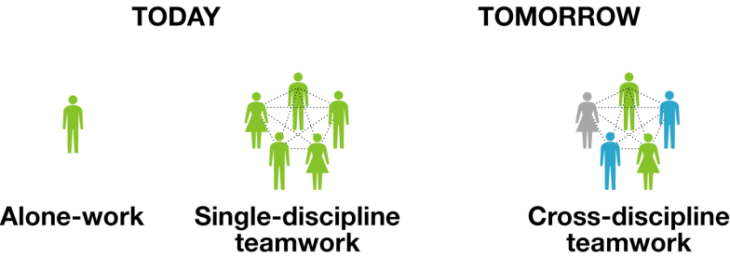



HUMAN DEVELOPMENT AND HEALTH IN THE BIGGER BANK’S PICTURE
The Bank’s High5s:
Feed Africa
Light Up and Power Africa
Industrialise Africa
Integrate Africa
Improve quality of life of Africans
Inclusive and green growth
Targeting results (impact evaluations)
Inclusive financial and social systems
Inclusive service delivery
Skills for competitiveness & jobs
Multisectoral teams in education, health & social protection
Governance
Agriculture
Private Sector
Infrastructure
Education
Health
Social Protection
SKILLS AND TECHNOLOGY
Notes:
Show:
- High5s
-Ten year Strategy
-Domain of intervention of the human development department
Our vision is that of a health sector as a vector of economic transformation which concretizes its potential as:
A productive sector that contributes to job creation, gradually creating the 2 million jobs which are currently missing in the sector, developing the pharmaceutical industry and partnering with the private sector in particular to exploit the export potential of the health sector
An innovative sector which African countries can bank on, enhancing African research and ICT-related innovation (e-health; m-health; e-learning; ICT-based disease surveillance systems).
A major source of efficiency gains and governance progress, at par with education and other social sectors which commonly absorb half of public expenditures and a large part of household expenditures.

Slide 8
HUMAN CAPITAL STRATEGY 2014-2018
SKILLS AND TECHNOLOGY
Human Resources for Health:
Centres of Excellence (biomedical sciences);
New teaching/learning methods based on ICT;
HRH reforms in RMCs (Task Shifting, Health Extension Workers)
Other High5/TYS
Priorities
Enabler 1:
Inclusive Service Delivery
Value for Money (VfM): Health Systems; Health Financing; Voice and Accountability; Management.
Access to the « last mile ».
E-Health & m-Health
Enabler 2:
Inclusive Financial and Social Systems
Health Insurance
Health-related cash transfers
Nutrition
Climate change and HC
Water and Sanitation
Private Sector ( pharmaceuticals and other economic opportunities)
Notes:
HCS approved 18 months ago.
Say few words on each of the topics in red colour and announce Part 4 of ppt on portfolio

Slide 9
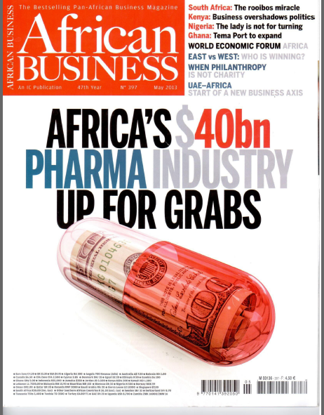
HEALTH AS A SOURCE OF JOBS AND GROWTH
2 million health jobs missing in Africa
Over the next decade, US$ 30-50 billion in new investments will be needed in healthcare assets to meet the growing demand
Africa healthcare markets are estimated to reach US$ 200 billion (including South Africa and North African countries) by 2020.
Pharmaceuticals sales (USD25bn out of global 960 bn) are expected to grow steadily in Africa (demographic trends; rising medical needs)
Notes:
Health as a business:
Areas such as the pharmaceutical sector, medical tourism, hospitals, etc. have a large potential to contribute to generate value and offer opportunities for employment, in particular for the youth

Slide 10
OUTLINE
Overview of the health situation in Africa and related challenges
The Bank’s strategies: High5s - Ten-Year Strategy-
Human Capital Strategy
Financing instruments
Highlights of the Bank’s Portfolio and pipeline

Slide 11
financing HUMAN DEVELOPMENT PROJECTS
(Reminder of this morning’s presentation)
African Development Fund/African Development Bank
Grants and Loans
National or regional projects/programmes:
Investment Projects
Policy-Based Operations
Results-Based Financing under consideration
Special Relief Fund (SRF)
Grants
For emergency assistance (Ebola, Cholera, floods etc.)
Trust Funds (Grants)
Grants
Value for Money; Nigeria Trust Fund; Korea Trust Fund; South-South; etc.
MIC TAF Grants
Middle Income Countries Technical Assistance Fund

Slide 12
OUTLINE
Overview of the health situation in Africa and related challenges
The Bank’s strategies: High5s - Ten-Year Strategy-
Human Capital Strategy
Financing instruments
Highlights of the Bank’s Portfolio and pipeline

Slide 13
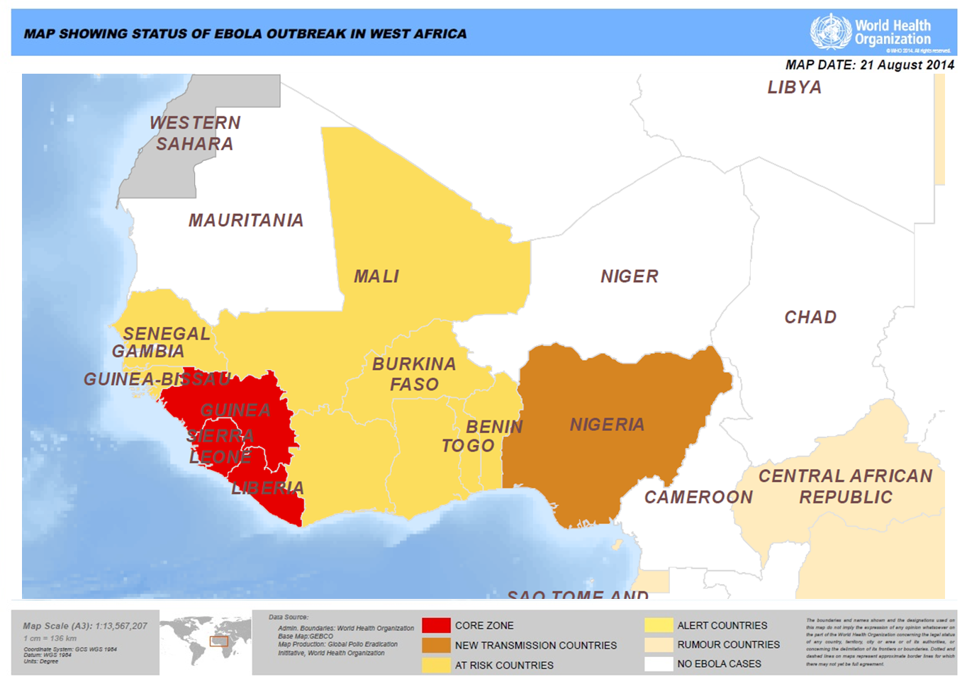
Highlight of BANK portfolio (1/3)
AfDB provided $223 million to fight Ebola
In response to the Ebola outbreak in West Africa, the Bank approved nine new operations totalling USD 223 million:
USD 3 million project for Guinea and neighbouring countries (23rd April 2014);
USD 56 million project for ECOWAS countries (18th August 2014);
USD 1 million emergency operation for Guinea (18th August 2014);
USD 1 million emergency operation for Liberia (18th August 2014);
USD 1 million emergency operation for Sierra Leone (18th August 2014);
USD 1 million emergency operation for Nigeria (18th August 2014);
USD 1 million emergency operation for DRC (22nd September 2014);
USD 150 million budget support for Côte d’Ivoire, Guinea, Liberia and Sierra Leone (1st October 2014);
USD 7.7 million Technical Assistance for Guinea, Liberia and Sierra Leone (1st October 2014).
NEW:
Post-Ebola Recovery Social Investment Fund (PERSIF –USD 33m seed funding incl. 5 from USA) for Guinea, Liberia and Sierra Leone)
Open for additional funding from bilateral donors and private sector.

Slide 14
HighlightS of BANK portfolio (2/3)
Newly approved ADF operations:
EAST Africa Centres of Excellence (ADF). Ongoing in Rwanda, Uganda, Kenya and Tanzania
Sudan: Capacity building for service delivery
Older ADF operations (all procurement completed)
Ebola countries – Benin – Equatorial Guinea – Cabo Verde (DHS) – SADC (communicable diseases) – Uganda (Mulago hospital)
Notes:
EAC:
Nephrology and Urology in Kenya,
Oncology in Uganda,
Biomedical Engineering and eHealth in Rwanda.
Cardiovascular in Tanzania
Works USD 25m – Goods USD 18m – Services USD 17m
Sudan:
The Sudan Building Capacity for Inclusive Service Delivery Project was approved by the Board on 25th March 2015. The project is financed by an ADF grant of USD 39m
Institutional, human resources and community capacity building
Activities:
Development of 10 teaching health facilities – grooming of existing locality level health facilities
ICT solution – Data bases (Population health, population skill profile, training data, health workforce, health insurance and service delivery), training tools and e-health
Leadership training

Slide 15
HighlightS of Bank portfolio (3/3)
Ongoing projects funded by Trust Funds:
Zambia m-Health (collaboration with WHO/International Telecommunications Union) – USD 385,000
Health PPPs in Burkina Faso, Malawi, Zimbabwe and South-Africa (University of Witwatersrand and Health Systems Research India Initiative) – USD 925,000
Morocco health financing strategy (OPM) – USD 345,000
Tunisia Export of Health Services (to be adversised Q1 2016) – USD 410,000
Tunisia Health Human Resources Study (Conseil Santé) -
Capacity building in Value for Money including collaboration with Harvard University – Funding Norway and GAVI – USD 6m Looking for additional donors.
Notes:
Zambia: Harnessing mobile technology to provide sustainable, scalable, and cost-effective solutions to reduce the exposure of vulnerable groups to key non-communicable disease (NCD) risk factors – smoking, alcohol consumption, lack of physical activity, and a poor diet.
PPPs: The DEVELOPPING COORDINATED PUBLIC-PRIVATE PARTNERSHIPS AND SYSTEMS FOR FINANCING HEALTH IN AFRICA PROJECT is funded under the Indian Trust Fund assist selected RMCs (Burkina Faso, Malawi, Zimbabwe and South Africa) to strengthen their Health care financing systems.
Share expertise and successful pilots
Support ministries to identify opportunities for attracting and mainstreaming private investment and household financing by using sovereign resources catalytically through development of focused evidence-based solutions and debates on prioritized health financing systems challenges facing the countries.
The two service providers of the project activities are: The University of Witwatersrand (Graduate School of Public and Development Management) and the Health Systems Research India Initiative (HSRII) in India in close collaboration with the Institute of Public Health of India.
Tunisia Export: Support the promotion of investments in Tunisian health sector and the export of health services. Will be signed soon then publication of General Procurement notice: watch our Website!
VfM TF:
USD 6 million from NORAD and GAVI
Done so far:
Development of curriculum and capacity building materials for senior officials, parliamentarians, CSOs and technocrats from various sector ministries of RMCs.
Capacity building events that include two rounds of senior officials and CSOs of EAC and SADC Member countries; and parliamentarians of ECOWAS and SADC countries.
Technical contribution to two rounds of Ministerial Leadership Forum for Ministers of Finance with Harvard School of Public Health and a follow up round table.
Support to Tanzania to conduct fiscal space study that helped the country to develop a robust and evidence based strategy for Universal Health Coverage.
A study to establish the linkages between health (domestic) financing and flow of foreign direct investment to make the case for increased domestic and sustained investment for health.
Use of various communication means to reach out to key stakeholders to increase awareness on the importance of focusing on improving value for money
Want to do more and mobolise additional resources:
Scale up
Institutionalise (develop long lasting partnership with universitities/training institutions)
Deepen: increasingly offer tailored TA to countries

Slide 16
Highlights of Bank’s pIPELINE IN Health (1/2)
Lending:
Private sector can be service provider or partner in PPPs
ADF - Africa Center of Disease Control ACDC (co-financing being sought) – Est. USD 100m
ADF - Second phase of centers of excellence for skills development (co-financing being sought) – Est. USD 150m
ADF – Nutrition interventions in countries of the Horn of Africa and the Sahel regions (co-financing being sought)
ADF – Djibouti hospital (early stage of preparation)
Pharmaceutical Industry in Côte d’Ivoire (+ other countries)***
[ADB - Morocco social protection budget support]
Notes:
ACDC: AU initiative
Networking existing institutions to strengthen disaese surveillance and make a new Ebola impossible
Bank looks for co-financing to develop West Africa component of ACDC

Slide 17
Highlights of Bank’s pIPELINE IN Health (2/2)
Non-lending:
TF: Egypt study on social protection (Est. USD 200K)
TF: Egypt study on health insurance (Est. USD 250K)
Establishment of a Nutrition TF (gradual USD 10-200 m)
Notes:
Nutrition TF:
High level advocacy and institutional support for a multi-sector approach .
Support to nutrition specific interventions especially promotion of breastfeeding best practices, complementary feeding, micronutrient supplementation, home fortification, disease management and treatment of acute malnutrition, support to community nutrition projects, awareness through education and sensitisation for behavioral change.
Support to harmonization of norms and standards of food fortification at regional and sub-regional levels.
Support to the inclusion of nutrition sensitive interventions in the agriculture sector, education (school feeding programme, center of excellence in nutrition), social protection, etc.
Support agro-food processing for nutrition purpose (industry for complementary, supplementary and therapeutic feeding) including reforms towards an enabling private sector environment and financial inclusion (medium and small scale enterprise for food processing).

Slide 18
Thank you !
f.sergent@afdb.org

