Slide 1
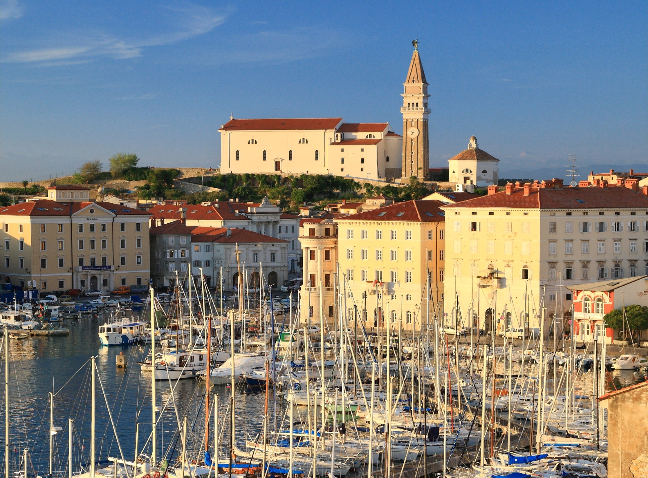
Investment Opportunities in Slovenia
Boštjan SKALAR
Acting Director
Istanbul, 16 January 2014
Notes:
1

Slide 2
Index
Business opportunities – GENERAL
Wood processing projects
Tourism – Hospitality projects
Food-processing projects
Commercial property development projects

Slide 3
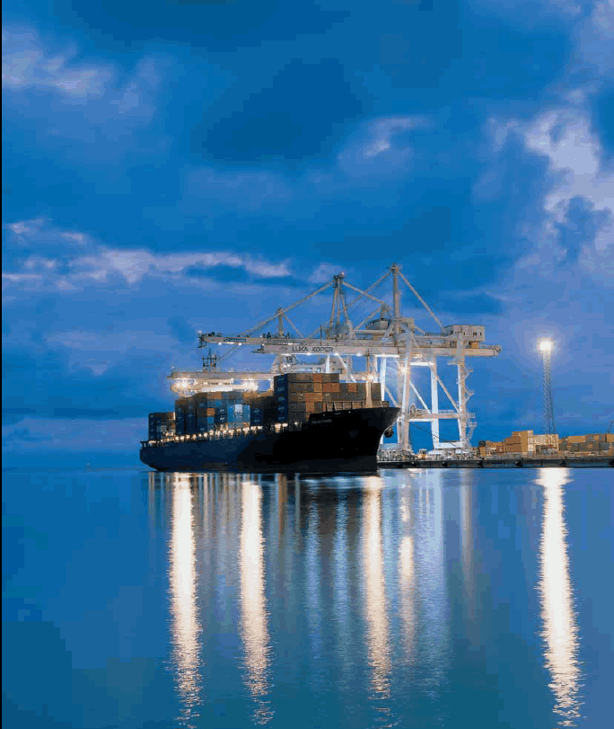
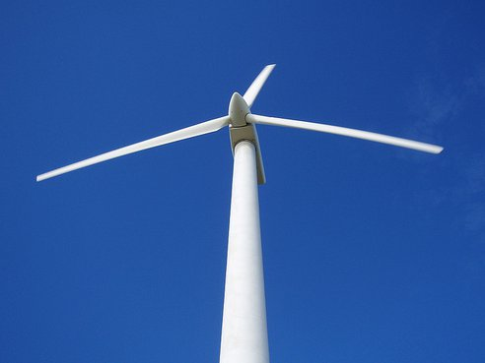
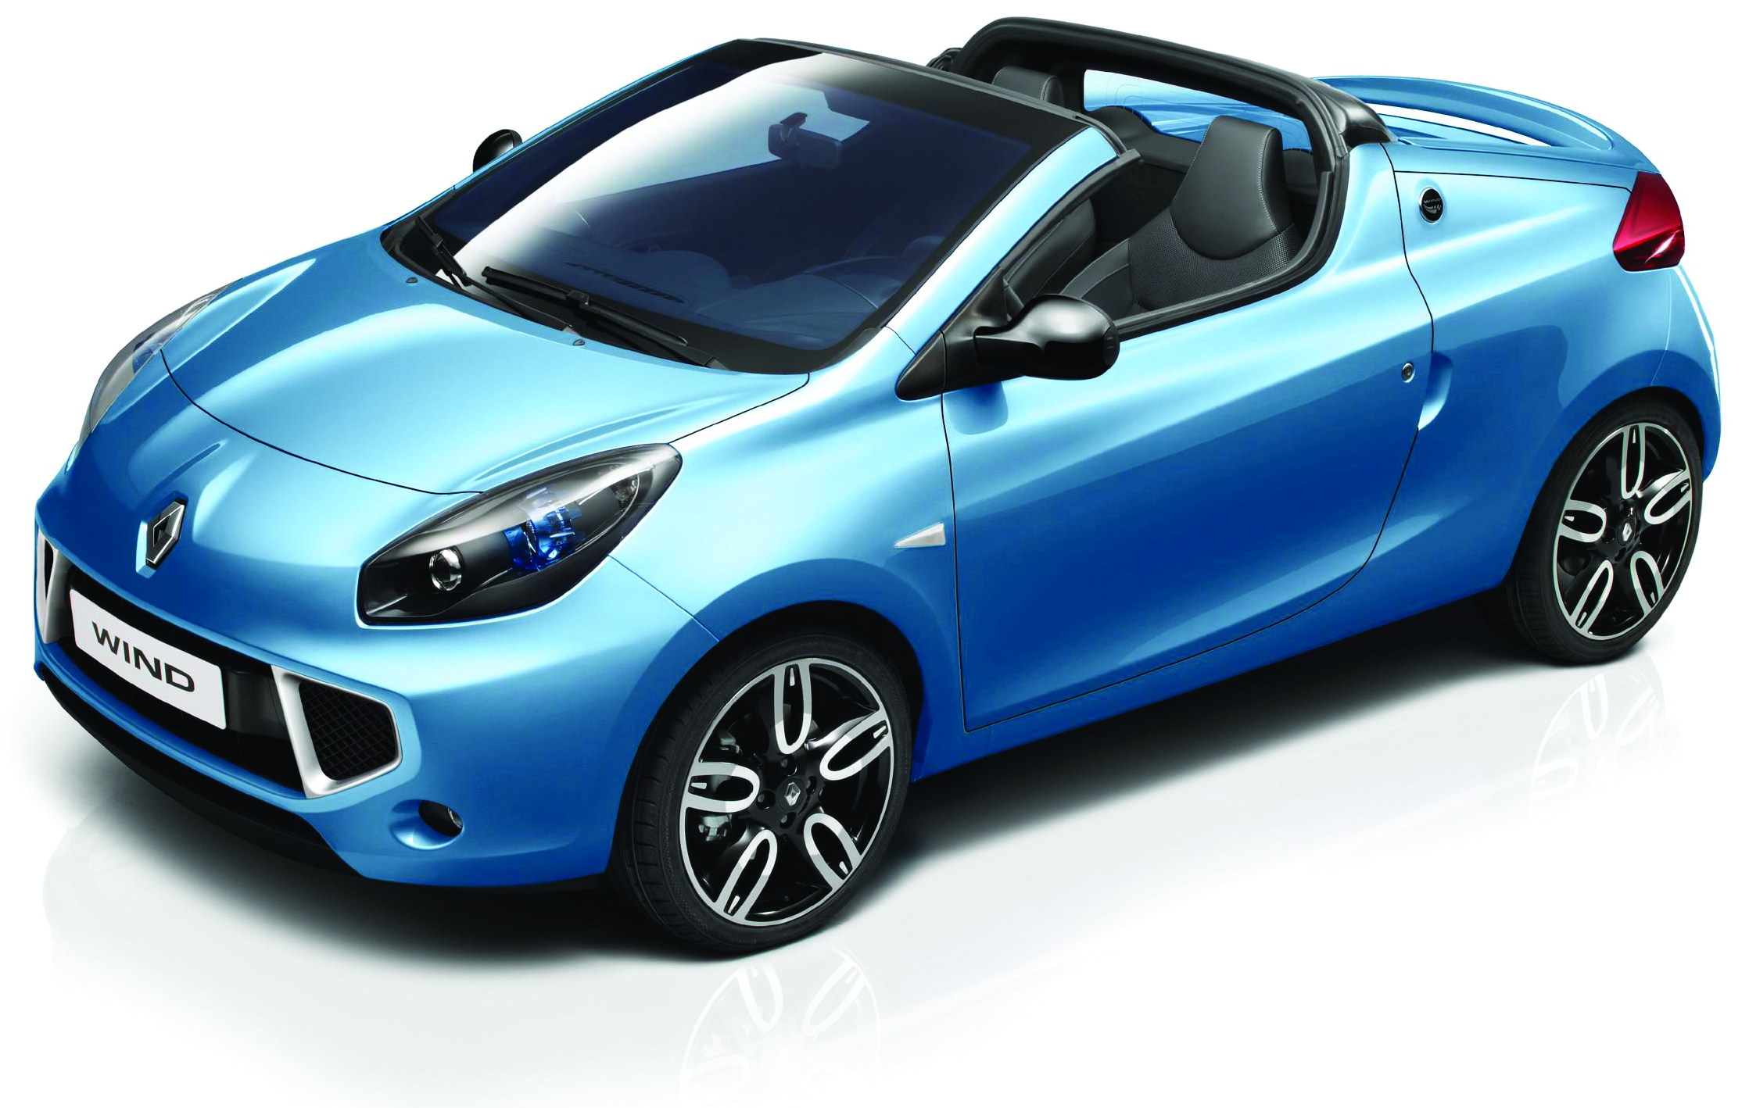
Business Opportunities
Logistics & Transport
Slovenia has all the attributes of a distribution and logistics hub for Central and South-Eastern Europe
Green technologies & Recycling
A number of inovative companies in different fields
Automotive industry
DRIVING force of Slovenian economy
Slovenia’s automotive industry generates 10% of the country’s GDP and 15% of country’s export
Port of Koper /
Port and logistics services
REVOZ /
Renault Wind, assembled exclusively in Slovenia

Slide 4

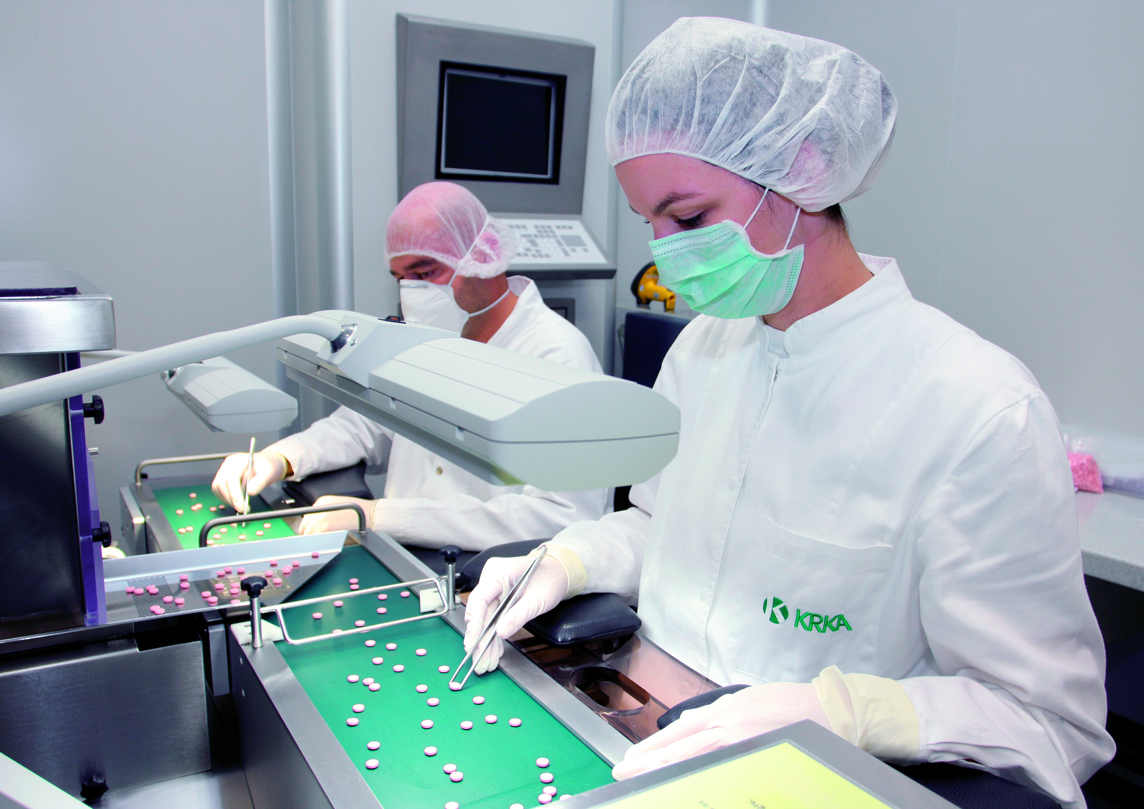
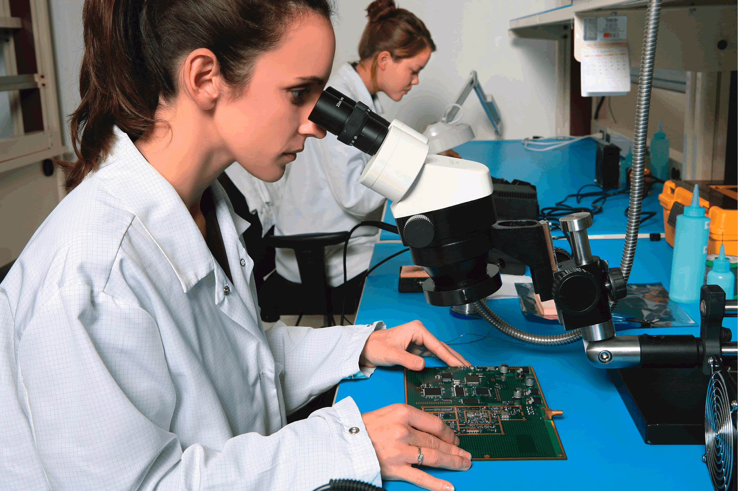
Business Opportunities
ICT & Nanotechnology
High degree of specialization, focus on satisfying specific (and unique) customer requirements
Pharmaceutical & Chemicals Industry
Slovene companies Krka and Lek are the leading manufacturers of generic drugs in CEE and the engine of the sector’s growth
Long industrial tradition in processing basic chemicals
Electrical & Electronics
A number of home-grown companies
A strong presence in Europe’s east and southeast markets
KRKA/
Pharmaceutical and research development centre

Slide 5

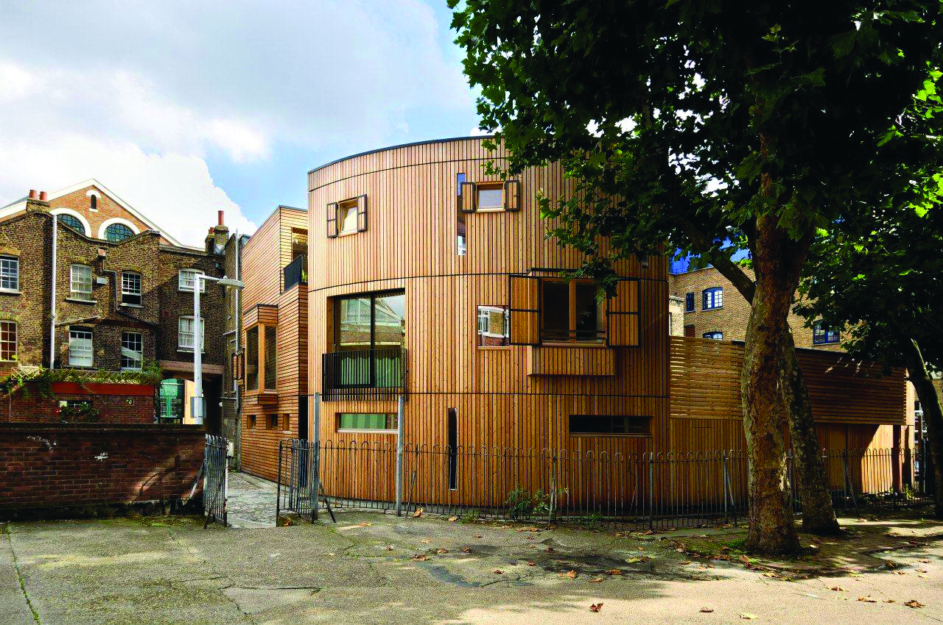

Wood-processing Projects
Wood-processing Industry - key figures 2012
Number of companies: 887
Number of employees: 11,800
Revenues (in €): 951 million
Exports (in €): 483 million
Contemporary or classical design, innovation and high quality raw materials
Huge forest ecosystem – 3rd in Europe (60 % of territory under forests)
Mizarstvo Bolcic / Table
Riko / House in London

Slide 6
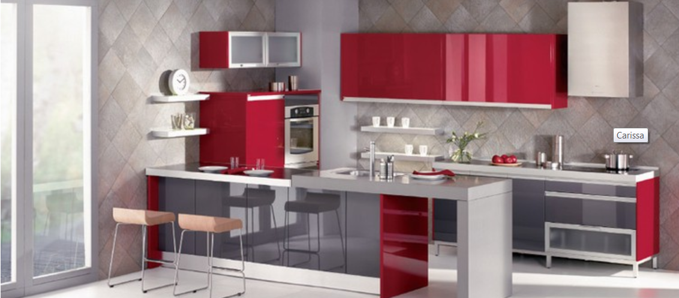
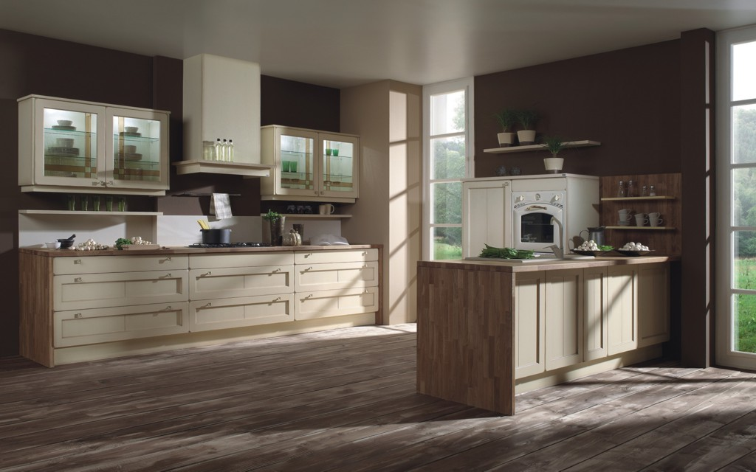
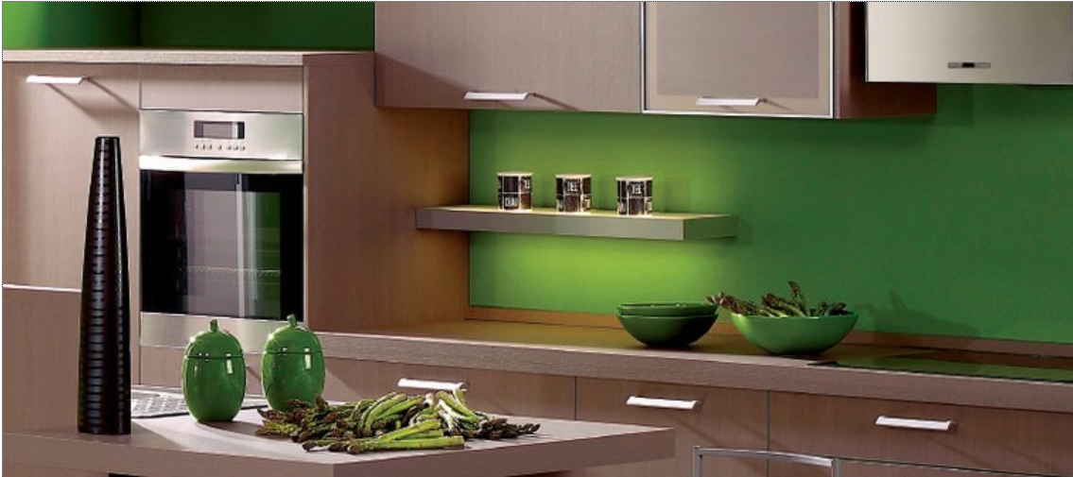

SVEA Lesna industrija d. d. (wood and furniture)
Executive summary
SVEA – is a well known Slovenian manufacturer of
kitchen and other wood furniture
modern, environmentally and people friendly
solutions for quality living.
64 years of tradition,
numerous awards for design,
exports to 25 countries (Croatia, Netherland, France,
Canada…)
130 skilled employees
€10.8 mn sales in 2012

Slide 7
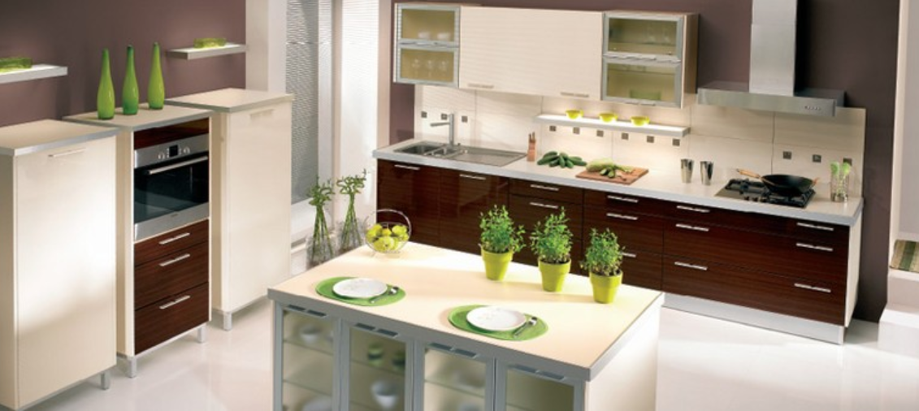
SVEA Lesna industrija d. d. (wood and furniture)
Investment opportunity
in insolvency register since 2 December 2013
Long term investor with access to new markets.
investment of € 5 to 10 mn.
73.100 m2 surface area,
33.500 m2 modern technology production area.
Flexibility in the production, special focus and know-how in veneer and massive wood.
Contact Point
SVEA Lesna Industrija, d. d. – v stečaju
Mr Tomaž Kos, oficial receiver
Cesta 20. julija 23
SI-1410 Zagorje ob Savi
Tel +386 3 565 5211
Fax +386 3 565 5205
Email info@svea.si
http://www.svea.si

Slide 8


LIP BLED, d. o. o. /wood processing center Bohinj
Executive summary
131,000 m3 of spruce and fir logs will be processed
in the factory by two frame saws and one band saw.
Production programme:
  Shuttering boards: 1,300,000 m2,
  Cross laminated timber: 21,000 m3
  Window laminated profiles: 10,500 m3,
  Pellets: 22,729 tons
  Production of electricity by cogeneration (CHP): 10 GWh; heat power 52 GWh
Value of investment in equipment and working
capital: € 37,595,886
Contact Point
LIP Bohinj, d.o.o
Mr. Alojz Burja – C E O
Ulica Tomaža Godca 5
SI-4264 Bohinjska Bistrica
Phone: +386 4 579 51 12
Email: alojz.burja@lip-bled.si

Slide 9
LIP BLED, d. o. o. /wood processing center Bohinj
Investment opportunity
Frame financial construction:
Owner's funds: € 7,000,000
Bank and equipment suppliers' credits: € 23,595,886
Non refundable funds: € 7,000,000
Exports to more than 20 European countries: Austria, Italy, countries of the ex-Yugoslavia and Switzerland.
Number of employees: 298
Profit and loss account after the realised investment:
Depreciation: € 3,149,248
Annual after-tax profit: € 2,805,690
Project realisation: In the years between 2014 and 2015.
Investment required
In addition to the funds foreseen for equipment purchase and a smaller amount for the construction and renovation of facilities in the amount of € 28,045,000, additional € 9,550,886 are required to finance working capital; in total € 37,595,886.
Annual revenue: € 37,845,921
The current LIP Bohinj's annual turnover amounts between €14 and 15 mn

Slide 10

TALUM d. d. (production of laminated timber)
Executive summary
Talum d. d. provides location, infrastructure, energy, human resources, technical support, engineering etc.:
the ROI of the most modern timber centre amounts to less than 7 years
the total investment is worth 20 million EUR
Talum d.d. willing to participate with a share of 25%
Total of 16 hectares available for the construction of a »wood centre«
Slovenia supports investments in the »green technology« with grants as well as
combined heat and power generation with a continuous buyout of electricity and a subsidized
purchase price
the production of laminated timber in the EU in the year 2012 amounted to more than 1 million m3.

Slide 11
TALUM d. d. (production of laminated timber)
Investment opportunity
processing of sawn timber 60.000 m3 / year
production of laminated timber 45.000 m3 / year
electricity generation 4.800 Mwh/ year
heat generation 15.999 Mwh /year
ROI > 15%
The plan is to erect a plant for the production of laminated timber made of softwood,
for the needs of the construction industry; structural timber (KVH), 2-layered laminated timber (Duo),
3- layered laminated timber (Trio) and cross- laminated timber panels (CLT).
Contact Point
Talum d. d. Kidričevo
Mr. Milan Firbas
Tovarniška cesta 10
2325 Kidričevo
Tel: +386 2 7995 100
http://www.talum.si

Slide 12
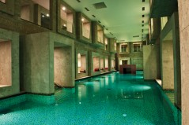
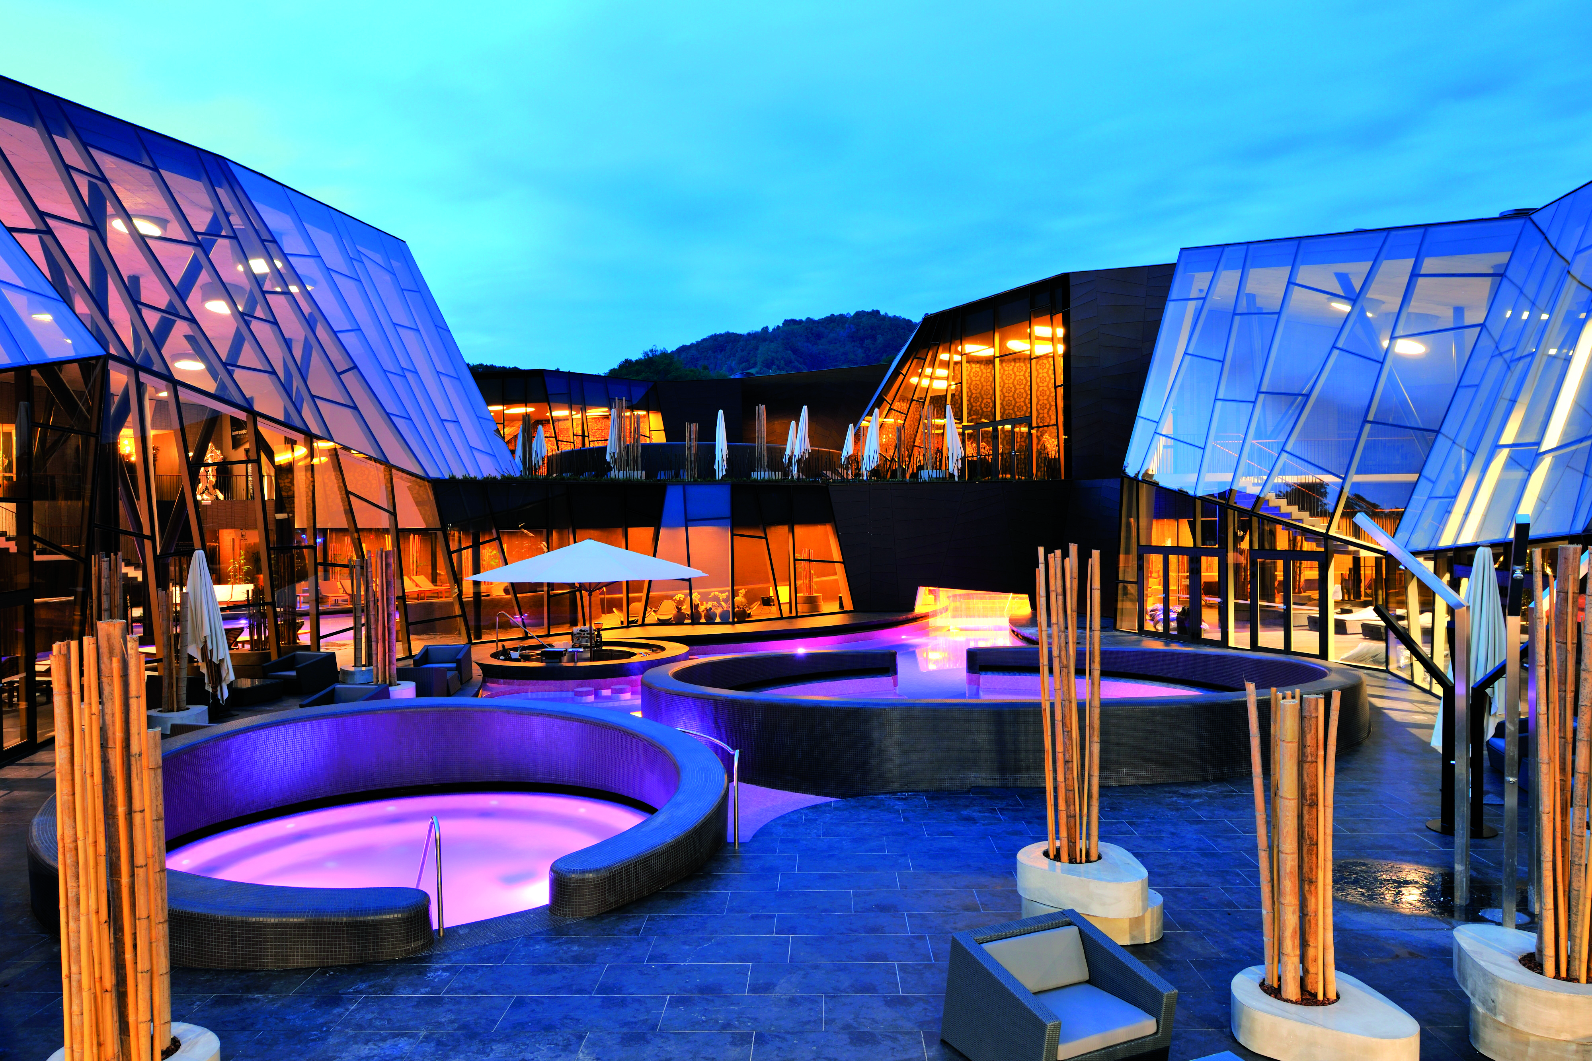
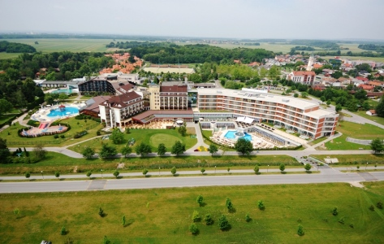
Tourism – Hospitality projects
Tourism - Key figures 2012
Number of employees: 45,000
Revenues (in €): 2 bn
12 % of GDP
Variety of offers in a small area (seaside, lake, river and
mountain tourism, health tourism, adrenaline and adventure
parks, sport tourism etc.) - an ideal destination for tourists looking
for a broad range of experiences in a short period of time
Infrastructure complementing accommodation development
Upgrading built environment
New recreational and outdoor attractions
New nature based experiences
Rimske Terme SPA

Slide 13

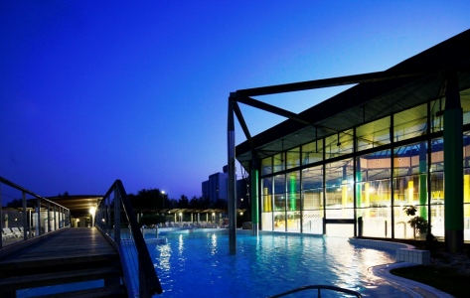
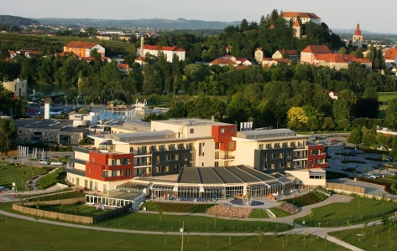

SAVA d. d. (tourism and banking)
Executive summary
One of the largest financial holdings and business
groups in Slovenia
Main divisions are tourism and banking
Sava Turizem d. d. (Sava Hotels & Resorts; SHR)
is the leading tourism service provider and hotel
operator in Slovenia with a market share of 13%.
Main strategic goals: further deleveraging of parent
company and consolidation of it’s investments in
tourism and banking.

Slide 14
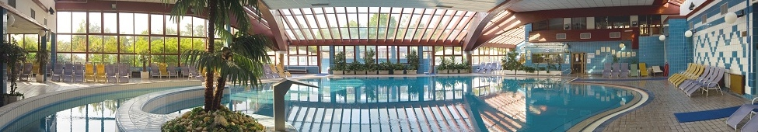
SAVA d. d. (tourism and banking)
Investment opportunity
Seeking a strategic partner that would support us in pursuing further consolidation of our banking holdings with the goal to recapitalize and exploit developing market opportunities.
In tourism sector seeking strategic and/or equity partner to further development and scale-up of specific products domestically and internationally
Contact Point
Sava, d. d.
Mr. Andrej Andoljšek, member of management board
Dunajska cesta 152
SI-1000 Ljubljana
Phone: +386 (0) 4 206 53 20
andrej.andoljsek@sava.si
http://www.sava.si

Slide 15

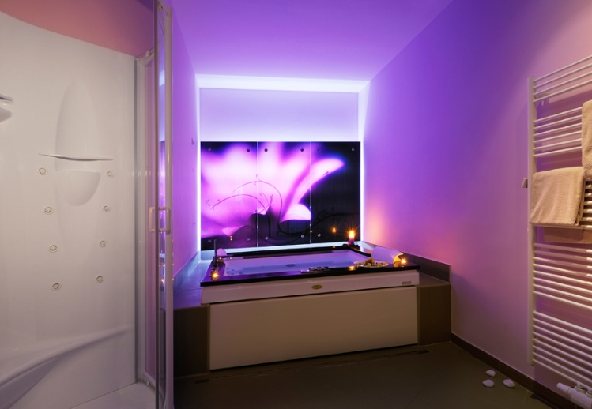


Thermana d. d. (wellness centre and tourism)
Executive summary
One of the most important health spas and tourist centres in Slovenia
Especially intended for people with movement difficulties
The company’s strategy is based on:
  Medical programs
  Basic health service
  Diagnostic
  Prevention
  Medical rehabilitation
  Renewed rehabilitation
  M.I.C.E.
Wellness programs
  Care for elderly people
  Business and seminar tourism
  Tourist starting-point for exploring
  Slovenia

Slide 16
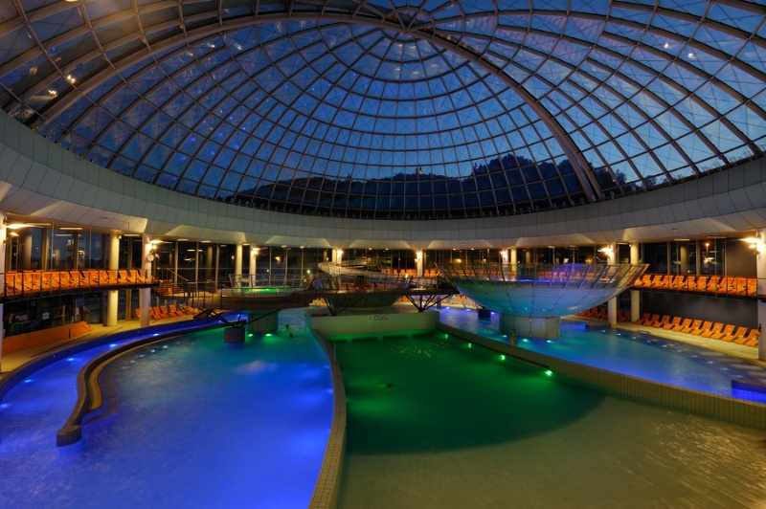
Thermana d. d. (wellness centre and tourism)
Investment opportunity
Sales of company shares to strategic or financial investors
Increase of company equity with emission of new shares
(Financing of Investment Program)
Business collaboration on marketing
Contact point:
Thermana d. d.
Mr. Andrej Bošnjak
Zdraviliška cesta 6
SI-3270 Laško
Tel: +386 3 423 2000
Fax: +386 3 423 2400
E- mail: info@thermana.si
http://www.thermana.si

Slide 17
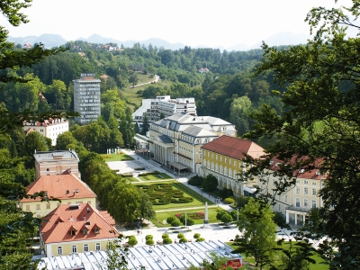
Hotel in Rogaška Slatina
Executive Summary
The hotel is located in the centre of Rogaška Slatina with the regional road Tekačevo - Rogaška Slatina nearby.
The area mainly consists of buildings for the purposes of tourism and well-kept park grounds. Existing building was built in secession style in 1908.
Net surface area of existing building is 1000m2 and comprises basement, ground floor, first and second floor.
Through hotel land runs thermal water the use of which is granted by easement. At the moment the hotel is not in use.

Slide 18
Hotel in Rogaška Slatina
Investment opportunity
Property can be developed into boutique spa & wellness hotel. The existing object has to be renovated and upgraded to luxury five-star hotel with capacity of 20 rooms. Building land adjacent to hotel has the area of some 6.000m2 and is intended for the construction of a new five-star hotel with capacity of 92 rooms and 3 suites. All project documentation for renovation of the existing object and construction of new hotel has been completed and construction permit issued.
Investment required
The developer is prepared to sell the project for € 4 mn.
Advantages
Thermal water exploitation, great location at the international visibility of the health resort Rogaška Slatina, project meets the EU incentive funding requirements for tourism infrastructure.
Contact point:
Trimpeks d.o.o.
Mr. Silvo Ambrož
Kosarjeva ulica 44
2000 Maribor
Tel: +386 41 669 364
E-mail: silvo.ambroz@trimpeks.si

Slide 19
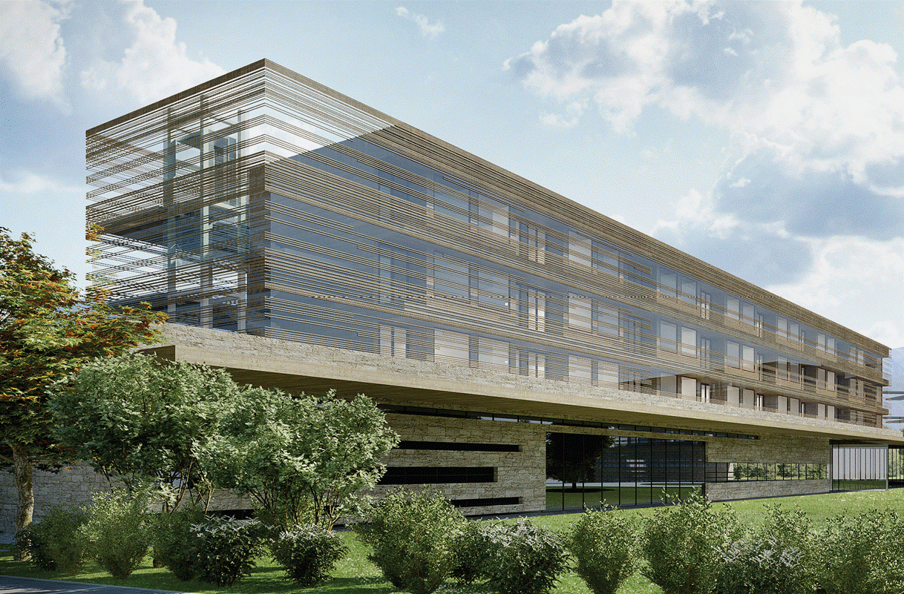
Mivka Resort Hotel Bled (greenfield)
Executive summary
Real Estate project "Mivka Resort Hotel"
is situated in a beautiful surroundings on
Lake Bled, which has the only island in
Slovenia.
Lake Bled with its surroundings lakes
and mountains is the top location for
leisure in Slovenia.
On the plot size of 110,000 m²
investors plans to built a hotel
with maximum of 200 beds and
50 apartments.
It's going to be incorporated in a
beautiful pine tree forest, with a big attention to detail and ecology.
Investor already signed a management contract with Falkensteiner Hotels & Resort from Austria,
one of the leading hotel brands in SEE.

Slide 20
Mivka Resort Hotel Bled (greenfield)
Investment opportunity
Leisure objects are a great opportunity for private or public real estate funds, which seek stable returns (between 5 - 8%).
Investment required
The investment cost, without apartments and with the whole plot size, is € 33 mn.
Contact point:
Intering Holding d.o.o
Mr. Iztok Polanič
Phone: +386 40 397 326
iztok.polanic@intering.si

Slide 21


Food-processing projects
Food-processing Industry - key figures 2012
Number of companies: 617
Number of employees: 12,886
Revenues (in €): 2 bn
Exports (in €): 449 mn
Well diversified
Applies the same technological methods as in
other EU countries

Slide 22
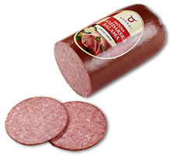
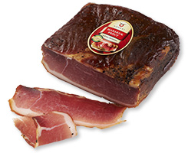

KOŠAKI TMI d. d. (meat- processing company)
Executive summary
The company TMI Košaki has 140 years of tradition of meat and meat product production
Two locations in Maribor with superb organisation and a technically modern production as
well as own laboratory.
Košaki TMI have gathered numerous certificates and awards during the years such as:
HALAL, ISO 9001:2000, EU licence, IFS certificate,
HACCP standard, certificate to export to
Russian Federation etc.

Slide 23
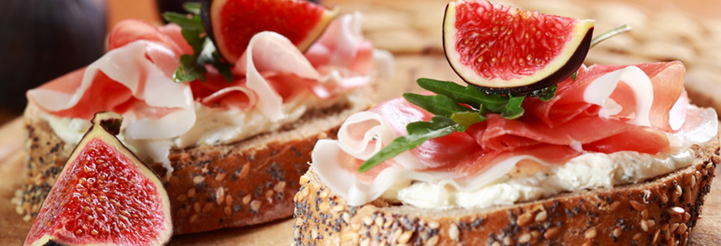
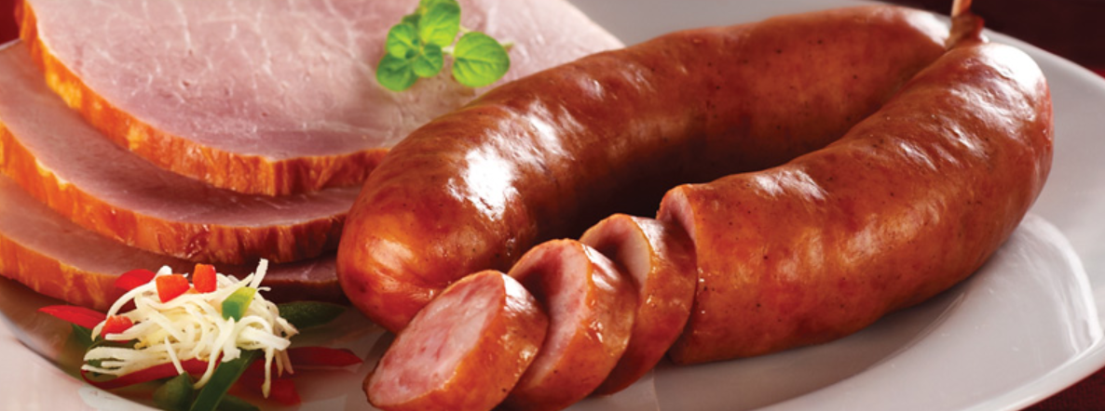
KOŠAKI TMI d. d. (meat- processing company)
Investment opportunity
A company has obtained a building permit for building a new meat processing plant and
obtained a positive decision on the 2.4 million EU grant funding.
Company is looking for strategic partners.
Contact point:
Košaki TMI d. d.
Ms. Meta Lovše
Oreško nabrežje 1
2000 Maribor
Tel: +386 2 23 52 200
Email: info@kosaki.si
http://www.kosaki.si

Slide 24


Uskok, d. d.
Executive summary
Uskok d.d. owns production line and brand of
natural mineral water COSTELLA
USKOK d. d. is one of the leading water bottling
plant in Slovenia. Its market share is 20% of
total sales of water in Slovenia.
Utilization of the filling line is an average of 18%
which means, that the company has significant
growth potential.
Interested investors are able to perform a due diligence process of the company USKOK d.d., as long as company interests are not affected. Investors are able to perform the due diligence
process from June 2013.

Slide 25
Uskok, d. d.
Investment opportunity
Need for a strategic partner that will able to increased sales, thereby improving the utilization of the filling line, and consequently company profit.
The legal owner of 75.28 % shares of USKOK d.d. is the company Gozdarstvo Grča d.d.
E Nalozbe d.o.o. , a Slovenian financial institution, holds exclusive contract for sale of those shares and is organizing sales process. The company is responsible for all communication with potential bidders for the equity share.
Contact point:
Enaložbe d.o.o.
Mr. Damjan Gale,
email: damjan.gale@enalozbe.si, tel: +386 1 620 97 13, mobile: +386 41 333 865

Slide 26
Commercial property development projects
Imos (residential, commercial & office projects)
Hidria Fin (Tomos Sever – logistics & mix use)
Sportina (Retail)

Slide 27

IMOS Holding, d. d.
Executive summary
IMOS is one of the leading Slovenian companies in the field of conducting complex engineering for all types of buildings.
Today, the IMOS Group includes nine companies. The parent company of the IMOS Group is IMOS HOLDING
The IMOS Group offers four clusters of services to the contractors:
Project development
Consulting engineering during the planning stages
Consulting engineering during the building process
Building management

Slide 28
IMOS Holding, d. d.
Investment opportunity
The company is looking for foreign investor(s) or strategic partner(s) or portfolio investors (funds).
Advantages
The company has some market extremely attractive real estate projects.
Contact point:
IMOS Holding d.d.
Mr. Joze Novak
Fajfarjeva ulica 33
1000 Ljubljana, Slovenia
Phone: +386- 41 754382
Email: joze.novak@imos.si
http://www.imos.si

Slide 29
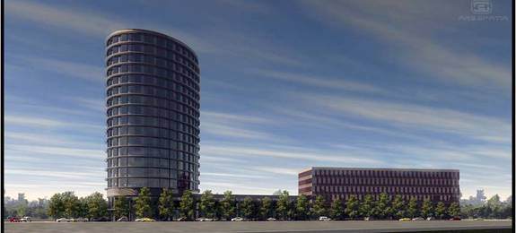
Litostroj Business and technology Park
Executive summary
As a sustainable urban redevelopment of a
brownfield site, the LITOSTROJ Business and
Technology Park is an inspiring example of a
multi-disciplinary approach with excellent results
The intent and purpose of the Litostroj Business
and Technology Park is to develop a high quality
state-of-the-art business and technology centre
within a work environment that blends
operational efficiency with a pleasing atmosphere.
The southern part of the project site is divided into 5 lots ranging from 5,800 sq. m to 14,660 sq. m in area. The total gross floor area of all new buildings is some 88,771 sq. m, with a total of 1,985 parking places.

Slide 30
Litostroj Business and technology Park
Investment opportunity
The company has obtained this area with a view to create a new business and technology park in the capital city with a diverse selection of sites and facilities for businesses planning their next business expansion.
The value of the project LITOSTROJ offered to a developer or investor – building plot P1 including the three buildings – is estimated on € 58.2 mn.
Contact point:
IMOS Holding d.d.
Mr. Joze Novak
Fajfarjeva ulica 33
1000 Ljubljana, Slovenia
Phone: +386- 41 754382
Email: joze.novak@imos.si
http://www.imos.si

Slide 31
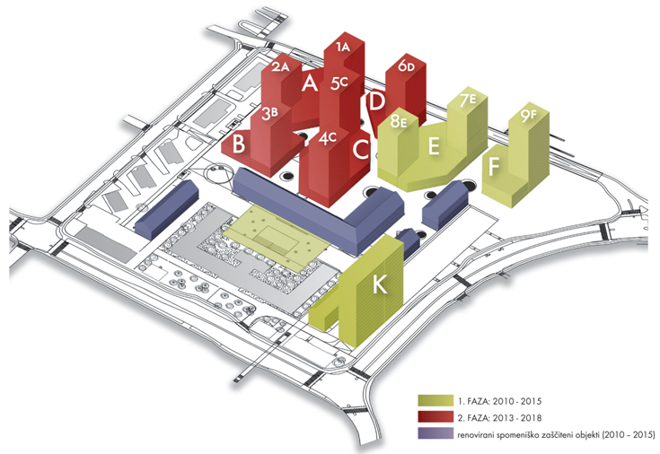
TobacnaCity
Multifunctional Project with Residential, Business and Service programme
The site for Tobačna City lies to the west of downtown Ljubljana, Slovenia’s capital. There were manufacturing facilities until 2004 when a decision was taken to redevelop the degraded site and turn it into an upmarket extension of the city centre. IMOS has acquired the property to turn a brownfield site into a place of distinction.
Key figures
Total size of the development area: 65,000 sq. m
Total service area of new buildings: 129,000 sq. m
37% share of business premises (48,000 sq. m)
63% share of residential area (81,000 sq. m)
Underground area 137,600 sq. m (3,500 parking lots)
Old buildings (cultural heritage) – 22,850 sq. m

Slide 32
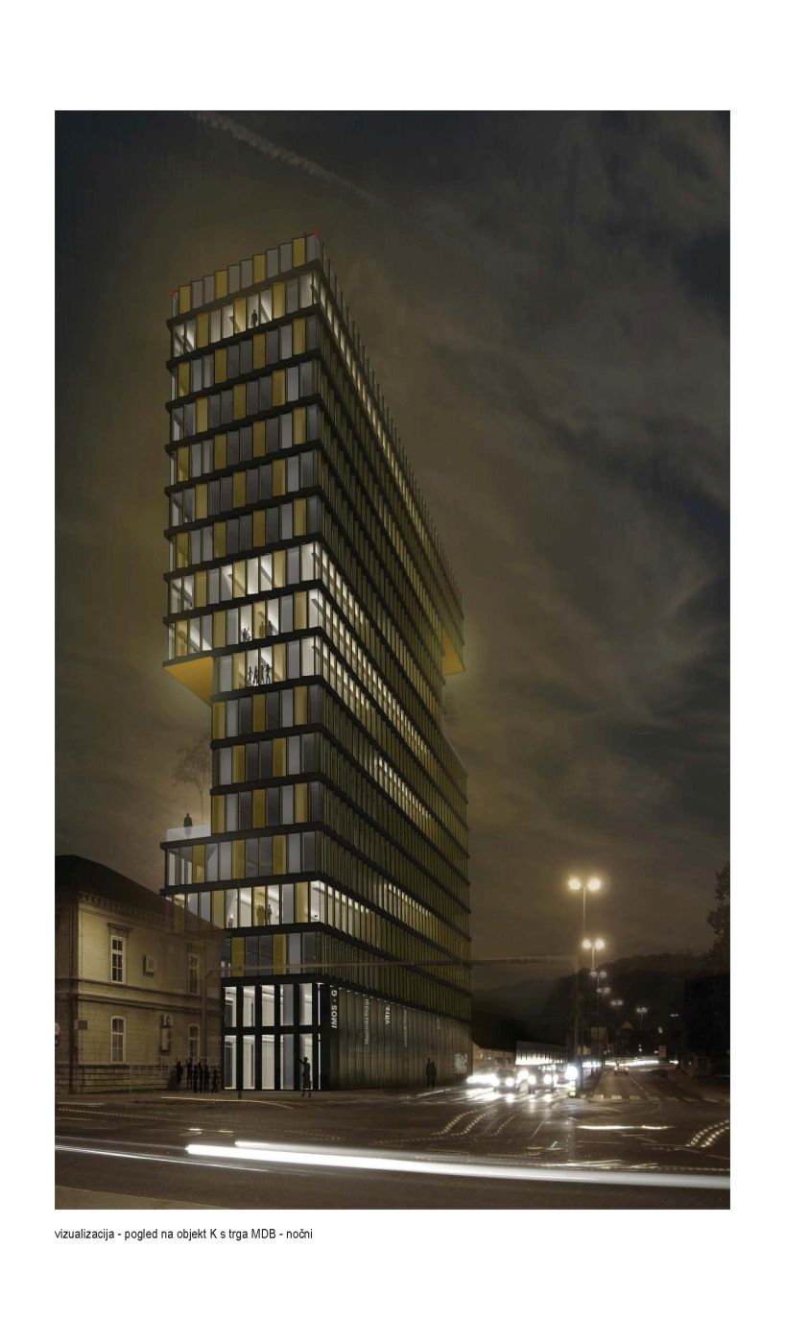
TobacnaCity
Investment opportunity
Tobačna City, the mixed-use development project of IMOS,
is the largest project of its kind in Slovenia. A unique brownfield
location in Slovenia’s capital city with a huge potential to be
converted into a distinct residential, retail and office space.
The options for the collaboration with investors:
1st option: purchase of the project phase 1.1 with the buildings E
and F
2nd option: purchase of the building K+27
3rd option: partnership (joint venture) for any investment option
under the two options above
The total value of the TOBACNA City development project is
approximately € 320 mn.

Slide 33

HIDRIA FIN, d. d.
Executive summary
A leading European and global provider of integral solutions for climate
technologies and automotive technologies.
Hidria organizational structure is basing on two pillars: industrial and financial.
Industrial pillar is focusing on research, production and sales of innovative technologies in
building climate solutions and automotive technologies.
Financial Pillar (Hidria FIN) is dealing with investment related to Hidria business strategy, but
also with other portfolio investments on the market. Hidria FIN is responsible for real estates,
restructuring of the companies, financial policy, controlling, treasury and risk management on a
corporate level.
Contribution to the sustainable development of natural and social environments.

Slide 34
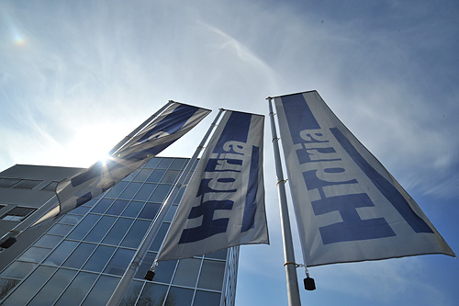
HIDRIA FIN, d. d.
Investment opportunity
The company is looking for foreign investor(s) or strategic partner(s) or portfolio investors (funds).
Advantages
The company has some market extremely attractive real estate projects.
Contact Point
Hidria Fin
Mr. Andrej Lavrič
Nazorjeva 6
SI-1000 Ljubljana
Tel. +386 30 609605
Email: andrej.lavric@hidria.com
http://www.hidria.com

Slide 35
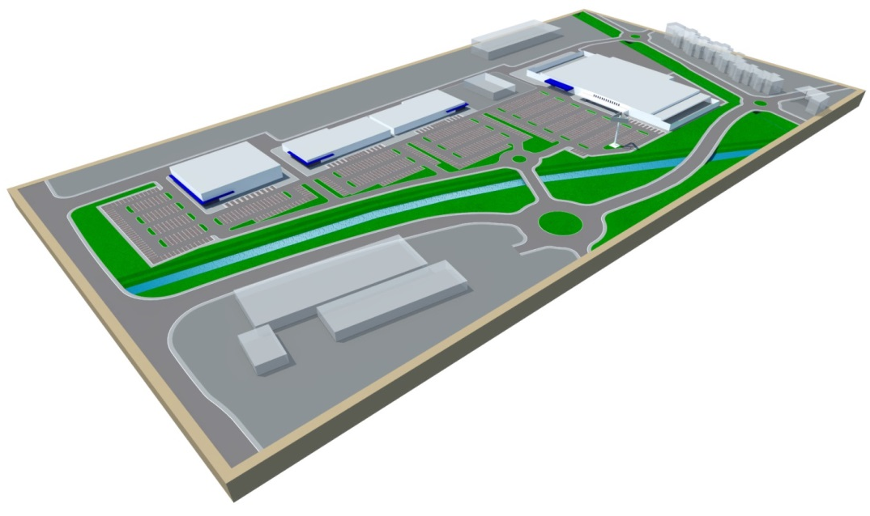
Tomos Sever
Centre for Logistics, transport, trade and education
The real estate is located in Koper on the road that connects Koper with the main border crossing with Croatia and near the port of Koper. The main usage of the property as set by local municipality is a land use for industrial buildings and warehouses. In the course of a procedure is a plan to extend the land-use and activities to all central activities such as shopping centre, services and other business activities. Plan will be formally accept in December 2013. The property is served by all major utilities.
The total area is 56,155 sq.m.
Sell of smaller units possible.
Business building facilities: 36,400 sq.m.

Slide 36
Tomos Sever
Investment opportunity
Based on the favourable macro and micro locations, besides its size,
the property offers a wide range of development and investment options such as:
Commercial or/and shopping centre, mall
Outlet centre
Retail space development
Business centre (offices...)
Industrial or logistics park
Investment required
Investment value: € 35.4 mn
Contact Point
Hidria Fin
Mr. Andrej Lavrič
Nazorjeva 6
SI-1000 Ljubljana
Tel. +386 30 609605
Email: andrej.lavric@hidria.com
http://www.hidria.com

Slide 37

Retail: SPORTINA Group
Executive summary
As fashion specialist, it represents more than 80 globally known brands across every price range in more than 278 stores in the region. Sportina Group does not merely consist of stores, it offers the overall regional infrastructure necessary for brand development in a certain market.
7 regional markets (Slovenia, Croatia, Bosnia and Herzegovina, Montenegro, Bulgaria,
Kosovo and Serbia.)
176 stores of Sportina Group
102 stores (joint venture - Tom Tailor and Tally Weijl)
65,221 sq.m. retail area
2,013 employees

Slide 38
SPORTINA Group
Investment opportunity
With 278 stores under management and more than 20 years of experience in retail, Sportina Group is among the largest fashion traders in South-eastern Europe. The Sportina Group offers the overall regional infrastructure necessary for brand development in a certain market.
Due to company's vast portfolio of trendy fashion brands in various price segments, the team has the knowledge to create contemporary lifestyle environment in almost any shopping mall. Up to 10,000m² in a single shopping centre could be filled.
Contact Point
Sportina Bled d. o. o.
Mr. Bahtijar Bajrović
Alpska cesta 43, 4248 Lesce, Slovenia
Phone: +386 4 537 00 00
Fax: + 386 4 537 00 25

Slide 39
Thank you for your attention!

