Slide 1
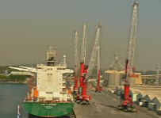
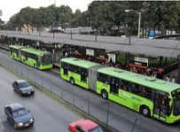
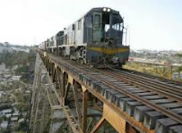
www.agenciadealianzas.gob.gt
Project Pipeline – January, 2015

Slide 2
Introducing ANADIE: the Agency for Public and Private Partnerships (PPP) in Guatemala
Law passed in 2010, creates a specialized project finance Agency in charge of the whole process a PPP project undergoes
The law gives the legal framework to public-private partnerships in order to attract more foreign investment an promote productive investment.
Agency started operations in 2012. Processes, Human Capital and regulations are in place and functional
First set of Projects will be tendered in 2014

Slide 3
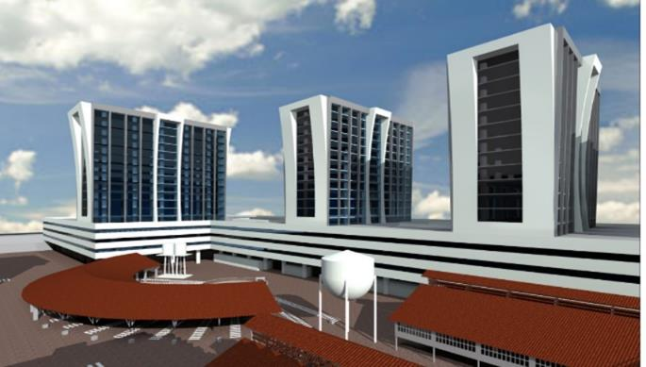
Government Administrative Complex
Guatemala – Mexico`s Border

Slide 4
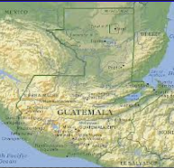
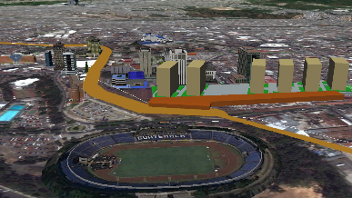
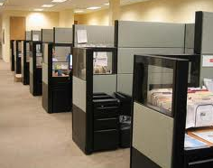
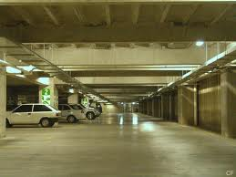
1-Government Administrative Complex
Background and Objective
The Executive branch of Government has not built new administrative office space since the 1970s. In that period of time the amount of central government civil servants has grown more than six fold. As a result, the government has satisfied its need for office space by renting hundreds of spaces across the city. This has resulted in high rent expenses, high related costs of maintenance, energy and security. Many of the owned and rented facilities are not in good enough condition for Government offices and public servants and contribute to rising traffic congestion in the city.
The project aims to tackle this problem by structuring a PPP in which a private investor builds and operates an office complex for 10-12,000 public occupants, in exchange for availability and maintenance payments in a 20 year period. The space will be 100% occupied by the Government so there is no demand risk. The projects is located in a central property next to other Government facilities and next to the Urban train central station.
Total Estimated Investment
$180 Million
Contracting Entity:
Ministry of Finance
STATUS:
Prequalification of investors
through applications in
www.guatecompras.gt/
NOG: 3708926
Deadline: March 16th. 2015

Slide 5
Government Administrative Complex: Roles
Private Participant role and investments
Design Build and operate a government office complex of about 180,000M2
Maintenance of facilities: water, electricity, elevators operation, internet, etc. in such a way that the service is continuous and of the specified quality.
Management of private tenants, parking and other areas in a rational yet efficient and profitable manner
Estimated investment US$180 million
Revenue Sources:
A charge for capital investment – availability payment paid by central government
A maintenance and operation charge paid by government
A fare charge (regulated)
Estimated $15-25 million revenue start of operation^{1.} Minimal demand risk
Government Role
The project is being contracted by the ministry of finance
Provide property and support for all permits
Facilitate financing structure needed and provide a robust consistent payment mechanism
Allocate space and regulate relationship with tenants (from different government departments)
Coordination with the projects connected in the same property (train station, bus station, museums, other)
¹ Initial estimates based on a capital/availability charge to Government and commercial real estate charges.

Slide 6
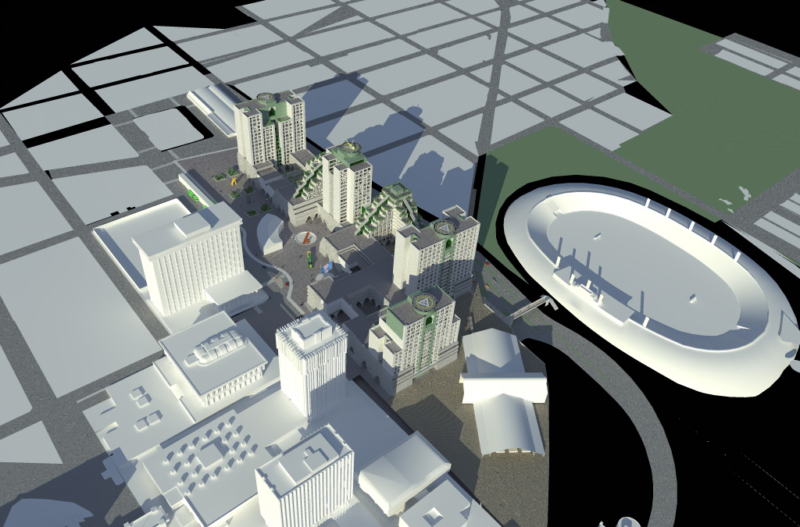
Concept design – Final design to be proposed by the private partner

Slide 7
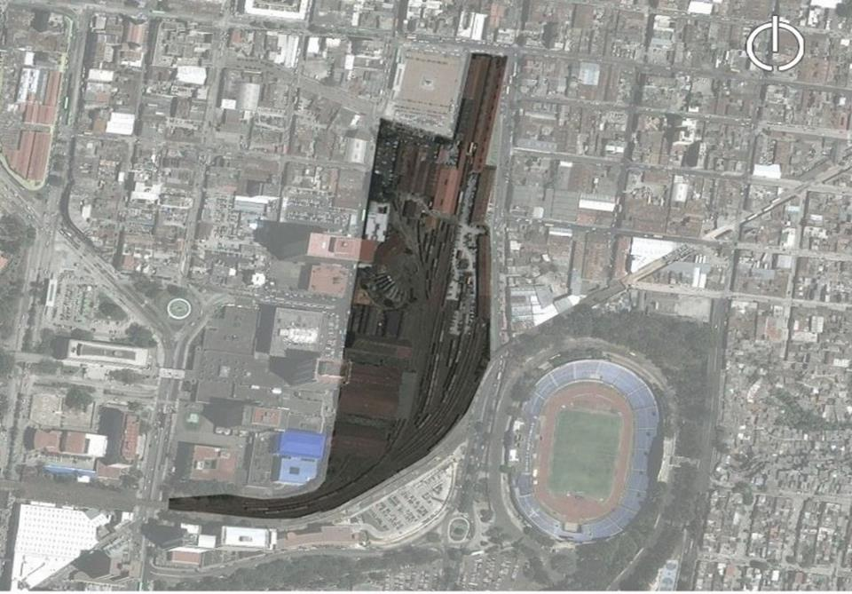
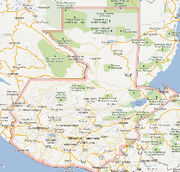
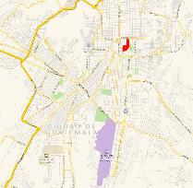
Government Administrative Complex: Location
The project is located next to the rail and metrobus (BRT) central station for the whole Metropolitan area and also to the “Centro Civico” the main public offices agglomeration with estimated 15,000 public servants today.
The recovery of the FEGUA railroad assets allowed the use of the former Central Station
Location:
Zone 1, Guatemala City, Guatemala

Slide 8
Government Administrative Complex: Blueprint
Jan 14 Mar 14 May 14 Jul 14 Sep 14 Nov 14
Jan 15 Mar 15 May 15 Jul 15 Aug 15 Nov 15
Ene 15 Mar 15 May 15 Jul 15 Sep 15 Jun 18
Ene 14 Mar 14 May 14 Jul 14 Sep 14 Nov 14 Ene 15 Mar 15 May 15 Jul 15 Sep 15 N Jan 16 Dec 16
Compliance with the Law requirements
Feasibility Studies
Project Structuring
Prequalification Terms approved
Prequalification
Prequalified list published
Bidding
Award
Congress Approval
Financial Closing
Construction
Start of Operations

Slide 9
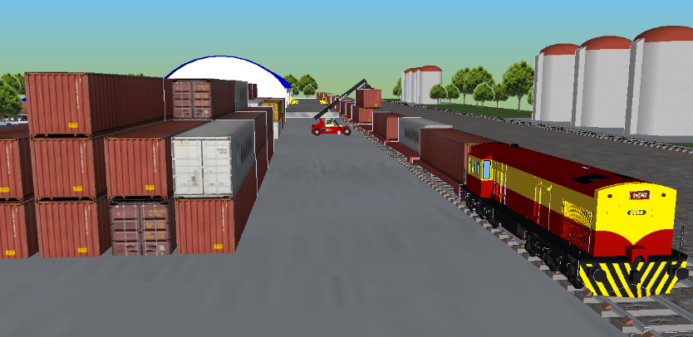
INTERMODAL BORDER PORT
TECUN UMAN II
Guatemala – Mexico`s Border

Slide 10
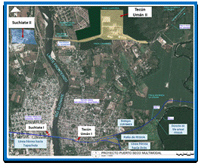
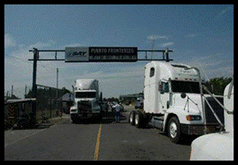
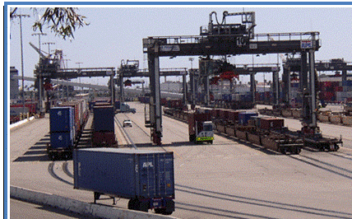
2-Intermodal Border Port Tecun Uman
Background and Objective
98% of land-based trade between Mexico and Central America, over US$4 Billion, 2M Tons of cargo and >150,000 trucks a year, pass through the Border Crossing point Tecun Umán II. It is also the point where the Mexican Rail System goes into and connects with Guatemala.
The rail line that connects with Guatemala is the Chiapas–Mayab that was recently rehabilitated after damages suffered in 2005. There is a need to build and upgrade the facilities in the border crossing in order to offer more and valued added logistical services for the truck-to-truck transshipment (Mexican trucks are not allowed into Guatemala and vice versa) and the soon to grow to a significant amount train-to-truck transshipment. The facilities are to be built and operated in a long-term PPP contract by a private investor with experience in ports, dry-ports and rail cargo projects.
The Government will grant the exclusive use of the facilities with primary fiscal zone status and the use of the rail right of way and operation rights.
Total Estimated Investment
$30-40 Million
STATUS:
Prequalification of investors starting in
February, 18th. 2015
Contracting Entity:
Minister of Economy
FEGUA (Rail SOE)

Slide 11
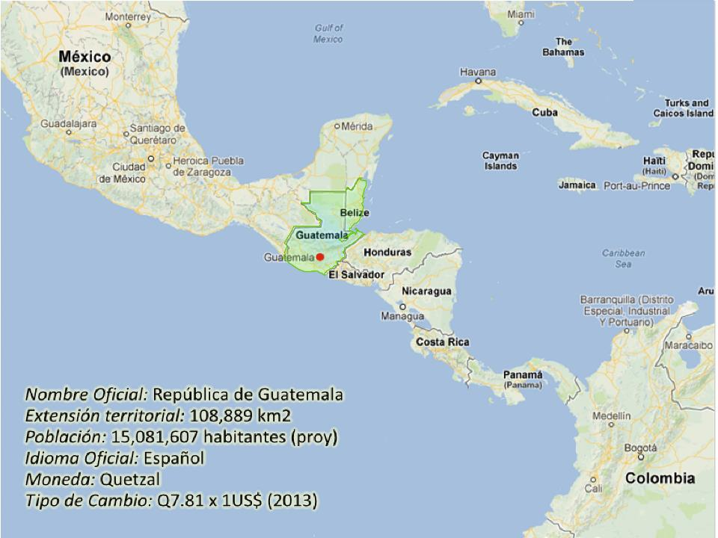
Guatemala
The project will transform the main land border between Central America and Mexico (Central America´s NAFTA access) in a dry port and logistics center for the major supply chains in Central America. The project will interconnect with the Mexican rail network giving access to North America.

Slide 12
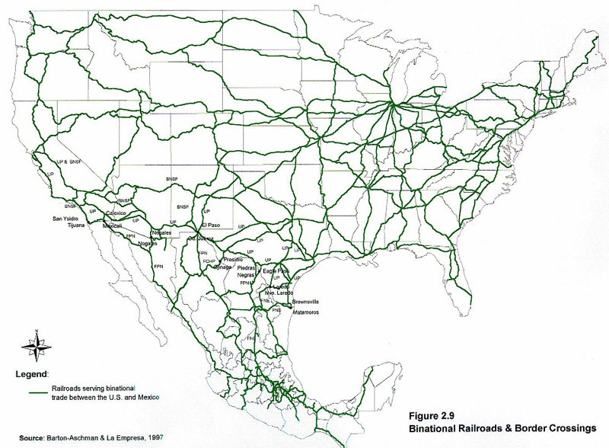
The entry point to NAFTA
México-EEUU Main Railway lines (2009)

Slide 13
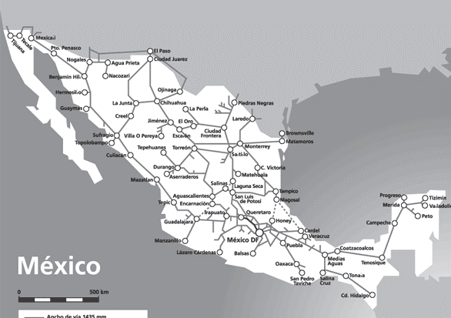
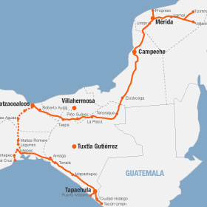
The Mexican rail system is divided in sections which have private-public concessions. In 2005, the "Chiapas - Mayab" section suffered damages from Hurricane Stan and railway operation was discontinued...
Mexican Rail System
Mexico's government invested more than US$ 300 mm in the rehabilitation of the railway section. Operational since April 2014.

Slide 14
Intermodal Border Port Tecun Uman: Roles
Private Participant role and investments
Build and upgrade Logistic Facilities for state-of the-art “drop and hook” capabilities, storage and transshipment.
Construction and operation of 5 Kms. of rail line on the Guatemalan side plus the equipment for operation, loading and unloading of cargo train-truck.
Minor additional investments to improve custom clearing and immigration facilities and provide complimentary services such as: space rental for cafeterias, offices, commerce and others amenities for pilots and customs staff
Optional: specialized off-duty storage facilities or warehousing
Investment in phases, adds up to est. $35 million
Revenue Sources:
Logistic port services: drop &hook, cargo trans-shipment, container loading and unloading (non-regulated)
Fiscal Warehousing and related services (non-regulated)
Rail-line and train operation services (regulated)
Custom process revision fees (X-ray and intrusive) (regulated)
Space Rental for Services (food, parking, etc.)
Estimated $11 million revenue by year 5 of operation¹
Government Role
Operate and maintain efficient custom and immigration operation as a specialized cargo entry point
Provide the property (currently owned) for the port operation
Secure right of way for the rail line extension (done)
Coordination with Mexico in rail and border crossing
IMPORTANT NOTE: It is an ongoing border crossing operation and has operated for 10 years. The overall structure of treaties and border crossing is not changing
Government expected reward: efficient operation. May demand a % of revenues (still to be defined)
¹Conservative estimate based on a 30% market share of the current logistics (truck – truck) business in the zone and a 25% conversion of cargo from Truck to Rail in the Mexico-Guatemala´s cargo route

Slide 15
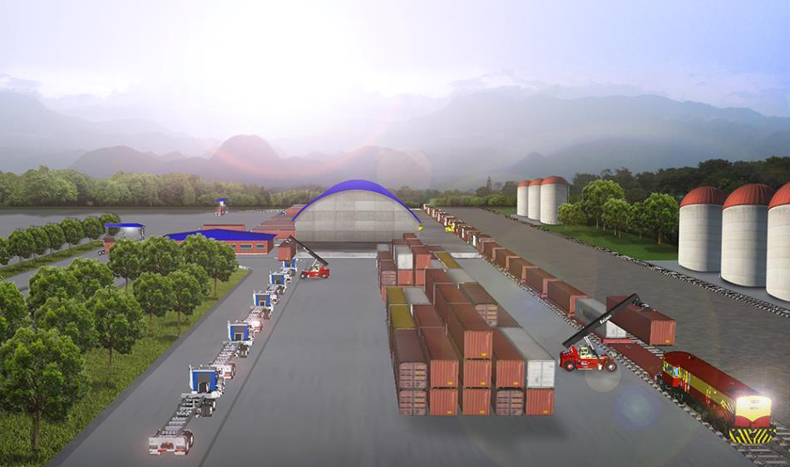
Private Investor will build and operate modern intermodal port facilities and customs

Slide 16
Intermodal Border Port Tecun Uman: Blueprint
Ene 14 Mar 14 May 14 Jul 14 Sep 14 Nov 14
Ene 15 Mar 15 May 15 Jul 15 Sep 15 Nov 15
Ene 14 Mar 14 May 14 Jul 14 Sep 14 Nov 14 Ene 15 Mar 15 May 15 Jul 15 Sep 15 Nov 15 Ene16 Sep16 Nov16
Compliance with the Law requirements
Feasibility Studies
Project Structuring
Prequalification Terms approved
Prequalification
Prequalified list published
Bidding
Award
Congress Approval
Financial Closing
Construction
Start of Operations

Slide 17
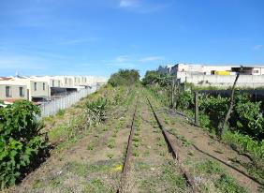
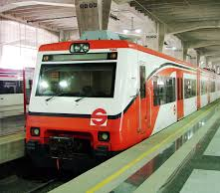
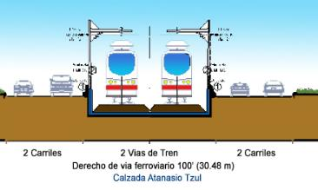
3-Urban passenger train
Background and Objective
The Guatemala City Metropolitan Area (AMG) is a conglomeration of large municipalities surrounding the Guatemala City, it had a formal population more than
3.2 millions in 2013, being the most populous in Central America. Guatemala´s public transportation system is based on normal transit buses, with a bad service, since 5 year ago, the Municipality of Guatemala, operates the first Bus Rapid Transit (BRT) system in Guatemala, which has a daily ridership more than 120,000 with better service. However, de demand of safer and better public transportation grows dramatically every year.
The government of Guatemala decided to develop a new public transportation system, the urban passenger train, which will connect the north (Centra Norte) with the south (Centra Sur) of the city, building a 25 km rail line in the actual right of way, FEGUAs own property. The urban train will attend more than 280,000 (both north and south stations) people, plus the extra demand generated by Government Administrative Complex project with a 7 station (max) system.
Total Estimated Investment
$350 Million
Contracting Entity:
“Municipalidad de Guatemala”
FEGUA

Slide 18
Urban passenger train: Roles
Private Participant role and investments
Design all the system;
Build the 25 km rail line;
Rolling stock procurement;
Operate the route for 30 years maximum.
Maintenance of the rail line;
Revenue Sources:
A charge for capital investment –paid by central government;
A maintenance and operation charge paid by government;
Charge fares to users (regulated).
Estimated $30-40 million revenue
Minimal demand risk guarantee
Government Role
The project is being contracted by FEGUA;
Government will participate in the initial CAPEX with 50-70% of Investment.
Provide property and support for all permits;
Facilitate financing structure needed and provide a robust consistent payment mechanism;
Coordination with the projects connected in the same propoerty

Slide 19
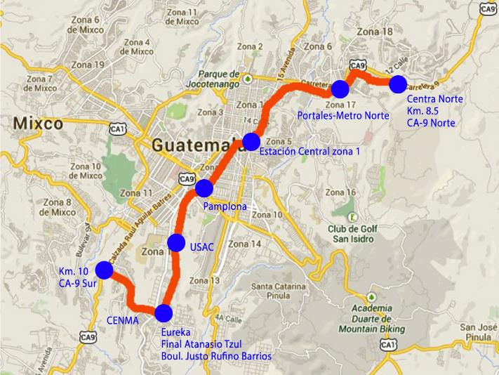
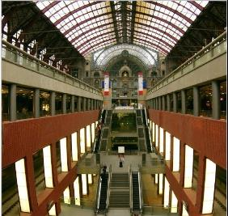
Urban Passenger Train: Central Station Location
The Central Station will be located next Government Administrative Complex and Transmetro (BRT) central station and also to the “Centro Civico” the main public offices agglomeration with estimated 15,000 public servants today.

Slide 20
Urban Passenger Train: Blueprint
Oct 14 Dec 14
Nov 15
Jan 16 May 16 Jul 16 Dec 16
Mar 17 May 17
2018
Dec 19
Structuring studies
Hiring process 1
Project Structuring
Prequalification Terms approved
Prequalification
Prequalified list published
Bidding
Award
Congress Approval
Financial Closing
¹ Studies contracted through BID Project financing
- PRONACOM/MINECO (US$1.6-1.8M. Investment).
Construction
Start of Operations

Slide 21
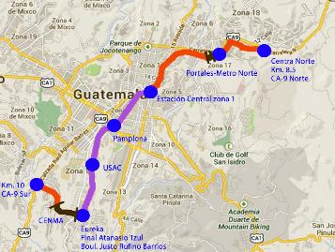
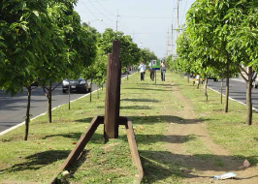
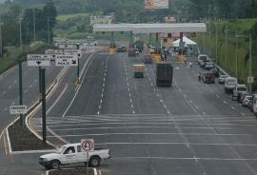
4-Urban highway
Background and Objective
Taking advantage of the 30 m right of way rail line, the Guatemala Municipality wants to build a Urban Highway both sides the rail line, connecting a transit route from north to south and vice versa, attending lightweight and heavy vehicles and buses.
Today, traffic flow in the north route is lightweight vehicle = 15,000, heavy vehicles = 6,000, and 1,500 buses, and in the south route is lightweight vehicle = 3,000, heavy vehicles = 2,000, and 800 buses, and already exists a 10 km roadway named “Calzada Atanasio Sur” (see: the purple line in the map) it was built both sides the right of way rail line, keeping the right of way invaders free.
The project will build two principle bridges (see: the black lines in the map), one to connect the south, a 900 mt. long bridge, and the other one a 300 mt. long bridge, and also will build all the road infrastructure necessary to connect both regions.
Total Estimated Investment
$220 Million
Contracting Entity:
“Municipalidad de Guatemala”

Slide 22
Urban highway: Roles
Private Participant role and investments
Design the infrastructure;
Build the 2 main bridges;
Build all the road infrastructure, toll booths, etc.
Operate and maintain the highway for 30 years maximum;
Revenue Sources:
Toll Road fares
Publicity and related revenues
Estimated $30-40 million annual revenue. Minimal demand risk guarantee projected
Government Role
The project is being contracted by FEGUA with the support of the Guatemala City Municipality;
Governement provides de rights of way (already in possession)
Facilitate financing structure needed and provide a robust consistent payment mechanism;
Coordination with the projects connected in the same property

Slide 23
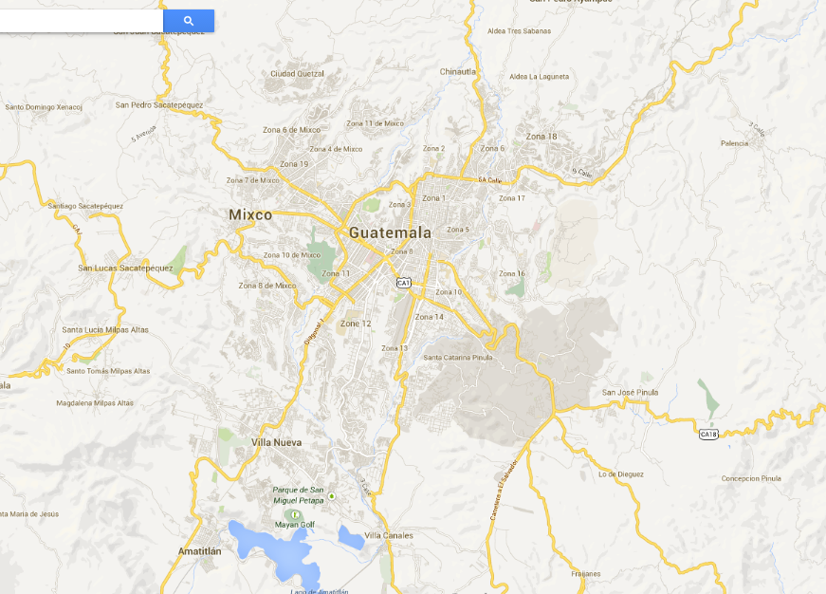
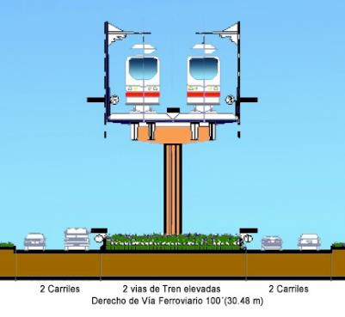
Urban highway 31 Kms. - From the Km. 11 Pacific rd. to Km. 8 Atlantic rd.
Líneas Transmetro
DBOT
30 years
US$220M
CENMA

Slide 24
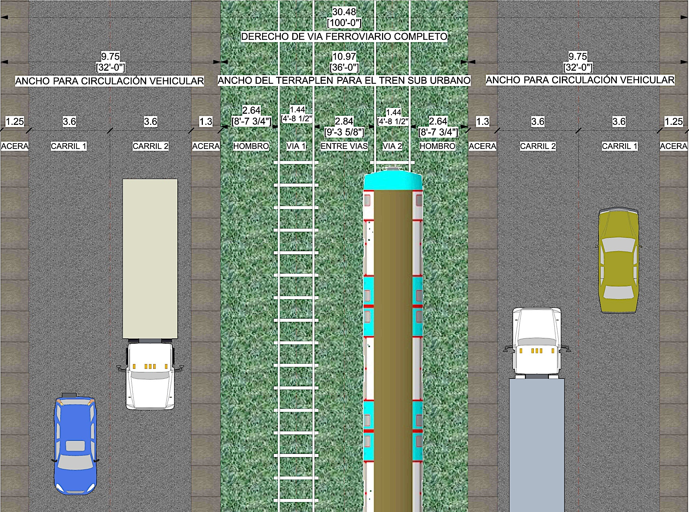
Urban Highway & Urban Passenger Train

Slide 25
Urban Highway & Urban Passenger Train
TRAIN SECTION AND URBAN HIGHWAY IN ATANASIO TZUL SOUTH AND NORTH (Level)
TRAIN SECTION AND URBAN HIGHWAY IN ATANASIO TZUL CENTER (5 KMS. APROX.)

Slide 26
Urban Highway: Blueprint
Oct 14 Dec 14
Nov 15
Jan 16 May 16 Jul 16 Dec 16
Mar 17 May 17
2018
Dec 19
Currently in sync with Urban Train.
Decision to tender together or separately to be taken in early 2015
Structuring studies
Hiring process 1
Currently in sync with Urban Train.
Decision to tender together or separately to be taken in early 2015
Project Structuring
Prequalification Terms approved
Prequalification
Prequalified list published
Bidding
Award
Congress Approval
Financial Closing
¹ Studies contracted through BID Project financing
- PRONACOM/MINECO (US$1.6-1.8M. Investment).
Construction
Start of Operations

Slide 27
More information
www.agenciadealianzas.gob.gt
cpivaral@agenciadealianzas.gob.gt

