Slide 1
Doing Business in PERU; investment opportunities

Slide 2
Doing Business in Peru
Peruvian economy
Politics of trade integration
Legal aspects of doing business in Peru
Panamerican and Para Panamerican sport events 2019

Slide 3
Doing Business in Peru
Peruvian Economy
2016 - 2021

Slide 4
Country overview
General Information
Population: 30, 9 million
Capital: Lima, 9 million
Languages: Spanish, Quechua and Aimara
Currency Nueva Sol (S/.) 1 (U.S.)= S/. 3.20
Type of Government: Constitutional Republic
Area: 1´285,216 Km²
Location: (Peru is located) in the middle of South America(facing) the Pacific Ocean.
Regional Governments: 24 Regional Governments and the Constitutional Province of Callao

Slide 5
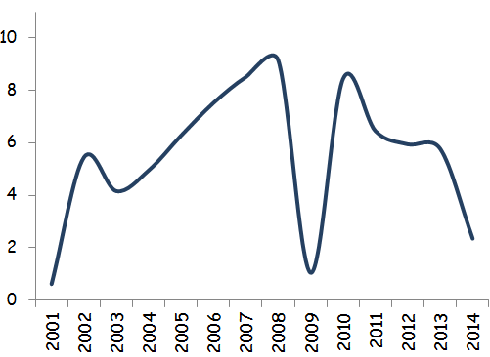
Starting point - National context
Economic Growth (Var %)
Potential Economic Growth (Var %)
C: Capital, E: Employment, P: Productivity
CP: Potential
Growth
C
Minimum growh required to maintain
actual conditions: 3.4% for Poverty & 4.0% for Employment
.
Decrease
(2010-2015)
Transformation curve
2.5% (average)
2014-2015*)
Projection 2015 (Range): 2.6-2.8%.
CP actual:
4.5%
CP:
5.3%
CP:
6.5%
E
Economic Informality
:
60.9%
Poverty
:
24.4%
* estimate
8.4%: Average Annual Growth 2006-2010 (without thel 2009)
Informal Labor:
74.0%
Inequality:
0.48%
6.1%: Average Annual Growth 2011-2013
Underemployment:
47.3%
2.5%: Average Annual Growth 2014-2015 (estimate)
Source: Libro “Agenda Económica
para el Cambio”, César Peñaranda C.
Average 2014-2015: 2.5%, 3.6 pp. Less than
2011-2013

Slide 6
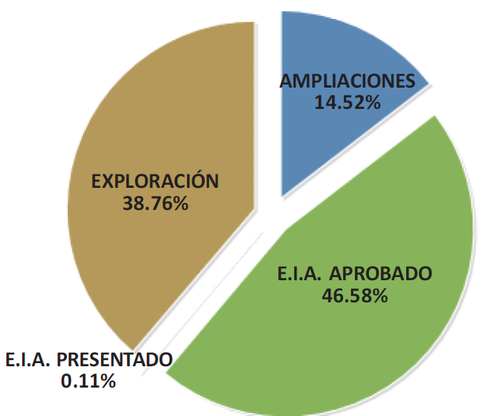
PE 2016-2021 – Motors of Growth: Investment: Projects
Estimated Project Portfolio Mining:
US$ 63,115 millon
US$ 19.7 mill.
US$ 9.1 mill.
Copper is the principal mineral with US$ MM 42,253 (66.9% of the total).
Gold follows (12.3%) & iron (8.4%) amongst the most important.
Fuente: Ministerio de Energía y Minas Elaboración: IEDEP-CCL

Slide 7
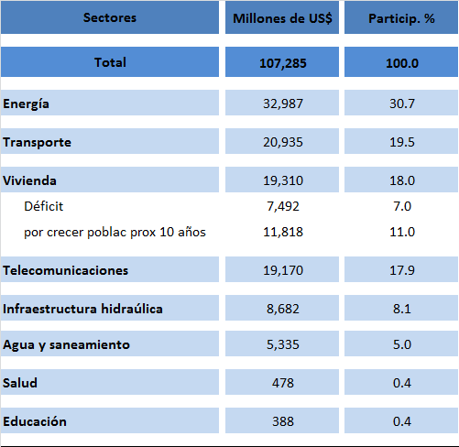
PE 2016-2021 – Motores del Crecimiento: Inversión: Oportunidades
Infrastructure Breach at 2021
107,285
Sectors must be potentialized, APP & works for taxes
Fuente: AFIN, IEDEP-CCL
Book “Agenda Económica para el Cambio” , César Peñaranda C.

Slide 8
Growth is the Challenge
Seek progressive increase of potential growth
Potential Economic Growth (Var %)
C: Capital, E: Employment, P: Productivityd
CP: Potetial Growth
C
Economic Program
2016-2021
Growth
(2016-2021)
To face the challenge of growth requires:
Transformation Curve
Maintain Economic Stability
Prerequisite:
Strengthen Institutions
2.5% (average
2014-2015*)
1.- Investment
CP actual:
4.5%
E
Motors of Growth:
CP:
5.3%
CP:
6.5%
2.- Production
* estimate
3.- Exports
Source: Book “Agenda Económica para el Cambio”, César Peñaranda C.
Prepared by : César Peñaranda C.

Slide 9
Politics of trade integration

Slide 10
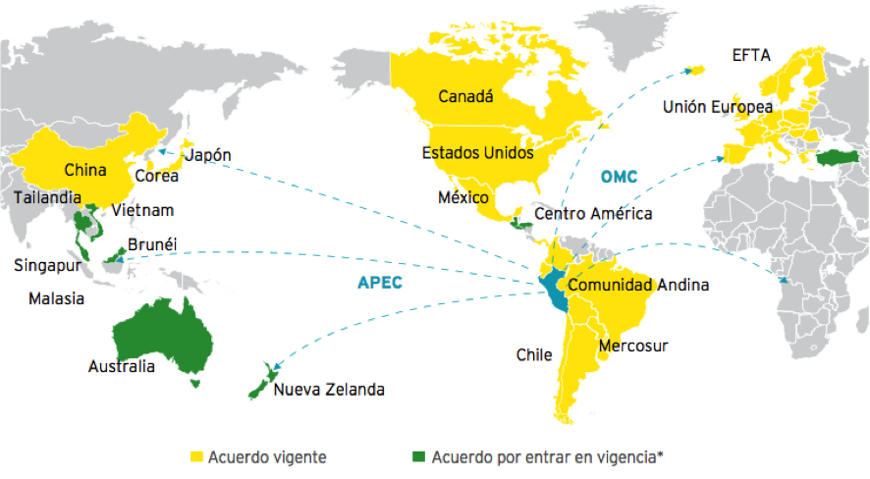
An economy that works in the process of globalization, with preferential access to larger markets.
POLITICS OF TRADE INTEGRATION
Access To Markets
In addition considered the U.S. Commercial Free Trade Agreement, The Pacific Alliance (Colombia, Chile, Mexico) and the Trans-Pacific Partnership Agreement (Brunei, Chile, New Zealand, Singapore, Australia, United States, Malaysia, Viet Nam, Canada, Mexico and Japan)

Slide 11
World Leader in NO Traditional Exports
POLITICS OF TRADE INTEGRATION
1
Fresh asparagus. Organic coffee
Quinoa
Garments: niches with high purchasing power in USA and South America (shirts, T-shirts-blouses, wool)
Agricultural Industry: global competitiveness in fine vegetables (asparagus, artichokes, peppers) and fresh fruits (mango, banana, citrus) in the EU and USA.
Chemical: high quality in the beauty and plastic industry, with high demand in Central and South America.
Fishery: prawn (USA), giant squid (China-Spain), canned mackerel, horse mackerel and sardine (EU-Africa)
2
Canned asparagus, Virola, mahogany wood. Organic coffee
Organic banana. Avocados
3
Scallops, Natural calcium phosphate, Evaporated milk
4
Frozen giant squid, Canned artichoke, Capsicum
5
Fresh grapes
Fresh mango
6
Cotton polo shirt
Canned olives
Source: SUNAT

Slide 12
World Leader in Traditional Exports
POLITICS OF TRADE INTEGRATION
1
Fish oil - Fishmeal
Metals: copper, gold, zinc and lead – Demanded by the industrial and construction sector in Asia and the EU.
Fishmeal: high demand of the aquiculture sector in Asia.
Coffee: gourmet product (organic, fair trade, special) demanded by the EU and USA.
Oil Derivatives: Nafta (1st derivative of Camisea) demanded by the petrochemical industry in California.
2
Lead concentrate
Copper concentrate
Molybdenum
3
Zinc concentrate
Silver
4
Gold Coffee
5
Refined copper
Source: SUNAT

Slide 13
Background
Constitution of 1979
1,800 public companies
Agrarian Reform
Goverment (García) with 7000% inflation
Constitution of 1993
International agreements: BID, FMI, etc.,
Dismissal 700,000 public employees
Goverment is not allow(ed) commercial activities
Reduced the Goverment (less minist(t)ries)
Favorable financial conditions
Arbitration
Cannot modify contracts
Easy and fast constitution of companies

Slide 14
Favorable legal framework for foreign investment
FAVORABLE INVESTMENT CLIMATE
Non-discriminatory treatment: foreign investors receive the same treatment as national investors.
Unrestricted access to the majority of economic sectors.
Free transfer of capital.
Free market
Guarantee of private property
Freedom to acquire shares to (in) local companies.
Freedom to access internal and external credit.
Freedom to remit local and international royalties.
Access to international mechanisms for the settlement of disputes.
Participation in the Investment Committee of the Organization for cooperation and economic development (OCDE) – Promotes implementation guidelines for multinational OCDE Companies.

Slide 15
Legal Aspects for Doing Business in Perú

Slide 16
Articles of the Constitution guarantees free market economy
Doing Business in Peru
ARTC 62
Contracts can´t be modified by any law
The settlement of disputes can be settled through arbitration or court
Contract law: The state provides guarantees and securities that can´t be modified by any law
You have the right to sign a contract law if you invest 5 million dollars in any economy activity except mining and hydrocabors (oil) that you in this case have to invest 10 million dollars.
ARTC 63
Domestic national and foreign investment are subject to the same conditions and rights.
Peruvians and foreign are equal under the law.
ARTC 70
The government can expropriate private property for reasons of national security or public necessity declared by law and previous payment in cash compensation, including compensation appreciate value for any law.

Slide 17
A) INCENTIVES TO PRIVATE INVESTMENT IN PERU
Legislative Decree 674 (Law for the promotion of private investment in state companies).
Legislative Decree 757 (Framework Law for the Growth of Private Investment)
General Legal Framework of Legislative Decrees 674 and 757:
No discrimination for foreigners. Nationals and foreigners have the same rights, according to the Peruvian Constitution;
Equal treatment to all juridical forms to do business in Perú;
Free access to all juridical forms to do business in Perú;
Right to access to private property in all sectors is available for both (nationals and foreigners);
Right to undertake and develop any economic activity for both (nationals and foreigners);
Import and export rights;
Income tax 28% and Tax on dividens 6.8%
Right of foreigners to acquire shares, participations and all types of assets from nationals;
Free access to the exchange market for nationals and foreigners.

Slide 18
B) JURIDICAL STABILITY CONTRACTS
Characteristics of the Juridical Stability Contracts In Peru:
Special contracts to protect the national and foreign investment
They have the same force as a law , and cannot be modified unilaterally by neither party without the consent of the other.
The term of the contract is of 10 years or the time of the concession period.
The contract can be submitted to international or national arbitration, in which the controversy is resolved faster than the Judicial Power.
The investment should be made within a period that not exceed 2 years from the contract´s subscription date.
Stability regarding income tax and labor rules.
Guarantee for the continuance of the benefits for special regimes for the refund of taxes, temporary importation and regime granted to exporters.

Slide 19
C) ARBITRATION
Settlement of disputes with any entity of the Peruvian Government must be by arbitration, without the obligation to appeal against the Judicial Power.

Slide 20
PLACE OF OPERATIONS
Investment in Peru can be done by:
Companies that will operate from abroad
Establishing a branch
Without establishing a branch, only with the appointment of representatives
Companies that will operate by establishing in Peru
By incorporating a Subsidiary
Place of operations

Slide 21
TERM
The registration of new companies and branches in the Public Registry, will take approximately 15 days, from the filling of all the documents against the Public Registry

Slide 22
PERUVIAN GOVERNMENT CONTRACTING
National Register of Suppliers
Transparency principle
Electronic System of Procurement and Contracting with the State (SEACE)
Annual Plan of Contracting of the State
Request for copies of proposals of bidders at the end of tender and the contract signed
Advance payment (30% in contracts with Peruvian entities)
Disputes settlement only by arbitration
Resolution of contracts

Slide 23
Doing Business in Peru
Panamerican and Para-Panamerican
Sport Events 2019

Slide 24
Doing Business in Peru

Slide 25
Doing Business in Peru

Slide 26
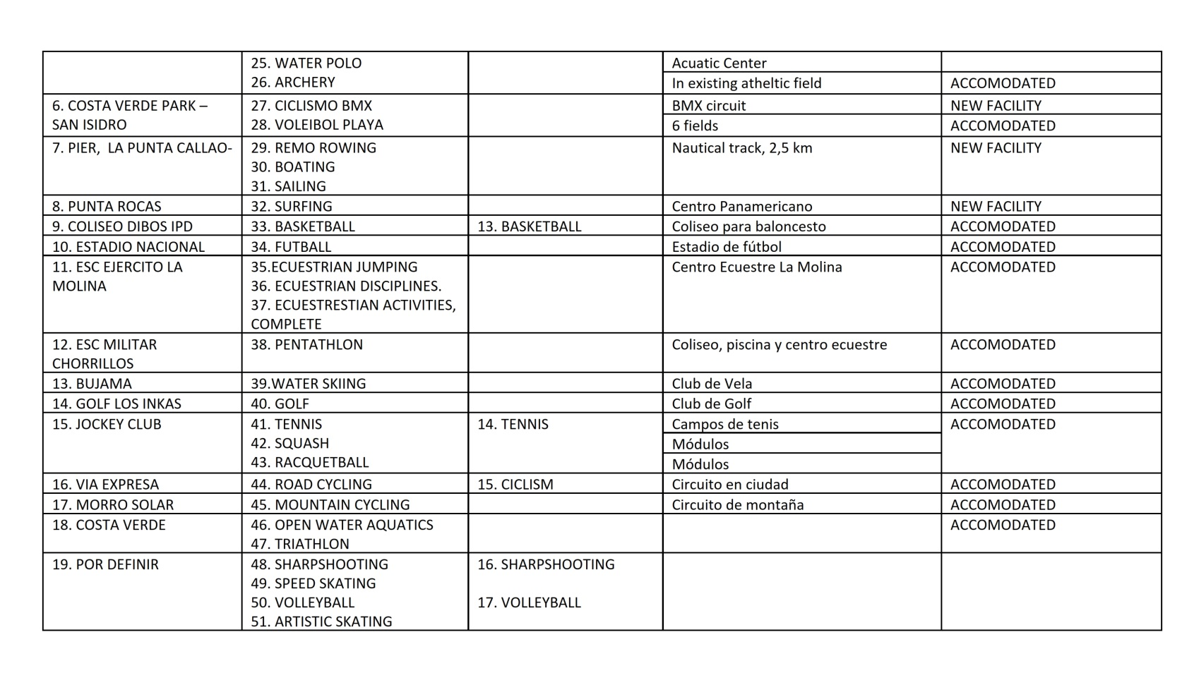
Doing Business in Peru

Slide 27
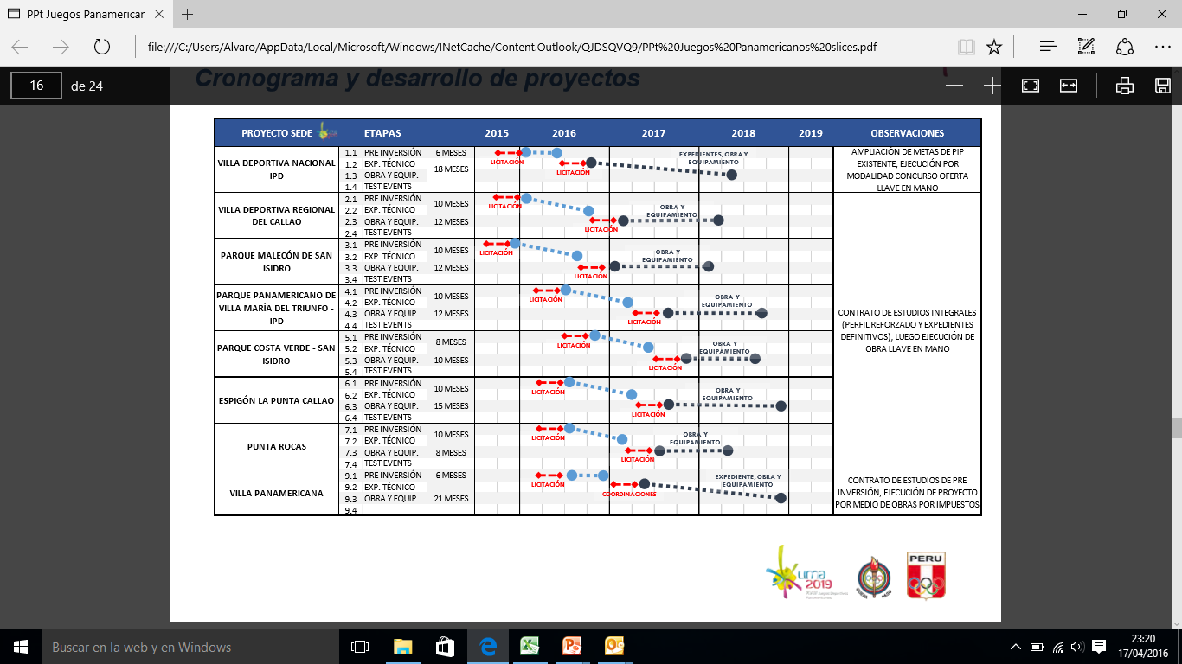
Doing Business in Peru

Slide 28
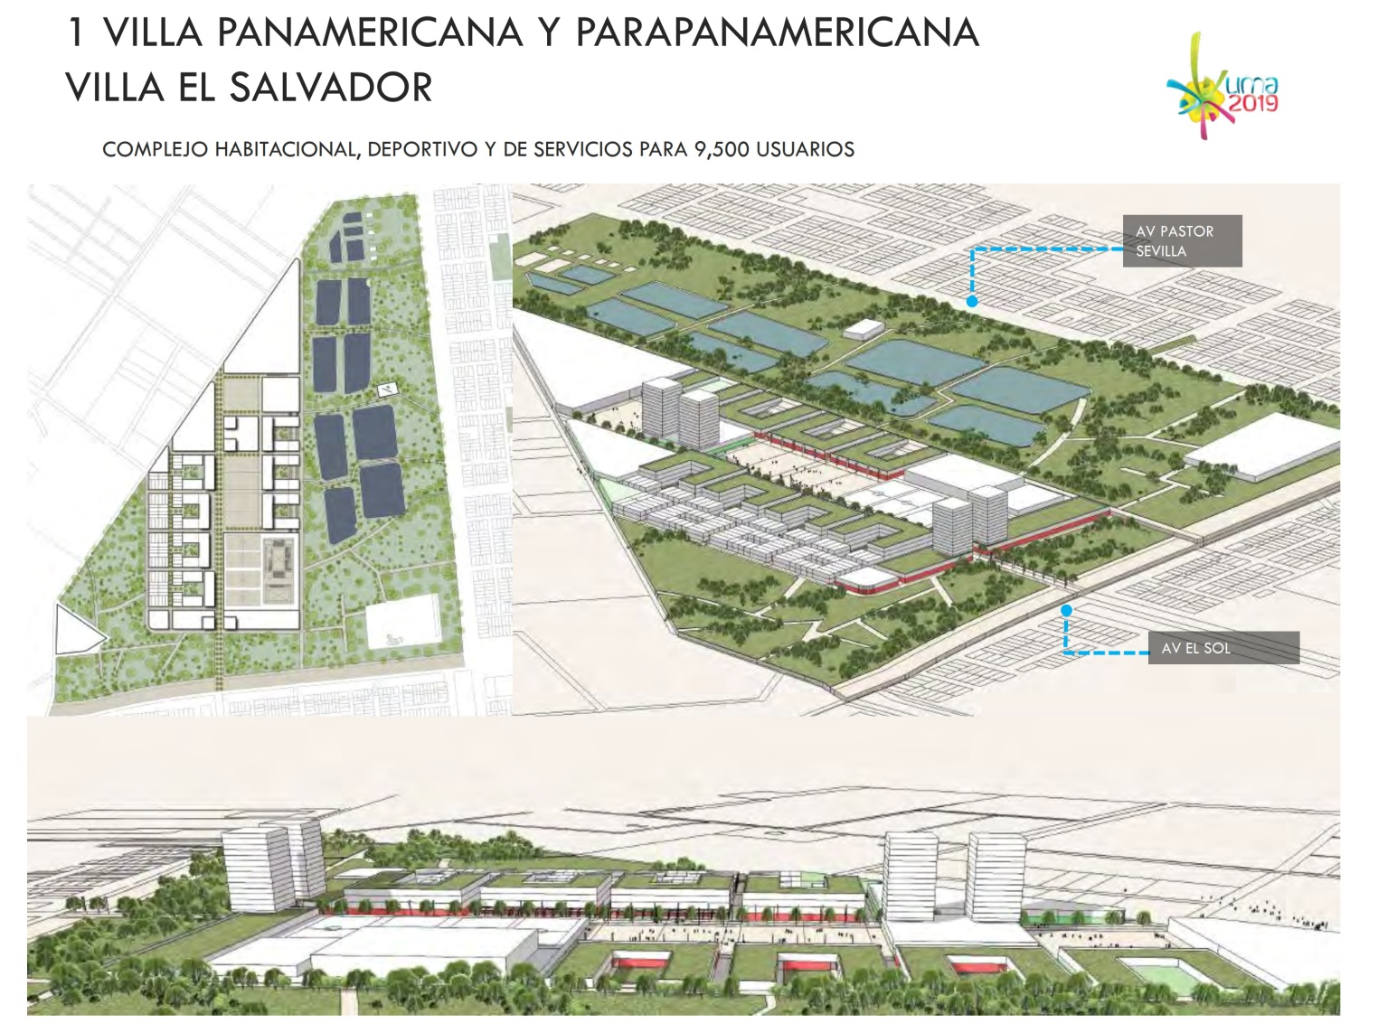
Doing Business in Peru

Slide 29
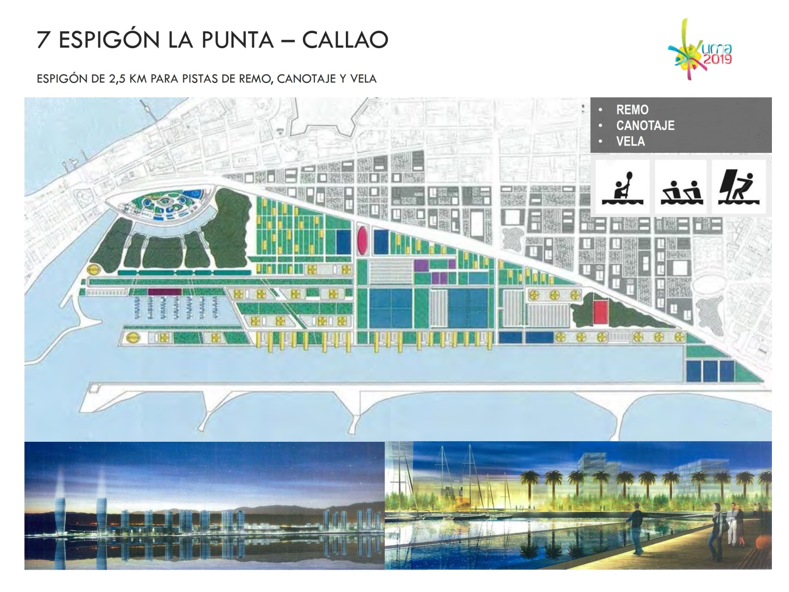
Doing Business in Peru

Slide 30
