Slide 1
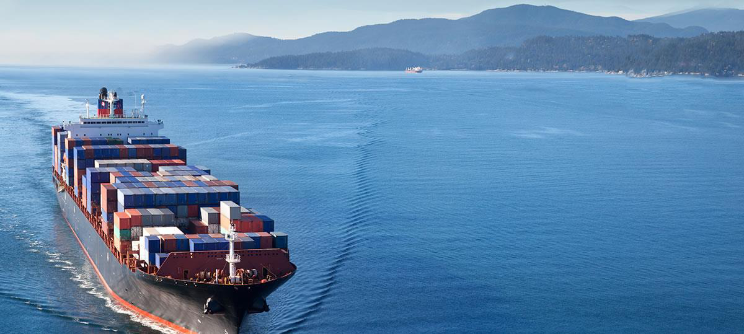
The Nicaragua Canal – An Opportunity for Growth and Prosperity
THE GRAND INTEROCEANIC CANAL IN THE ECONOMIC DEVELOPMENT OF NICARAGUA, CENTRAL AMERICA AND LATIN AMERICA
      WORLD AND REGIONAL MULTIMODAL LOGISTICAL CENTER
DR. PAUL OQUIST
Minister
Private Secretary for National Policies
Presidency of the Republic
Nicaragua
Foreign Economic Relations Board (DEİK)
ISTANBUL, TURKEY
26 MARCH 2015

Slide 2
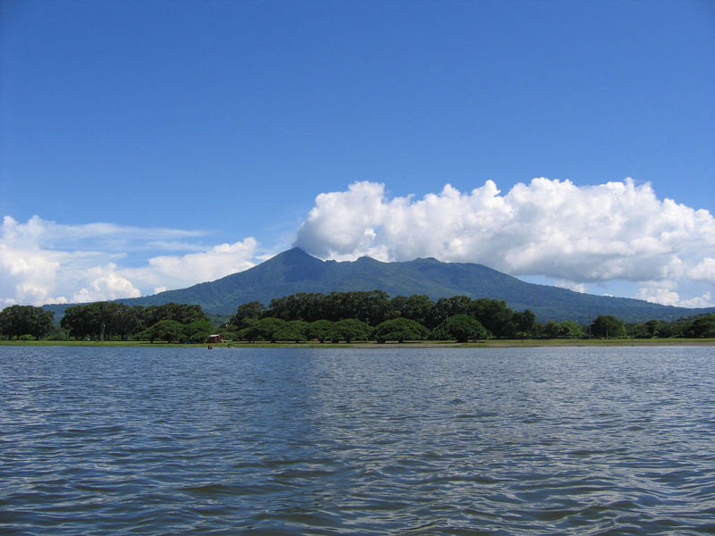
NICARAGUA IS A COUNTRY WITH A DEMONSTRATED CAPACITY TO FORMULATE AND ACHIEVE STRATEGIC OBJECTIVES
    NATIONAL HUMAN DEVELOPMENT PLAN 2007/2016
OBJECTIVE:
ECONOMIC GROWTH WITH MACROECONOMIC STABILITY,
JOB CREATION,
POVERTY AND INEQUALITY REDUCTION

Slide 3
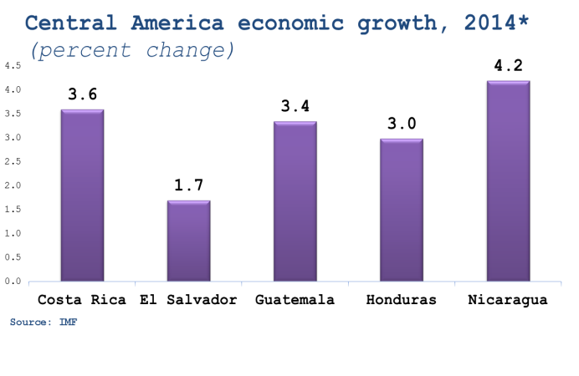
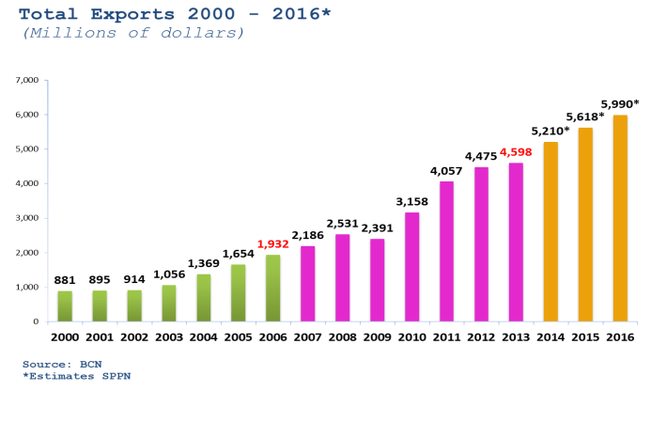
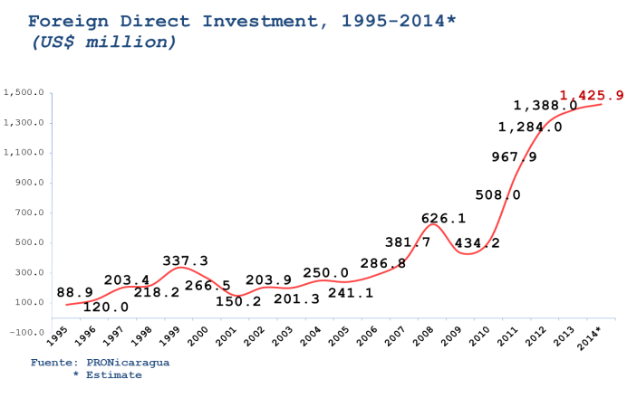
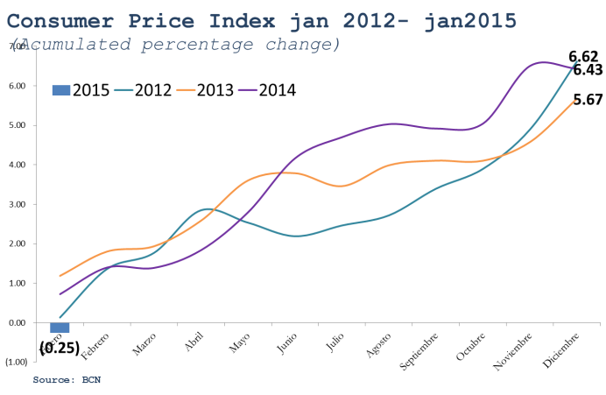
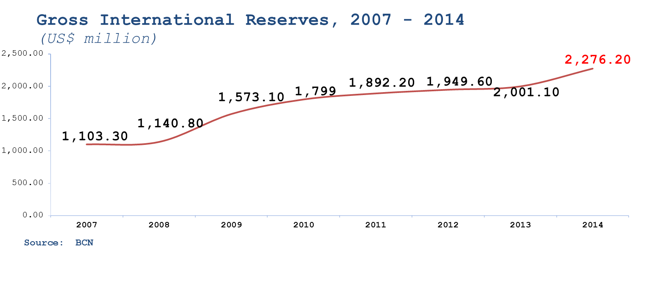
Economic growth with macroeconomic stability
Export Dinamism
GRUN
Before GRUN
5% average growth
2011-2013
Highest Economic Growth in Central America
Exports doubled between 2006 and 2012
Investment Boom
Huracán Mitch
Investment record: More than 5 times 2006
1-digit inflation and decreasing
High International Reserves: 2.8 times the monetary base, allows free exchange and currency stability

Slide 4
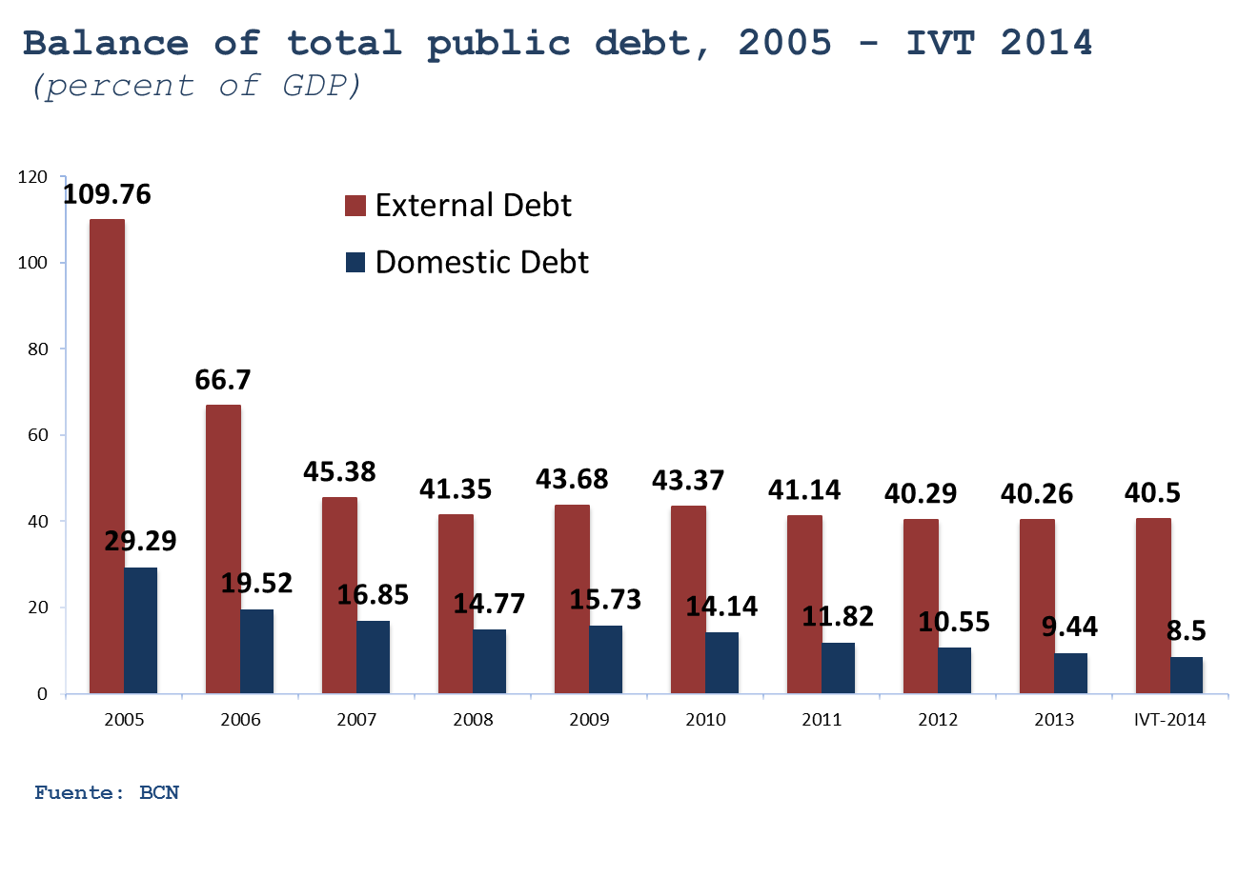
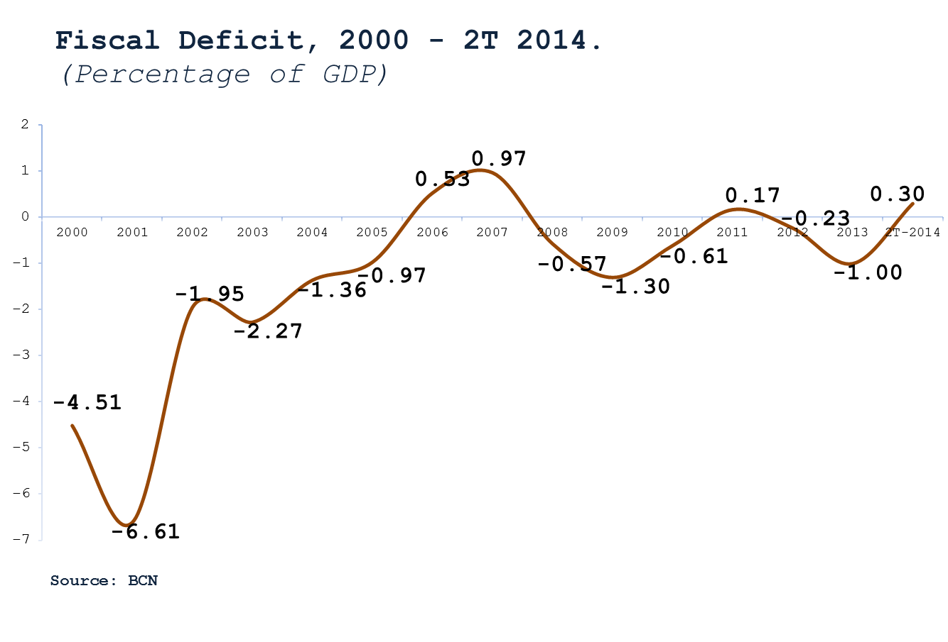
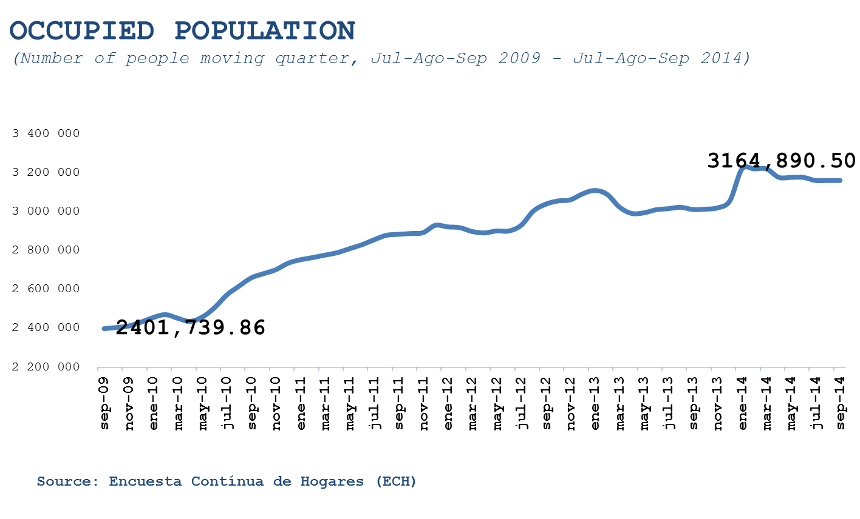
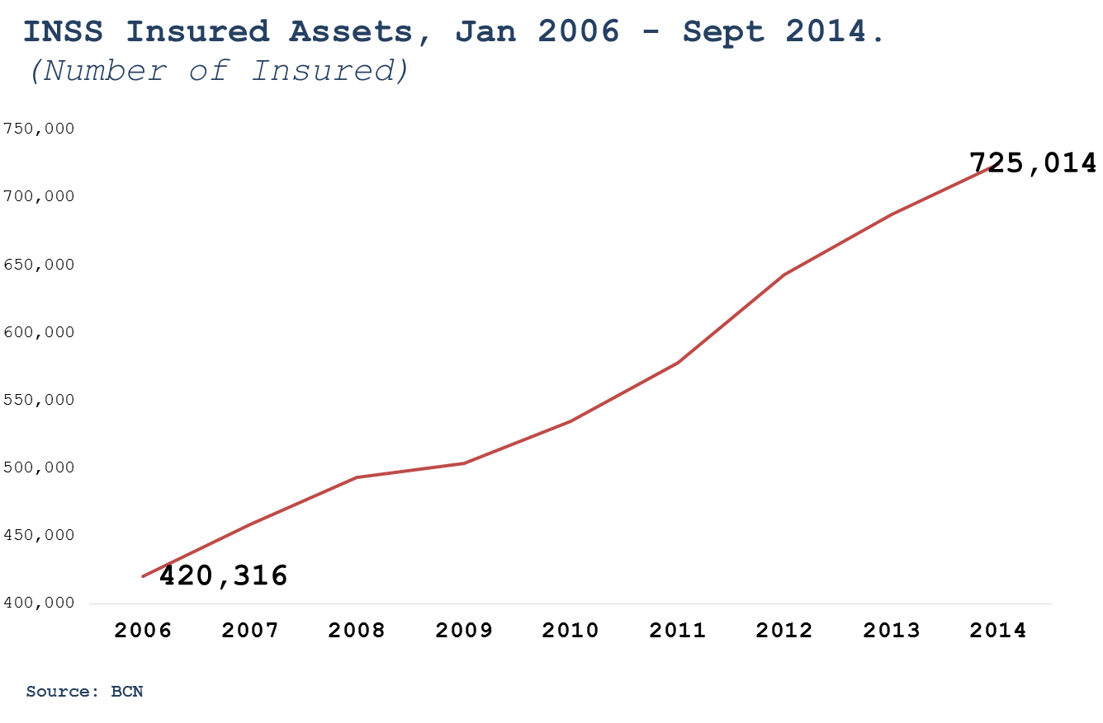
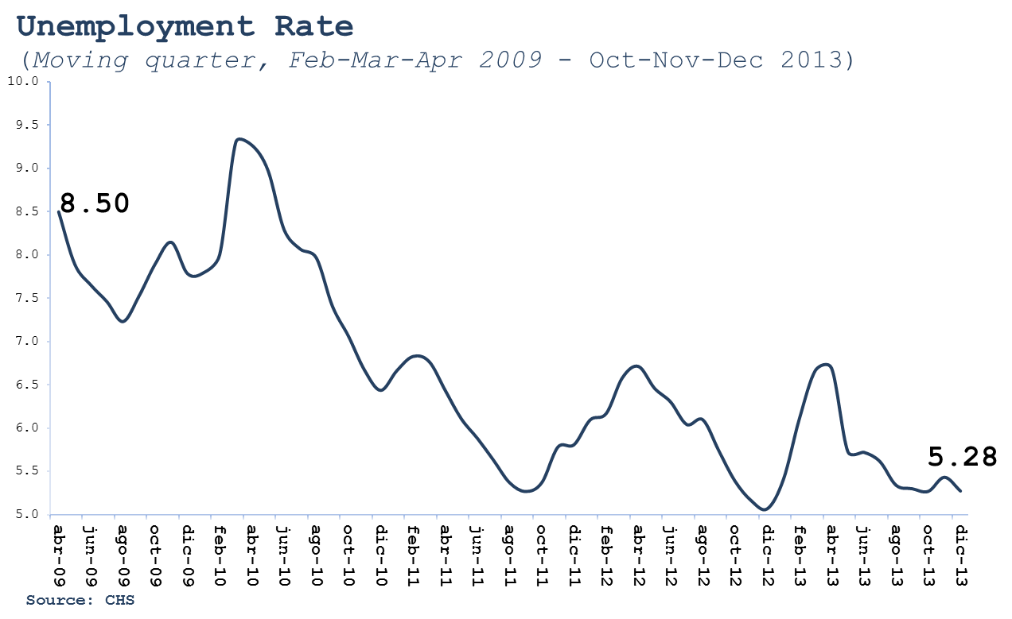
Fiscal Stability
Increased work
Sustainable fiscal deficit at -0.3 in 2014
Sustainable fiscal deficit
Constant reduction of national debt
2014/2006: +27.4%
(867,875 people)
2014/2006: +72.4%
(304,698 people)
More work: 38.9% more than in 2006
Formal employment growth: 77.3% more people registered than in 2006
Fewer unemployment

Slide 5
POVERTY AND INEQUALITY REDUCTION
General poverty measured by consumption
Extreme poverty measured by consumption
Poverty measured by income, poverty fell -10.6 percentage points and -15.7 in rural areas
GINI consumption Nicaragua
2005 | 0.41*
2009 | 0.37*
2010 | 0.35**
2011 | 0.34**
GINI income Nicaragua
2005 | 0.51
2009 | 0.46

Slide 6
GREATER GENDER EQUALITY
World Gender Gap Index 2013
-World Economic Forum, Davos-
Nicaragua is #1 in the World with regard to women in the National Cabinet , 57% (IPU, 2013)
Rank | Country
1 | Iceland
2 | Finland
3 | Noway
4 | Sweden
5 | Denmark
6 | Nicaragua
7 | Rwanda
8 | Ireland
9 | Phillipines
10 | Belgium
11 | Switzerland
12 | Germany
13 | New Zeland
14 | Netherlands
15 | Latvia
16 | France
17 | Burundi
18 | South Africa
19 | Canada
20 | United States
"Women in Politics 2014"
Percentage of women in parliaments of the world
 | COUNTRY | PERCENTAGE OF WOMEN | WOMEN / SEATS
1 | RWANDA | 63.8% | 51/80
2 | ANDORRA | 50.0% | 14/28
3 | CUBA | 48.9% | 299/612
4 | SEYCHELLES | 43.8% | 14/32
5 | SWEDEN | 43.6% | 152/349
6 | SENEGAL | 43.3% | 65/150
7 | FINLAND | 42.5% | 85/200
8 | NICARAGUA | 42.4% | 39/92
9 | ECUADOR | 41.6% | 57/137
10 | SOUTHAFRICA | 44.8% | 179/400
From 90th in 2007 to 6th in 2014
It went from 18% in 2006 to 42% in 2012.
The new law 50% -50% in the National Assembly and mayors, vice mayors and councilors, will take Nicaragua to second place in the world in 2016.
Women in positions of Minister of Defense, Minister of Interior, National Police Chief, General Prosecutor and President of the Supreme Court

Slide 7
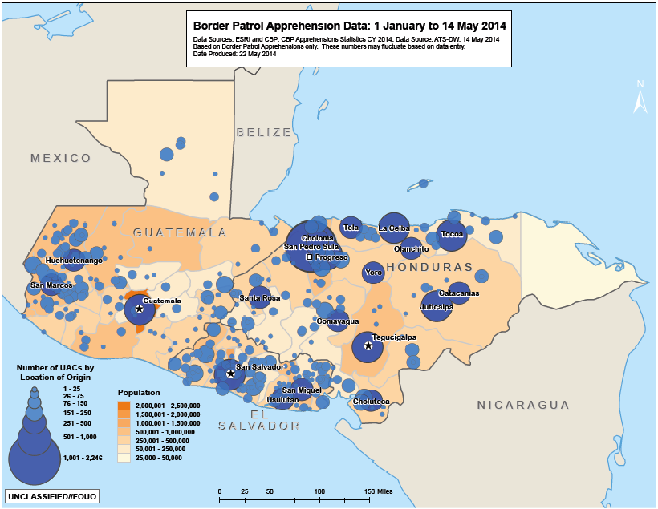
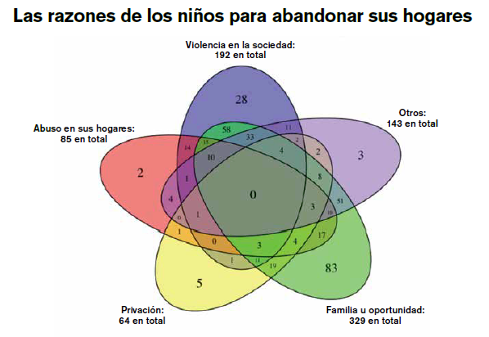


UNACCOMPANIED MIGRANT CHILDREN
Most of migrant children come from extremely violent cities in Central America
Fuente: US Department of Homeland Security
Fuente: BBC
The children´s reasons to leave their homes
Fuente: ACNUR
Familiares en EEUU o mejor oportunidad:
329 en total
www.breitbart.com; 5/jun/2014

Slide 8
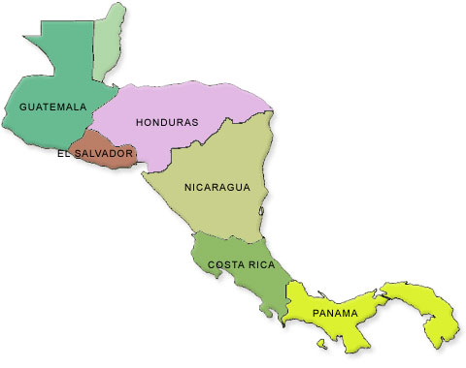
SURVEY OF COST OF LIVING IN LATIN AMERICA: MANAGUA (POSITION 207 of 211) THE CITIES WITH LOWEST COST OF LIVING IN LATIN AMERICA
THE BEST PUBLIC SAFETY IN CENTRAL AMERICA
LAC | 2014 | CITY | COUNTRY
1 | 49 | Sao Paulo | Brazil
2 | 65 | Rio de Janeiro | Brazil
3 | 70 | Pointe-a-Pitre | Guadalupe
4 | 81 | Port-au-Prince | Haití
5 | 86 | Buenos Aires | Argentina
6 | 88 | Santiago | Chile
7 | 98 | Bogotá | Colombia
8 | 114 | Montevideo | Uruguay
9 | 132 | San José | Costa Rica
10 | 134 | La Habana | Cuba
11 | 135 | Lima | Perú
12 | 139 | San Juan | Puerto Rico
13 | 144 | Brasilia | Brazil
14 | 145 | Panamá | Panama
15 | 149 | Puerto España | Trinidad & Tobago
16 | 150 | Mexico | Mexico
17 | 170 | Guatemala | Guatemala
18 | 173 | Santo Domingo | Dominican Republic
19 | 176 | Asunción | Paraguay
20 | 177 | Quito | Ecuador
21 | 183 | Monterrey | Mexico
22 | 190 | San Salvador | El Salvador
23 | 200 | Tegucigalpa | Honduras
24 | 204 | La Paz | Bolivia
25 | 207 | Managua | Nicaragua
In the past four years, violent deaths have fallen by -22.4% in Nicaragua.
Source: MERCER
Nicaragua
2012: 30% less than 2011.
2013: 21.1% less than in 2012.
The National Police of Nicaragua (PNN) is a leader In Central America and in the world, as a police model with a "preventive, proactive and community" approach.
  UNDP. 2013. Regional Human Development Report 2013-2014. Public security with a human face: diagnosis and proposals to Latin America

Slide 9
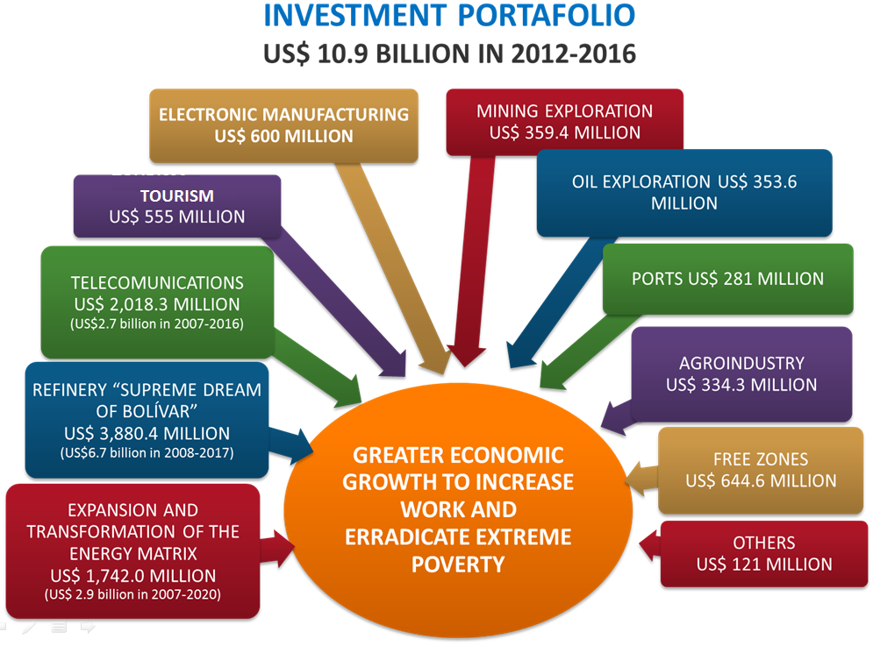
INVESTMENT BOOM
Investment Portfolio
US$ 10.9 billions by 2014

Slide 10
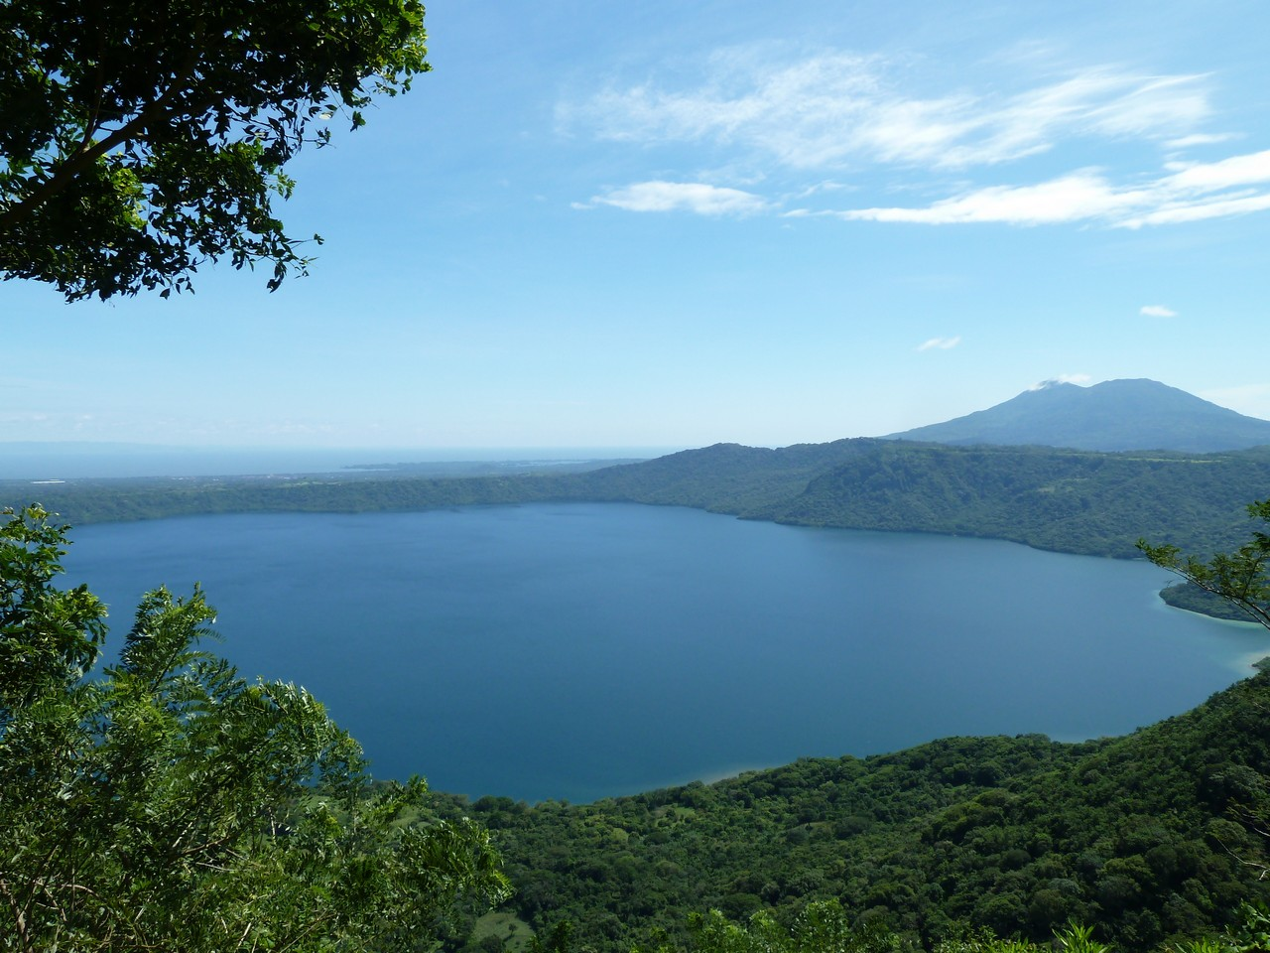
INVESTMENTS 2015 BY SECTOR
1. Productive
7. Grand Interoceanic Canal
3. Expansion and transformation of the Energy Matrix
2. Infraestructure
5. Refinery
Geothermal
Other projects
Hydropower
6. Communications

Slide 11
INVESTMENTS 2015 BY PROJECTS
1. Tumarín & Boboké Hydroelectric Projects
4. CEMEX New Plant
5. Cargill
6. Walmart Group
2. Aguas El Carmen Hydroelectric Project
3. Geothermal Park
US$50 miiion for refrigeration plant as part of US$240 million expansion
US$ 1,345 million
323 MW
+US$1,754 million
+364 MW
US$330 million
85 MW
US$55 million
US$15 million
7. Harnesses and auto parts
Yazaki
Dräxlmaier

Slide 12
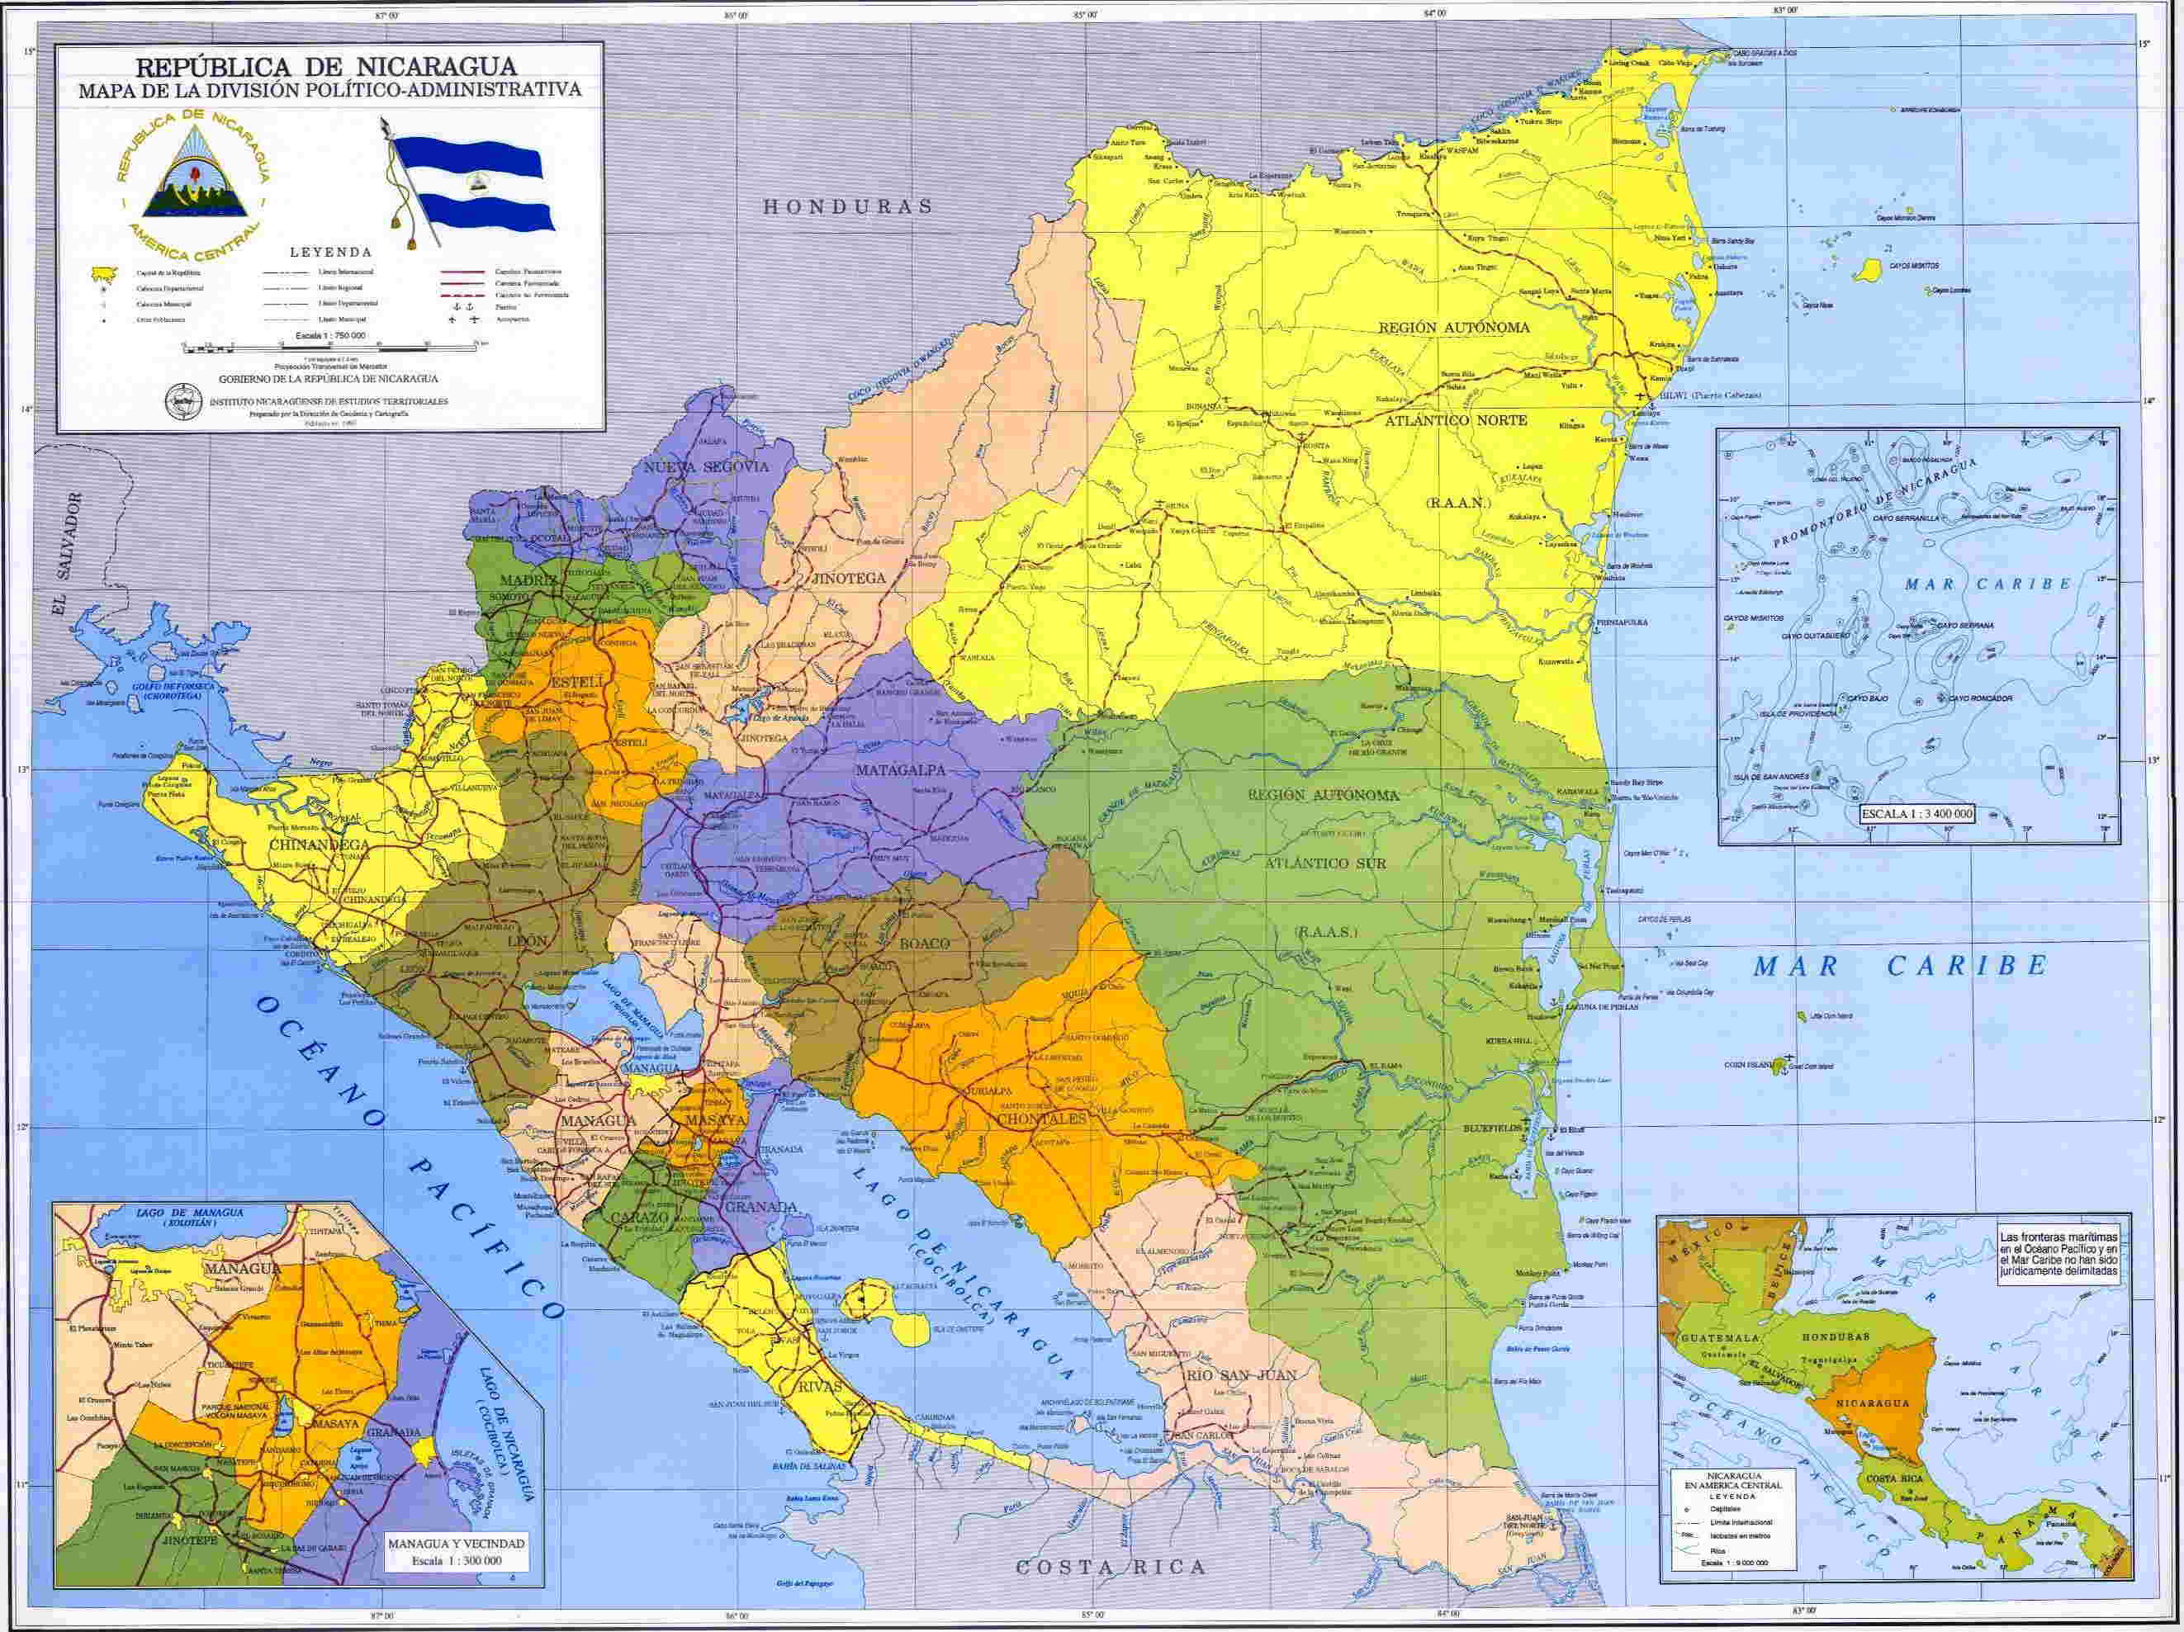
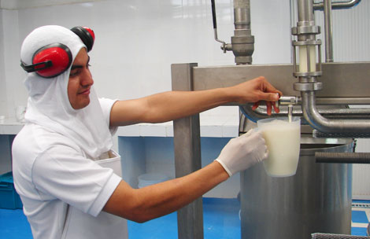

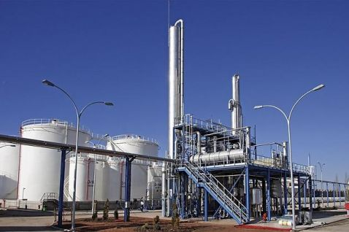




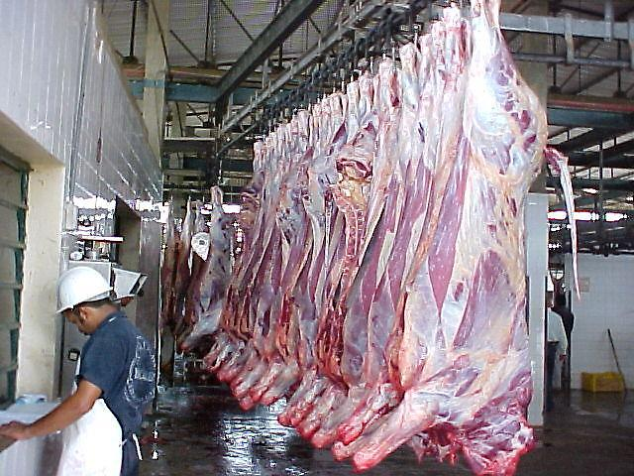
PRODUCTIVE INVESTMENTS
Condega Slaughterhouse Project (Panama Investment)
Milk collection center (ALBA)
Corn Processing Plant(ALBA)
Milk collection center (ALBA)
Industrial Slaughterhouse (ALBA)
Milk collection center (ALBA)
Dairy plant (ALBA)
Milk collection center (ALBA)
Slaughterhouse (ALBA)
Dairy plant (ALBA)
Milk collection center(ALBA)
Milk collection center (ALBA)
New Slaughterhouse: SUKARNE, FEDEGAN, Taiwan, Panama
206 rural agro-industrial projects

Slide 13
TRANSPORT INFRAESTRUCTURE
Acoyapa-San Carlos & Santa Fe Bridges
Roads improvements in the Caribbean Coast
La Costanera;
Managua – Rama;
La Libertad – Santo Domingo;
Boaco – Muy Muy – Río Blanco;
Ruta alterna a Masaya;
Nejapa – Port Sandino
ROADS
Deep sea Port in the Caribbean
Bilwi
Harbor Cruise, San Juan del Sur, Rivas
(ROYAL CARIBBEAN)
PORTS

Slide 14
Punta Huete (Managua)
San Carlos, Rio San Juan
San Juan de Nicaragua (Rio San Juan)
AIRPORTS IN TOURIST SITES
Montelimar (Managua)
Playa Iguana (Guacalito de la Isla)
Isla de Ometepe (Rivas)
Airports improvements in the Caribbean

Slide 15
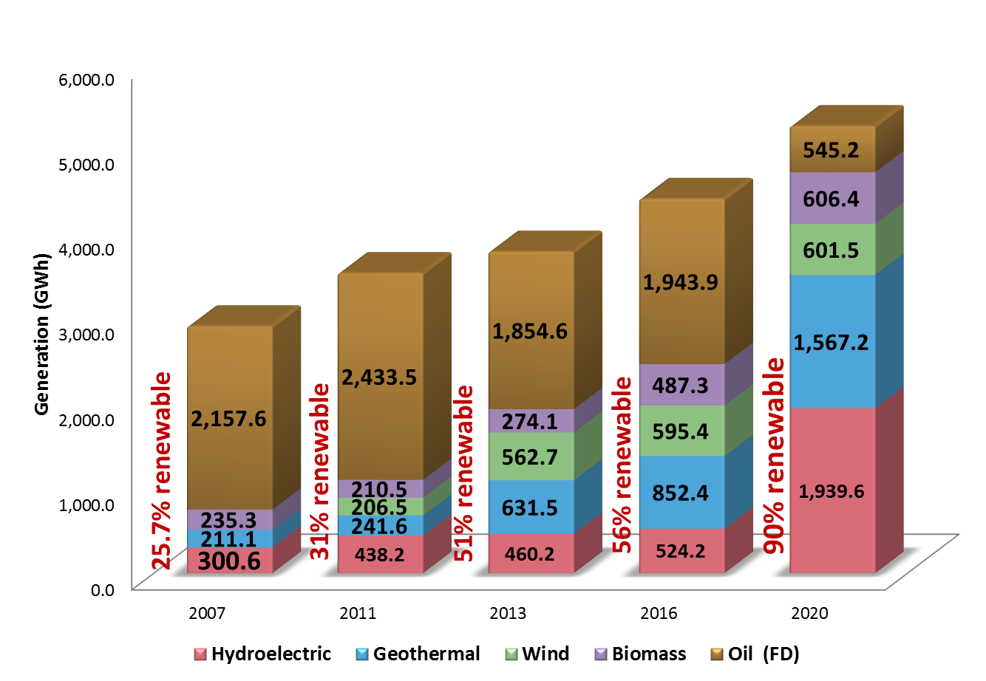
EXPANSION AND TRANSFORMATION OF THE ENERGY MATRIX
2012-2020: U.S. $ 2.9 billion investment, over mainly foreign direct investment
103% of demand (peak) recorded in 2012 and 97% and 75% of the planned by 2016 and 2020.

Slide 16
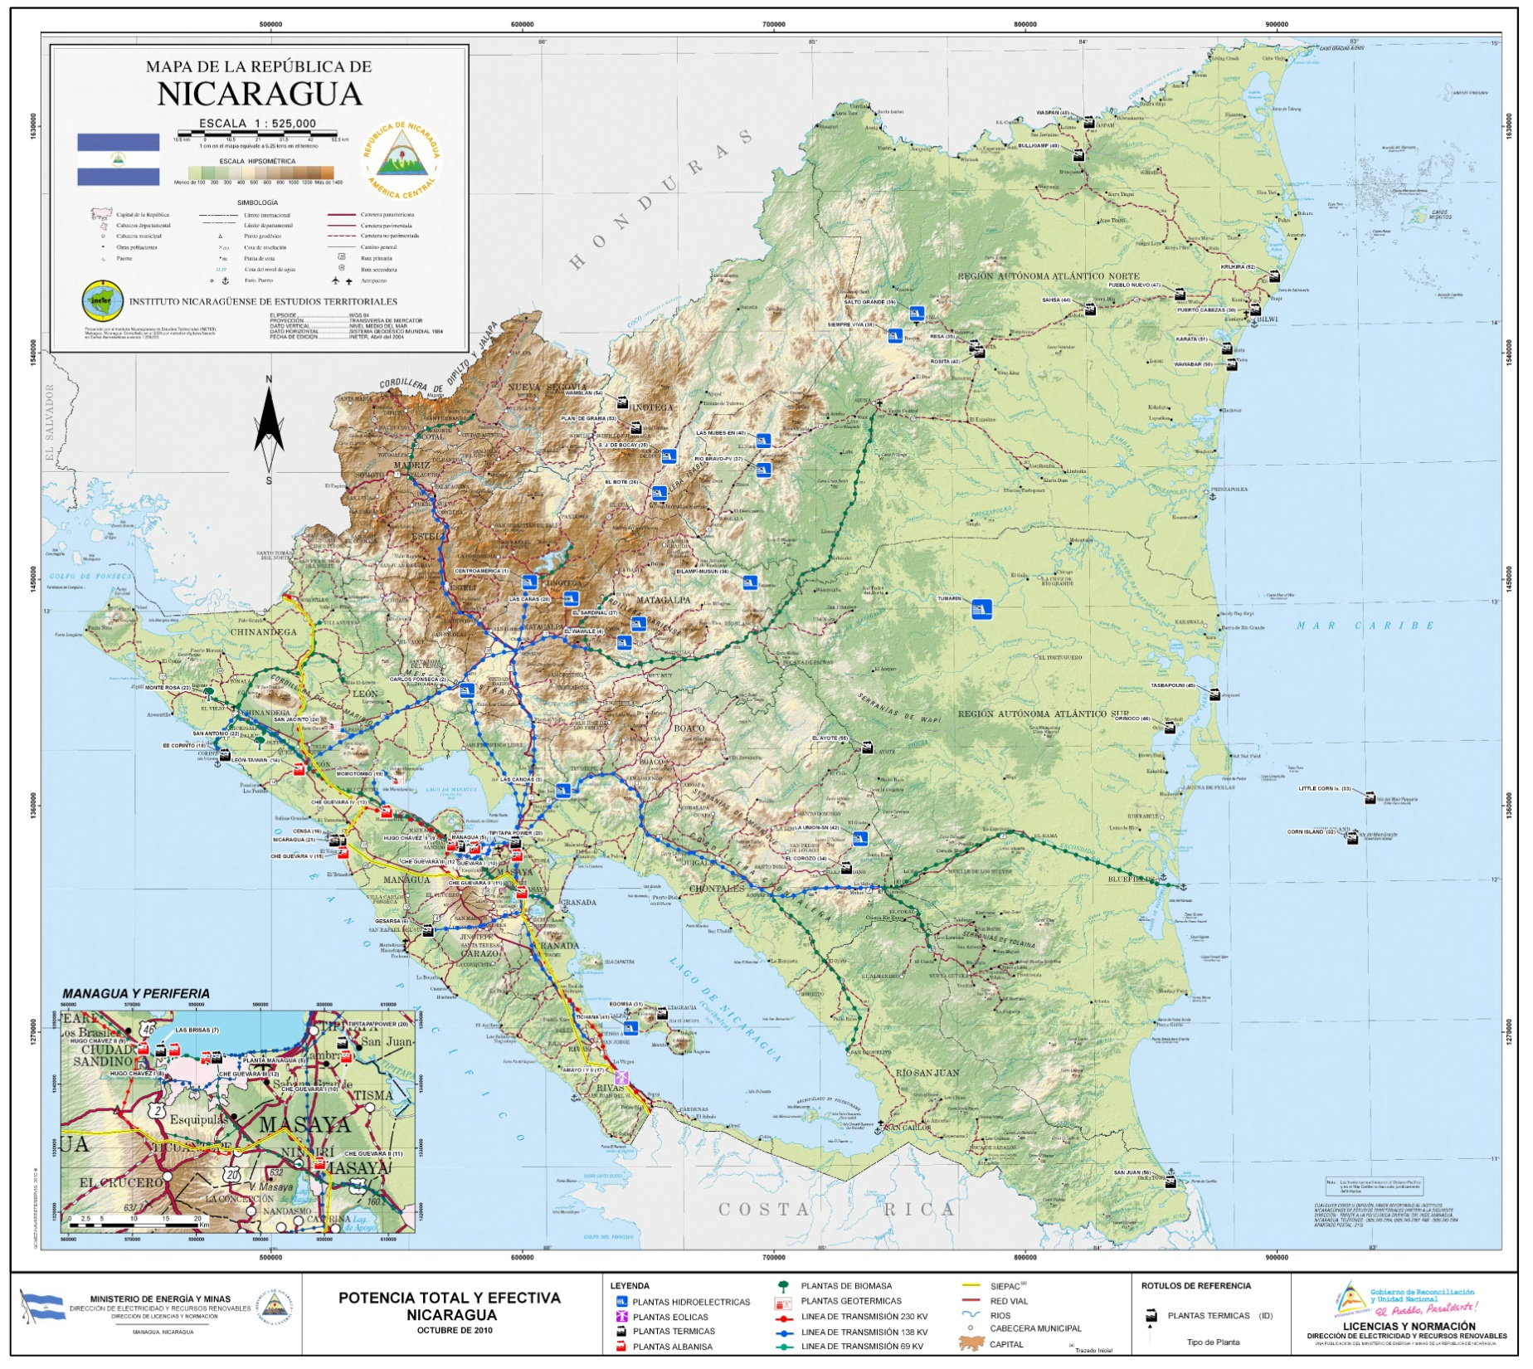
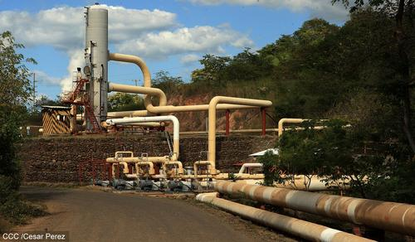
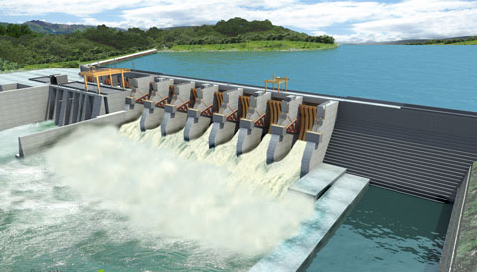
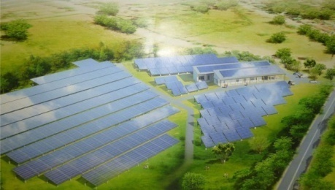
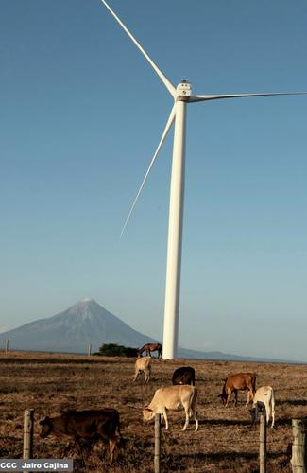
Nicaragua Energy Projects
Geothermal
Momotombo
San Jacinto-Tizate
Planta Binaria
Casita-San Cristóbal
(138 MW; US$ 485.0 mill)
SOLAR PANELS, MICRO AND SMALL HYDROELECTRIC PROJECTS FOR ISOLATES AREAS
HYDROELECTRIC TUMARIN AND BOBOKÉ, RAAS 323 MW (253MW + 70MW ); US$ 1.345 million
Solar
La Trinidad, Diriamba (50.5MW)
Chinandega (4 stages of 25MW; 100MW)
Other hydroelectric projects:
Copalar
El Carmen
Piedra Fina
Corriente Lira
Amayo I, II, III
Eolo (Rivas)
La Fe San Martín (Rivas)
ALBA Rivas (Rivas)
(187 MW; US$ 264.2 mill)
Electricity coverage rose from 54% in 2007 to 76% in 2013, with the target of 85% by 2017

Slide 17
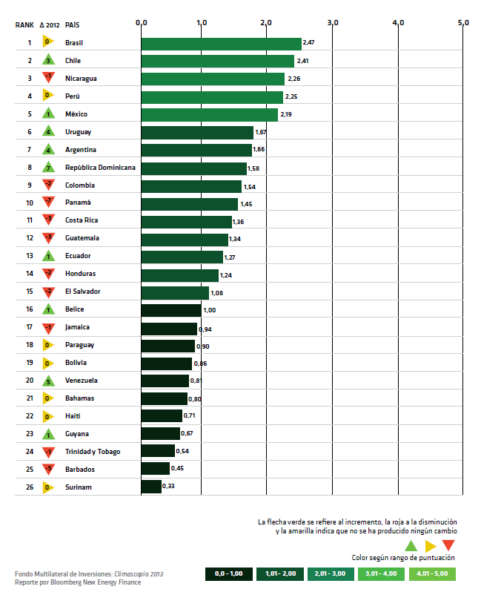

BLOOMBERG´S
In the Bloomberg and Interamerican Development Bank (IDB) Climatescope, second edition, Brazil, Chile and Nicaragua top the list of most attractive markets for clean energy in Latin America and the Caribbean.
Despite being the second poorest country in the region, Nicaragua was ranked among the first three, just behind Brazil and Chile, due to the high penetration of renewables in its energy matrix and significant flow of investment in proportion to its small economy.
Nicaragua was the country that received the highest score in the categories “Suitable Setting and Clean Energy”, “Investment parameters” and “Loans to Projects relating to Climate Change”.
In 2012, Nicaragua saw its installed renewable energy capacity grow 40% due to the US$ 292 million that was allocated to clean energy market in the context of an economy of US$ 10,500 million.

Slide 18
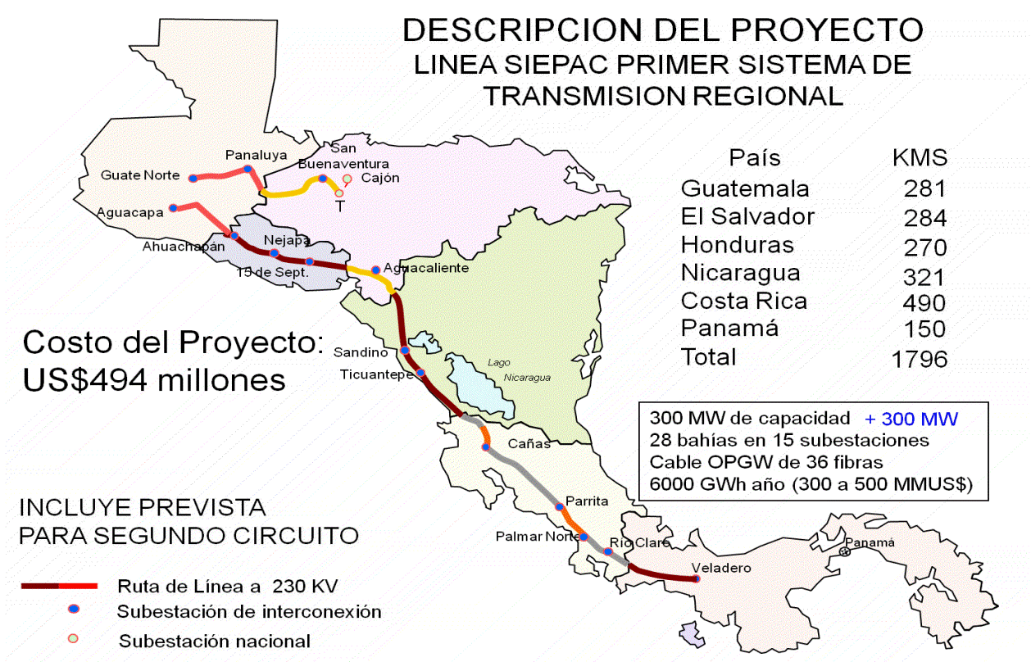
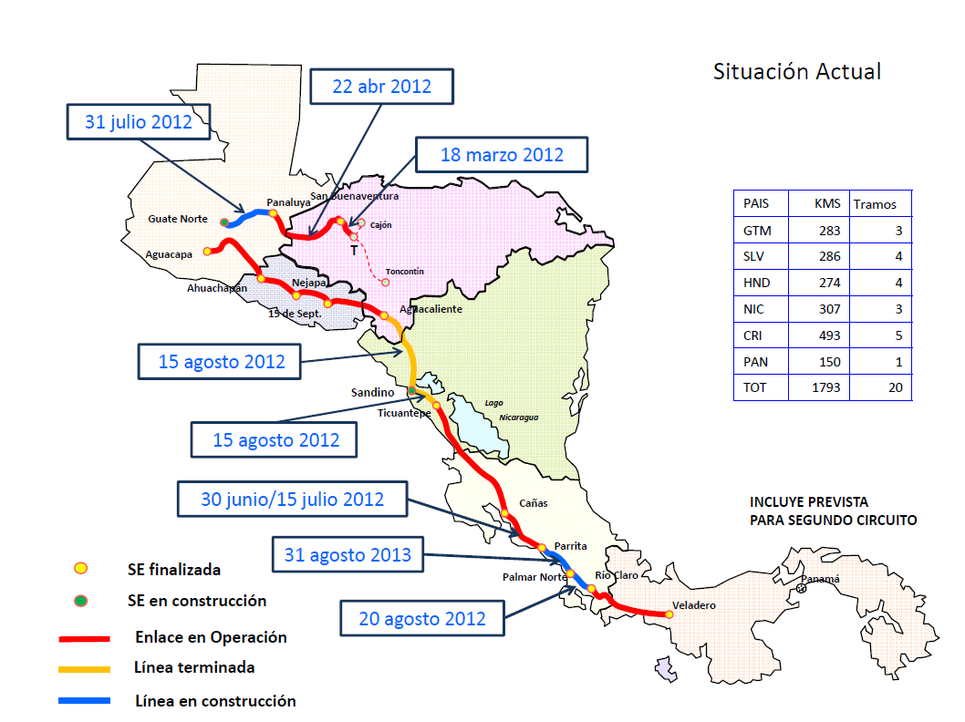
SIEPAC PROJECT
1794

Slide 19
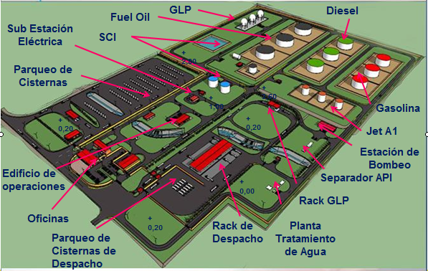
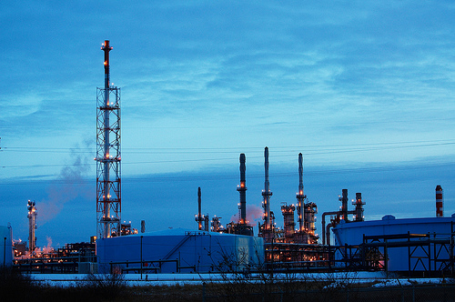
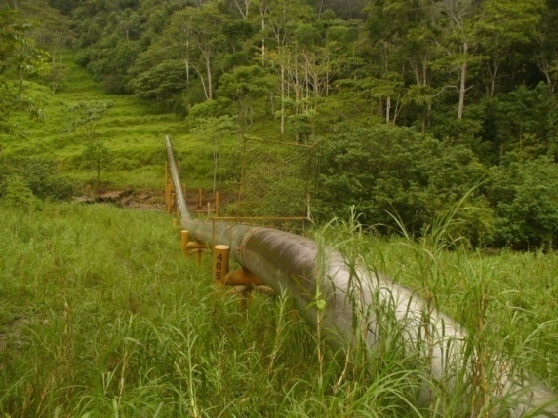
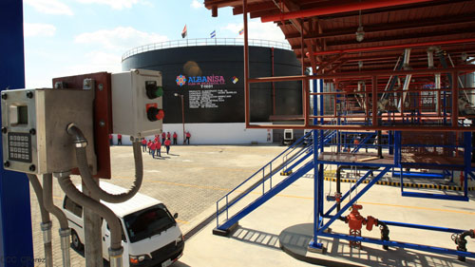
INDUSTRIAL COMPLEX "SUPREMO SUEÑO DE BOLIVAR"
FUEL STORAGE COMPLEX IN MIRAMAR
Refinery with a processing capacity of 140,000 b / d, US$ 3.6 billion
Petrochemical Industry: US$ 2.8 billion
Fuel Distribution Plant Miramar 1.08 million barrels, US$ 306 million
Pipeline Monkey Point-Puerto Sandino: $ 270 million
GLP Project: US$ 25.9 million
Storage complex in Corinto
Total Industrial Complex Investment : US$ 6,700 million

Slide 20

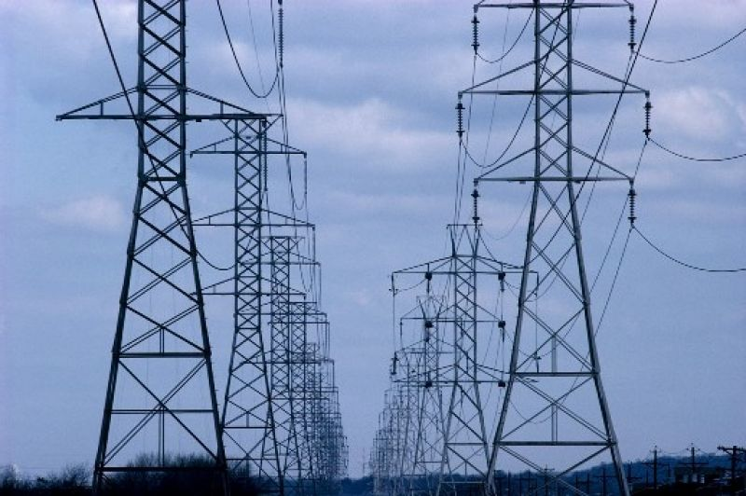
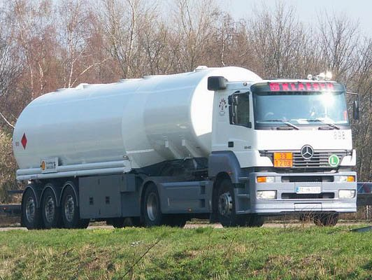
In 2020, Nicaragua will be a net exporter of electricity and petroleum
In 2006-2007, Nicaragua was a country of "blackouts" by 8, 10 and even 12 hours a day

Slide 21
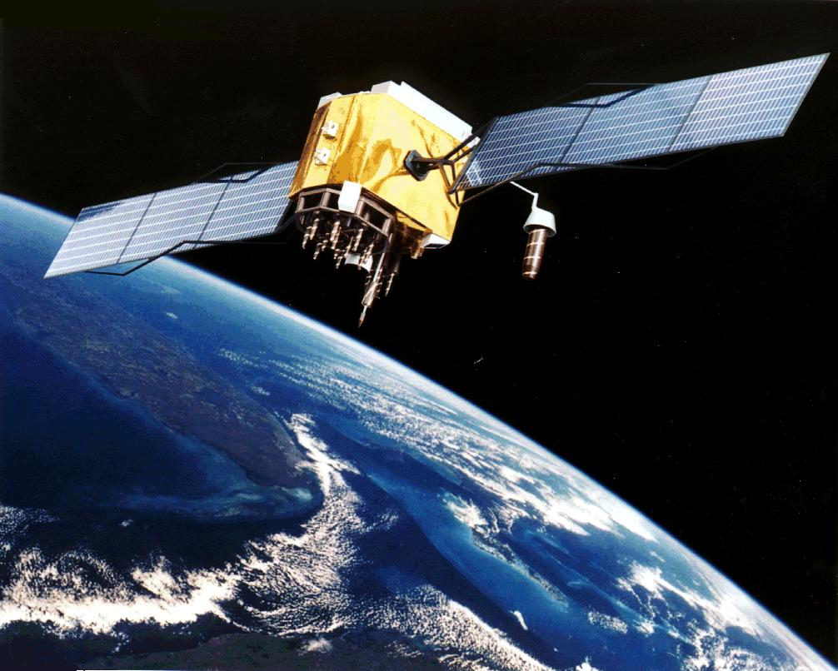
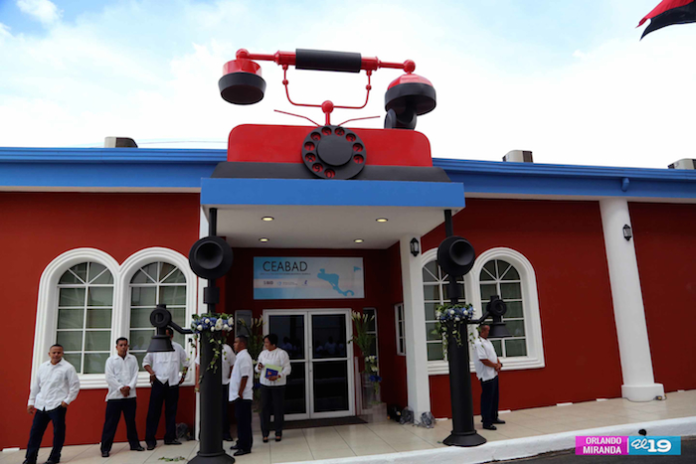
NICASAT 1
COMMUNICATIONS INFRAESTRUCTURE
REGIONAL CENTER FOR ADVANCED STUDIES IN BROADBAND FOR DEVELOPMENT
FIRST COUNTRY IN CENTRAL AMERICA WITH ITS OWN SATELLITE
In orbit by 2016
Investment US$ 300 million, 15 years of lifetime
2017: A Second Satellite, US$ 300 million
With support of China and Korea
The Center will train over the next 10 years to 12 thousand professionals linked to telecommunications throughout the Central American region.
With support of Korea and IDB.
Expansion of Broadband
US$ 400 million
WORLD CLASS COMMUNICATIONS FOR A REGIONAL AND GLOBAL LOGISTICS CENTER

Slide 22
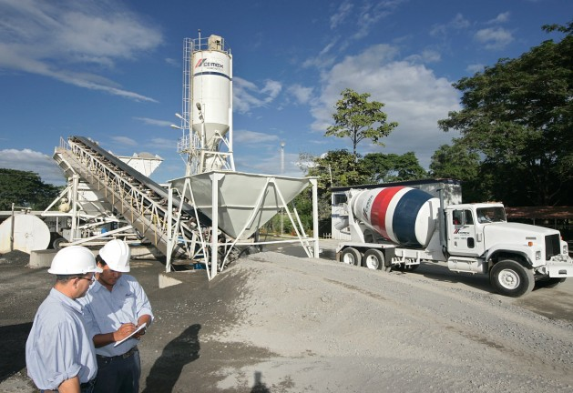
CEMEX CONSTRUCTS A NEW PLANT
Construction of a new cement grinding plant in Nicaragua
  Announced in Monterrey on May 5, 2014
  cost of US $ 55 million.
First phase:
  First half of 2015
  US $ 30 million in the installation of a cement factory in Ciudad Sandino
  Production capacity of 220,000 tons.
  Second phase
  End of 2017
  The installation includes a second grinding mill
  Capacity of 220,000 tons.
Positioning for Central American development pole of the century in Nicaragua.

Slide 23

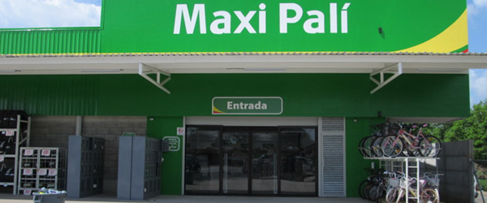
WALLMART GROUP
Walmart has invested US$ 300 million in the country since its opening.
In 2014 the investments were more than US$25 million
The Walmart group in Nicaragua directly employs about 3,270 people in stores, distribution center, agribusiness development plants and headquarters.
In 2015 Walmart will construct a new store. The project will have an estimated investment of US$15 million.
It expected to create 100 direct jobs and 10,000 indirect jobs

Slide 24

Auto Parts
Exports of automotive harnesses under the free zone regime have risen from 2.7 million in 2002 to 574 million in 2013, an increase of 21.159 percent.
In 2015, Yazaki, located in the city of León, will have 13,700 workers, 3,300 more than 2014, thanks to the expansion of its operations
It employs 1,400 people. It is expected that in 2015 employment will rise to between 1,700 and 1,800 people in the production of harnesses and auto parts.

Slide 25
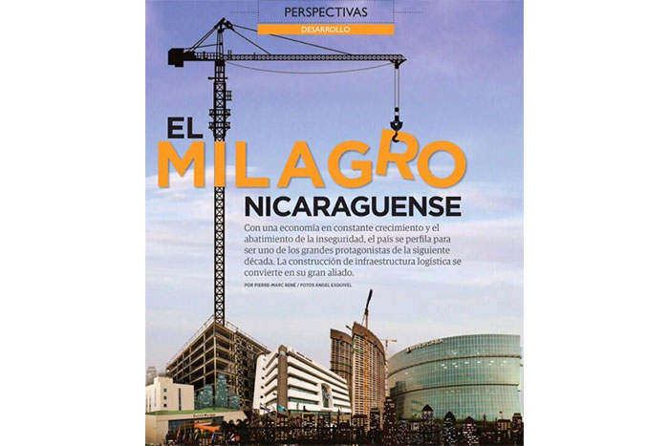
"The policies of the government of Daniel Ortega continue attracting even more investment and interest by international companies especially Chinese, Russian and American"
"Another issue that is drawing international attention is the project of construction of Nicaragua Canal, an initiative that the government of President Daniel Ortega seeks to develop in order to compete with Panama and offer an alternative to the transport of goods'
"Nicaragua is now an interesting destination for business because of the consensus reached between the government and the private sector"
FORBES MAGAZINE FOR CENTRAL AMERICA IN JULY, 2014

Slide 26
WE ARE GROWING AT 5% BUT TO MEET THE BASIC NEEDS OF NICARAGUAN PEOPLE WOULD HAVE TO GROW AT 8% AND 10% OR MORE TO ERRADICATE EXTREME POVERTY, REFOREST THE COUNTRY, TO ADAPT TO CLIMATE CHANGE AND INCREASING THE RESILIENCE OF OUR ECOSYSTEM
STRATEGY:
TAKE ADVANTAGE OF GEOGRAPHICAL POSITION AND WATER RESOURCES
  ACTION:
  THE CONSTRUCTION OF THE GRAND INTEROCEANIC CANAL

Slide 27
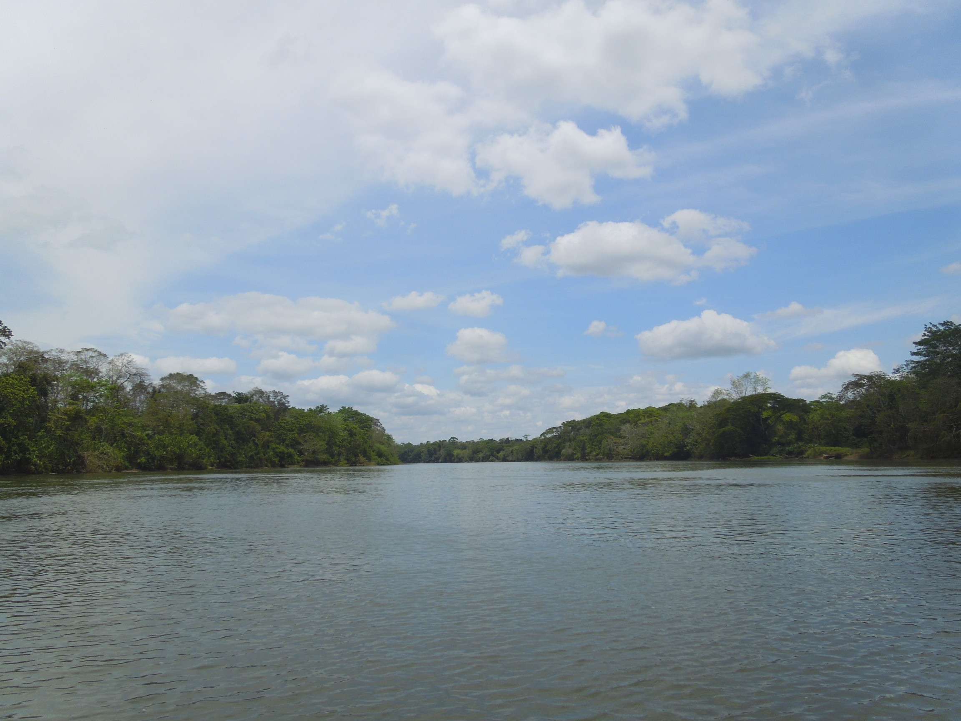
WHAT ARE THE EXPECTED ECONOMIC AND SOCIAL IMPACTS?

Slide 28
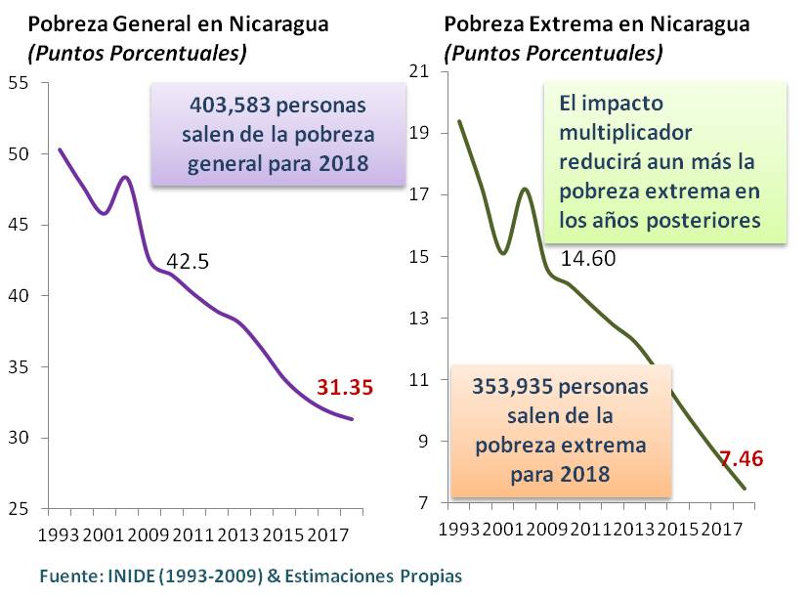
THE GRAND INTEROCEANIC CANAL OF NICARAGUA: MAIN IMPACTS EXPECTED
5th year (2018)
  More formal jobs than informal
  1.2 million formal jobs
  26% of nicaraguans with bank relations in 2013; they could be 50% in 2020
+1,264,535
+945,410
+640,791
+355,589
+185,638
General Poverty in Nicaragua (Percentage points)
Extreme Poverty in Nicaragua (Percentage points)
Source: PEF, IMF & Own estimates
The increase in Government revenue, will be a source of funding to fight extreme poverty.
403,583 people out of general poverty by 2018
The multiplier effect will further reduce extreme poverty in later years
2012
16.46% of GDP
2013
Estimated income US$ 1,897.40
million
2019
Projected Income
US$ 4,081.25 million
353,935 people out of extreme poverty by 2018
+115.10% more than 2013

Slide 29

GROWTH GDP: NICARAGUA AND PANAMÁ
THE PANAMA ECONOMY HAS DOUBLED DURING THE LAST 7 YEARS DESPITE THE FINANCIAL AND ECONOMIC CRISIS

Slide 30
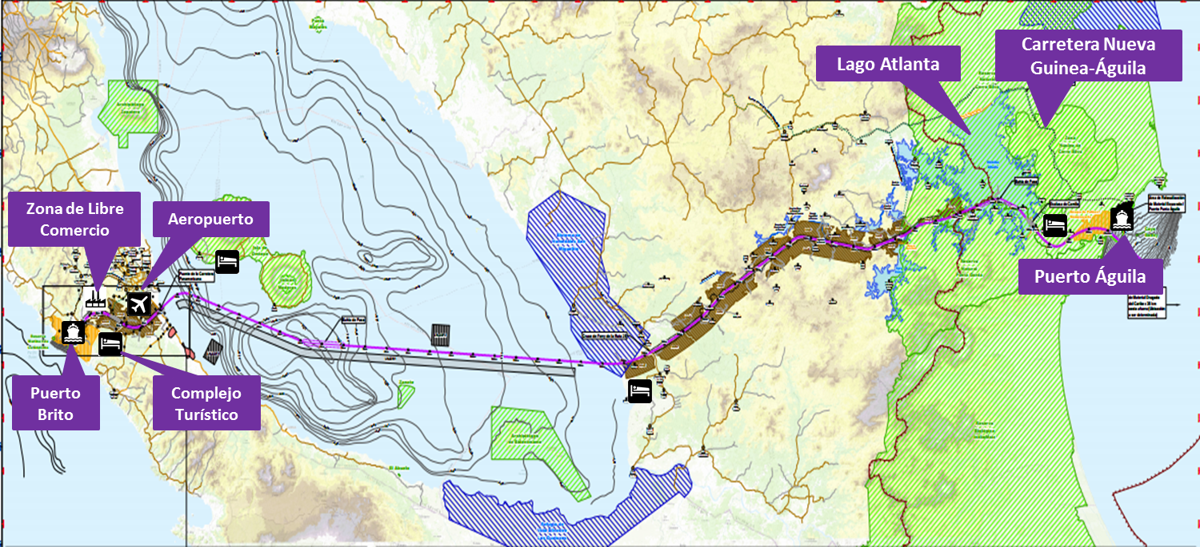
DIRECT IMPACTS OF THE CANAL AND SUB PROJECTS IN THE EMPLOYMENT
50,000 jobs in the construction stage
Operation: 3,700 jobs in 2020
12,700 in 2050
113 thousand jobs in free trade zone
More than 3000 jobs in resorts
PLUS MULTIPLIER EFFECTS IN EMPLOYMENT THROUGHOUT THE ECONOMY
25, 000 foreign workers
25, 000 nicaraguan workers

Slide 31
What DOES the Grand Interoceanic Canal / World and Regional LogisticAL Center CONSIST OF?

Slide 32
THE GRAND INTEROCEANIC CANAL OF NICARAGUA:
MULTIMODAL LOGISTIC CENTER FOR REGIONAL AND GLOBAL TRADE
The final proposal : 7 sub proyectos
1. A Ship Canal joining the Caribbean Sea and the Pacific Ocean
2. A Port at Punta Águila in the Caribbean coast
3. A port at Brito in the Pacific coast
5. An International Airport in Rivas
6. 595.66km of Roads, highways, access roads and 2 bridges
7. Tourist Complexes (Lodging for construction/operation, opening to tourism later)
4. A Free Trade Zone on the Pacific coast (Rivas)
US$40 TO 50 BILLION INVESTMENT

Slide 33
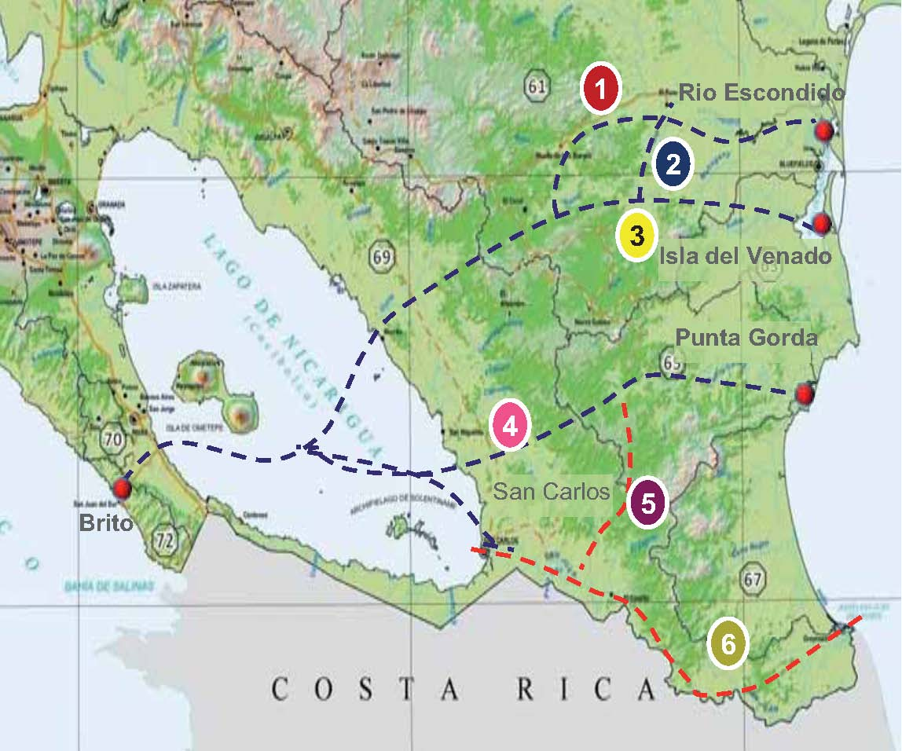
SELECTION PROCESS OF ROUTE
Previously Identified Routes
Eastern Segment of Routes:
1, 2 - Bluefields Bay and north of the Cerro Silva Reserve
3 - Bluefields Bay and central Cerro Silva
4 - Punta Gorda and Tule River
5 - Punta Gorda, Rio San Juan, San Carlos
6 - Indio Maiz, Rio San Juan and San Carlos

Slide 34
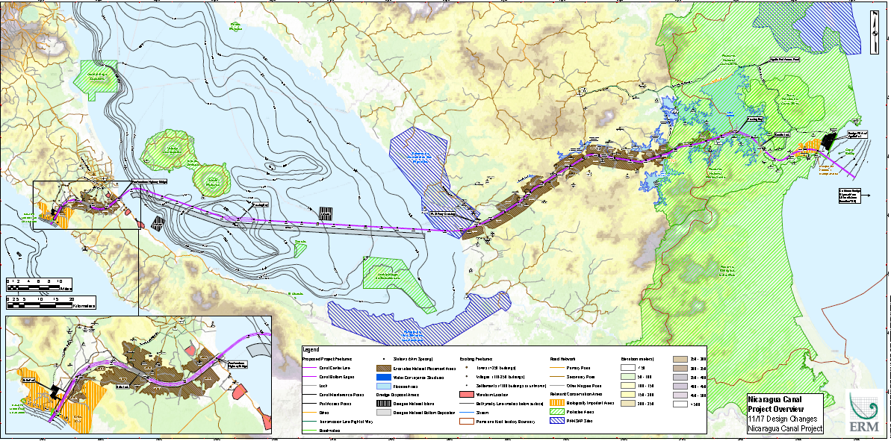
Choice of route 4: It has superior economic cost, but it is the route with the lowest environmental and social impact
275.5Km Length, 280 m wide base, 30-33m depth
Theoretical Capacity: 9,153 ships per year
Expected load for 2050: 5,100 vessels per year (14 ships per day), with 30 hours of each boat traffic.
Stretch | Length
West section | 25.9 Km
East section | 126.7 Km
Lake Nicaragua | 106.8 Km
Stretches Pacífic and Caribbean | 16.1Km
Total Length | 275.5 Km
Stretch | Length
Lake Atlanta | 35.9 Km
Lake Nicaragua | 106.8 Km
Pacífic stretch | 1.7 Km
Caribbean stretch | 14.4 Km
Length by water | 158.8 Km
Stretch | Length
West Section (Rivas) | 25.9 Km
Caribbean Coast (mainland) | 90.8 Km
Length by land | 116.7 Km

Slide 35
Adjustments on Route 4
A Road linking the Port to Tola
A Rock Bund to be designed to enable better mix of salt and fresh water to mangrove.
Canal alignment and airport location changed to minimize impact in Rivas
The Grand Canal project has been designed to not make net use of water from Lake Nicaragua
The locks will capture water from the Punta Gorda River Basin, or the Zarca Water Reservoir.
Most of the Río Brito and healthy mangroves will NOT be affected
There will be hydraulic dredging (suction) of sediment. There will be no blasting inside the Lake.
Sand and hard materials will be distributed along the south side of the Canal route.
The alignment has been changed for the output from the Lake to the eastern area of the Canal, in order to minimize the impact on the wetlands of San Miguelito
Port Punta Aguila will be on dredge filled reclaimed land with minimal impact on the Indigenous People.
Canal route avoids impact to Booby Cay.

Slide 36
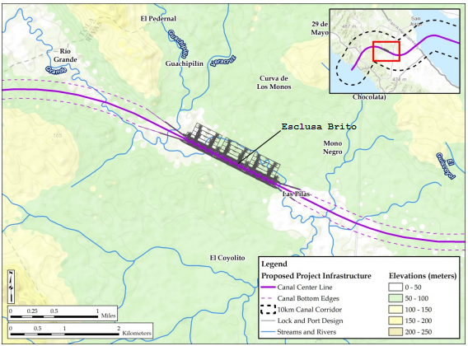
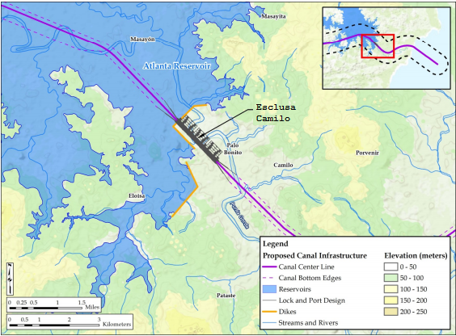
Brito & Camilo Locks: 3 Chambers & 9 water recicling pools
Same design for both: three consecutive chambers, which would raise the boats over 10 meters by chamber, for a total of approximately 30 meters.
Effective dimension for each one of the three chambers: 520 meters (long) x 75 meters (W) x 27.6 meters deep (threshold).
Brito Lock : located on the west segment of the canal, near the Mono Negro River,
approximately 14.5km from the Pacific Ocean.
Camilo Lock : located in the East segment of the Canal, near the confluence of Punta Gorda with Camilo Cano, approximately 13.7km from the Caribbean coast.

Slide 37
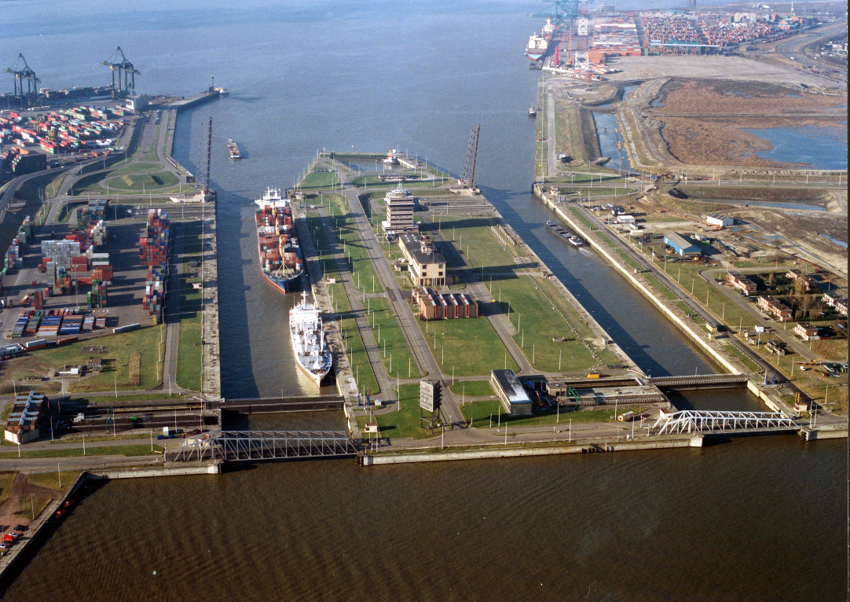
Comparison between the locks in the world
BERENDRECHT LOCK
Current World’s largest lock
Dimensions: 500 m x 68 m x 20 m
Equipped with rolling gates
No water saving basins
Rik Thomas was design & construction manager (1984-1989)
NEW PANAMA LOCKS (3rd lane)
Design based on Berendrecht lock
Dimensions: 427 m x 55 m x 18.3 m
Equipped with rolling gates
Water Saving Basins
SBE performed the reference design
DEURGANCKDOK LOCK
Future largest lock in the world (2016)
Design based on Berendrecht lock
Dimensions: 500 m x 68 m x 22 m
Equipped with rolling gates
No Water Saving Basins
SBE is Owner’s Engineer
BRITO & CAMILO LOCK’S (CARIBBEAN COAST)
Future largest lock in the world (2020)
Design based on Berendrecht lock – new Panama Locks
Dimensions: 520 m x 75 m x 27.6 m
Equipped with rolling gates
Water Saving Basins
SBE is Owner’s Engineer

Slide 38
TWO PORTS WILL BE BUILT, 1 IN THE PACIFIC AND OTHER IN THE CARIBBEAN
- Design capacity: 1.68 million TEU / year . Approximately 80th in top 100 world´s container ports
- North Wharf Structure, 1.100 meters long, capable of supporting 200,000 DWT bulk carriers or 25,000 TEU container ship;
- West Wharf berthing facilities, 1,200 meters long, with capacity for:
* Three container berths 70,000 DWT;
* A jetty oil / fuel of 30,000 DWT;
* 13 workboat berths
- Other marine services.
- Design capacity: 2.5 million TEU / year. Approximately 58th in top 100 world´s container ports
- Wharf Structure for container ship 200,000 DWT;
- Berthing Facilities 1,300 meters long, with capacity for:
* Three container berths 150 thousand DWT;
* A jetty oil / fuel of 30,000 DWT;
* 8 working boat docks;
- Other marine services.
BRITO PORT
ÁGUILA PORT

Slide 39
SEAWALLS
The Pacific breakwater would extend approximately 800 m from the shoreline on both sides of the canal. It will be constructed with armor rock sourced from the Brito Lock. The overall footprint of each breakwater will be about 62,000 square meters (m2), or 124,000 m2 total for the two breakwaters.
The Caribbean breakwater would include two different structures, one at each side of the canal. The breakwater located to the north of the canal would extend south from Punta Aguila approximately 7 kilometers to a location about 3 kilometers southwest of Booby Cay. The breakwater located to the south of the canal would be located about 1 kilometers north of the mouth of the Rio Punta Gorda and would be oriented perpendicular to the shoreline and extend approximately 3.5 kilometers. The overall footprint of north breakwater would be about 238,000 m2. The overall footprint of the south breakwater will be about 105,000 m2. Combined, this would be approximately 343,000 m2 total for the two breakwaters.

Slide 40
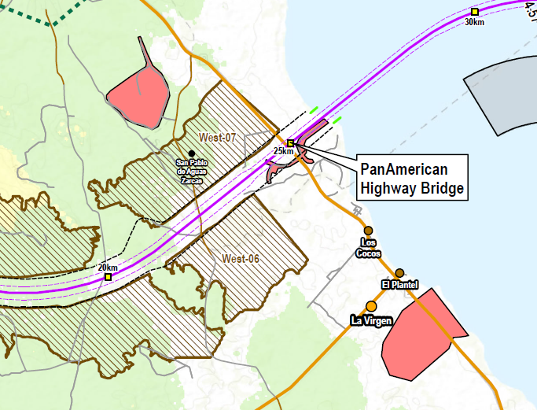
Bridge over the Panamerican Highway
80M high & 600M long

Slide 41

AGUA ZARCA HIDROELECTRICAL CENTRAL
10 MW
Canal operations require about 18 MW of electricity mainly for security operations (approximately 9 MW for each lock). Power will be supplied by Agua Zarca and the National Network through transmission lines that connect the Brito lock to the existing electrical substation Rivas and Camilo to the existing electrical substation Corocito.
Agua Zarca Hidroelectrical Project will start operations simultaneously with the Grand Canal and provide power for the operation of the eatsern Lock.
HKND will have backup diesel generators in each of the locks to ensure reliable power in the event of a power outage.

Slide 42
The Canal will be the largest civil earthmoving operation in history
5,000 Mm3 of excavated material
  4,019 Mm3 of "dry" material from upland (rock and soil)
  980 Mm3 marine and freshwater dredging.
35 areas for material disposal along the canal
  3,400 Mm3 storage volume and a total area of 179 km2
  These areas have been located to minimize environmental and social impacts 715Mm3 of lake sediment will be placed in 3 disposal sites in the Lake
The final surface of these areas will be graded so that they can be restored to agricultural or forestry.
Excavated material disposal areas (West)
7 Disposal areas
Disposal sites for dredged material (East)
15 Disposal areas
6,644Mm3 of material
26,620ha Area
Disposal sites for dredged material (Lake Nicaragua)
3 material disposal sites
610Mm3 of dredged material
731Mm3 Material
4,880ha. area

Slide 43
CANAL STEP BY STEP
JULY, 2014
PRESENTATION OF THE ROUTE
AUGUST 23-OCTOBER 15, 2014
CENSUS FROM POPULATION AND PROPERTY
NOVEMBER 20, 2014
PRESENTATION OF THE GRAND CANAL PROJECT
DECEMBER, 2014
PRESENTATION OF FESEABILITY STUDIES
DECEMBER 22, 2014
CONSTRUCTION STARTS
DECEMBER 2019
CONSTRUCTIONS ENDS

Slide 44
UPCOMING TENDERS
“REFERENCE DESIGNS”
“TENDER BRIEFS”
Locks
Dredging
Ports
Land movements

Slide 45
What is the LOGIC OF the grand interoceanic canal?

Slide 46


WORLD SEABORNE TRADE
GEOGRAPHICAL POSITION OF NICARAGUA
GEOGRAPHICAL PROXIMITY
Norfolk – Long Beach route
(Distances between Panama Canal and Grand Canal of Nicaragua)
Long Beach, CA
Norfolk, VA
Route by Nicaragua is
943 Km (509 Mi) closer
Route by Gran Canal of Nicaragua:
7,955 Km
(4,295 Mi)
Route by Panama Canal:
8,898 Km (4,804 Mi)

Slide 47


WATER RESOURCES
WATER NICARAGUA…..BLESSED WITH THE LARGEST WATER RESOURCES BETWEEN U.S. GREAT LAKES AND GUARANI ACQUIFER OF PARAGUAY BUT WITH THE LOWEST LEVEL OF UTILIZATION
Availability: 38,668 cubic meters per year PER CAPITA (m3/YEAR)
Diagnostico del Agua en las Américas, IANAS, FCCTAL, 2012
http://www.cira-unan.edu.ni/media/documentos/nicaragua.pdf.pdf

Slide 48




THE WORLD NEEDS A LARGER CANAL
TRIPLE E SHIPS DOMINATE WORLD SEABORNE TRADE
World exports of goods, by value,
2000-2020
Source: HKND-Group.com
⬆ 246.5%
Global maritime traffic will grow 42.2% between 2011 and 2025
From US$ 19.9 trillion to US$35.6 trillion in 2020
Transiting the Panama Canal today
By 2030 post-Panamax vessels will represent 30% of all vessels and 60-70% of world trade
Vessels of 10,000 TEUs and over accounted for 48% of the order book as of October 2011. It is evident that large ships are displacing smaller ships in all trade routes due to cost efficiencies of larger ships
US Army Engineers Corps, 2012
Can transit the Panama Canal after expansion
Can not transit by Panama Canal even after expansion
Mega container, (2014-)
13,500 TEU, 366*49*15.2m
TEU:20-feet container equivalent unit

Slide 49




LIMITATIONS OF THE PANAMA CANAL FOR LARGER VESSELS
Current Locks
New Locks
Panama (new):
Length: 427m
Width: 55m
Depth: 18.3m
Height: 61.3m
Nicaragua:
Length: 520m
Width: 750mm
Depth: 27.6m
Height: 80m
Las Américas bridge
61.3 m
Maersk EEE

Slide 50

EEE VESSELS REDUCE TRASNPORT COSTS AND CO2 EMISSIONS
400 meters long, 59 meters wide y 73 meters high, 12.6 meters deep
Reduce CO2 emissions by 50% per twenty-foot-equivalent units (TEU), compared to industry average on the Asia-Europe trade.
Consumes approximately 35% less fuel per container than the 13,100 TEU vessels
Emits less grams of CO2/ton km than other forms of transport
UP TO 30% REDUCTION IN COST OF METRIC TONNE SHIPPED

Slide 51


The largest ships in the world
MSC «OSCAR» (January 2015)
  Capacity: 19.224 TEU
  395.4 m. in length
  59m breadth
  16m depth
Property of China’s Bank of Communications
2. CSCL GLOBE (December 2014)
  Capacity:19,100 TEU
  400 m. in length
  58.6 m breadth
  15m depth
  Consumes 20% less energy than a ship of 10,000 TEUs
Property of China Shipping Container Lines
MAERSK LINE (Triple E’s owner) plans to build six ships of 19,000 TEU by 2017

Slide 52










SOME OF THE WORLD'S LARGEST SHIPYARD
4
1
3
2
8
5
6
7
9
Hyundai Heavy Industries, Korea.
Samsung Heavy Industries, Korea.
Daewoo Shipbuilding & Marine Engineering, Korea.
STX Offshore & Shipbuilding, Korea.
Jiangsu Rongsheng, China.
Oshima Shipbuilding Co., Japan.
Hudong-Zhonghua Naval Shipbuilding, China.
Jiangsu New YZJ, China.
Changxing, China (under construction).

Slide 53



WHO BUILT THE LARGEST SHIP IN THE WORLD?
Maersk EEE was built by Daewoo Shipbuilding in Okpo, South Korea, 2013
Prelude FLNG is the largest ever built first floating liquefied natural gas platform in the world and the ship. The Prelude is being built by Samsung Heavy Industries in Geoje, South Korea, by Royal Dutch Shell.
Hyundai Heavy Industries has begun the construction of the first of five container ships of 19,000 TEUs of China Shipping Container Lines.

Slide 54

Dimensions and capacities of the Grand Interoceanic Canal of Nicaragua
Grand Interoceanic Canal of Nicaragua
Length: 275.5km (106.8km on Lake Nicaragua)
Width: 280m
Depth: 30-33m
  Capacity: 5,100 ships a year(2050), with 30 hours of transit each boat.
The Canal will allow the transit of:
  25,000 TEU container ships,
  bulk ships of 400 thousand dwt,
  Oil tankers of 320 thousand dwt.
The capacity of a Triple-E vessel is 18,800 TEU
Panama Canal
Actual:
Length: 80Km
Width : 91-300m
Depth : 12.8m (Atlantic), 13.7m (Pacific)
4,500 TEU vessels, maximun
With the ampliation:
  13,000 TEU vessels, maximun
  Bulk ships of 200 thousand dwt
  Oil tankers of 120 thousand dwt

Slide 55

Estimating the state of demand for maritime transport in 2050
In 2050
Present day
The gap Supply / demand of ships has been increasing
Assuming a 2% average growth per year, the growth will be from 150 million today to 450 million TEUs in 2050. With 4% this would become 640 million TEU.
Entire fleet will be replaced.
If a fleet three times larger than the current is assumed, US $ 600 billion would be needed to acquire biggest new fleet. The largest ships are constructed in China, South Korea and Japan
Cumulative loss of $ 6 billion in the period 2009-2013 for the 18 companies who have published their results.
Without Maersk Line and CMA CGM, the remaining 16 companies have an accumulated loss of US $ 10.4 billion.
Strategy for survival: larger, more efficient ships to save the gains.
Fuente: Lars Jenssen, CEO SeaIntel Consulting.

Slide 56

THE INTEROCEANIC GRAND CANAL OF NICARAGUA:
THE ROUTE FOR EXTERNAL COMMERCE
The Grand Canal will assume 5% of the world trade transport
900 million tons per year will transit by the Canal
Iron, oil, gas from Venezuela and Brazil, soybean production from South America to Asia
Route of copper, fruit and wine from Chile and Peru to Europe and European manufactured goods to the west coast of South America
Oil and gas from the United States and Canada (Keystone XL Pipeline) to Asia
Route from the West Coast USA to Europe and vice versa
Asian manufactured goods to USA, South America and Europe and vice versa

Slide 57
CHINA: FROM SELLER TO BUYER
In the past 30 years, the world was buying from China
In the next 30 years, the world will be selling to China
The size of the Chinese economy will reach the United States and 31 years from now will exceed it.
China will be soon the largest consumer in the World
United States
China will be the world's largest economy by 2044

Slide 58

Port Throughput by Relative Share
(Containers)
Source: Gonzalez laxe, Freire & Pais (2011)

Slide 59
NEW PORT IN THE CARIBBEAN WILL REDUCE COSTS OF IMPORTS AND EXPORTS IN NICARAGUA
Annual Logistics Cost Savings to the Home Economics
Calculation of Cost Savings
Concepts | % of GDP | US$ million
Nicaragua GDP, 2013 | 100% | 11,255.60
Logistics costs without Port Aguila | 25% | 2,813.91
Logistics Costs with Port Aguila | 13% | 1,463.23
Savings generated by Port Aguila | 12% | 1,350.67
Source: Martínez & Piñeiro (2014)

Slide 60
Transportation and Logistic Costs
48
45
40
36
29
29
wheat
Rice
Maize
Source: Guasch y Kogan, 2006
Source: Economics Unit, World Bank, 2010

Slide 61
Freight Estimated Savings in the main exports to Asia
Considering that the transport of goods in larger vessels reduce the cost of freight by 30% per ton.
FOB exports from Brazil to Asia (excluding Middle East) January-September 2014. example: 3 main products (million tons. and US $ million)
 | Weight (TM.) | US$ | Approximate cost of freight | Estimated Savings
General Total (others included) | 250.94 | 59,320.65 | 4,449.05 | 1,334.71
Soy | 35.60 | 18,127.05 | 1,359.53 | 407.86
Iron ore | 167.72 | 12,481.26 | 936.09 | 280.83
Oil* | 7.21 | 45,45.65 | 340.92 | 102.28
*It will grow with offshore fields
Ministry for Development, Industry and Foreign Trade, Brazil
Venezuela fuel exports to Asia. 2012
Total exports from Argentina to China. 2012
 | US$ millions
Total | 38,363.3
Approximate cost of freight | 2,877.2
Estimated Savings | 863.2
 | US$ millions
Total | 5,900
Approximate cost of freight | 442.5
Estimated Savings | 132.8
World Trade Organization (WTO)

Slide 62
Development Process of the Gran Interoceanic Canal Legal Framework
June 14, 2013
September 5, 2012
August 26, 2014
2013-2014
July 3, 2012
Law 800 'Law of Legal Regime of the Grand Interoceanic Canal of Nicaragua and Creation of the Authority of the Grand Interoceanic Canal of Nicaragua»
May 23, 2013
Memorandum of Understanding with HKND
Consultations with the Autonomous Southern Caribbean Regional Council
Law 840 "Special Law for the Development of Infrastructure and Transportation relating to Nicaraguan Canal , Free Trade Zone and associated infrastructure"
Permission granted for canal studies to HKND by the Territorial Government Rama-Kriol
Constitutional Reform

Slide 63

Law 840 «Special Law for the Development of Nicaraguan Infrastructure and Transportation related to the Canal, Free Trade Zone & Associated Infrastructures»
Grants an exclusive concession in favor of The Investor and its concessionaries for the Development and Operation of every Sub- Project, according to the MCA for a term of fifty (50) years, renewable for other 50 years.
HKND assumes all costs and risks of the feasibility
HKND commits to mobilize at least US$40 billion for the construction.
The Nicaraguan Canal Commission approves the plans of the subprojects and monitors their execution, emits environmental and construction permits through a one stop shop window and is in charge of environmental protection.

Slide 64
THE MASTER CONCESSION AGREEMENT AND IMPLEMENTATION FRAMEWORK WITH NICARAGUA HK INVESTMENT DEVELOPMENT COMPANY, LTD. (HKND)
Law 840 grants to HKND Concession to conduct studies, and to promote further concessions for subprojects.
Nicaragua will start, 1% of shares and shall be increased by 10% its stake in every 10 years. Also receive $ 100 million in 10 annual payments for the concession.
Concession of use for a period of 50 years, renewable for another 50 years.
Commission of the Development of the Grand Canal Project will monitor financial and physical execution of each subproject and will issue all environmental permits and construction permits.
Each sub project should have its feasibility studies and a plan approved by the Commission of the Grand Canal Project.
Fiscal and legal incentives to attract investments to the Canal and subprojects.

Slide 65


FEASIBILITY STUDIES
2nd largest governmental construction company of China
The 5th environmental and social consultant
World's most prestigious consulting firm
Shipping company
International Marine Shipping Container of China(CIMC);
China National Corporation of Building Materials (CNBM)
Group of Xuzhou Construction Machinery (XCMG)
No. 7 construction machinery industry of China
China Ocean Shipping (Group) Company (COSCO);
World leader in shipping
The world's largest manufacturer of shipping containers
Major industry group of building materials of China
5th most prestigious law firm in the USA
MEC Mining. Australia.
Open pit mining and civil engineering
Washington-base public relations
Civil Engineering, based in Belgium;
Specialized in locks and canals
Communications with the financial media (Bloomberg, Financial Times, among others)
INVESTORS:
HKND
PRIVATE EQUITY FUNDS
PRIVATE INVESTMENT BANKS
MULTILATERAL BANKS
.. Òther investors when feasibility studies are concluded

Slide 66

From Financial Times:
“Public face of $40bn project to boost China-Latin America links”
"It is one of the largest infrastructure projects in the world. The feasibility study alone is set to cost $900 million. And when complete, the Nicaragua Canal should lower transport costs for shipping oil from Latin America to China. "
"Right now, 4,000 people, including staff McKinsey, British environmental consultancy ERC the law firm from USA, Kirkland, and research institutes belonging to the CRC, are working on the feasibility study. Mr. Wang said that HKND could cover with its own funds, the operating cost even before the start of construction, scheduled for late 2014 "

Slide 67


"Ninety percent of world trade is by sea. Shipping is cheaper and more convenient than transport by rail.
"It doesn't matter where industries are located because this canal is connecting East and West. It's definitely commercially viable; otherwise we wouldn't be investing in it."
"We are in talks with local people, even opponents of the plan. We want to produce a thorough report but that takes time.
"I thought this country really needed this canal. Nicaragua is a beautiful country with a long history and rich culture, but many people there live in poverty.
If the canal can be built successfully, it will transform the economy and people's lives."
Wang Jing for BBC News
March 18th, 2015

Slide 68

«The world´s largest container carrier Maersk Line believes it, makes good sense to construct an alternative to the Pnama Canal that can handle the biggest container ship.»
Maersk Line apoya el Canal de Nicaragua
“Building a Nicaragua Canal seems to make sense. The Canal is projected to have room for the biggest ships, while also saving 800 kilometers on a journey from New Yor to Los Alngeles. We generally support infraestructure improvements. It brings opportunities for transport, and therefore trade. When we built container ships 20 years ago were scaled according to the Panama Canal, but, ships today are larger than 4,500 TEU that could fit into the larger ships then. Even after the Panama Canal expansion, larger ships can not fit there, "Keith Svendsen, Head of Operations at Maersk Line daily.

Slide 69

ONUDI is going to provide technical advice to the Commission of the Grand Canal, in environmental issues, resource efficiency, quality and certification, employment generation and monitoring and evaluation of projects

Slide 70
CEMEX CONSTRUCTS A NEW PLANT
Construction of a new cement grinding plant in Nicaragua
  Announced in Monterrey on May 5, 2014
  cost of US $ 55 million.
First pahse:
  First half of 2015
  US $ 30 million in the installation of a cement factory in Ciudad Sandino
  Production capacity of 220,000 tons.
  Second phase
  End of 2017
  The installation includes a second grinding mill
  Capacity of 220,000 tons.
Positioning for Central American development pole of the century in Nicaragua.

Slide 71
WHAT ARE THE CHALLENGES AND OPPORTUNITIES FOR NICARAGUA?

Slide 72
CANAL AREA CHALLENGE
All construction projects have an environmental and social cost.
The route has been chosen, engineering choices have been made and the necessary adjustments that minimize environmental and social impact have been decided.
Mitigation and compensation measures, improving the environment to cause a net positive environmental impact
THE GOAL IS A POSITIVE NET ENVIRONMENTAL IMPACT, WHETHER IN THE AREA OF CANAL OR AT THE NATIONAL LEVEL. WITH THE RESOURCES FOR MASSIVE REFORESTATION, WHICH CAN INCREASE THE RESILIENCE OF THE ECOSYSTEMS.

Slide 73
Commitment to increasing the ecosystems resilience
A road linking the port with Tola.
A rock wall will be designed to allow a good mix of fresh and salt water for the mangroves.
Small-scale dredging of the lake by suction (hydraulic)l.
THERE WILL BE NO BLASTING IN THE LAKE
The sand and hard materials will be arranged at along the south side of Route Canal.
West Entrance into Lake (avoid populated areas).
Canal alignment and Airport location will change to avoid impacting Rivas.
Most of the Río Brito and healthy mangroves NOT be affected.
Brito´s Mangroves, southward of Canal, remain intact.

Slide 74
Commitment to increasing the ecosystems resilience
The alignment has been changed to the output from the Lake to the east of the Canal, in order to avoid environmentally sensitive areas.
Protection of Indio Maíz. The Canal acts as a barrier to the intrusions of people in the area.
The impact on palm forest in the Caribbean will be minimized.
Puerto Águila will be filled with dredged to minimize the impact on Indigenous Peoples.
Canal Route avoids the impact on Booby Cay.

Slide 75
Globally, the construction of the Grand Canal will reduce 32.5 million tons in annual CO2 emissions made by maritime trade worldwide
Fuente: Indicadores Mundiales de Desarrollo. Banco Mundial
The avoided emissions are greater than the emissions of the countries of Central America and comparable with those produced by countries like Switzerland

Slide 76


NET POSITIVE ENVIRONMENTAL IMPACT: On the site of the Canal
Reverse deforestation trends
Prevent further penetration into Reserves Indian Corn and Punta Gorda
Rehabilitation of degraded areas in Indio Maiz Reservations and Punta Gorda and improve watershed management
Provide compensation and funding to improve RAMSAR site of San Miguelito.
Provide alternatives and better living conditions

Slide 77


THE CHALLENGE OF AN ONGOING DEFORESTATION
25% of the total land area is forested.
Current rate of deforestation is 70 thousand hectares annually.
The estimated reforestation of 20 thousand hectares per year.
It is necessary to contain the advance of the agricultural frontier
THE ROUTE OF GRAND INTEROCEANIC CANAL, RUNS THROUGH AREAS WITH DEGRADED SOILS BY THE AGRICULTURE FRONTIER

Slide 78






NET POSITIVE ENVIRONMENTAL IMPACT: NATIONAL LEVEL
Stop present and future sedimentation of Lake Nicaragua
Integrated watershed management (massive reforestation, reinjection of water, biodiversity protection)
MASSIVE REFORESTATION
Protection of local populations from flood or drought.
Environmental monitoring, climate and integrated health.
Strengthen protected areas — 17% territory
  ECLAC estimate that in 2011 Nicaragua had adaptation needs over US$ 1,900 Millions
  The Canal is a water project whose viability depends on water and this on massive reforestation and watershed management.

Slide 79
WHAT ARE THE EMPLOYEMENT AND BUSINESS OPPONTUNITIES?

Slide 80


OPPORTUNITIES
Opportunities for young Nicaraguans and Central Americans for professional, technical, and skilled formal sector employment in news fields, including:
  Example 1: Maritime industry
  Example 2: Regional and world multimodal logistical center

Slide 81


A Free Trade Zone on the Pacific coast (Rivas)
Location: 20 km from the Pan American Highway and Rivas in the east, 120km from Managua in the north , 8km from the tourist complex planned in the south, and 17km from San Juan del Sur, and 16 km from the new airport near Rivas.
4 functional areas: 29.2Km2, 113 thousand jobs
Urban Areas: 15.08 km2.
140 thousand residents
Export Processing Zone: 7.87Km2.
58 thousand jobs.
US$2,000 million in 2030
Free Trade Zone: 4.34Km2. 30 thousand comercial jobs.
US$25,000 million of import and export trade in 2030
Financial Offices Area: 0.82Km2.
will focus on providing financial, and transportation services.
25 thousand jobs

Slide 82



Touristic Complexes
The complex will be:
Superior Field Service lodging during project implementation
Tourism destination for Nicaraguans
1st world level themed coastal resort in Nicaragua
Tourist Complex
6.94km2
377,600 m2 of built area
761 villages
Hotel with 1,400 rooms, and from 1.800 to 2.200 beds
3,000 jobs

Slide 83
Power plants, steel and cement, etc.
Sub projects needed to ensure the supply of materials and energy during implementation and operation of the project
It is currently undergoing the feasibility studies

Slide 84
Requirement of building materials
Material | Año 1 | Año 2 | Año 3 | Año 4 | Año 5 | Año 6 | Total
Cement (10,000 ton) | 4.3 | 25.5 | 178.2 | 174.4 | 112.3 | 1.2 | 495.9
Explosives (10,000 ton) | 4.2 | 25.5 | 35.8 | 36.2 | 34.0 | 2.5 | 138.2
Steal and corrugated (10,000 ton) | 10.4 | 6.4 | 22.2 | 27.0 | 27.6 | 1.9 | 95.5
Coal Ash | 0.2 | 1.5 | 30.7 | 30.2 | 18.0 | 0.1 | 80.8
Lubricants | 10.4 | 6.4 | 22.2 | 27.0 | 27.6 | 1.9 | 95.4

Slide 85

GREATER OPPORTUNITIES FOR INTEGRATION

Slide 86
THE CHALLENGE OF TECHNICAL EDUCATION AND TRAINING FOR THE NEW ECONOMY
Public Universities
Private Universities
Public technical institutes and centers
Presidency
Ministry of Education
Coordination Commission of Education and Technical Training
Government - Private Sector
CREATE THE NATIONAL CAPACITIES FOR THE TRANSFORMATION OF NICARAGUA
SOCIAL PARTICIPATION
PUBLIC ADMINISTRATION ALIGNED TO THE DEVELOPMENT
CONSTRUCTION AND OPERATION OF THE GRAND CANAL AND OTHER PROJECTS
TRANSFORMATION OF CURRENT AGRICULTURAL ECONOMY
MITIGATION AND ADAPTATION TO CLIMATE CHANGE
INNOVATION AND ENTREPRENEURSHIP
Professional Profiles
Identification of needs
Adjustments to the education system

Slide 87
The multiplier effect of the project: The greatest positive economic, social and environmental impact on the country
Multiplier effect of the Canal from now to 2020
Canal construction and complementary infrastructure
Operation and Administration of the World and Regional Logistics Center
Great formal employment growth
Increased income of Central Government
Increased investment, trade growth, accelerating growth

Slide 88
The Grand Canal: historic opportunity for Nicaragua
The Grand Canal will generate the resources to build the desired development to achieve a prosperous and fairer Nicaragua
Overcoming of Extreme Poverty
Formal Employment
Increasing resilience of ecosystems
Climate change adaptation
Construction of economic independence
Combining economic Independence with political independence already achieved by the FSLN
Growth of resources for social programs
Recovery of soil and water sources
Habitat and biodiversity restoration
massive reforestation

Slide 89


0
Dr. Paul Oquist Kelley
paul.oquist@sppn.gob.ni
Executive Secretary of the Commission of the Grand Interoceanic Canal of Nicaragua
Minister, Private Secretary for National Policies of the Presidency of the Republic
THANK YOU

