Slide 1
BUSINESS AND INVESTMENT OPPORTUNITIES IN PERU

Slide 2
BUSINESS & INVESTMENT OPPORTUNITIES IN PERU
General Facts & Economic Indicators
Friendly investment Environment & Trade Integration Policy
Peru – Turkey Trade Relationship
Notes:
Sin duda la crisis financiera internacional afecta las perspectivas de inversión en el mundo y lleva a los expertos a evaluar los proyectos propuestos con mayor cuidado, lo cual no implica que las empresas puedan dejar de pensar en sus desarrollos de largo plazo.
En este contexto, el Perú destaca como un destino de inversión que vale la pena evaluar. Las razones se pueden resumir en 4 campos básicos:
Estabilidad macroeconómica: la economía peruana presenta excelentes resultados siendo uno de los países mejor preparados para enfrentar la crisis global.
Clima favorable para la inversión: el país ha consolidado uno de los marcos legales más modernos y atractivos para la inversión extranjera responsable.
Acceso a mercados: el Perú ha establecido una amplia red de acuerdos comerciales que le aseguran acceso preferente a prácticamente todos los mercados más dinámicos del mundo.
Desarrollo de infraestructura: el crecimiento exponencial del comercio internacional peruano está generando un sustantivo aumento de la demanda por infraestructura y servicios logísticos. En ese sentido el Estado peruano viene desarrollando obras de infraestructura de importante magnitud en las cual promueve la participación del sector privado. Ello permitirá elevar nuestra competitividad y proyectarnos como una eficiente plataforma productiva y comercial en el Pacífico Sudamericano.
2

Slide 3
GENERAL FACTS & MACROECONOMIC INDICATORS

Slide 4
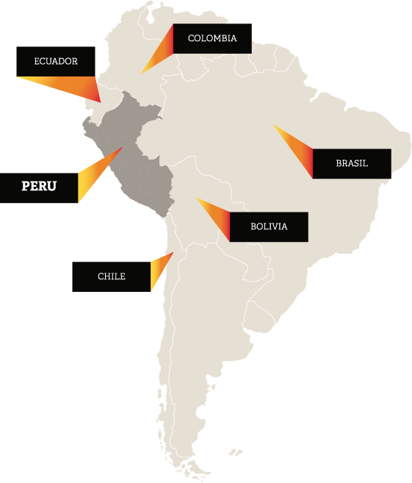

PERU
Location: Western South America,
Area: 1’285, 215 square Km.
The 3rd largest country in South America
3 Natural Regions: Coast, Highlands and Amazon Rainforest.
Estimated population: 31.1 million people
Currency: Sol (S/.3.27 / 1 USD)
GDP: 42,48 billion USD
GDP Per capita: 13,300.00 USD
GDP Growth: 2.7% (2017) 3.6% (est.2018)
Inflation: 3.2%
Exports: 44.0 billion USD
Imports: 39.7 billion USD
Natural Resources: Minerals: copper & silver, gold, Peroleum, Fish, Natural Gas, Timber
Notes:
Opción 1

Slide 5

10
Reasons for Doing Business with Peru
Macroeconomic Stability.
18 years of uninterrupted growth.
Investment Grade (A3 / BBB+) .
Non Discriminatory Treatment for foreign investors.
Free competition.
Open Trade Policy.
Dynamic Commercial Trade.
Stable Exchange Rates.
Low Inflation rate
Excelent regional connectivity.
Notes:
Opción 1

Slide 6
MACROECONOMIC SOUNDNESS
Peru leads regional growth
Average GDP - 2000 - 2016
(Average change in constant prices in dollars)
Real GDP – Forecasts for Latin America 2017
(Annual Average Variation %)
Source: CEPAL
Source: IMF / * in Peru case, source: BCRP.

Slide 7
MACROECONOMIC SOUNDNESS
ESTABILIDAD MACROECONÓMICA
MACROECONOMIC STABILITY
Economic growth was driven by Private Investment (almost 20% of GDP)
Private Investment 2006-2019*
(% of GDP)
Total investment – LATAM 2017
(% of GDP)
Source: BCRP-
* Estimated figures of BCRP (Inflation report as of September 2017)
Source: IMF.
*Estimated figures as from IMF ( World Economic Outlook Database – October 2017)

Slide 8
MACROECONOMIC SOUNDNESS
ESTABILIDAD MACROECONÓMICA
MACROECONOMIC STABILITY
Peru is an attractive market for Foreign Investment, which recorded $ 7 billion in 2016
Foreign direct investment flow 2005 – 2019*
(US$ Billion)
Foreign direct investment – LATAM 2016
(% GDP)
Source: BCRP.
* Estimated figures BCRP ( inflation report , September 2017)
Source: Cepal

Slide 9
MACROECONOMIC SOUNDNESS
Growth in Domestic Demand
Real domestic demand 2005–2019*
(real annual Var. % )
Imports of vehicles
for private use
(US$ million)
Imports of domestic assets /1 (US$ million)
4.5 Times
2.6 Times
Source: Central Reserve Bank of Peru.
*Estimated figures BCRP (Inflation report, September 2017)
Source: SUNAT
1/ Includes imports of machines and appliance. Furniture and other house equipment's

Slide 10
MACROECONOMIC SOUNDNESS
ESTABILIDAD MACROECONÓMICA
MACROECONOMIC STABILITY
This is complemented by a dynamic commercial trade…
Balance of Trade 2005-2019*
(US$ million)
Source: BCRP
* Estimated figures BCRP ( Inflation report, September 2017)

Slide 11
MACROECONOMIC SOUNDNESS
All this, in a frame of macroeconomic stability. Peru records the lowest inflation rate at a regional level
CPI – Latin America 2007- 2017*
(Annual Average Variation %)
CPI – Latin America 2017*
(Annual Average Variation %)
Source: IMF (World Economic outlook Database – October 2017) in Peru case , BCRP (inflation report, September 2017)
*Estimated figures

Slide 12
MACROECONOMIC SOUNDNESS
… has maintained stable exchange rates and a level of risk under the regional average
Exchange Rate in Latin America 2004-2016 (*)
(Index, Base year 2005 = 100)
JP Morgan EMBI+
(Basic points)
Source: CEPAL
(*) As of August 2016
Source: BCRP

Slide 13
MACROECONOMIC SOUNDNESS
Peru maintains a healthy level of debt…
Public Debt– Peru 2005-2019*
(% of GDP)
Public Debt– Latin America 2017*
(% of GDP)
Source: BCRP.
*Estimated figures, BCRP (Inflation report September 2017)
Source: IMF; and Peru figures source BCRP

Slide 14
MACROECONOMIC SOUNDNESS
… and has accumulated international reserves for a third of the GDP
Net International Reserves
( US$ Billion)
NIR Adequacy Indicators
 | 2006 | 2011 | 2016*
NIR (% del GDP) | 19.6 | 28.6 | 31.5
NIR (% short -term foreign debt) | 166 | 471 | 541
RIN (% Short-term Foreign Debt plus Current Account deficit) | 230 | 360 | 350
Source: Central Reserve Bank of Peru
*Up to January 31 th, 2017
Source: BCRP.
*Estimated figures, BCRP (Inflation report December 2016)

Slide 15
MACROECONOMIC SOUNDNESS
Peru earned the investment grade and investor´s confidence by practicing a responsible political economy
Investment grade
Latin America benchmarking
Countries | Moody's | S&P | Fitch
Chile | Aa3 | A+ | A+
Peru | A3 | BBB+ | BBB+
Mexico | A3 | BBB+ | BBB+
Colombia | Baa2 | BBB | BBB
Uruguay | Baa2 | BBB | BBB-
Paraguay | Ba1 | BB | BB
Brazil | Ba2 | BB | BB
Bolivia | Ba3 | BB | BB-
Argentina | B3 | B+ | B
Ecuador | B3 | B- | B
Venezuela | Caa3 | CC | C
Source: Standard & Poor`s, Fitch Ratings and Moody´s.
Updated as of 9 November, 2017
Notes:
15
En cuanto a la posición externa…
La responsable política económica, que ha mantenido continuidad a través de la sucesión de gobiernos democráticos, ha permitido acumular reservas internacionales que cubren en exceso la deuda externa, fortalecer el sistema financiero (muy baja morosidad), mantener un importante superávit fiscal y reducir el ratio deuda-PBI, lo cual coloca al Perú en mejores condiciones que muchos otros países en el mundo para afrontar el actual escenario de crisis internacional.
Perú ha venido registrando superávit presupuestales por varios años y el nivel de su deuda pública es bajo. De hecho, Perú es uno de los pocos países donde las reservas internacionales del Banco Central (US$ 31 mil millones o 26% del PBI) exceden el total de la deuda pública interna y externa (US$ 30 mil millones).
Finalmente, cabe anotar que ante un escenario de mayor volatilidad, donde aumenta la percepción del riesgo sobre las economías emergentes, el Perú sigue manteniendo un nivel de riesgo país por debajo del promedio regional y ha podido alcanzar (desde julio de 2008) que 3 agencia clasificadoras de riesgo (Standard & Poors, Fitch Ratings y la agencia canadiense Dominion Bond Rating Service) lo posicionen como país con grado de inversión.
En cuanto a la posición externa…
La responsable política económica, que ha mantenido continuidad a través de la sucesión de gobiernos democráticos, ha permitido acumular reservas internacionales que cubren en exceso la deuda externa, fortalecer el sistema financiero (muy baja morosidad), mantener un importante superávit fiscal y reducir el ratio deuda-PBI, lo cual coloca al Perú en mejores condiciones que muchos otros países en el mundo para afrontar el actual escenario de crisis internacional.
Perú ha venido registrando superávit presupuestales por varios años y el nivel de su deuda pública es bajo. De hecho, Perú es uno de los pocos países donde las reservas internacionales del Banco Central (US$ 31 mil millones o 26% del PBI) exceden el total de la deuda pública interna y externa (US$ 30 mil millones).
Finalmente, cabe anotar que ante un escenario de mayor volatilidad, donde aumenta la percepción del riesgo sobre las economías emergentes, el Perú sigue manteniendo un nivel de riesgo país por debajo del promedio regional y ha podido alcanzar (desde julio de 2008) que 3 agencia clasificadoras de riesgo (Standard & Poors, Fitch Ratings y la agencia canadiense Dominion Bond Rating Service) lo posicionen como país con grado de inversión.

Slide 16
FRIENDLY INVESTMENT ENVIRONMENT & TRADE INTEGRATION POLICY

Slide 17
FRIENDLY INVESTMENT ENVIRONMENT
Peru offers a favorable legal framework for foreign investment:
  Non discriminatory treatment: Foreign investors receive the same treatment as local investors.
  Unrestrictive access to most economic sectors *.
  Free transfer of capital.
  Free competition.
  Guarantee for Private Property.
  Freedom to purchase stocks from locals.
  Freedom to access internal and external credit.
  Access to international disputes settlement mechanism
  Peru participates in the Investment Committee of the Organization for Economic Co-operation and Development (OECD) – It promotes the implementation of the Guidelines for Multinational Enterprises.
*Investments that require authorization: Located within 50 km in the frontier line and those destined to arms, ammunitions and explosive. Likewise, a principal local partner for investments in maritime cabotage as well as in air transport is required.

Slide 18
A steady tax regime:
FRIENDLY INVESTMENT ENVIRONMENT
Tax |  | Applicable Rate
INCOME | Corporate profits | 29.5%
 |  | Agriculture and agribusiness 15%
 | Dividends | 5.0%
 | Royalties | 30.0%
 | Interest rate on loans from abroad | 4.9%
Value Added Tax (VAT) |  | 18.0%
Financial Transactions Tax |  | 0.005%
Temporary to net assets, applicable to the excess of S/. 1 000 000 |  | 0.4%

Slide 19
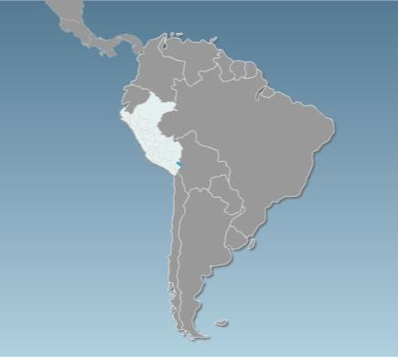
FRIENDLY INVESTMENT ENVIRONMENT
Continuous effort to facilitate the establishment and operation of business
Venezuela
187
Guyana
3rd
in the regional ranking of ease of doing business in Latin America
Colombia
124
53
Surinam
.
Ecuador
158
114
Brasil
Position | Country
1 | Mexico
2 | Colombia
3 | Peru
4 | Chile
5 | Panama
Perú
123
58
Bolivia
Paraguay
149
92
Chile
Uruguay
57
90
Argentina
116
Source: World Bank Doing Business 2017
Notes:
19

Slide 20
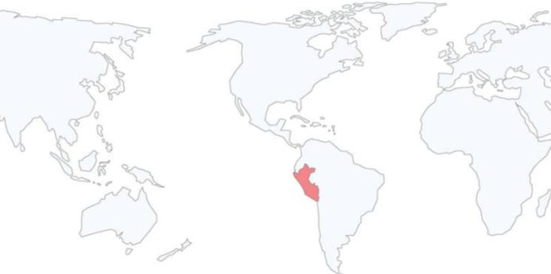
FRIENDLY INVESTMENT ENVIRONMENT
Investment Agreements
  Peru has signed and currently has in force Agreements for the Promotion and Reciprocal Protection of Investment and Trade Agreements of further scope that includes investment chapters that underpin our liberalization policy.
European Union ²
European Association of free Trade (Iceland, Liechtenstein, Switzerland and Norway) ¹
Australia
China ¹
Korea ¹
Malaysia
Singapore ¹
Thailand
Japan
Brunei
New Zealand
Vietnam
Canada ¹
United States¹
Mexico ¹
Cuba
El Salvador
Costa Rica ¹
Panama ¹
Argentina
Bolivia
Chile ¹
Colombia
Ecuador
Paraguay
Venezuela
Trade agreements
Trade Agreement. Besides , Peru has Investment bilateral agreements with Germany, Belgium, Luxemburg, Denmark, Spain, Finland, France, Holland, Italy, Portugal, United Kingdom, Check Republic, Sweden and Switzerland.
  It has also signed 8 agreements to avoid double taxation with Andean Community, Brazil, Chile, Canada, Korea, Mexico, Portugal and Switzerland.
Notes:
20

Slide 21
OPEN TRADE AND MARKET ACCESS POLICY
An open trade policy sustained over time
Evolution of nominal and effective tariff; and tariff dispersion 1993 – 2016 (*)
(*) AS of September 2016
Source:MEF
Notes:
1) Affective Tariff= (Amount of total revenue Ad valoren CIF / Total Amount of CIF Imports)*100.
2)Tariff Dispersion= Standard Deviation

Slide 22
Reduced tariff structure with low tariff dispersion
OPEN TRADE AND MARKET ACCESS POLICY
LEVELS OF AD VALOREM | TARIFF LINES 2/
 | NUMBER | PROPORTION (%)
0 | 5497 | 70,45%
4% | 2 | 0,03%
6% | 1621 | 20,78%
11% | 682 | 8,74%
Total | 7802 | 100 %
EFFECTIVE AVERAGE TARIFF % |  | 2.2
EFFECTIVE TARIFF % |  | 1.0
STANDARD DEVIATION % |  | 3.6
Source: SUNAT – MEF

Slide 23
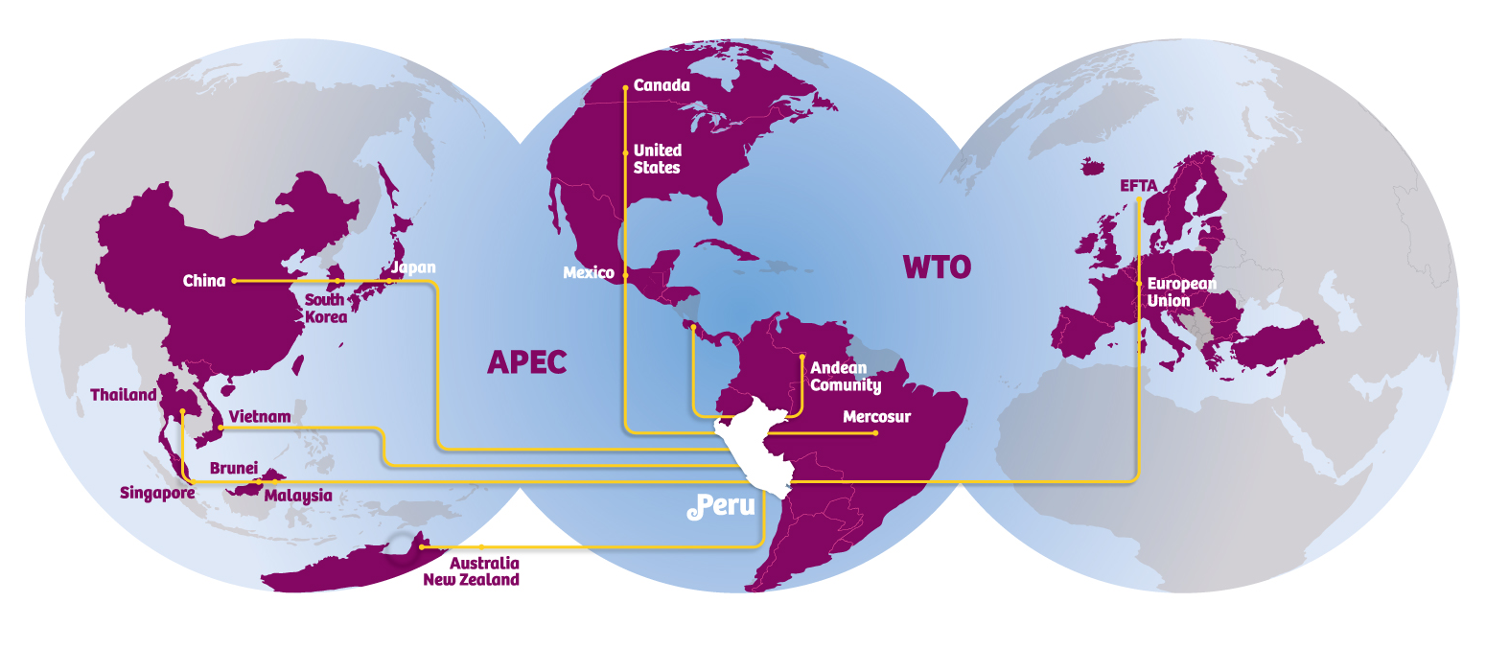
OPEN TRADE AND MARKET ACCESS POLICY
Working to become a globalized economy,
with preferential access to the world’s largest markets
These countries stand for enlarged market of over 4 billion people with a joint GDP over US$ 56 trillion
96% of Peruvian exports
Notes:
23
Un tercer factor de importancia a tomar en cuenta para evaluar al Perú con destino de inversiones es su activa política de integración comercial con el mundo.
A través de diversos esquemas de integración, se ha logrado el acceso a importantes mercados ampliados, hacia los cuales podrá acceder el inversionista que se establezca en el país. Ejemplo de ello son los Tratados de Libre Comercio suscritos con Estados Unidos, Canadá, Singapur y China, y el Acuerdo con Tailandia. Destacar que el tratado con Estados Unidos entró en plena vigencia el 1 de febrero de este año y se negocian otros tratados con la Unión Europea, EFTA y Corea.
El Perú es además miembro de la Comunidad Andina de Naciones y mantiene también preferencias arancelarias con la mayoría de los países latinoamericanos como México, Chile, Mercosur, etc.
Es meta del Perú convertirse en el principal hub de negocios o plataforma exportadora en la región del Pacífico Sudamericano.

Slide 24
PERU - TURKEY TRADE RELATIONSHIP

Slide 25
TURKEY’S EXPORTS TO PERU
CHAPTER | DESCRIPTION | 2016 | 2017 | %
72 | Iron & Steel (Angles, bars) | 51.888 | 35.280 | -32,01
84 | Machinery for mining | 22.521 | 27.169 | 20,64
87 | Vehicles (Parts & accessories / tractors) | 8.166 | 8.628 | 5,66
61 | Apparel knitted (t-shirts, underwear) | 5.583 | 6.267 | 12,25
85 | Electrical machinery (transformers, panels) | 6.243 | 6.169 | -1,19
62 | Apparel woven (jackets, suits, blouses) | 5.553 | 5.849 | 5,33
28 | Inorganic chemicals | 1.929 | 5.583 | 189,42
39 | Plastics & articles of plastic | 1.142 | 1.508 | 32,05
73 | Containers of steel | 6.278 | 4.181 | -33,40
44 | Wood Producsts (fibreboard of wood) | 3.564 | 2.870 | -19,47
40 | Rubber and articles of rubber | 2.349 | 2.402 | 2,26
18 | Chocolates | 1.237 | 2.282 | 84,48
74 | Products of copper | 306 | 2.062 | 573,86
70 | Glassware | 1.863 | 1.995 | 7,09
15 | Olive Oil | 0 | 1.850
 | Other | 22.085 | 24.335 | 10,19
 | Total | 140,707 | 138.430 | (-1.62)

Slide 26
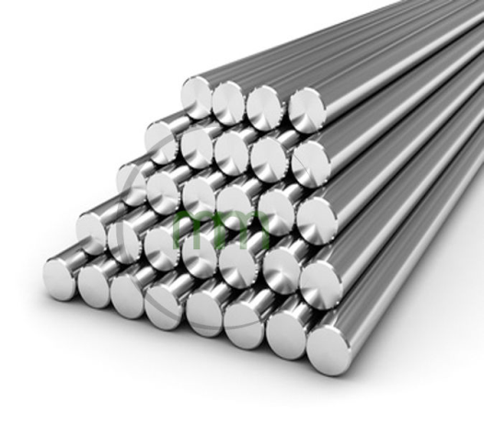
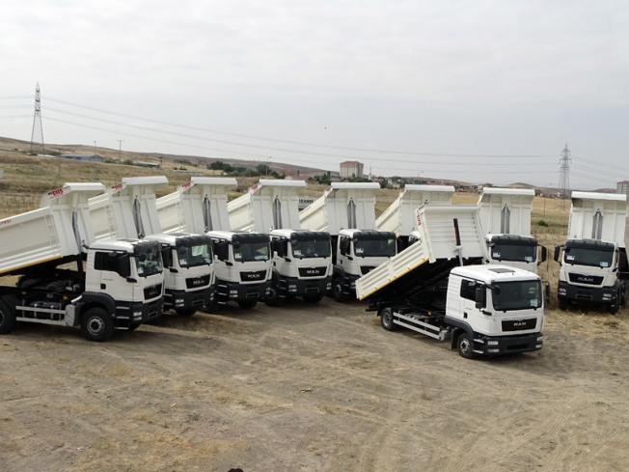
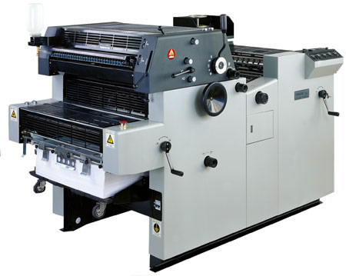
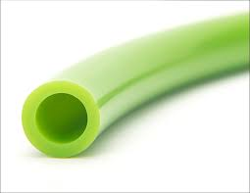
Business Opportunities in Peru for Turkish Products
Iron, Steel & artickles
Machinery, mechanical appliances & parts
Animal or vegetable fats & oils
Vehicles & parts
Prefabricated buildings, furniture & parts
Electrical machinery, equipment & parts
Wood & articles of wood
Rubber & articles
Plastics & articles

Slide 27
PERU’S EXPORTS TO TURKEY
CHAPTER | DESCRİPTİON | 2016 | 2017 | %
79 | Unwrought Zinc | 18.236 | 26.432 | 44,94
71 | Gold | 0 | 5.872
23 | Fish Meal | 2.089 | 3.971 | 90,09
15 | Fish Oil | 0 | 3
25 | Andalusite | 1.358 | 1.351 | -0,52
12 | Oil Seeds | 288 | 941 | 226,74
55 | Acrylic fibers | 35 | 822 | 2248,57
32 | Vegetable & animal colouring | 994 | 773 | -22,23
20 | Canned Vegetables | 237 | 667 | 181,43
10 | Cereals | 237 | 667 | 181,43
7 | Dried leguminous | 492 | 538 | 9,35
80 | Unwrought Tin | 5.818 | 535 | -90,80
3 | Molluscs (Squid) | 8 | 438 | 5375,00
84 | Machinery & Equipment | 204 | 435 | 113,24
39 | Plastics | 0 | 415
 | Other | 3.501 | 5.529 | 57,93
 | Total | 33.497 | 49.389 | 47,44

Slide 28
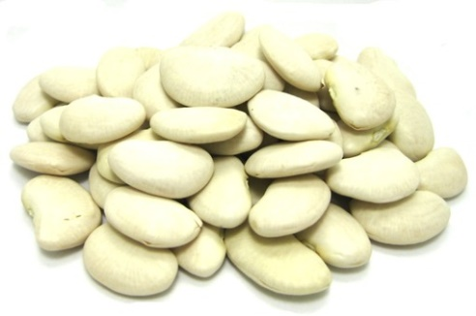
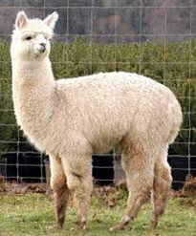
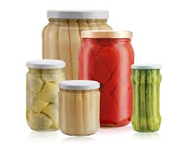
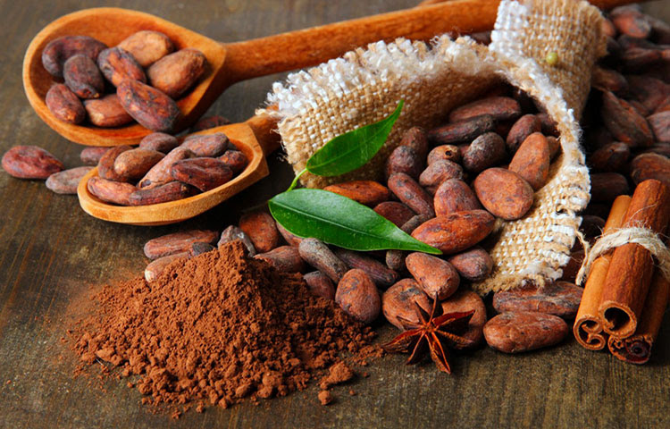
Business Opportunities for Peruvian Products in Turkey
Preserved Food (Asparagus,Artichoke, Peppers)
Cacao
Zinc Derivates and Alloys
Non-metallic Minerals (Anthracite / Andalucite)
Alpaca Fiber, Yarn & Wool
Pulses (Black Eyed Beans,Lima Beans,
Redondo Beans,Fava Beans)

Slide 29
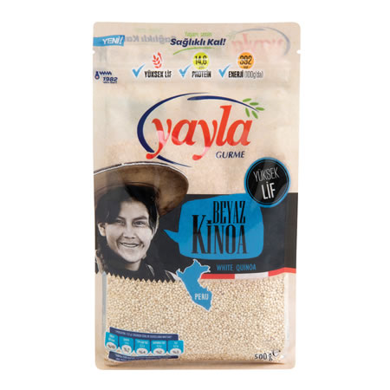
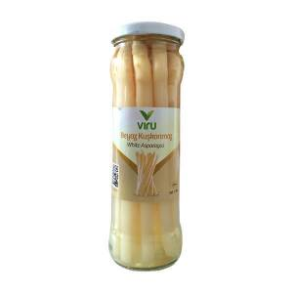
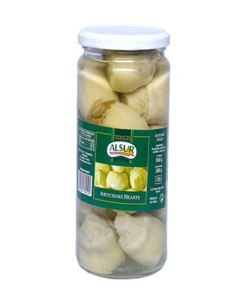
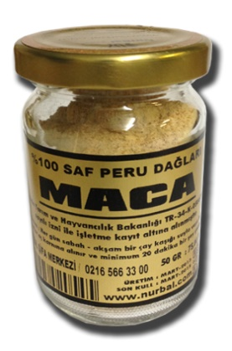
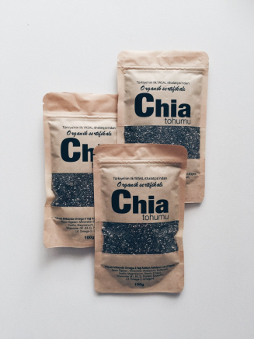
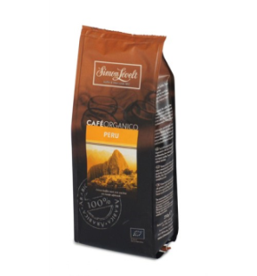
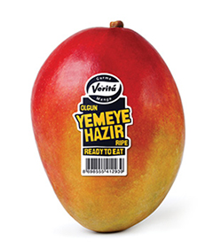
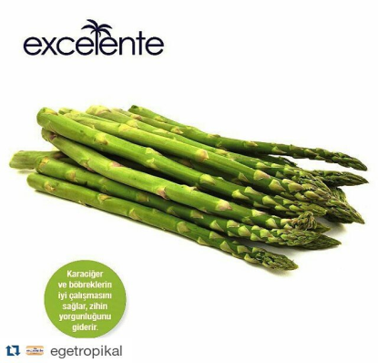
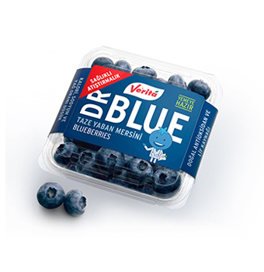
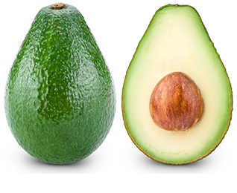
Peruvian Products already in the Turkish Market
Maca Powder
Chia Seeds
Quinoa
Preserved Asparagus
Quinoa Grains
Preserved Artichoke Hearts
Filter Coffee
Mango
Blueberries
Avocado
Fresh Asparagus

Slide 30





Main Fairs and Business Meetings in Peru 2018
Logo | Event | Date | Email | Web
 | Perú Moda & Perú Gift | 25 - 27 April | mchavez@promperu.gob.pe | http://www.perumoda.com/es/
 | MINPRO | 5 - 6 June | ventas@minproperu.com | www.minproperu.com
 | EXPOFRANQUICIAS | 18-19June | expofranquicias@camaralima.org.pe | www.expofranquicias.com.pe
Rueda de Negocios INDUSTRIA PERÚ | Rueda de Negocios INDUSTRIA PERÚ | 19 June |  | http://ruedasnegocios.promperu.gob.pe
 | EXPOARCON International Meeting of suppliers for Construction and Infrastructure Development | 04 - 07 July | ventas@expoarcon.com | www.expoarcon.com
 | Perú Service Summit | 23 August |  | http://www.peruservicesummit.com

Slide 31


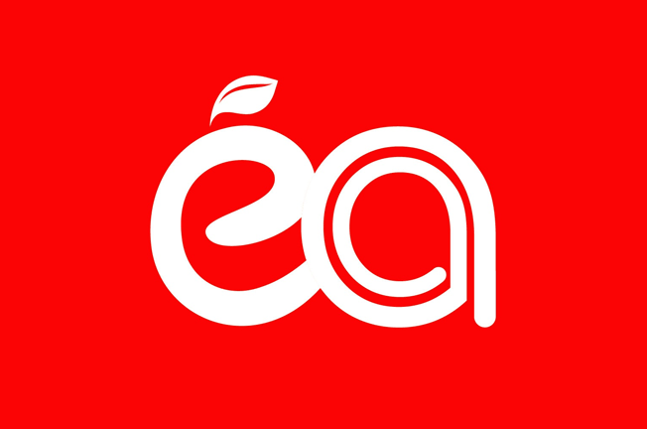
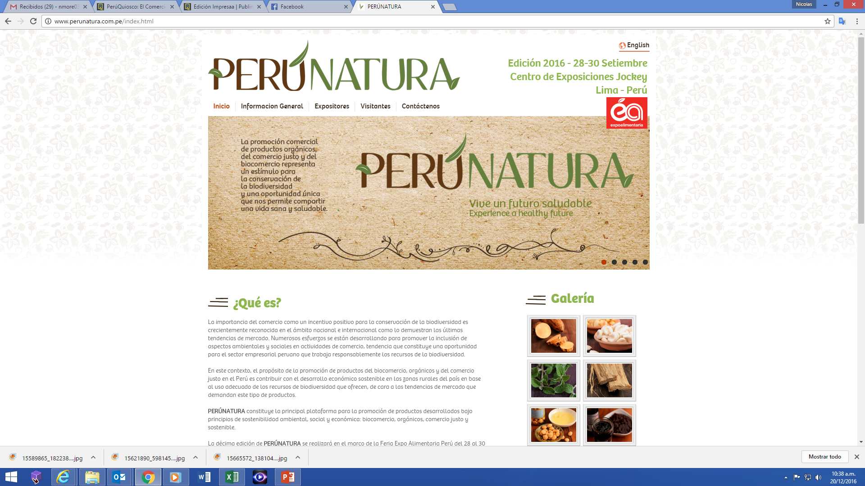

Main Fairs and Business Meetings in Peru 2018
Logo | Event | Date | Email | Web
 | Business Meeting FICAFE | 14-16 September | informes@sdn.com.pe | http://www.ficafe.com.pe
 | TECNOSALUD International Convention for Health Products | 13-15 September | tecnosalud@camaralima.org.pe | www.tecnosalud.com.pe
 | Expoalimentaria, Fair for Food and Beverage | 26-28 September | alavado@adexperu.org.pe | http://www.expoalimentariaperu.com
 | Perú Natura, Fair for Super foods and Natural Products | 29 September |  | http://www.perunatura.com.pe
 | Franchise International Fair | 30-31 May | info@consorcioferialdelperu.com | http://www.feriafranquiciasperu.com

Slide 32
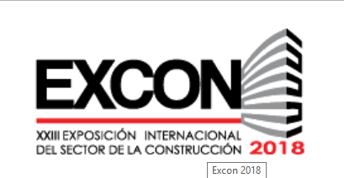


Main Fairs and Business Meetings in Peru 2018
Logo | Event | Date | Email | Web
 | EXCON XXII International Exhition of the Construction Sector | 09-13 October | informes@excon.pe | www.excon.com.pe
 | EXPOTEXTIL, TEXMODA, CALZATEX 2017 XI International Fair of the Textile and Apparel Sector | 08-11 November | info@plastic-concept.com | www.expotextilperu.com
 | EXPOPESCA & ACUIPERÚ International Fair for Seafood Products and Aquaculture | 06-09 November (2019) | thais@thaiscorp.com | www.thaiscorp.com

Slide 33
Fernando Albareda – Commercial Counselor
falbareda@mincetur.gob.pe
Notes:
33

