Slide 1

ARGENTINA
AT A GLANCE
TURKEY-ARGENTINA BUSINESS COUNCIL ROUNDTABLE MEETING
June 1st 2022
DEİK Skyland Office, İstanbul, Turkey

Slide 2

Large and Diversified Economy
3rd largest GDP in LATAM: USD 488 billion (2021)
GDP per capita of USD 10,658 (2021)
EXPORTS: USD 77,934 M (2021)
~47 M inhabitants (~60% under 35)
Access to 295 M inhabitants in Mercosur
Vast Availability of Natural Resources
Argentina
at a glance
8th largest country in the world, with 53% of agricultural lands
Top global exporter of soybean oil, corn, lemons, and lithium, among others
World-class meat products, exported to top destinations (USA, Canada, China, Japan)
705,000 km² of mining areas with high potential and 250 projects at an initial stage
2nd largest shale gas and 4th largest shale oil reservoirs in the world
Dynamic Industrial Complexes and Fast-Growing Sectors
Steel pipes, farm machinery, medical equipment, and the automotive industry are leading export sectors in Argentina
Fast-growing sectors, such as biotechnology and knowledge-based services
High-Quality Human Capital
• +440k highly qualified workforce. +110k STEM graduates
1st in Latin America in English Proficiency

Slide 3
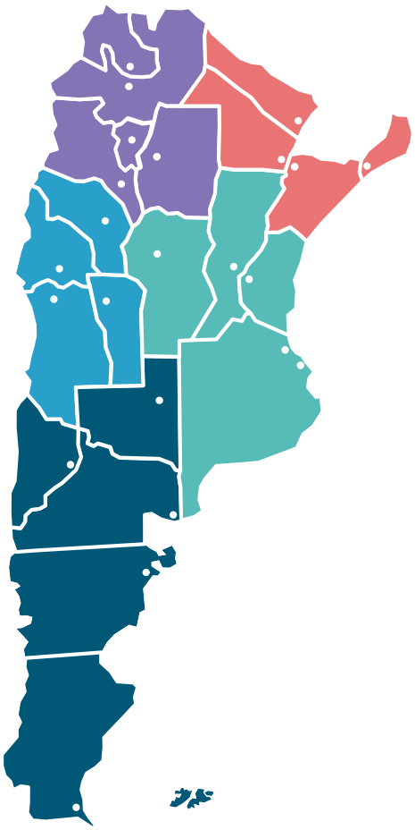




Five economic regions
Jujuy
NORTHWEST | Agricultural products: soy, corn, sugar cane, rice, citrus fruits, wood. Mining: gold, silver, lithium, potassium.
NORTHEAST | Agricultural products: rice, soy, corn, ‘yerba mate’, tea, tobacco, citrus fruits. Forestry (pulp and paper), aquaculture. Mining: precious and semi-precious stones. ICT, software (Misiones, Chaco).
CUYO | Mining: gold, silver, copper, lime. Agricultural Products: wine, nuts, olives. Manufacturing of electronic appliances. Renewable energy (solar and wind). ICT and software (Mendoza).
CENTER | Agricultural products: soy, wheat, corn, sunflower, peanuts. Stockbreeding, dairy. Industrial: Automotive industry. Agricultural equipment, petrochemical, pharmaceutical, real estate, creative, and cultural industries. ICT (Buenos Aires, Córdoba).
PATAGONIA | Agricultural products: fish, fruit, sheep farming. Energy: petroleum, shale oil, shale gas. Renewable Energy (wind). Industrial: manufacturing of electronic devices.
Salta
Formosa
INFRASTRUCTURE
Tucumán
Chaco
Misiones
Catamarca
Santiago
del Estero
Airports: 55
La Rioja
Corrientes
Santa
Fe
San Juan
Córdoba
Entre Ríos
Docks: 101
San Luis
Mendoza
Ciudad de Buenos Aires
Routes: 500,000 km
La Pampa
Buenos Aires
Neuqué n
Federal routes: 37,500 km
Río Negro
Railways:
Cargo: 12,000 km
Passengers: 3,870 km
Chubut
Santa
Cruz
Electric Power Generation:
12,623 Ttoe
Tierra del Fuego

Slide 4
Growth and foreign trade are growing
Jujuy
Economy activity is above the pre-pandemic levels and still on the rise
Salta
Formosa
GDP grew 10.3% in 2021, consolidating the first rise after 3 consecutive years of decline.
According to IMF estimates, growth is expected to continue, reaching 4% in 2022 and 3% in 2023.
Investments were the main driver of growth: they grew 21% y/y during the third quarter of 2021, and 13% in the fourth quarter.
At the regional level, Argentina is positioned as one of the three economies that have recovered fastest from the impact of the pandemic, at a rate similar to that of Chile and Colombia. This economic rebound exceeded official, private and international projections.
Unemployment rate was 7% in the last quarter of 2021, the lowest level registered in the whole series.
Tucumán
Chaco
Catamarca
Santiago
del Estero
La Rioja
Corrientes
Santa
Fe
San Juan
Córdoba
Entre Ríos
San Luis
Mendoza
Ciudad de Buenos Aires
La Pampa
Buenos Aires
Neuqué n
Río Negro
Chubut
Foreign trade continues to grow during 2022
Santa
Cruz
After the recovery of international trade during 2021, the current year continues to be positive for Argentine foreign trade: exports have increased 29% y/y during the first four months of 2022, while imports have risen 42%.

Slide 5

Argentine-Turkey overall trade is on the rise: between 2016 and 2021, it has grown from USD 660 million to USD 870 million *
Argentine-Turkey bilateral relationship
Exports from Turkey to Argentina (2021): US$ 313 million *
Turkish imports from Argentina (2021): US$ 557 million *
Main products Turkey imports from Argentina (2021)*:
    Residues and waste from the food industries; prepared animal fodder (US$ 362 million)
Oil seeds and oleaginous fruits; miscellaneous grains, seeds and fruits (US$ 43 million)
Edible vegetables and certain roots and tubers (US$ 36 million)
Cereals (US$ 20 million)
Cotton (US$ 19 million)
Main products Turkey exports to Argentina (2021)*:
    Iron and Steel (US$ 60 million)
Machinery, mechanical appliances, nuclear reactors, boilers (US$ 42 million)
Vehicles other than railway or tramway rolling stock, and parts and accessories (US$ 29 million)
Plastics and articles thereof (US$ 14 million)
Electrical machinery and equipment and parts thereof; sound recorders and reproducers, television (US$ 13 million)
* according to Argentine statistics

Slide 6
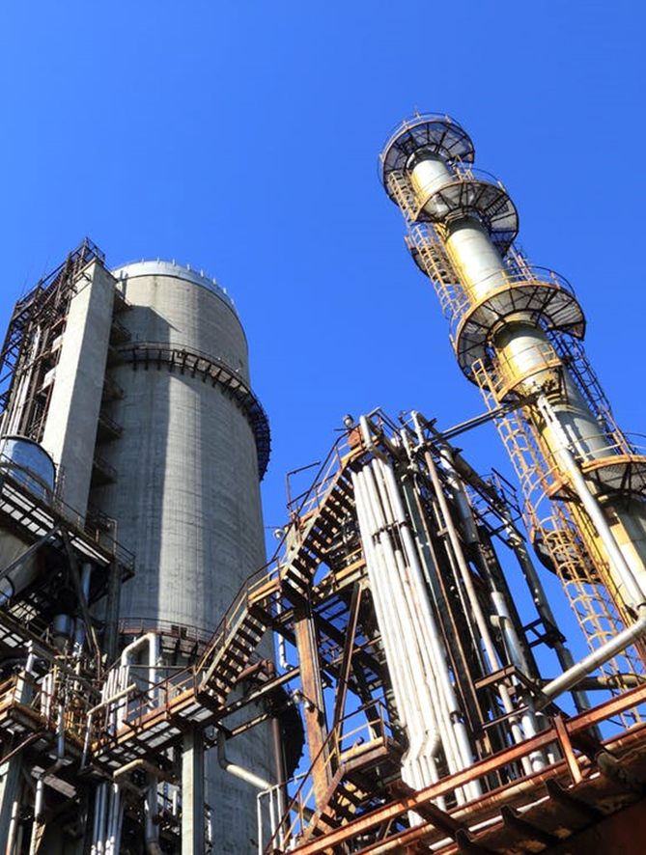
Agribusiness
Biotechnology
Oil & Gas
Water services
Pharmaceutical products
Tourism
Key economic sectors

Slide 7
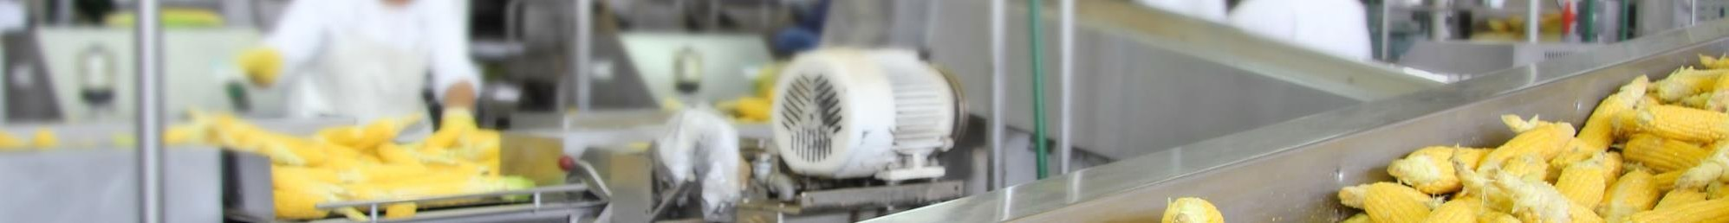
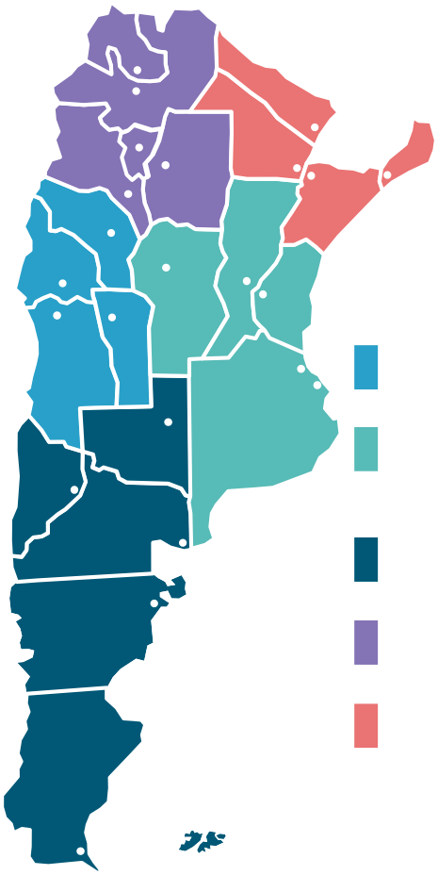
Agribusiness: quality and productivity world-class reputation
Jujuy
Vast availability of natural resources
Salta
Formosa
Large stretches of highly-productive land
Fertile territory and widespread availability of water
Geographic and climate diversity
World’s second-largest stretch of certified organic land
Tucumán
Chaco
Misiones
Catamarca
Santiago
del Estero
La Rioja
Corrientes
Santa
Fe
San Juan
Córdoba
Entre Ríos
San Luis
CUYO:
WINE AND NUTS.
Highly professionalized and technologically advanced sector
Mendoza
Ciudad de Buenos Aires
La Pampa
Buenos Aires
CENTER/EAST:
SOY, WHEAT, CORN, SUNFLOWER, PEANUTS, STOCKBREEDING
Qualified human resources
Cutting-edge technology and advanced management practices
One of the leading nations in the application and development of AgTech
Neuqué n
Río Negro
PATAGONIA:
FISH AND FRUIT.
Chubut
NORTHWEST:
SOY, CORN, SUGAR CANE.
Internationally-recognised reputation for natural, healthy, and high-quality products
NORTHEAST:
RICE, SOY, CORN, ‘YERBA MATE’, TEA, FORESTRY,
CITRUS FRUITS.
Free from African and Classical swine fever, and PRRS
Free from FMD with and without vaccination
Insignificant risk of BSE disease
Santa
Cruz
Tierra del Fuego
Ongoing national infrastructure plan to continue lowering domestic logistics costs

Slide 8
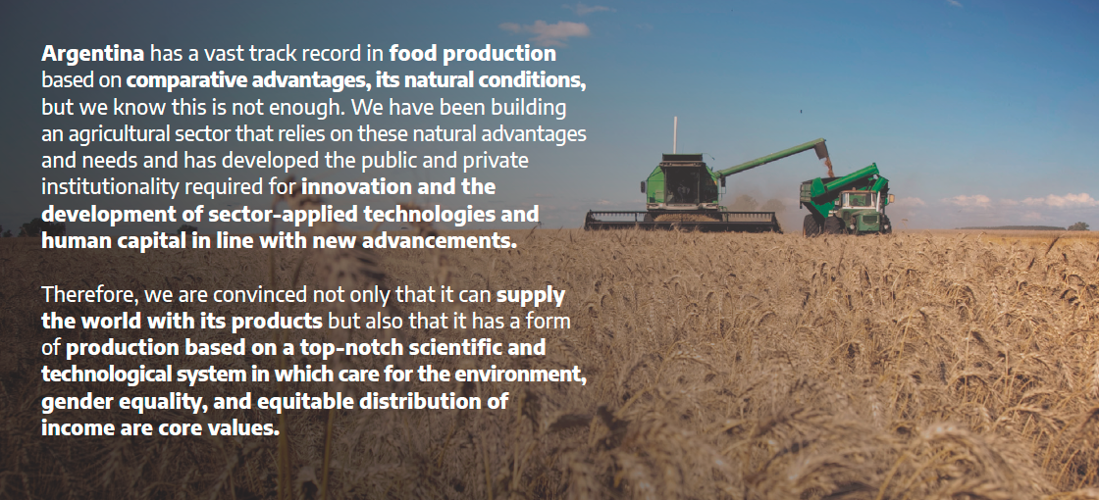
Biotechnology: innovation in agribusiness

Slide 9
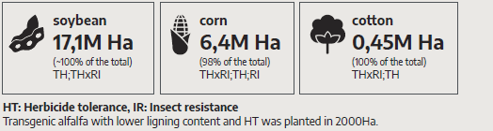
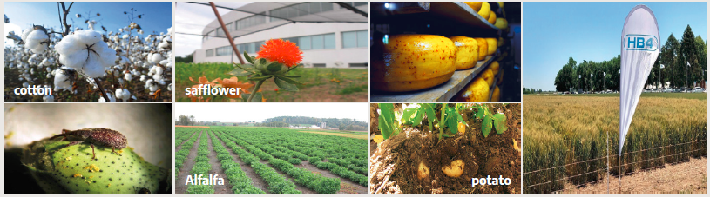
Biotechnology: Argentina GM crops
2019/2020 crop year

Slide 10
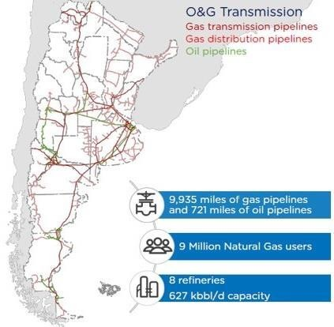
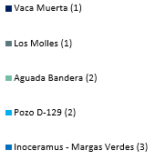
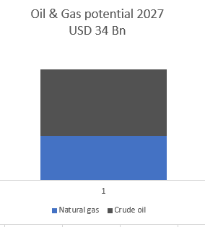
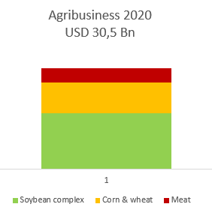
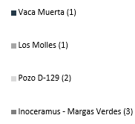
Oil and gas: Road to development
Vaca Muerta: world-class shale resource
100 years of strong oil production.
Extensive and high-quality unconventional resources in early stages of development (including Vaca Muerta).
Potential in offshore and deepwater.
SHALE GAS RESOURCES IN ARGENTINA
802 TCF
Export potential comparison
27 Bn BBL
Source: Wood Mackenzie, IHS Energy, Deloitte LATCO, US Energy Information Administration, YPF, PAE, EIA

Slide 11
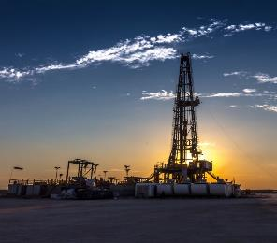

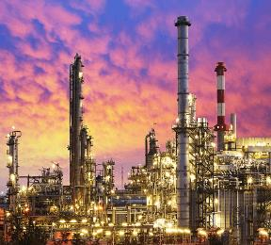
Oil and gas investment opportunities
EXPLORATION & PRODUCTION
GATHERING & INFRASTRUCTURE
DOWNSTREAM
Investments in shale oil & gas development wells
Opportunities to participate in offshore exploration
Opportunities in new shale oil & gas gathering systems, processing plants, and oil & gas trunk pipelines
Investments to build LNG liquefaction and export facilities, refineries, petrochemicals
USD 120 Bn by 2030
USD 30 Bn by 2030
USD 5 Bn by 2030

Slide 12
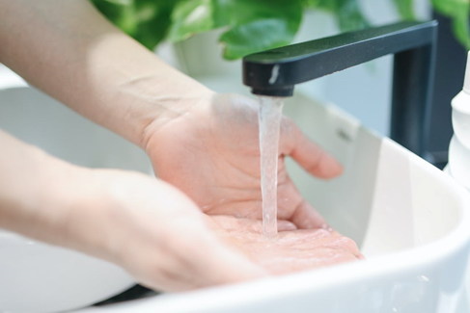
Water services
Availability and sustainable management of water and sanitation for all is one of the Sustainable Development Goals promoted by the UN.
Access to drinking water, free from health risks, together with a sanitation service that maintains a good hygiene condition, has positive, clear and immediate impacts on the health and economic productivity of the population.
More than 80% of the Argentine population has access to drinking water and 56% to sanitation. Water policy in Argentina is enforced by the National Direction of Potable Water and Sanitation.
Agua y Saneamientos Argentinos (AySA) is in charge of water management in Buenos Aires City and 26 other districts of Buenos Aires suburbs. The company covers a strategic region of Argentina and one of the most densely populated areas on the continent.

Slide 13

Pharmaceutical industry
Argentina’s national pharmaceutical industry is highly competitive and technologically modern. Argentina is ―altogether with countries such as USA, Japan, Germany and Switzerland― one of the few countries in the world where locally-owned laboratories presence and share in the domestic market are higher than multinational laboratories.
Pharmaceutical industry in Argentina is the third industrial sector in terms of industrial added-value, only behind oil refinery and iron and steel.
The Argentine pharmaceutical industry complies with the highest quality standards recommended by the World Health Organization (WHO) in terms of good manufacturing and drug control practices. Argentina’s Pharmaceutical industrial plants are authorized and approved by the National Administration of Pharmaceuticals, Foods and Medical Technology (ANMAT), which enforces the Pharmaceutical Inspection Cooperation Scheme (PIC/S) guides to good manufacturing practices.
Moreover, some of them have obtained certifications from health authorities of developed countries, such as the Food and Drug Administration (FDA, USA) and the European Medicines Agency (EMA, European Union).

Slide 14
Pharmaceutical industry
For the last eleven years, the manufacture of biotechnology medicines in local plants has experienced a significant boost.
Argentina has locally-owned laboratories that have become multinationals, with subsidiaries in most of the Latin American countries, USA, Europe and some Asian countries.
In terms of the research, innovation and development processes carried out by local firms, it is worthwhile highlighting four of the main recent success cases:
The agreement reached between a national company and AstraZeneca to produce the COVID-19 vaccine active ingredient at a modern industrial plant located in Garín (province of Buenos Aires) for the whole Latin America.
The agreement signed by a national laboratory and the Russian Gamaleya National Research Center for Epidemiology and Microbiology with the intermediation of Hetero laboratory (India), for the transfer of technology that will allow the Sputnik V vaccine production in Argentina.
The production of benznidazole, a medicine used to treat the Chagas disease, discontinued worldwide in 2011 and developed by a private and public consortium which involved a locally-owned laboratory.
The therapeutic vaccine against lung cancer, racotumomab (Vaxira), approved by the ANMAT and the CECMED (Cuba). This research, development and innovation effort was carried out by a public and private consortium.

Slide 15

Tourism: Argentina is the top destination in the region
1
4th exporting sector in the country (7% of total exports)
International tourism arrivals
Million arrivals in 2019
Accounts for 20% of
2
Leader in Corporate Tourism. International Congress and Convention Association (ICCA):
Argentina 7.4
total arrivals of non- residents in South America (UNWTO).
1st country destination in LATAM
Buenos Aires City: 1st destination city in the continent (for 11 consecutive years)
Brazil | 6.4
Chile | 4.5
Peru | 4.3
Colombia | 4.1
3
Hotel and eco/theme park opportunities found in most provinces
Total expenditure (USD): 11 billion
4
Unprecedented investments in air travel and recently-built infrastructure
Source: Ministry of Tourism and Sport/ INDEC
UNWTO & Central Bank.

Slide 16

OUR COMPANIES

Slide 17


Our companies
Participant:
GUILLERMO FERNANDEZ, Director
Participant:
GONZALO MESCHENGIESER, International Affairs Manager
Abax Travel is the result of a passion for travel, a long standing expertise in the hospitality industry, a strong motivation for excellence and the restless search for the most fantastic destinations and travel experiences.
We are reference in South America in the art of organizing unique travel experiences for some of the world’s most demanding markets. Since 2001 we offer the best solutions to our clients, a perfect combination of creative trips, efficient and with the best value for money, generating long term relations based on trust, which allow us to consolidate as one of the most reputable travel companies in Argentina
AySA is the 5th largest water & sanitation provider worldwide and the 2nd largest in Latin America, benefiting 14 million of inhabitants -the 30% of Argentina ́s population-. Its area of operation extends over 3.300 km2, including the City of Buenos Aires and the surrounding Metropolitan Area.
AySA’s mandate covers the complete cycle of water management: water collection, pre-treatment, distribution, recollection, transport and post-treatment.

Slide 18


Our companies
Participants:
MARIANI VENTURA MARTIN, Global Seed & Trait Manager
DIEGO MARCOS
Director Asia-Pacific Affairs
Participant:
GERARDO DANIEL SUÁREZ
Sales Executive
Bioceres is a fully integrated agricultural biotechnology company with a strong leadership position in South America and access to global agricultural markets through its own channels and industry-leading partners. At Bioceres they work with scientists and international agricultural firms for the creation, development, deregulation and commercialization of technologies destined for their markets, object of high growth in seed biotechnology and agribusiness.
Its seed biotechnology technologies and products are aimed at improving the productivity of various crops of global importance, including wheat, soybeans, corn and alfalfa. They apply their technology identification and product development (IT&DP) capabilities to develop and integrate agricultural inputs of biological origin, creating integrated agronomic solutions tailored to our clients.
They leverage their IT&DP capabilities to leverage opportunities in agro-industrial biotechnology, including enzyme production and fermentation solutions for the production of high-value compounds.
Aspro is an international company that manufactures and markets compression systems for all types of gases. Its products are used in CNG/NGV stations, Oil and Gas fields, and in other industrial applications. Since 1984 and through its worldwide network of representatives, it is present in 45 countries with more than 5,600 compressors.

Slide 19


Our companies
Participant:
ALEJANDRA SANTILLÁN,
International Commerce
Participant:
LAURA ORTIZ,
Global Sales Director
lt is a Laboratory of Medicinal Specialties first established as an export consortium which started its activities in 1995. lt was authorized by ANMAT as Laboratory of Medicinal Specialties according to Resolution 223/96 in 1997. In 2007 it inaugurates its Plant of active pharmaceutical ingredients (API) synthesis where it produces two anesthetics ever since: REMIFENTANIL and FENTANYL.
CONIFARMA has agreements of trade and representation with other Argentine companies, from Mercosur in Latin America to the Middle East. CONIFARMA exports drugs and active pharmaceutical ingredients (API) in Latin America to Bolivia, Brazil, Paraguay and Venezuela. lt also exports to India and countries of Asia.
lt has a staff of 15 biochemists, pharmacists and engineers. Dr. Juan Torres is its President and Technical Director. lts offices and Quality control laboratory are located in 10 Pringles 2° and 4° Floors Capital Federal. lts production plant is located in Av. Belgrano 3846 (GF) City of Buenos Aires.
The only DMC in LATIN AMERICA with its own local offices and own operation teams in 11 countries: Mexico, Guatemala, Peru, Argentina, Brazil, Ecuador, Bolivia, Chile, Colombia, Costa Rica, Panama. A complete homogenized company with same standards and operations in each country. Only one client service philosophy, respecting the client and his way of discovering a country.
QUIMBAYA LATIN AMERICA sells only B2B and is exclusively providing incoming services to all Tour Operators and Agents around the world in 6 different languages. For 35 years, the company has been creating unique tailor-made itineraries and specific product Collections for all segments: MICE, Luxury, Groups, FIT(individuals).
We have Guaranteed Departures for each of the 11 countries in English, French, Italian and German. Our product Collections include from travel types such as slow travel, cultural, city breaks, beach stays, sustainability, and community focus activities.
We offer many different combinations of destinations like our best seller the Big South America (4 countries in 17 days) or the Fantastic Central America with 5 destinations in 19 days.
Quimbaya teams are multi-language (English, French, Spanish, Italian) specialists, all committed to the same company culture. They have field experience and high level technical skills. They will know how to guide you through your best choice for your tours and most importantly make the right choice for your client.

Slide 20


Our companies
Participant:
MARCELA ALEJANDRA MAREY,
Business Unit Managers - Receptive Tourism
Participant:
HUGO G. MENZELLA,
PhD
We are based in Buenos Aires and very proud of our broad background that gives us the necessary Expertise to support all Travel Agents whose clients wish to visit this part of the world, our neck of the woods. Our main goal is bringing Argentina and Neighboring Countries closer to the rest of the world, with the best associates in each destination.
We are ready to accommodate everyone, from the FITs to Incentive groups, Special Interest trips, as well as Leisure Programs. Budget is not a problem; it will always be enough to get our personalized services with the quality and excellence to make your client's trip a unique and unforgettable experience.
We believe it is important to provide all the necessary information that travel agents might need to sell Suramerican destinations, knowing that clients will be in the best of hands. We work with Multilingual Professional Guides and properly certified vehicles in all destinations, to ensure that clients will enjoy a wonderful experience, handled with safety and professionalism.
Keclon develops innovative enzymes as environmentally friendly solutions to improve the performance of industrial processes. Our R&D team, large scale fermentation technology, and state-of-the-art downstream processing consolidate our position as regional leaders in the industrial supply of sustainable solutions.
Our company design, produces, and commercializes enzymes, complying with the highest international quality standards. We have developed a technological platform to rapidly generate new enzymes by using directed evolution, genetic engineering, and synthetic biology tools. Our intellectual property portfolio reflects our commitment to innovation.

Slide 21


Our companies
Participant:
ROBERTO FUNES,
Europe, Middle East and Africa Business Director
Participants:
ARIJ ABOU KHZAM and HADI ABOU KHZAM
Distributor Representative for Arab countries
Argentina based Biotechnology Company which over the past three decades has developed a global business in the supply of high quality biopharmaceuticals in the territories of Asia, Africa, Eastern Europe and Latin America.
Biosidus S.A. has two production sites. The Almagro Plant located in the city of Buenos Aires, devoted to R&D activities and to the production of APIs, equipped with bacterial fermentation capacities and also hosting mass cell culture areas. Filling, lyophilization and packaging operations are conducted in separate facility, Planta Bernal, located in the outskirts of Buenos Aires.
Biosidus S.A. counts on a robust pipeline of therapeutic proteins, in different stages of development.
Biosidus proprietary manufacturing processes and technologies rely on a solid IP policy which constitutes a competitive advantage in the scenario of biosimilars. With its impressive track record, Biosidus is committed to become a reliable global supplier of biosimilars.
The story begins in Montecarlo, Misiones, Argentina, and a colony at that time of immigrant inhabitants, mostly German, who had come in search of land for cultivation, to which they devoted themselves exhaustively. The plantations were essentially corn, tobacco, cassava and in 1926 they began to cultivate yerba mate.
The commercialization of crops was becoming more and more difficult and, tired of the abuses of intermediaries and the cost of consumer items, farmers decided to join forces on July 24, 1930 under cooperative principles, understanding that this was the only way in order to progress.
Thus they founded the Monte Carlo Mixed Agricultural Cooperative Limited. Today the Mixed Agricultural Cooperative of Monte Carlo Limited has more than 800 active associates, the vast majority of whom are small producers. Its fundamental activities are the production, elaboration and commercialization of yerba mate and cassava starch; although it also owns supermarkets and service stations and is dedicated to the collection and marketing of wood for the cellulose pulp industries. He is also a sales agent for one of the most important insurance companies in the country.

