Slide 1










BUSINESS
PORTAL
TAJInvest
STATE COMMITTEE ON INVESTMENT AND STATE PROPERTY MANAGEMENT OF
THE REPUBLIC OF TAJIKISTAN
Notes:
Welcome to our presentation!
Who is Tajinvest?
2010 founded, part of SCI and implements State investment policy
Why b2b Portal
1. Low FDI and negative trade balance
2. Lack of capacity in doing business among entrepreneurship
3. Lack of use of modern marketing instruments, especially internet
4. Insufficient interaction of local and international business
2018 idea of creating an interactive platform for entrepreneurs, i.e. a place, where all market participants would have the opportunity to present themselves, in addition to their products and services, contact each orther and have access to information from all over the business world.
It has become fancy to create portals in TJK, and you may ask, why another one? In the next minutes I will try to show, that b2b.tj is not just another project, but that it has its own quality and is needed in TJK.

Slide 2
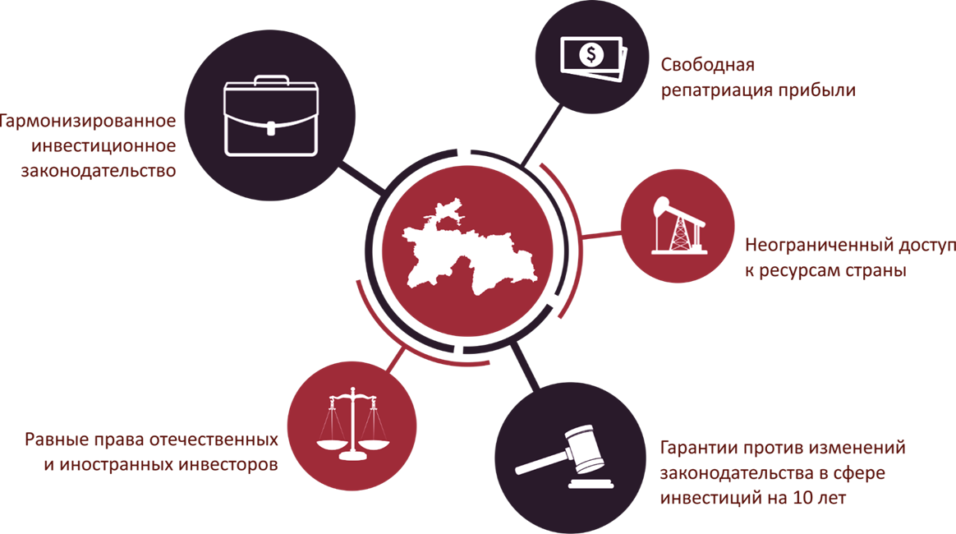
Doing business in Tajikistan
Free income repatriation
Harmonized investment legislation
Unlimited access to the country's resources
Equal playing ground for local and foreign investors
Guarantees protecting investments from amendments in the investment related legislation for a term of 10 years

Slide 3




Preferences by sectors
Exemption from profit tax
Investments of more than five million dollars
for a term of 5 years
  Investments from 2 to 4 million dollars
for a term of 4 years
    Investments from 500 thousand to 2 million dollars for a term of 3 years
      Investments from 200 thousand to 500 thousand dollars for a term of 2 years
Industry
The enterprises engaged in the full cycle of processing cotton fiber into the final product are exempted from profit tax and real estate tax for the period of 12 years.
Supply of precious metals and stones, jewelry, primary aluminum, cocoons, cotton fiber, cotton yarn and raw cotton is exempted from value added tax.
Tourism
Newly established enterprises operating in the sphere
of tourism are exempted from profit tax for a period of 5 years.
Importation of equipment and building materials for tourist sites is exempted from payment of value added tax and customs duties.
Securities market
Agriculture
Activity of the professional players of the securities market is exempted from payment of profit tax for a period of 5 years.
The investors, who are earning income from circulation of securities on the Stock Exchange of Tajikistan, are exempted from payment of income tax and dividend tax for a period of 5 years.
The importation of agricultural machinery is exempted from the payment of value added tax and custom duties.
Poultry farms and enterprises producing feed for poultry and cattle are exempted from profit tax, value added tax, real estate tax and motor road users tax for the period of 12 years.

Slide 4

SUE „TAJINVEST“
State Committee on Investment and State Property Management of the Republic of Tajikistan
2010 founded,
Integral part of State Committee on Investment
Part of the Implementation process of State investment policy
Functions and Tasks
Marketing
Event marketing
Direct attraction of FDI in private sector
Aftercare service
Business support
Business Development
Capacity building

Slide 5

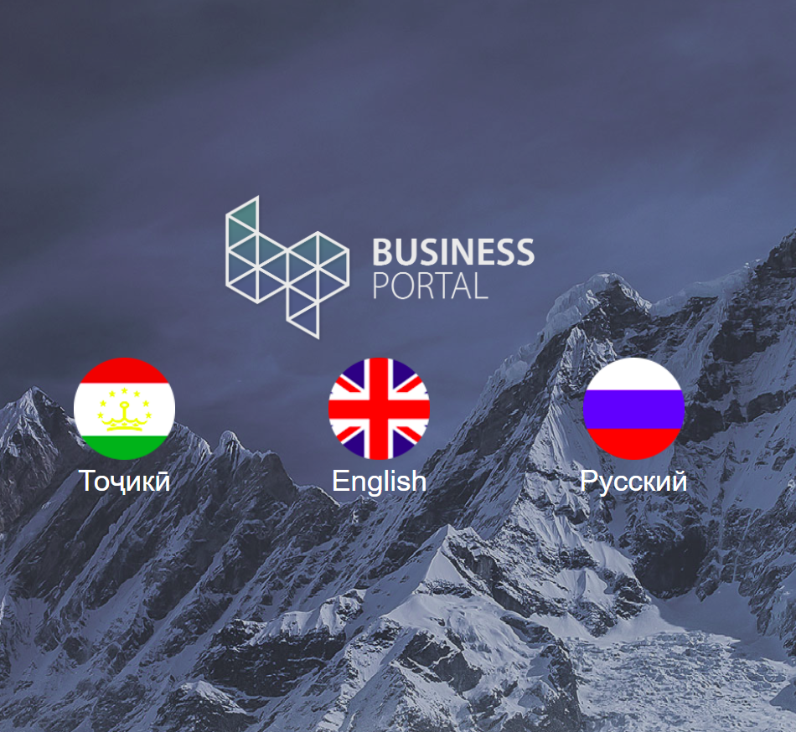
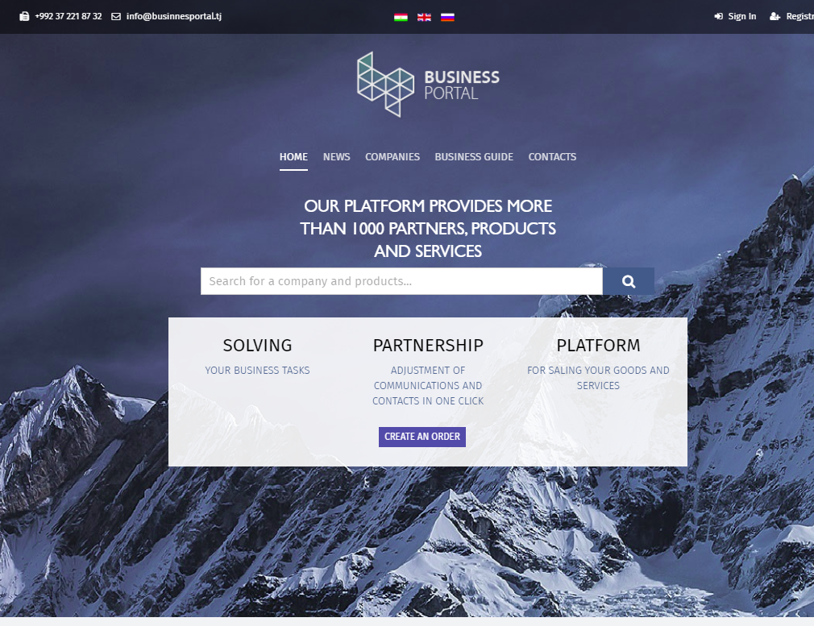
Business Portal Tajikistan
Source of information
Doing business
Investment opportunities
Finding partners
Databases
Legal documents
Financing sources
Investment projects
Assistance
Legal questions
Tax consulting
All questions related to doing business in RT
Capacity building for local entrepreneurs

Slide 6

FUNCTIONS OF PORTAL
ENTRANCE INTO TAJIK BUSINESS WORLD
Services to local and foreign companies
Providing a platform for company presentation
Providing an information resource on the legal and economic framework for doing business
Information about business opportunities in general Information on investment opportunities/climate in Tajikistan Provision of import / export assistance services
Facilitating business interaction in Tajikistan
Notes:
Services to local and foreign companies
Providing a platform for company presentation
ENTRANCE INTO TAJIK BUSINESS WORLD BY:
Providing an information resource on the legal and economic framework for doing business;
Information about business opportunities in general; Information on investment opportunities/climate in Tajikistan; Delivering of import / export assistance services
Facilitating business interaction in Tajikistan

Slide 7
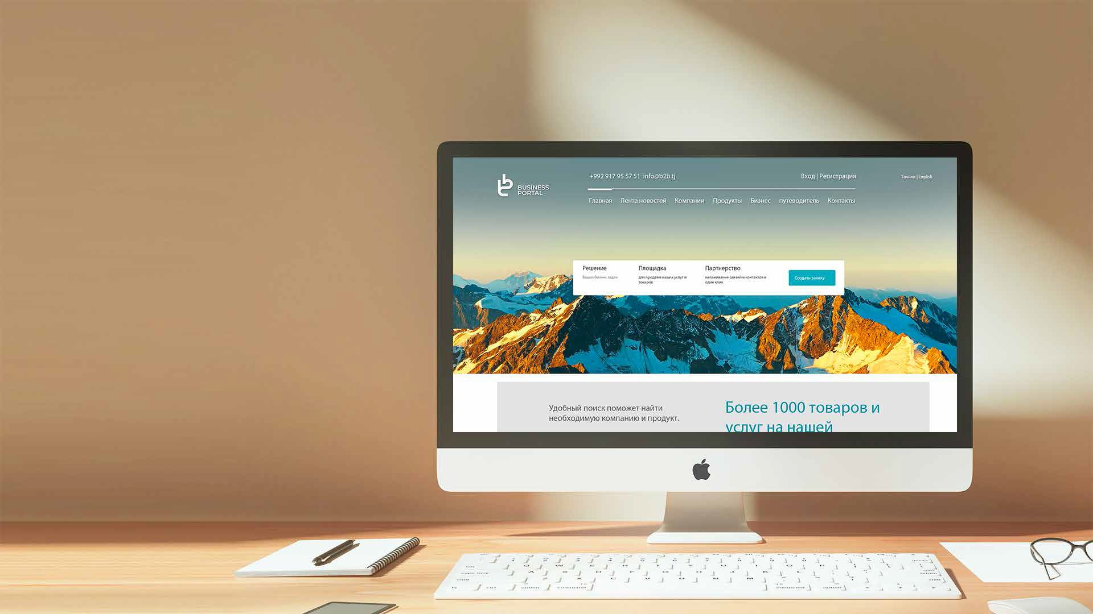

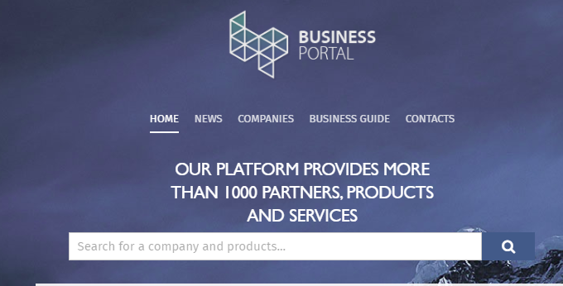
INSTANT SEARCH
26 categories (similar to European portals)
More than 1500 keywords
Search by product, company and/or keyword
Notes:
Intelligent search engine
by keywords, categories, products, companies
its constructed to similar search engines in Europe (e.g. europages.com)

Slide 8
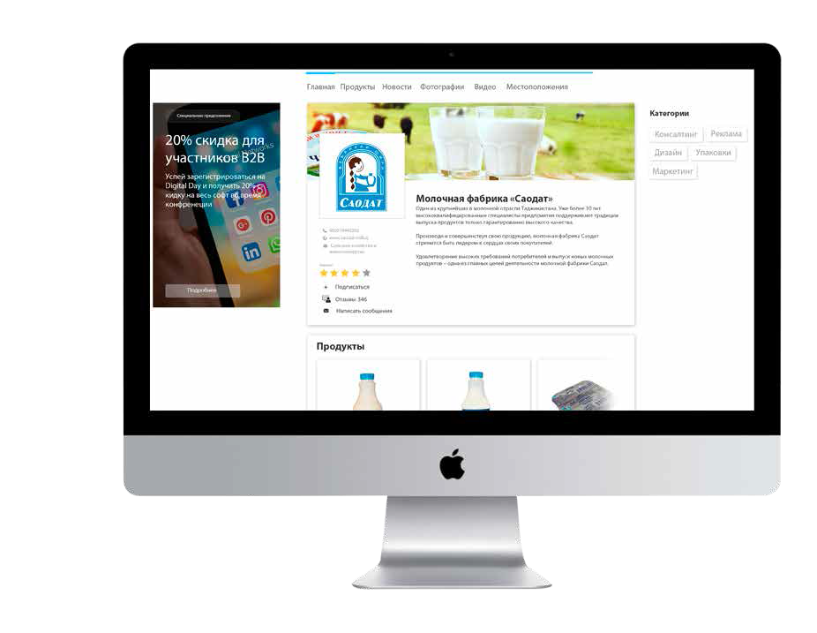
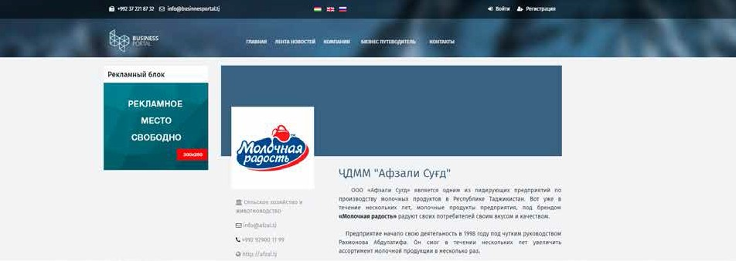
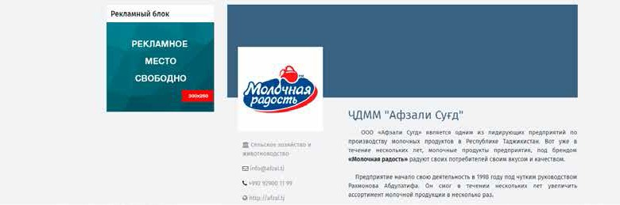

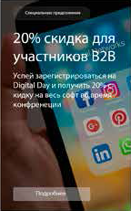

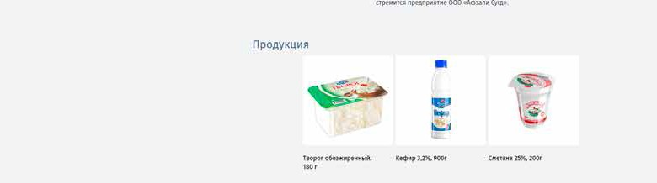
COMPANIES MINI SITES
PRODUCTS, SERVICES, CONTACTS, HISTORY
Affordable, also for Startups
Worldwide Promotion together with Portal
Each page of products and services is optimized for quick access and in- creased target requests.
Notes:
Information about
Description of the company
Products
Special actions
Certificates
Contact info
Delivery and sales conditions

Slide 9
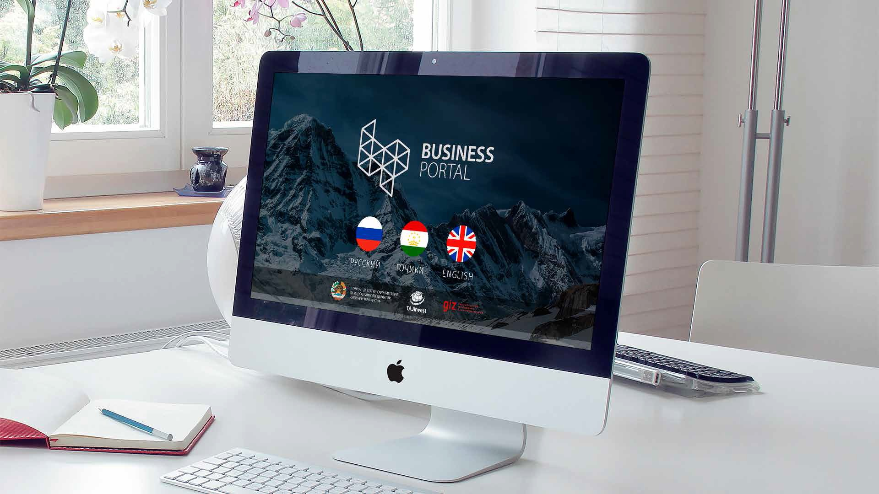

SPEAKS THE LANGUAGE OF YOUR PARTNERS
The company profile will be published in 3 languages, as well as even in Arabic and Chinese in the future.
Notes:
Tajik, English, Russian languages full version
Arabic, Chines short versions

Slide 10

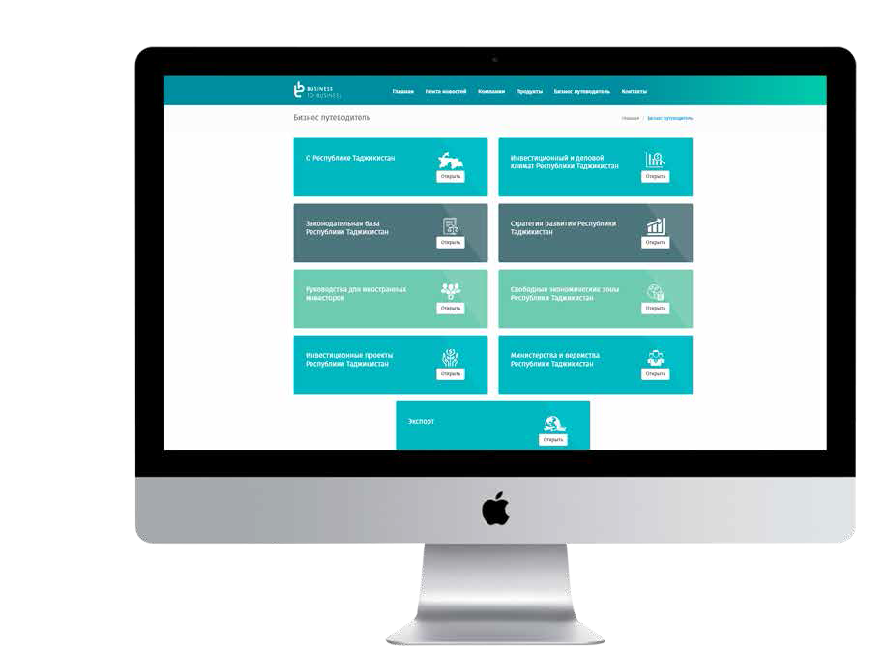
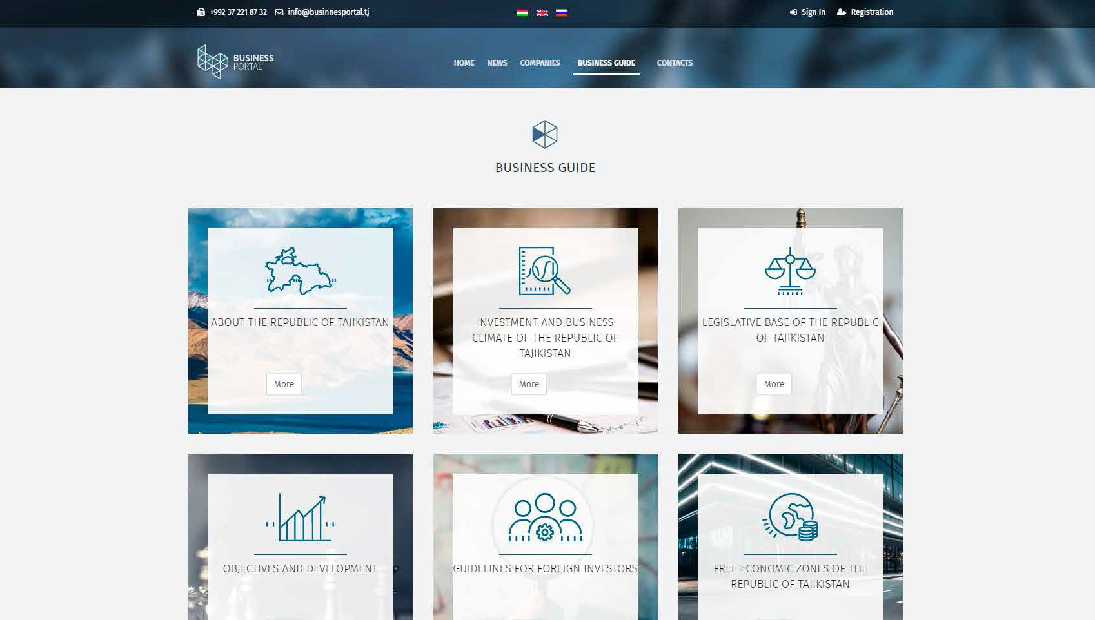
BUSINESS GUIDE
INVESTMENT CLIMATE
in GENERAL and by SECTORS:
Preferences, Legal Situation, Priority Sectors
Energy; Agriculture; Mining; Tourism; Infrastructure; Others.
Investors GUIDE:
How to...
Project DATABASE:
Nationwide and unified
Accessible for all
Notes:
Information about:
TJK
Legal Frameworks (incl. FEZ)
Sectors of Economy (Potential)
Business Climate
Investment Climate (see Slide)

Slide 11

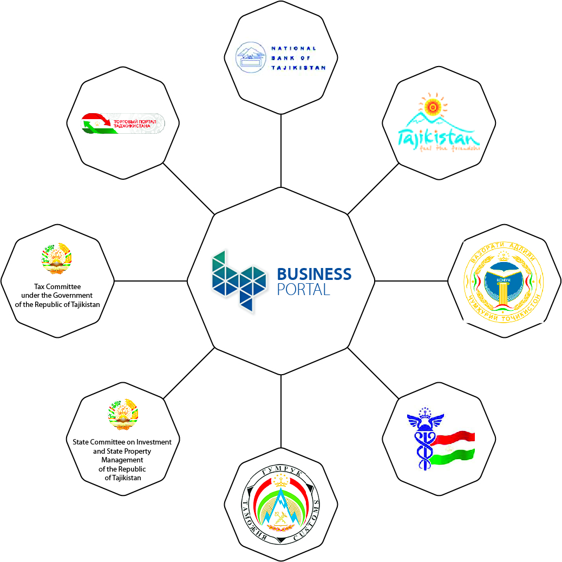








Integrator for information sources
TAX
SCI
Notes:
B2B portal is not a competitor to existing sites, but will play the role of an integrator for existing information resources, pointing to sectoral sources, e.g. export, taxes, etc. So, we will cooperate, not compete.
The main functional difference is the built-in sustainability. Once we achieved a certain amount of subscribers, we’ll be able to cover all expenses connected to the operation of the portal: This will be achieved with about 1.000 subscribers.
The most complicated period is now, while we have expenses but no income so far.

Slide 12






BENEFITS OF THE PORTAL
Finding new partners;
Worldwide promotion of the portal;
Interactivity;
Business guide for investors and businessmen;
Information resources about events in the business world;
Inexpensive and effective presentation on the Internet.
Notes:
What are the benefits for subscribing to the Portal?
It’s an affordable instrument, especially for startups and small enterprises
Without hiring special staff, companies will have their own website, will be able to receive tailored and updated information about business climate in TJK and abroad.
Companies will be enabled to find partners, products and services

Slide 13

THANK YOU FOR YOUR ATTENTION!
BUSINESS
PORTAL
www.businessportal.tj
Notes:
Thank you very much for your time and, hopefully, your interest.
We are convinced that the portal will contribute to the improvement of the business climate in TJK and to capacity building for our entrepreneurs.
The government of Tajikistan has found it important enough to include this project into the agenda of “300 days of reforms” in Tajikistan.

